Slide 1
Predicting the Price of the DAX
Here is where your presentation begins

Slide 2
Table of contents
1
2
3
4
5
6
Objective
Data Collection
Data Cleaning
Processing
Model Training and Validation
Results

Slide 3
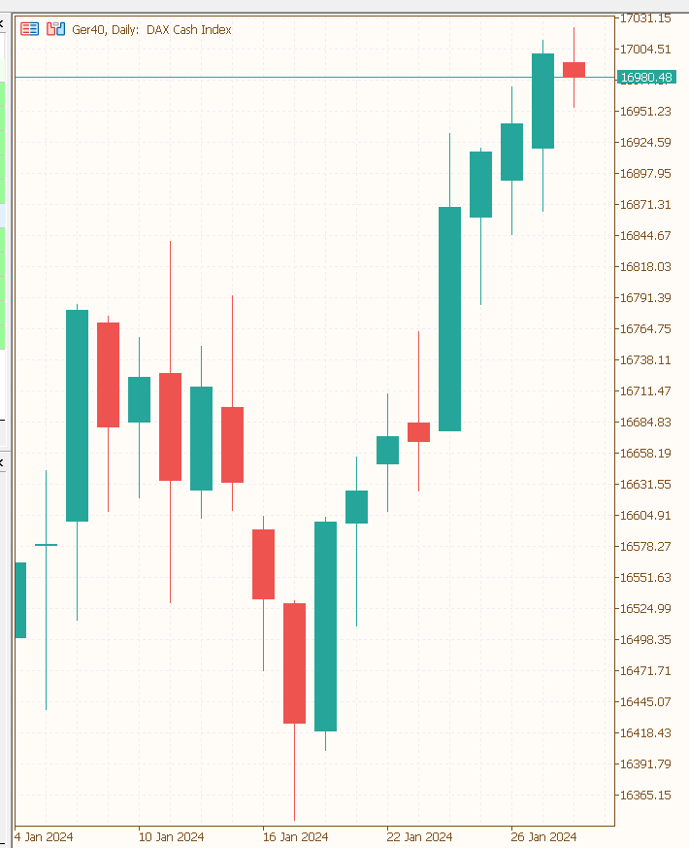
What is the direction of the Market?
Objective
Collection
Cleaning
Processing
Modelling
Results
Die typische Darstellung des Marktpreises ist das CandleStick-Diagramm
Jede Kerze repräsentiert eine Periode (in dem Beispiel einen Tag)
Jede Kerze wird durch vier Preise erstellt (open, high, low, close)
The direction can be defindet by the difference between close and open price
When the difference is positive the direction is upwards and when the difference is negative the direction is downwards

Slide 4
Wie wird der DAX berechnet?
Der DAX wird aus den 30 größten deutschen Unternehmen berechnet
Die Preisentwicklung der einzelnen Unternehmen hängt maßgeblich von Angebot und Nachfrage ab
Es gibt viele verschiedene Einflussfaktoren, die das Marktverhalten der Marktteilnehmer beeinflusst
Fundamental Daten:
Wirtschaftsnachrichten
Wirtschaftskennzahlen der einzelnen Unternehmen
Gewinn
Umsatz
Wachstumsraten
Technische Marktanalyse
Indikatoren
Pattern
Fundamental Daten

Slide 5
Data collection
Able to get the OLHC-price and the Volume from 1987 until now for the DAX by using the yfinance Libary
Calculate the direction (closeprice – openprice)
Computing Indicators in different Timeframes
Notes:
DAX=German Stock Index

Slide 6
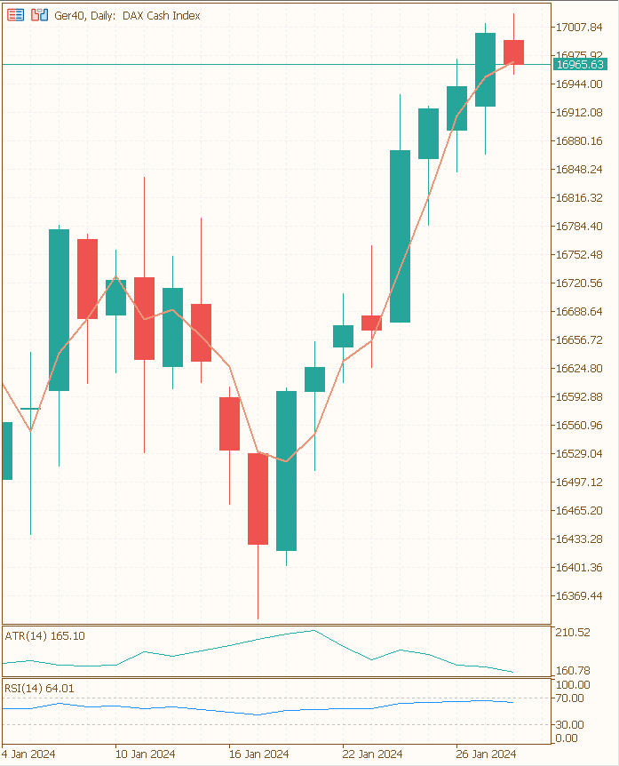
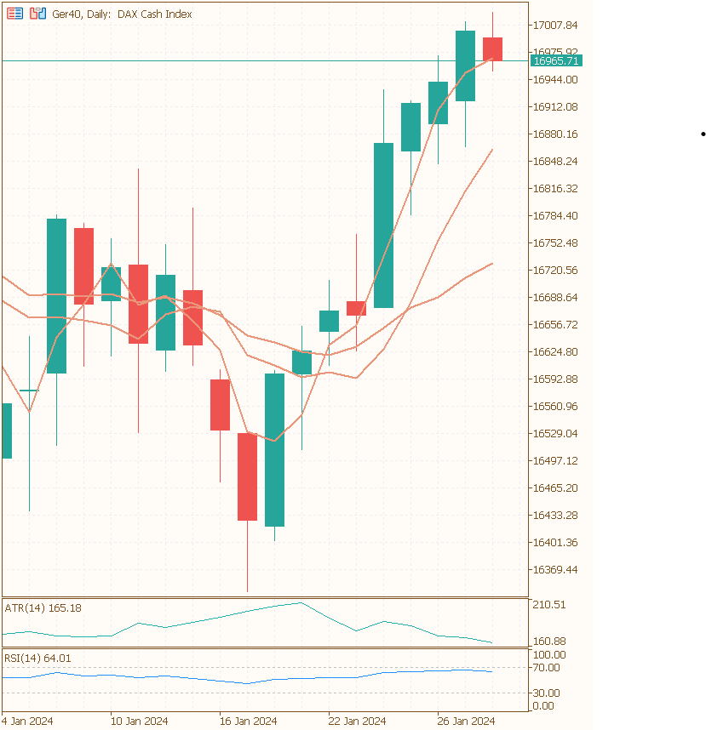
Indicators
10 different types of indicators
Momentum (rsi)
Trend (adx)
Overlap (sma)
Volatility (Bollinger Bands)
for every indicator 3 i used different Timeperiods
for every indicator which return a market price i created a categorical columns
Return 1 if the actual price above the indicator price
Return 0 if the acutal price is lover then the indicator price

Slide 7
Data Cleaning
Before 2000 i had missing Data for the Volume
The final Dataset started from 2000
By computing a Indicator with a certain timeperiod, the first x rows are missing
I dropped the first x days
Notes:
I can‘t compute the moving average from the last 7 days for the 5 day because there are 2 day‘s missing where i have no data.

Slide 8
Feature Selection
Use Varianace Threshold to drop Features with a Varaince less then 0.02
Use Correlation Matrix to identify Multicorrelarity Threshold = 1

Slide 10
Class Imbalance
Use Varianace Threshold to drop Features with a Varaince less then 0.02
Use Correlation Matrix to identify Multicorrelarity Threshold = 1

Slide 13
Results
 | Accuracy | F1 | Recall | Precission | Kappa
Logistic Regression | 0.90 | Special offers | $23,000 | No | Low
Company B |  | Reliability | $27,000 | No | Low
Company C |  | Repairs | $30,000 | Yes | High
Company D |  | Marketing | $24,000 | No | High
Company E | Technology | Customers | $32,000 | Yes | Low
Company F | Comfort | Best prices | $15,000 | Yes | High
Company G | Customization | Brand name | $45,000 | No | Low

