Slide 1
Predicting the Price of the DAX
Here is where your presentation begins

Slide 2
Table of contents
1
2
3
4
5
6
Objective
Data Collection
Data Cleaning
Processing
Model Training and Validation
Results

Slide 3
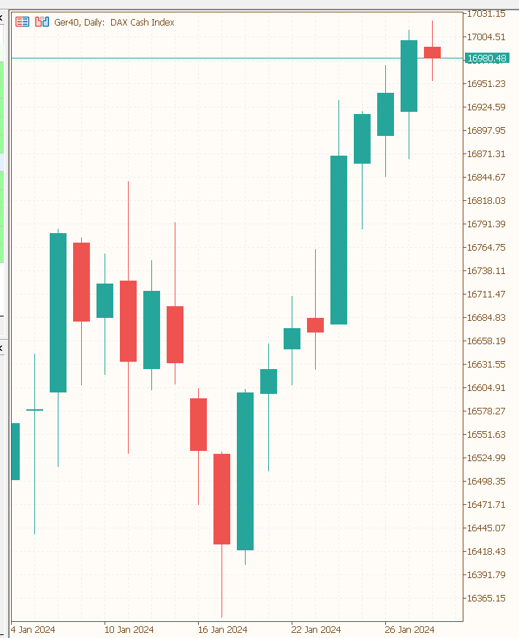
What is the direction of the Market?
Objective
Collection
Cleaning
Processing
Modelling
Results
Die typische Darstellung des Marktpreises ist das CandleStick-Diagramm
Jede Kerze repräsentiert eine Periode (in dem Beispiel einen Tag)
Jede Kerze wird durch vier Preise erstellt (open, high, low, close)
The direction can be defindet by the difference between close and open price
When the difference is positive the direction is upwards and when the difference is negative the direction is downwards

Slide 4
Wie wird der DAX berechnet?
Objective
Collection
Cleaning
Processing
Modelling
Results
Der DAX wird aus den 30 größten deutschen Unternehmen berechnet
Die Preisentwicklung der einzelnen Unternehmen hängt maßgeblich von Angebot und Nachfrage ab
Es gibt viele verschiedene Einflussfaktoren, die das Marktverhalten der Marktteilnehmer beeinflusst
Fundamental Daten:
Wirtschaftsnachrichten
Wirtschaftskennzahlen der einzelnen Unternehmen
Gewinn
Umsatz
Wachstumsraten
Technische Marktanalyse
Indikatoren
Pattern
Fundamental Daten

Slide 5
Data Collection
Objective
Collection
Cleaning
Processing
Modelling
Results
Get the OLHC-Price and the volume from 1987 until now for the DAX by using the yfinacne Libary
Calculate the direction (closeprice – openprice)
Computing Indicators in different TTimeframes
Notes:
I can‘t compute the moving average from the last 7 days for the 5 day because there are 2 day‘s missing where i have no data.

Slide 6
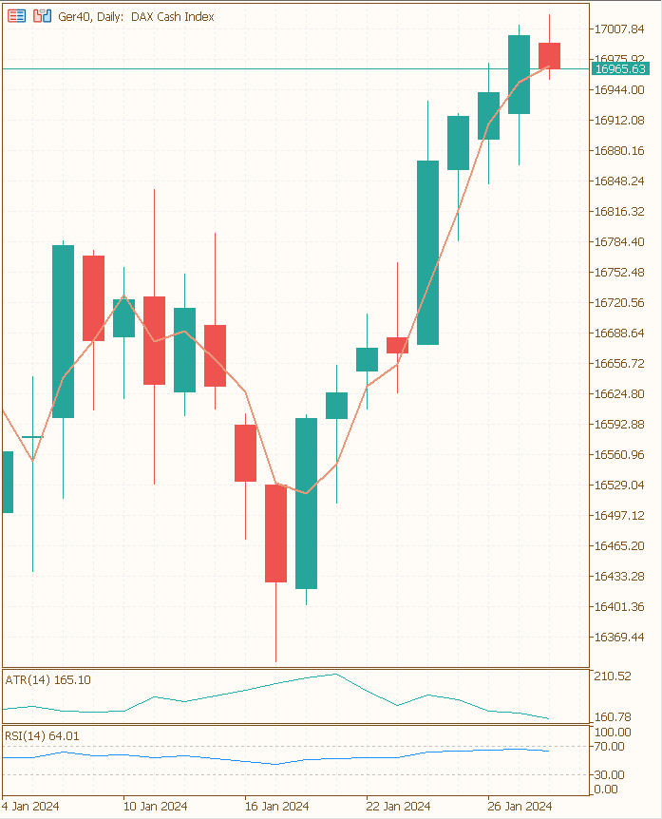
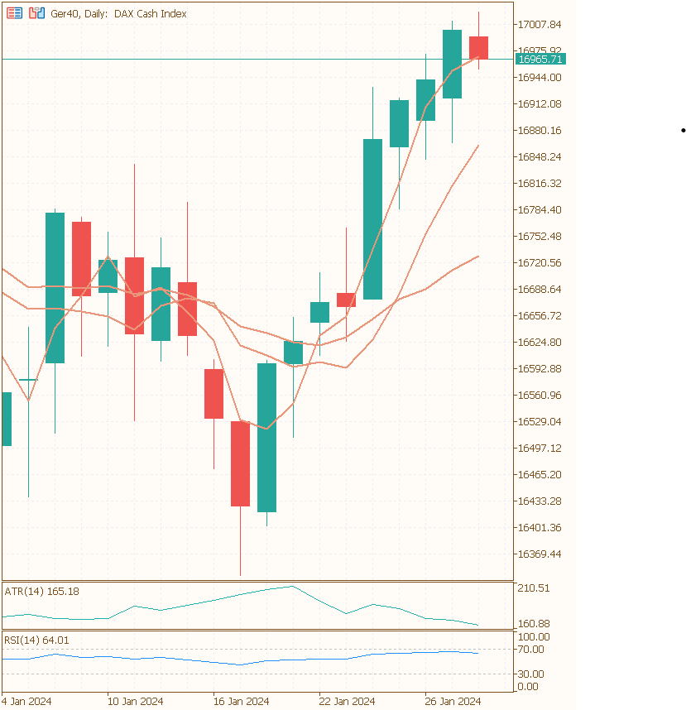
Indicators
Objective
Collection
Cleaning
Processing
Modelling
Results
10 different types of indicators
Momentum (rsi)
Trend (adx)
Overlap (sma)
Volatility (Bollinger Bands)
for every indicator 3 i used different Timeperiods
for every indicator which return a market price i created a categorical columns
Return 1 if the actual price above the indicator price
Return 0 if the acutal price is lover then the indicator price

Slide 7
Data Cleaning
Objective
Collection
Cleaning
Processing
Modelling
Results
Before 2000 i had missing Data for the Volume
The final Dataset started from 2000
By computing a Indicator with a certain timeperiod, the first x rows are missing
I dropped the first x days
Notes:
I can‘t compute the moving average from the last 7 days for the 5 day because there are 2 day‘s missing where i have no data.

Slide 8
Feature Selection
Objective
Collection
Cleaning
Processing
Modelling
Results
Use Varianace Threshold to drop Features with a Varaince less then 0.02
Use Correlation Matrix to identify Multicorrelarity Threshold = 1

Slide 9
Transforming and Scaling
Objective
Collection
Cleaning
Processing
Modelling
Results
z

Slide 10
X-y Split
Objective
Collection
Cleaning
Processing
Modelling
Results
Data-Set
40 %
30 %
10 %
Train-Set
Test-Set
Validation-Set

Slide 11
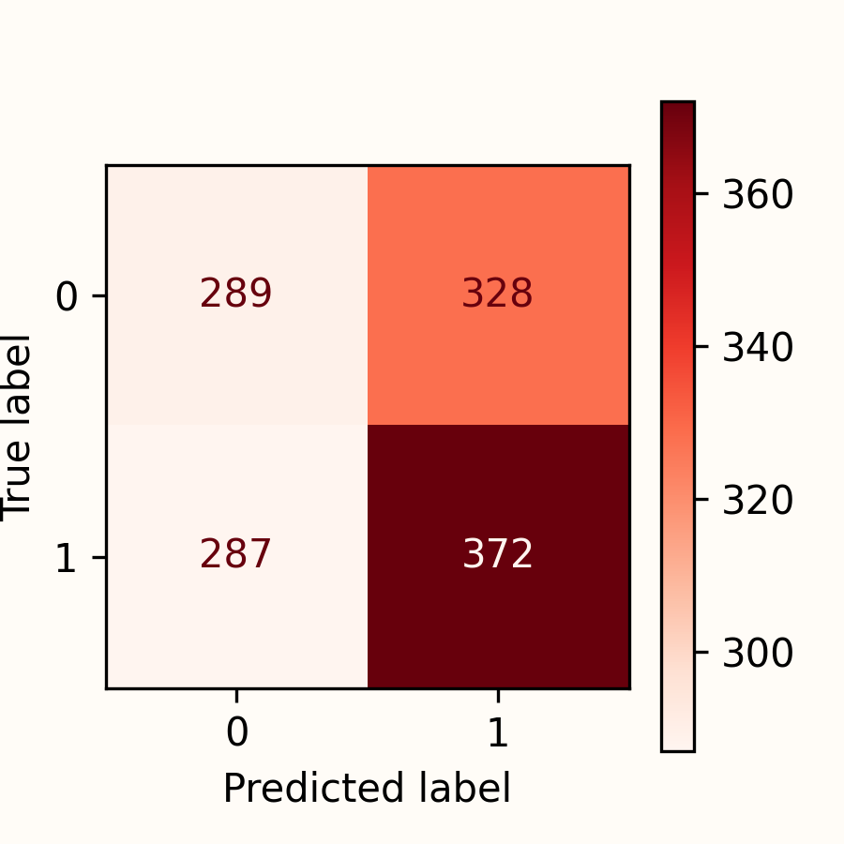
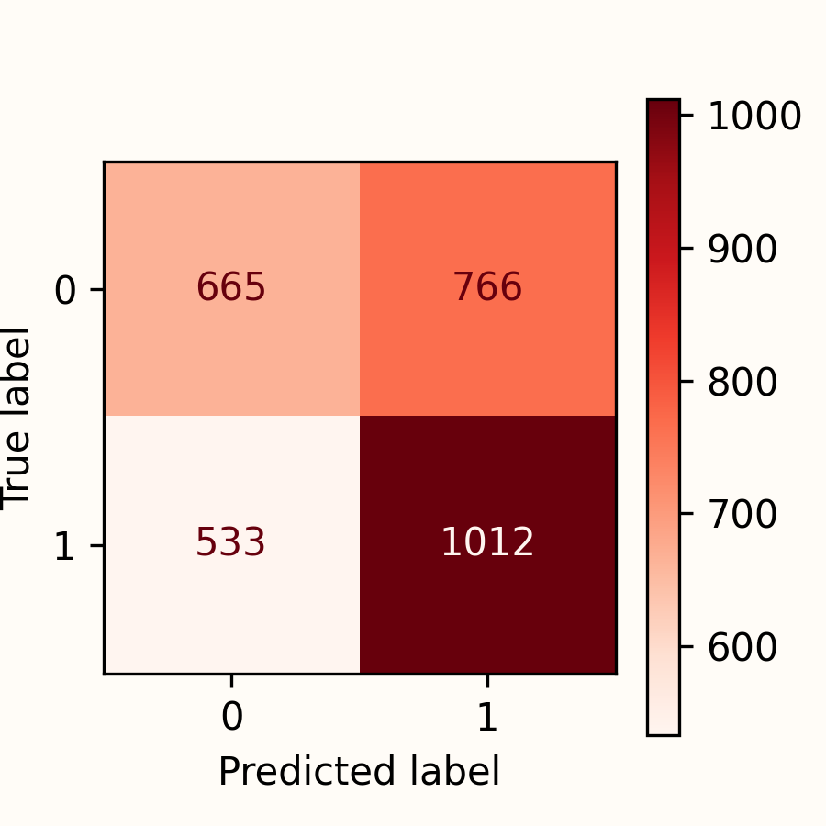
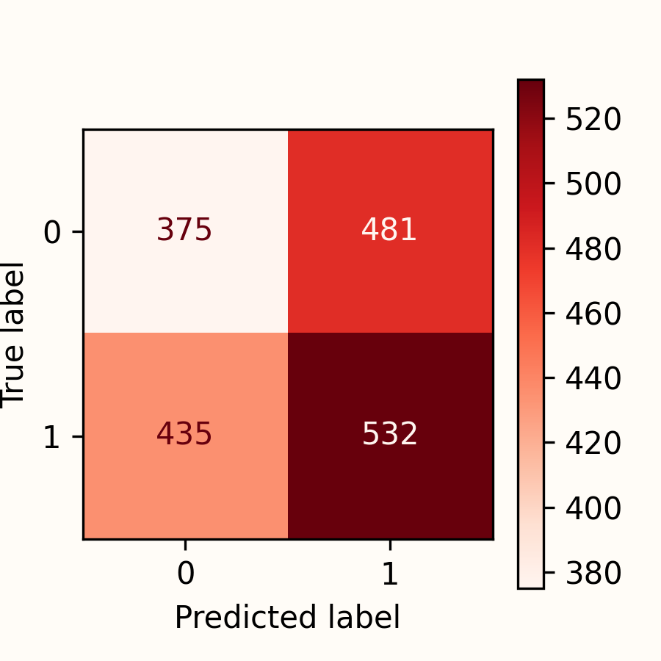
Logistic - Regression
Objective
Collection
Cleaning
Processing
Modelling
Results
Train-Set
Test-Set
Validation-Set
Accuracy |  | 0.563 |  | 0.518 |  | 0.497
Kappa |  | 0.120 |  | 0.032 |  | -0.011

Slide 13
Final Results
 | Accuracy | F1 | Recall | Precission | Kappa
Logistic Regression | 0.90 | Special offers | $23,000 | No | Low
Company B |  | Reliability | $27,000 | No | Low
Company C |  | Repairs | $30,000 | Yes | High
Don’t trust indicators better trust a goldfish

Slide 14
Inv in the Stock Market Pitch Deck
Here is where your presentation begins

Slide 15
Contents of this template
You can delete this slide when you’re done editing the presentation
Fonts | To view this template correctly in PowerPoint, download and install the fonts we used
Used and alternative resources | An assortment of graphic resources that are suitable for use in this presentation
Thanks slide | You must keep it so that proper credits for our design are given
Colors | All the colors used in this presentation
Icons and infographic resources | These can be used in the template, and their size and color can be edited
Editable presentation theme | You can edit the master slides easily. For more info, click here
For more info: SLIDESGO | BLOG | FAQs
You can visit our sister projects: FREEPIK | FLATICON | STORYSET | WEPIK | VIDEVO

Slide 16

What is a pitch deck?
A pitch deck is a short presentation that entrepreneurs use to describe their business and present it to potential investors. It usually consists of about 10 slides with:
An overview of the company's mission and the product or service offered
Market opportunity
Team, financials, etc.
The goal is to garner enough interest from investors so that they are motivated to invest in the business

Slide 17
Table of contents
1
2
3
4
5
6
Introduction
Problem & solution
Market opportunity
Product demo
Team & timeline
Financial & metrics

Slide 18

1
Introduction

Slide 19
Main ideas of a pitch deck
Presentation
Investors
Value
A great presentation for a pitch deck should be concise, clear and easy to understand. Visual elements such as charts, graphs, images, and videos can help to make the presentation engaging
When it comes to picking investors for a pitch deck, it's important to research potential investors and understand their preferences, goals
and interests
The value of a product is determined by how much customers are willing to pay for it. It's a combination of factors, including the quality of the product, its features, and how well it meets customer needs

Slide 20
Six recommendations
Keep it simple
Use visuals
Keep it short
Structure your pitch deck clearly and make sure all the important points are easy to understand
Incorporate visuals or graphics to illustrate your message and keep the audience engaged
A good pitch deck should be concise and clear; avoid using too much information
Make it memorable
Test & iterate
Main points
Include impactful stories, statistics, or facts that will help your audience remember your
message afterwards
Practice presenting your deck beforehand with friends or colleagues for feedback, then use this input to refine it further
A pitch deck is an overview of your business; focus on key points that get the most important ideas across

Slide 21
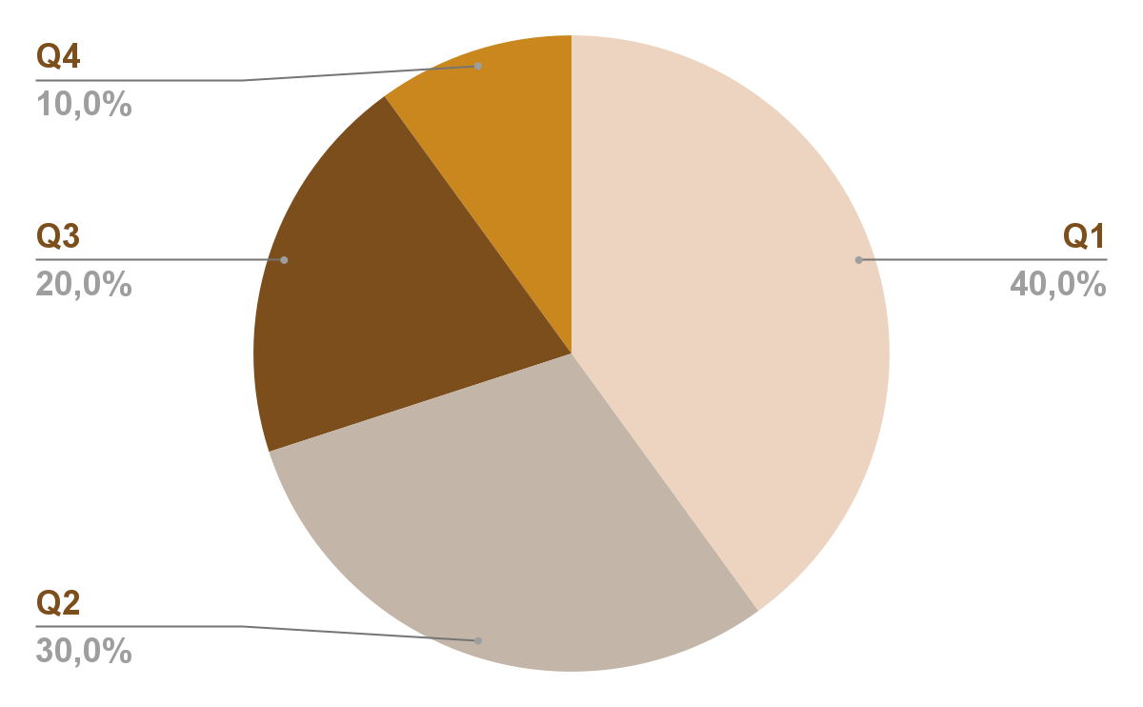
Revenue by quarter
Q1
Q2
Q3
Q4
January - March
April - June
July - September
Follow the link in the graph to modify its data and then paste the new one here. For more info, click here
October - December

Slide 22
Competition comparison
 | Features | Value | Pricing | Trial | Competence | Share
Company A | Fuel economy | Special offers | $23,000 | No | Low | 8%
Company B | Design | Reliability | $27,000 | No | Low | 5%
Company C | Performance | Repairs | $30,000 | Yes | High | 20%
Company D | Safety features | Marketing | $24,000 | No | High | 22%
Company E | Technology | Customers | $32,000 | Yes | Low | 10%
Company F | Comfort | Best prices | $15,000 | Yes | High | 30%
Company G | Customization | Brand name | $45,000 | No | Low | 5%

