Slide 1
Predicting the direction of the DAX by using indicators
Notes:
So my topic is about the prediction of the direciton of the German Stock Index by using indicators.

Slide 2
Table of Contents
1
2
3
4
5
6
Objective
Data Collection
Data Cleaning
Processing
Model Training and Validation
Results
Notes:
I structured my presentation in the way of the data analysis workflow.
So i started with the Objective.
Talk about how I collected my data.
How I did the cleaning and processing.
Which Model I used
And finaly talk about how they are performed.

Slide 3
Objective
Objective
Collection
Cleaning
Processing
Modelling
Results
Predict the direction of a finance market for a single day by just using indicators
By using the direction, I converting a numerical problem to a binary categorical problem
Indicators are commonly used in trading strategies
Notes:
Objective of my project
Why i decided to use indicators for the prediction?

Slide 4
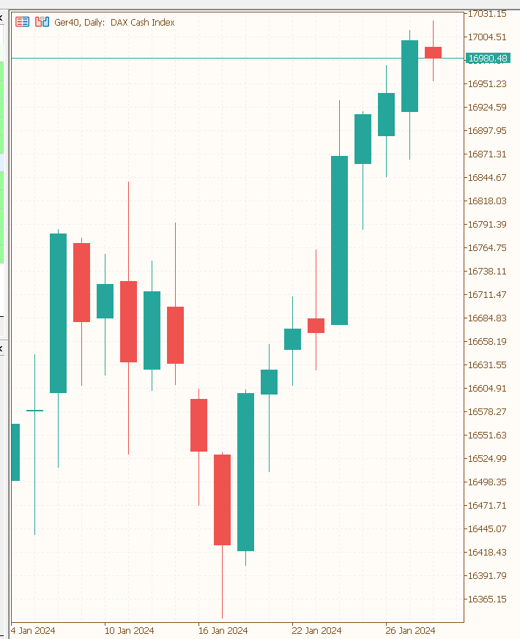
How does the data of a stock market look?
Objective
Collection
Cleaning
Processing
Modelling
Results
The typical representation of market prices is the candlestick chart
Each candle represents a period (in this example, one day)
Each candle contains four prices (open, high, low, close)
The direction can be defined by the difference between the close and open prices
When the difference is positive, the direction is upward; when the difference is negative, the direction is downward
high
close
open
low
Notes:
The Objective of my Project is to predict the direction of the market.
So lets start with the Question how does the data of a stock market look and what is the direction of the market?
….

Slide 5
How is the DAX calculated?
Objective
Collection
Cleaning
Processing
Modelling
Results
The DAX is calculated from the price of the 30 largest German companies
The price development of individual companies is generally influenced by supply and demand
There are many different factors that influence the market behaviors
Fundamental Data
Economic News
Technical Market Analysis
Profit
Revenue
Reports
Pattern
Indicators
Notes:
In the next slide i want quickly talk about how is the dax calculated.
So just to give you few examples
Reports and announcments

Slide 6
Data Collection
Objective
Collection
Cleaning
Processing
Modelling
Results
I have collected data from 2000 to the present by using the yfinance library
The data includes open, high, low, close (OHLC) prices and the volume of the market
The target variable is the direction, calculated by the difference between close-price and open-price
As input variables, I have calculated multiple indicators across different timeframes

Slide 7
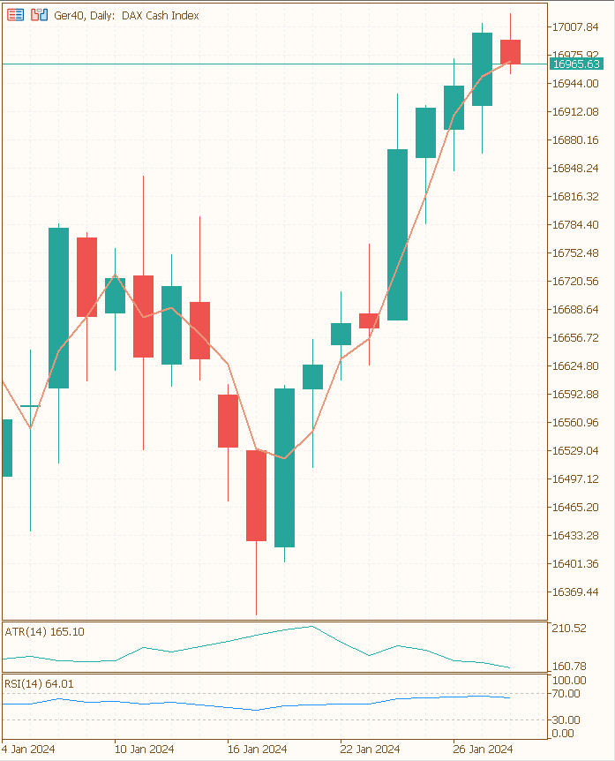
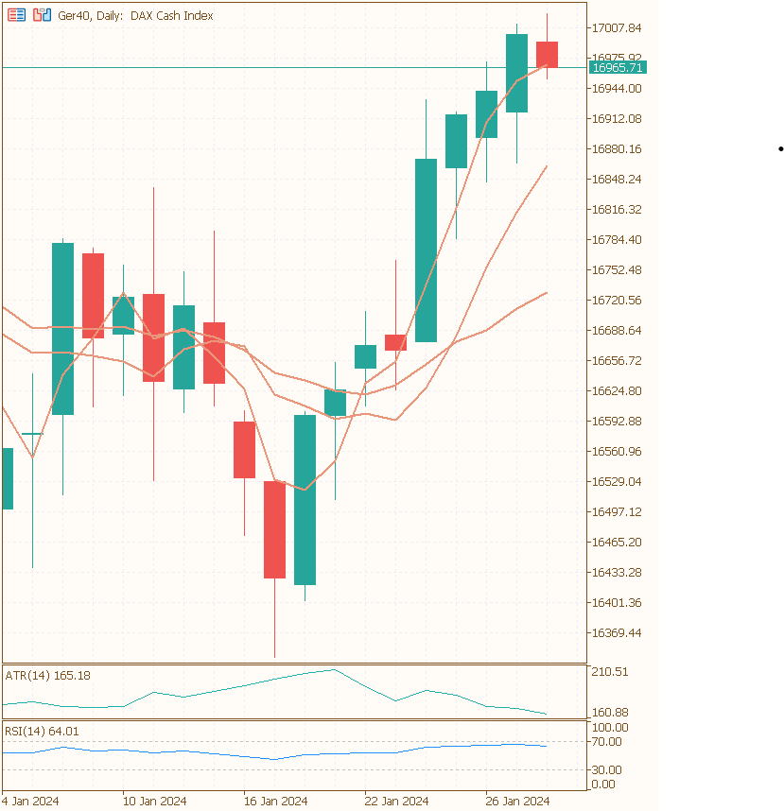
Indicators
Objective
Collection
Cleaning
Processing
Modelling
Results
Use 10 different types of indicators
Simple Moving Average
Relative Strength Index
Average True Range
Each indicator was calculated for three different time periods
For each indicator that returns a market price, i created a categorical column
1 if the price is above the indicator price
0 if the price is lover then the indicator price
Notes:
As you can see in the diagram, there are Indicator which returns just a number like ATR or RSI.
And there are Indicators which returns a Market Price.
The value of this column is 1 …
So there are Trading rules out there like if the RSI is low, the market is undersold and its more likely that the market goes up. One the other side when the RSI is high the market is overbought and goes more likely down.
…
At this point, we can play a little guessing game. Just by looking at the chart what do you think? So will be the next candle a red or a green one? At the end we will see

Slide 8
Time Dependency
Objective
Collection
Cleaning
Processing
Modelling
Results
 | open | low | high | close | moving average | direction
01.01.2024 | 5975 | 6048 | 5974 | 6048 | 6050 | Up
02.01.2024 | 6043 | 6058 | 6015 | 6032 | 6042 | Down
03.01.2024 | 6032 | 6047 | 5997 | 6034 | 6040 | Up
Notes:
In addition the general data cleaning like dealing with missing values i had to be aware with the time dependency of my data.
In the table you can see an example for three observations. You can see the open, low, high and close price.
Also an example of an indicator and the direction calculated out of the close and the open price.
Because of the time dependency I need to ensure that each observation only includes informations from the past otherwise my model will not perform under realistic circumstances. So it allways will perform much better as in reality because it has information about the future.
I hope I can make this more clear with the following example:
The Moving is an aggregated calculation with the past prices AND the current prices. Therefore i have set an offset to every indicator so that the calculation starts from the day before. Otherwise the Observation will have information from the future.
After calculating each indicator I also dropped every OLHC-price because it also contains information about the future and i was left with 60 different indicators and the direction.
If I would let these Informations in, the Model would already have all Information needed to calculate the direction.

Slide 9
Feature Selection
Objective
Collection
Cleaning
Processing
Modelling
Results
Varianace Threshold to drop features with a variance less then 0.02
Correlation Matrix to identify multicorrelarity with a threshold = 0.99
End up with 43 features
Transforming, Scaling and Sampling
Power Transformer
Min Max Scaler for X
My target is allready in a range between 0 and 1
Class Imbalance: Train-Set = 0.045 Test-Set = 0.044 -> So I did not use any sampling method

Slide 10
X-y Split
Objective
Collection
Cleaning
Processing
Modelling
Results
Data-Set
90 %
10 %
Data-Set
Validation-Set
80 %
20 %
Train-Set
Test-Set
Notes:
So my first Step for Model was the X-y-Split.
I used a Validation Set as well because i used hyperparameter tuning and i want to see how my models are perform on an independent Dataset.

Slide 11
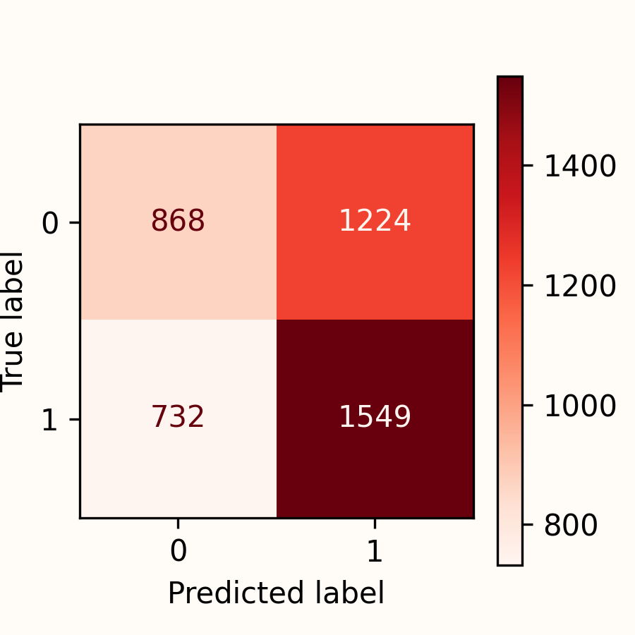
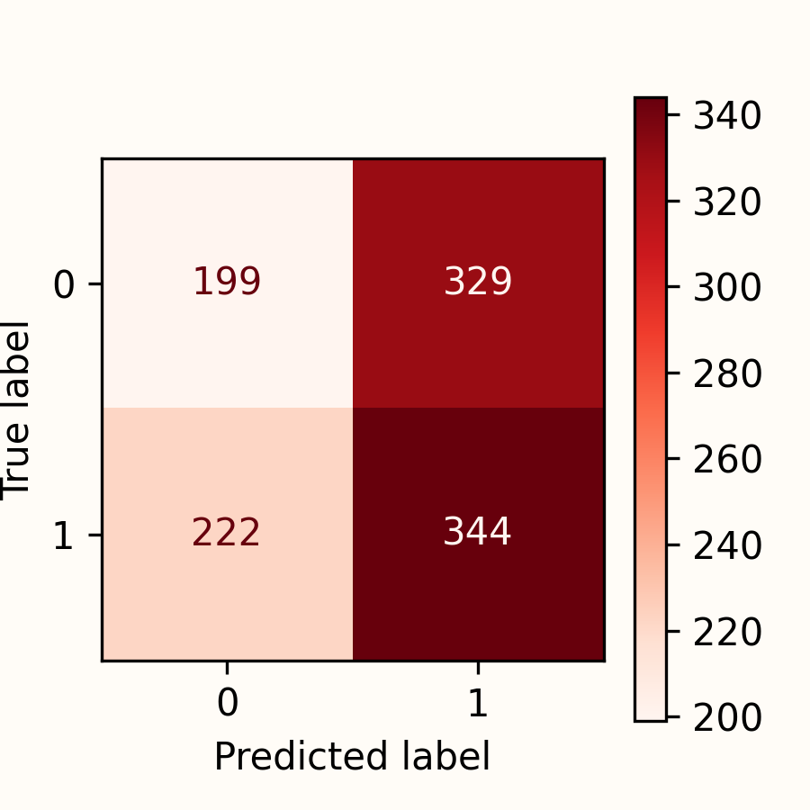
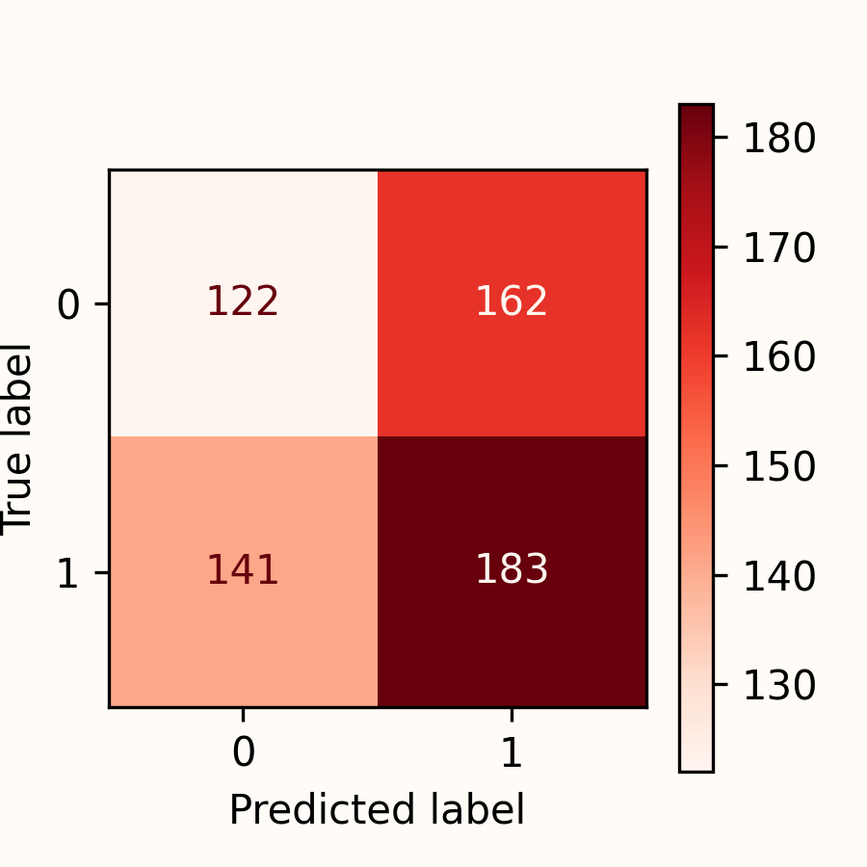
Logistic - Regression
Objective
Collection
Cleaning
Processing
Modelling
Results
Train-Set
Test-Set
Validation-Set
Accuracy |  | 0.552 |  | 0.496 |  | 0.501
Kappa |  | 0.094 |  | -0.015 |  | 0.005
Notes:
So my first Model was an Logistic- Regression.
I wish to present better resulst.
But the truth is that all my models performces realy bad.

Slide 12
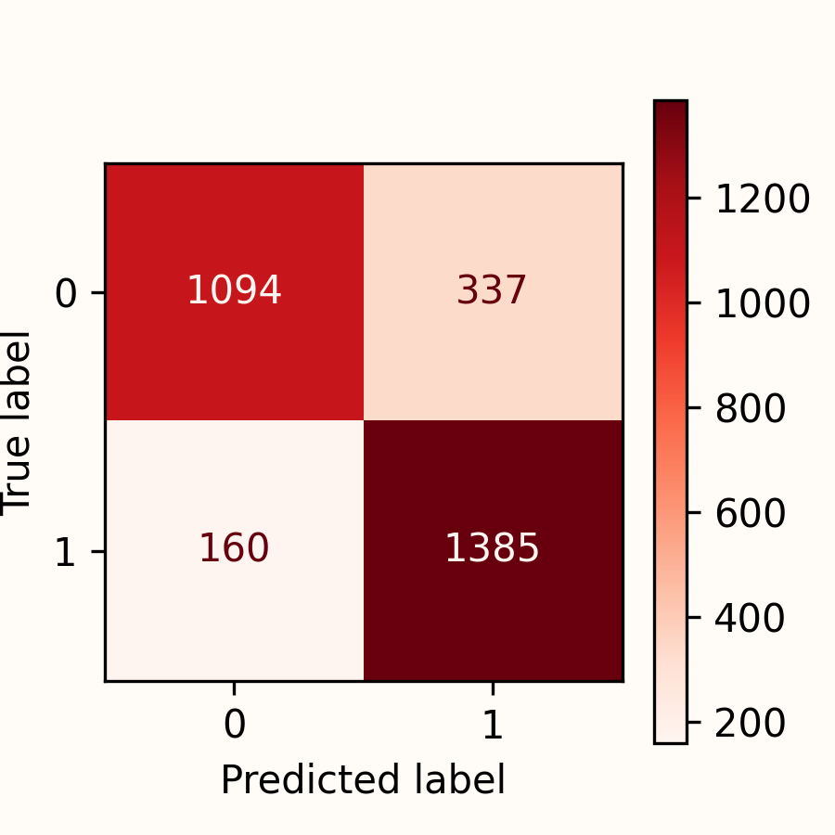
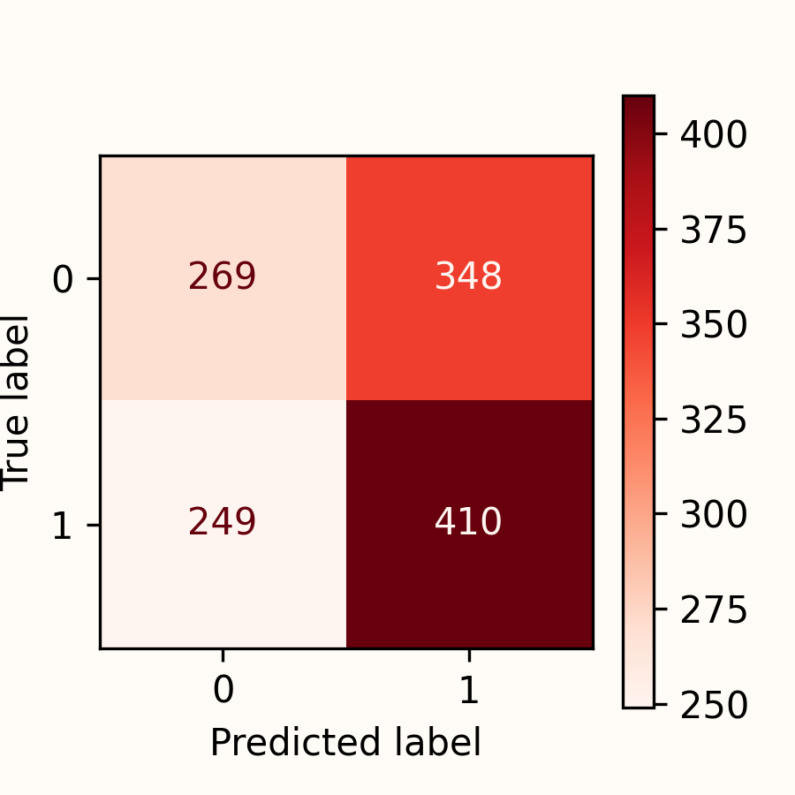
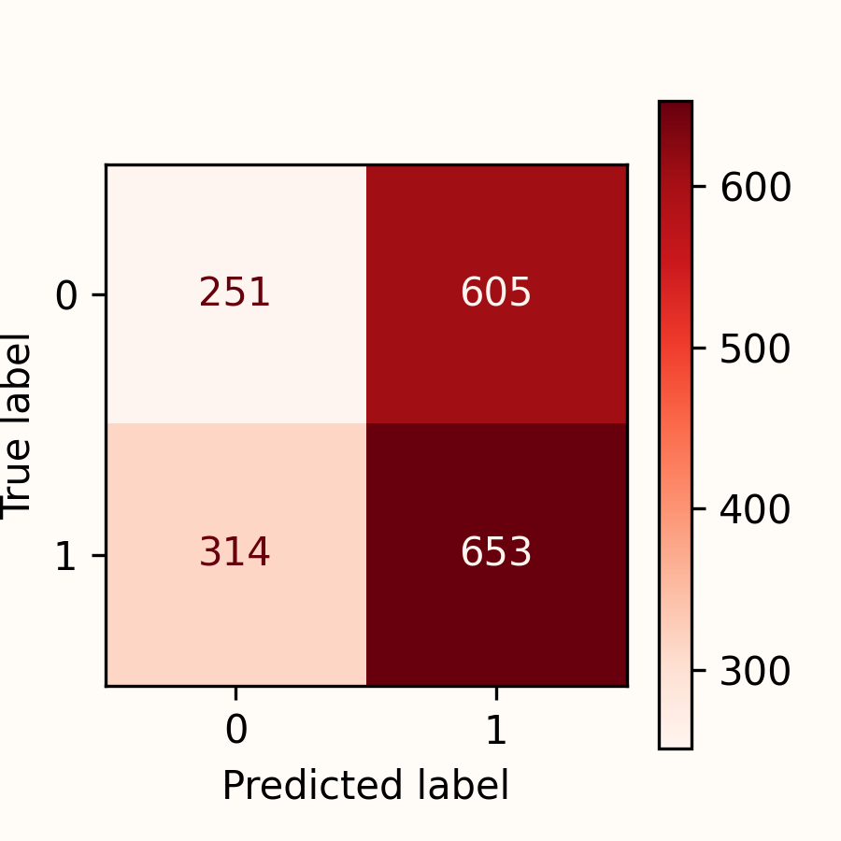
Random Forest with GridSearchCV
Objective
Collection
Cleaning
Processing
Modelling
Results
Train-Set
Test-Set
Validation-Set
Accuracy |  | 0.833 |  | 0.532 |  | 0.495
Kappa |  | 0.664 |  | 0.058 |  | -0.032
Notes:
Also in my secend Model the performance does not improve.
You can just see that only in the train-set i get a desent accuracy and kappa as well.
But as you can see this model suffers from overfitting.

Slide 13
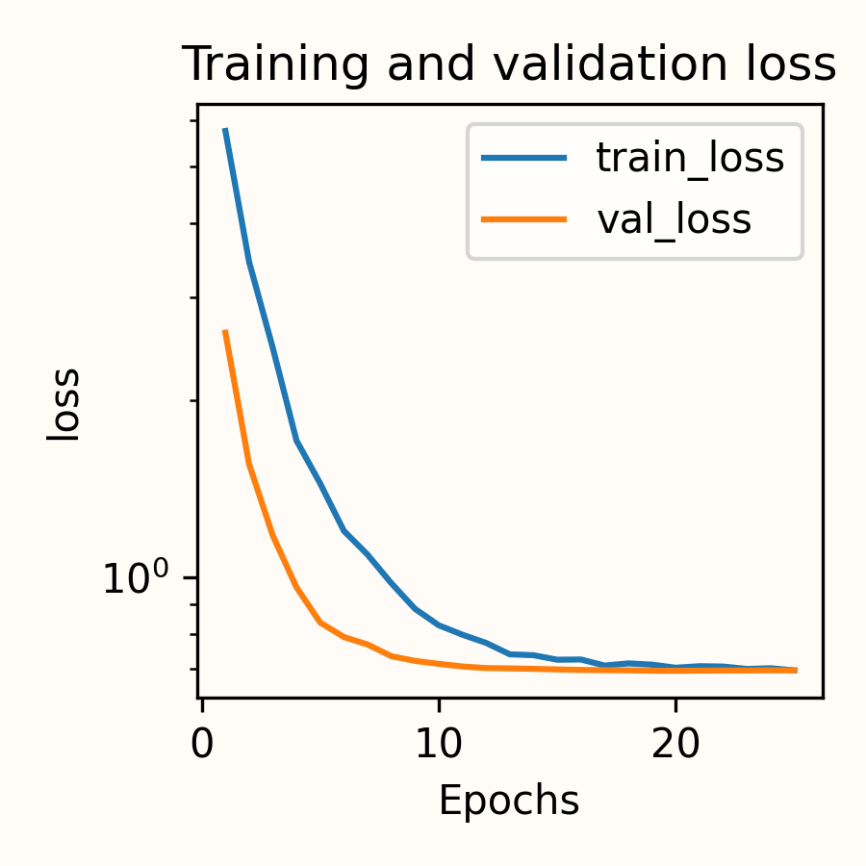
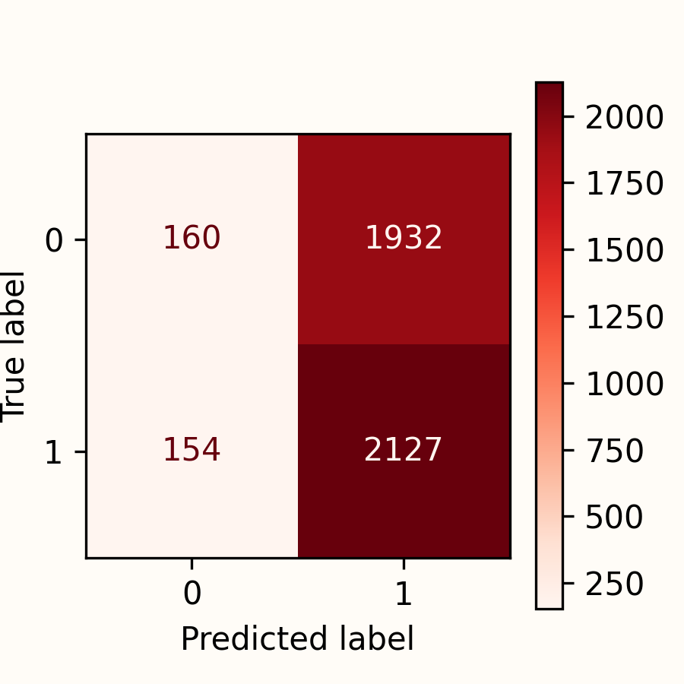
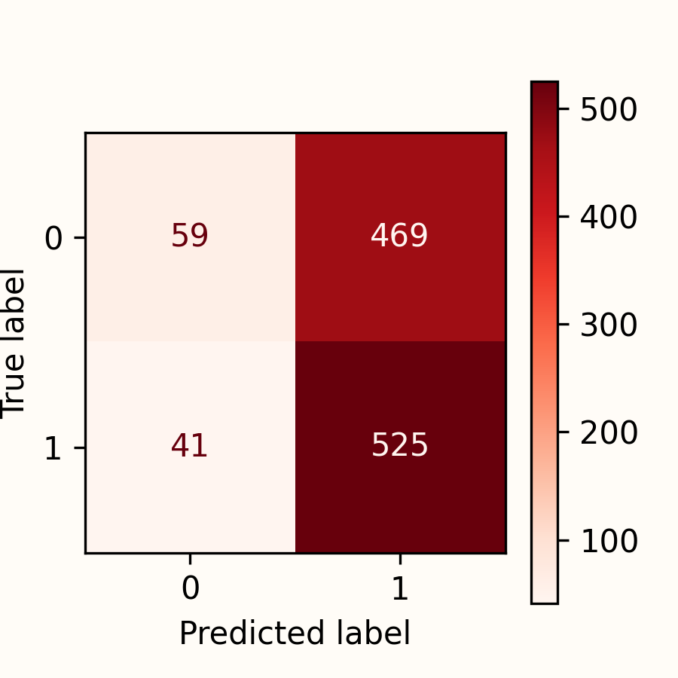
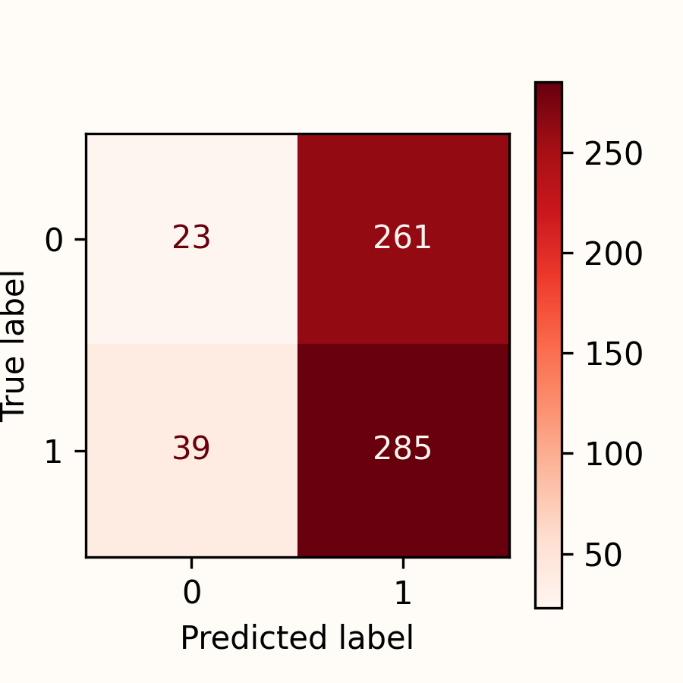
Neural Network
Objective
Collection
Cleaning
Processing
Modelling
Results
Train-Set
Test-Set
Validation-Set
Accuracy |  | 0.553 |  | 0.533 |  | 0.506
Kappa |  | 0.009 |  | 0.040 |  | -0.041
Notes:
My last Model was a neural network model but i was not able to improve the performance

Slide 14
Final Results & Conclusions
Validation Set | Accuracy | F1 | Recall | Precission | Kappa
Logistic Regression | 0.502 | 0.547 | 0.565 | 0.530 | -0.006
Random Forest | 0.498 | 0.593 | 0.685 | 0.522 | -0.030
Neural Network | 0.506 | 0.655 | 0.879 | 0.522 | -0.041
The performance of all models is realy bad -> they are not practical for actual use
Financial markets are known for their unpredictability and constant changes
The performance of a model heavely relies on the input features
Next Steps: Is there an improvement, if I add features from different sources like more pattern related indicators and fundamental data from the companies?
Notes:
Finaly I had to say that the performance of the models is quite bad. They are not practical for actual use.
I did not expect that model perform realy good because the financial markets are known for their unpredictability and constant changes.
I had also to say then until thursday my results looked a lot better. But I found out that I did a realy small mistake by calculating my categorical position columns. As you remember if the price lower or higher about a certain price. So my learning is how important it is to be careful when you are calculate your own data features.
It’s interesting that a more complex model will not perform better.
All in all that the performance of a model heavly depends of the input. As used to say garbarge in garbage out.
But I would like to see how the model improve if I add features from different sources like more pattern related indicators or even fundamental data from the companies
Even I had a decent amount of indicators, a lot of them working more then less them same. Therefore I had quite a lot of multicorellarity.

Slide 15
Thank you for your attention!
Notes:
Better trust a goldfish or flipping a coin.

