Slide 1
Song recommender
Search
Home
Library
Gnod

Slide 2
Introduction
Goals
Expand and improve music recommendation for the user
Recommend songs (not only bands)
Increase website traffic in order to promote company growth
Desired outcome
The user inputs a song from one “group” and the output is recommendations of songs from that same “group”
Outcome workflow
With the users input, the program will analyse it and predict:
Songs that are actually similar to the ones they picked from an acoustic point of view
Songs that are popular around the world right now, independently from their tastes
Notes:
Their website recommend bands, not songs
Company growth = revenue (ads) and partnerships

Slide 3
Process
Collect the current popular songs
Create clusters based on the songs audio features
Collect a mix of songs with different features (genre, audio, etc) not considered popular at the moment
Add the user input song to the cluster it belongs and recommend a similar song
Notes:
Their website recommend bands, not songs
Company growth = revenue (ads) and partnerships

Slide 4
Outcome
As current hot songs
The Billboard top 100
As not so hot songs:
A website with the 3000 most popular songs of all time
Spotify API to collect the songs information and audio features
Clustering based on the audio features in order to recommend a similar song
Notes:
Their website recommend bands, not songs
Company growth = revenue (ads) and partnerships

Slide 5
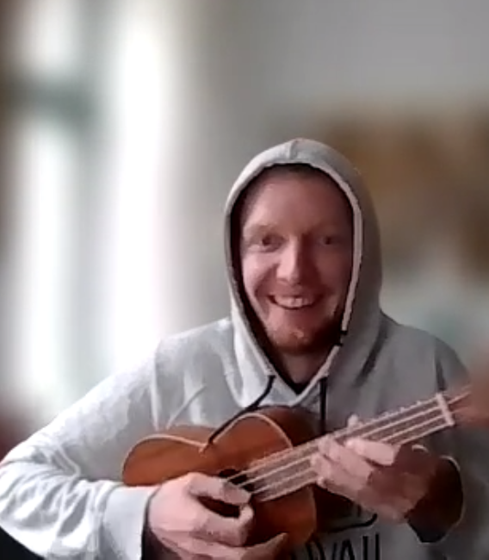
The song recommender
Search
Home
Library

Slide 6

Our new website

Slide 7

Next steps
Search
Home
Improve the web application user interface
Improve the backend code to handle different errors
Increase the amount of songs available
Update weekly the hot songs of the moment
Library

Slide 8
Thanks!
Search
Home
Library
Do you have any questions?
Vitória Schuckar
Patrick Schütten
Simone Fischer
Gnod

