Slide 1
SITE INFORMATION MANAGEMENT SYSTEM
CABLEWAY MANAGEMENT INTERFACE (CMI)
http://sims.water.usgs.gov
9/3/2014
Notes:
The Cableway Management Interface (CMI) is part of SIMS Safety, it was developed to address Cableway Safety at the field level but also as a management tool for inspectors, supervisors, safety personnel, and HQ Staff. Being part of SIMS, CMI has a national cableway perspective with locational data and maps. It also provides interactive data access to cableway attributes such as: type, status, aerial markers or not, recent visits, current and past inspection data, forms, inspectors, and remediation activity. This interactive system was designed to replace the annual cableway datacalls by the Regional Safety Managers. You can use this url to access CMI.

Slide 2
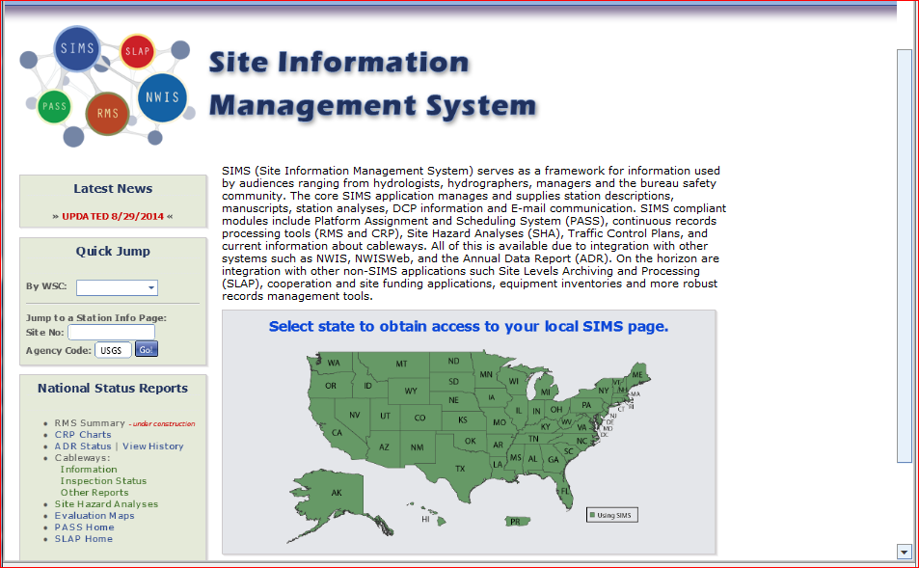
Notes:
First Login to SIMS at http://sims.water.usgs.gov. This is the SIMS homepage, it can be used to access the SIMS Cableway Management Interface. This past year we have made good progress. We now have a complete inventory of cableways across the country with site locations, maps, and actual inspection data. For a national list of cableways click on Cableways: “Information”. You can access your local WSC cableways from this page, by entering your state, clicking on your state, or inserting the station ID.

Slide 3
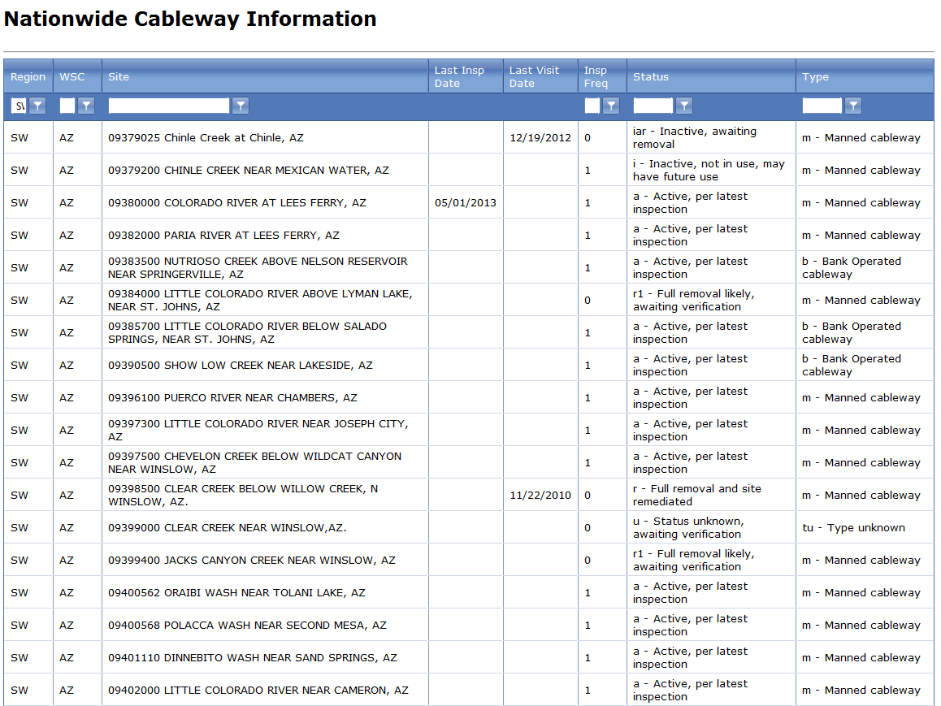
AZ
Winslow
Notes:
This National Cableway Information report provides a list of all USGS cableways. You can sort the national database by Region, WSC, Site, Status and Type, using the filter icon. In this case I sorted by the SW Region and AZ. This is also a great tool to sort for a lake, river, creek, city, or a station ID. Let’s say you only know the station ID, or you want all cableways in Winslow, AZ or any wash in AZ. Just insert the site criteria and click the filter icon.

Slide 4
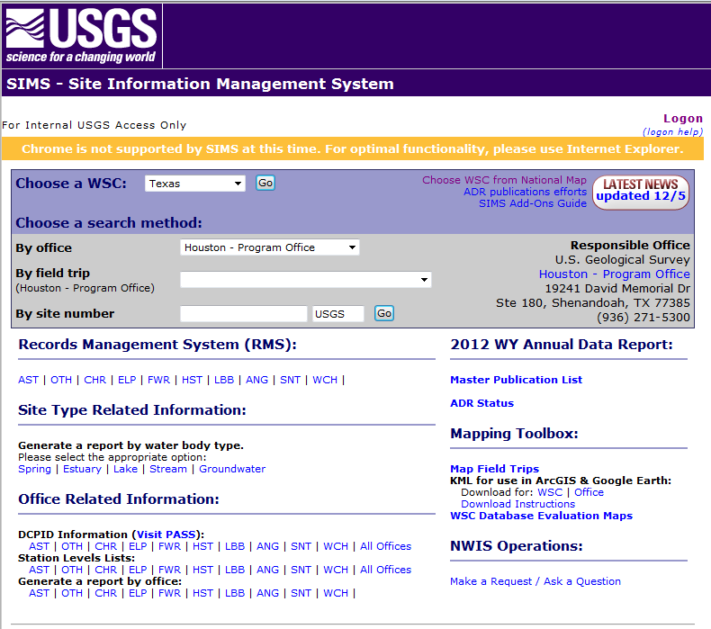

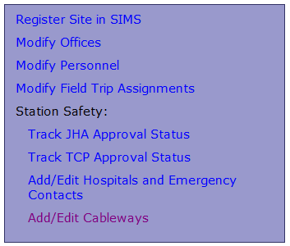
Notes:
You can also go directly to your state logon, click on Admin Tasks, and then Add/Edit Cableways. This will open up the CMI homepage where you will see a list of cableways associated with your WSC.

Slide 5
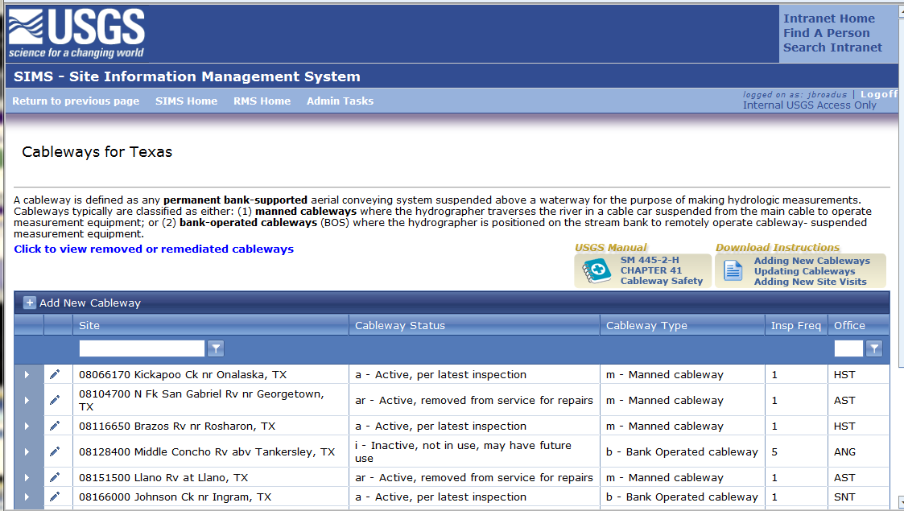
Notes:
This is the CMI homepage. There are four things to note in the header: 1. Cableway definition (the top), and links to: 2. Removed or remediated cableways (codes r or ro), 3. Survey Safety Manual, SM 445-2-H, Chapter 41 on Cableways, and 4. CMI instructions which you can download from SIMS.

Slide 6


CMI Cableway Tools & Tips
Tools: Pen (edit) View a Site Expand Site Records
Add Filter (sort) Information Delete
The Interface provides options to search by Regions, sites, office, cableway type, and status. Insert your search criteria then click filter icon
There is a column sort function which has a three a tap option: a-z, z-a, back to original station ID in numerical order
You can scan multiple documents (pages) and photos into a single .pdf or .doc file and upload into CMI
Everyone needs to start recording all site visits and inspections, and upload any documentation and pictures into CMI.
WMA Memorandum 13.03--Safety at Cableways (1).pdf
To transfer a cableway to another agency use a USGS 9-3107 form
CMI also provides an archive of historical documentation for remediated sites
X
X
Notes:
Before we get into the operation of CMI, here are some helpful hints. You will need to know each icon’s function to update cableways.

Slide 7

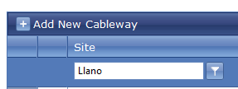

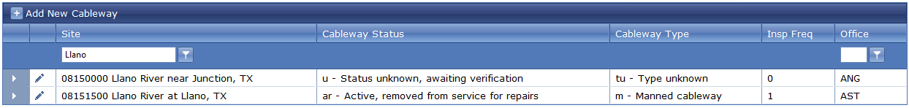
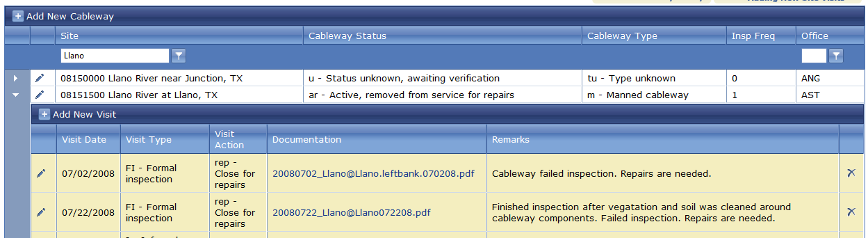
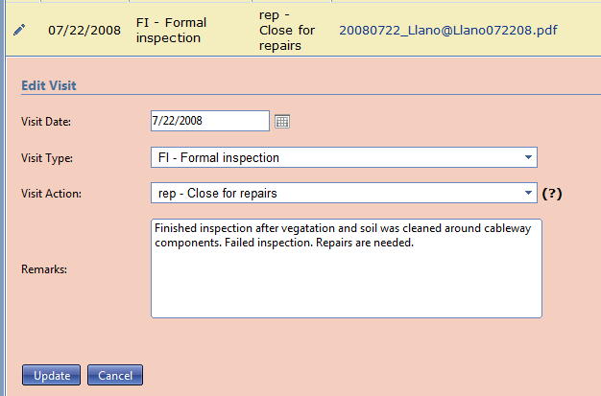

5. Other Interface Tools
Word search
Can also do an office search
Update or add info
Notes:
And here are some more helpful tools. From the home screen you can search for a Site or an Office, using the filter icon. You can also sort the headings alphabetically for Site, Status ( a – for active), or Type (m - for all manned cableways ). Once sorted you can then select a specific site and by expanding the site, you can then Add or Edit a site visit.

Slide 8
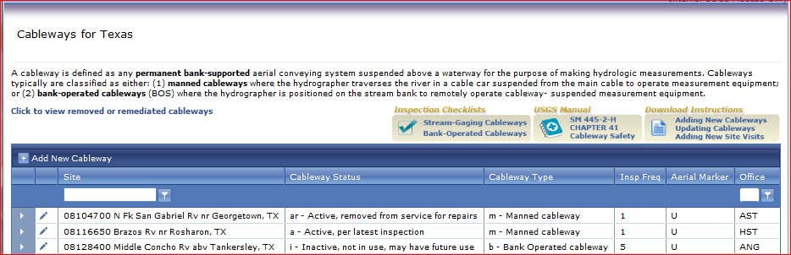
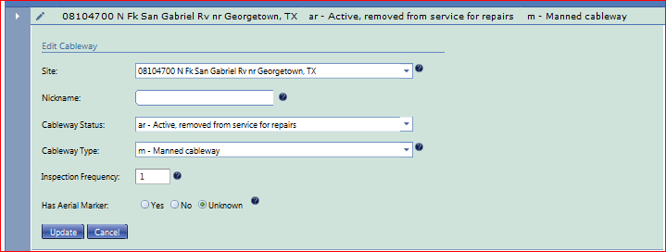
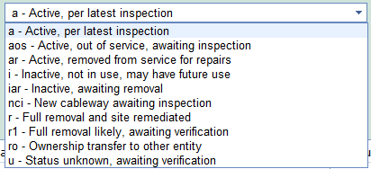



1. Update Cableway Site Information
Use the Pen to Select Site and Update
Status
In years
Notes:
The Update Cableway Status is the simplest CMI operation. If there is a change in cableway status (say active to inactive) this is how you update the cableway status. You can also change the type of cableway, such as a manned cableway being converted to a bank operated cableway; or add aerial markers if available. If there are more than one cableway at a site you can give them a “nickname” to identify each cableway (such as “manned” or “BOC” ). The inspection frequency is 365 days or one year.

Slide 9
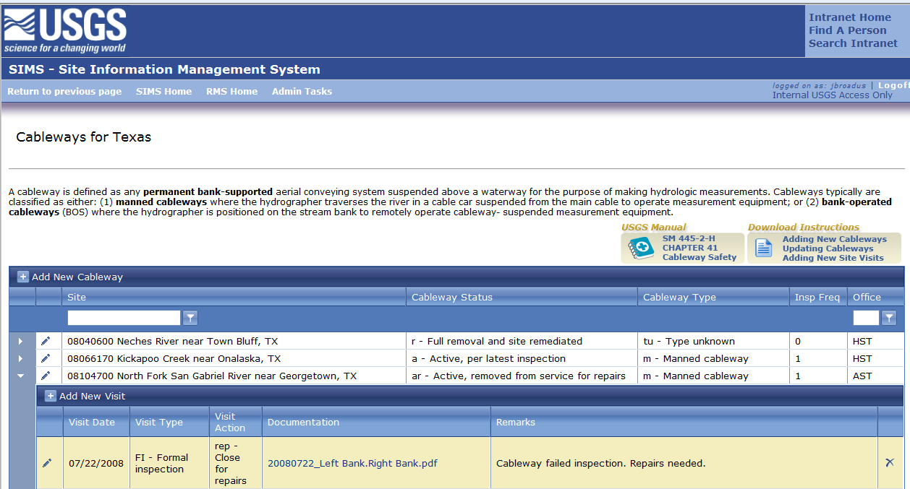
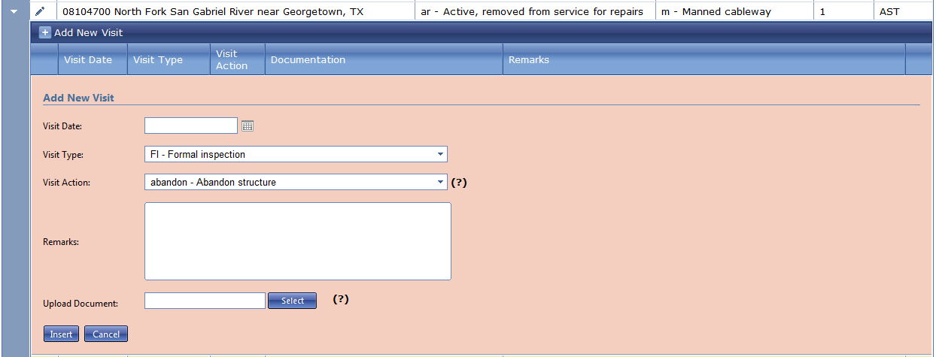


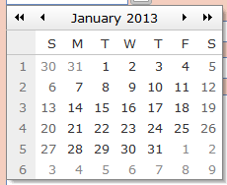
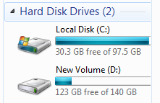

2. Add a New Site Visit
Expand to Add a new Site Visit
Type
Change cableway status to : Inactive, awaiting removal
Action
Enter text
Visit Date
2013_Left Bank_Right Bank.pdf
from
Notes:
To Add a New Site Visit select the site, use the expand icon, then chose Add New Visit, provide a date, the type of visit, the visit action, and any remarks..
Note the ? Marks provide information: Visit Action (?) “What you chose may impact the cableway status in which case you may need to edit the cableway status”. You should also upload any documentation (?); however “You can only upload one document, so merge all scanned documents into one .pdf or .doc file”, save to your computer, select the file, then upload from your computer into CMI.

Slide 10
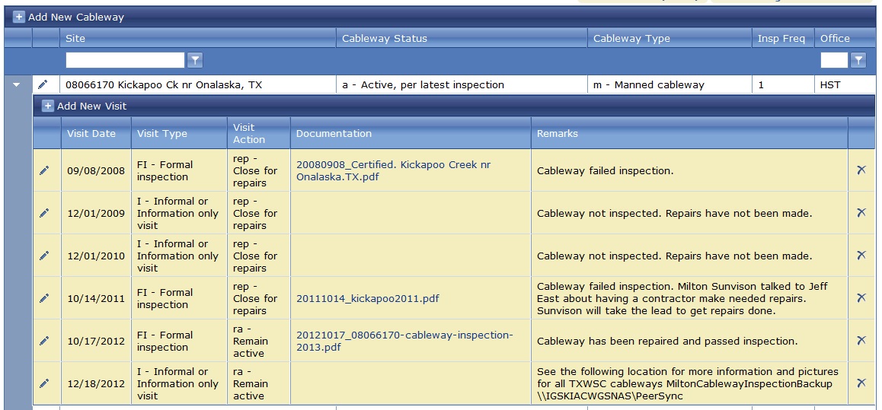
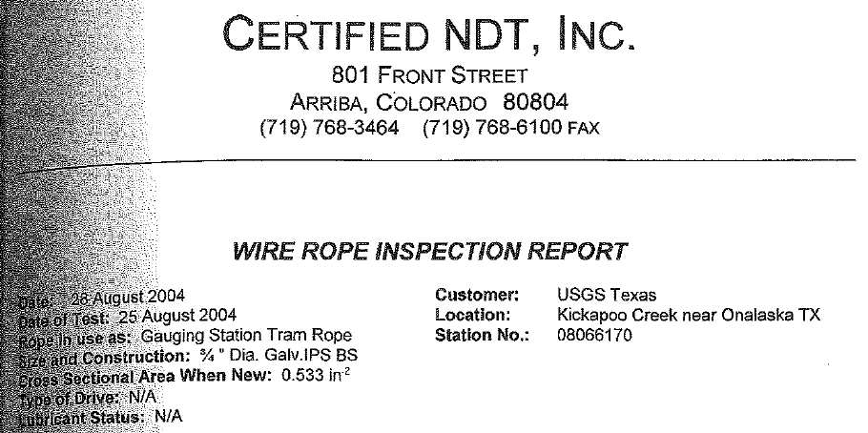
Notes:
This is an example of a good cableway report with multiple site visits by type, action taken, and an example of supporting documentation, along with remarks, all archived in CMI.

Slide 11
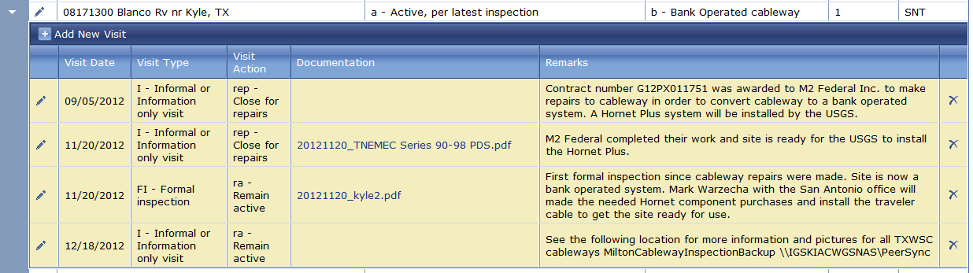
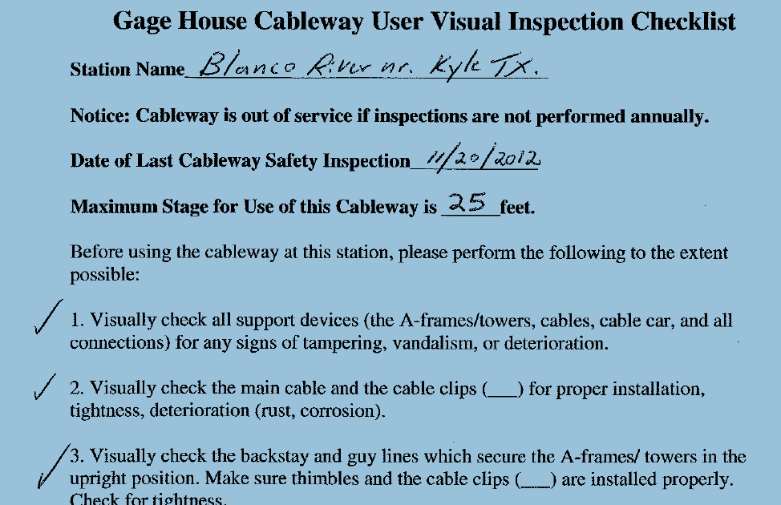
Notes:
This is just another example of documentation archived from this cableway site.

Slide 12
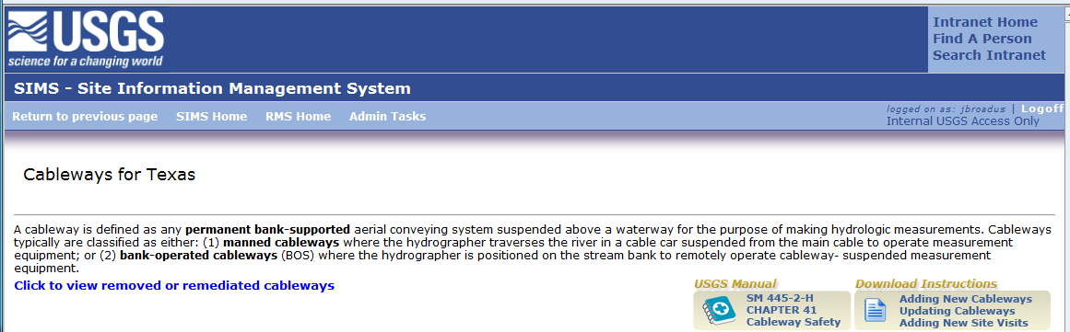
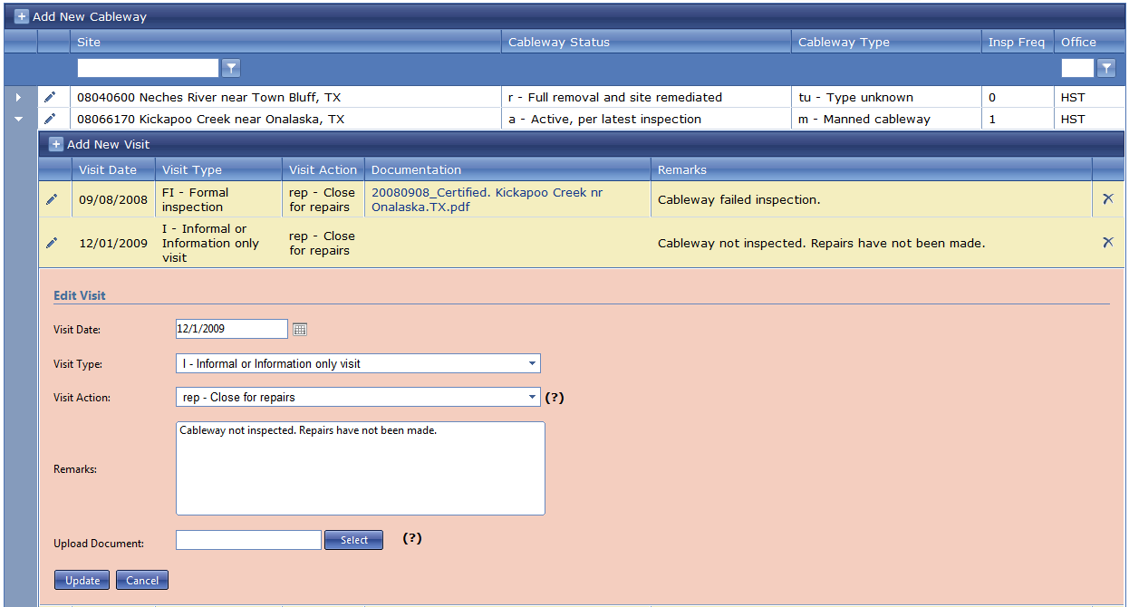
3. Edit Cableway Site Visits
Select site and expand to view, then edit
Enter info or edit text
Add any additional documentation
Notes:
To View or Edit an existing Site Visit, first select a site, expand, then edit. Changes can be made to the: date, visit type, action, or remarks. You can also upload any new, additional, or edited documentation by scanning the original documents, saving to a .pdf or .doc file, and uploading into the system.

Slide 13
Notes:
Back to the CMI homepage. If we want to add a new cableway, click , [+] Add New Cableway

Slide 14
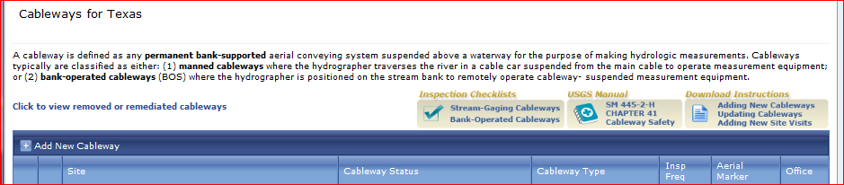
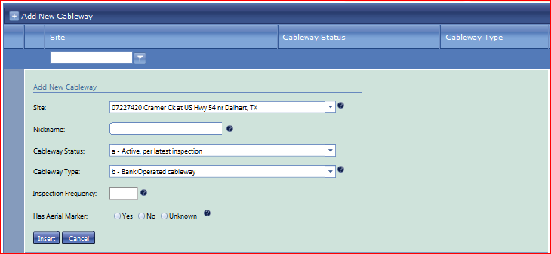
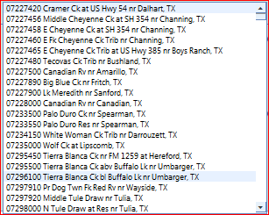
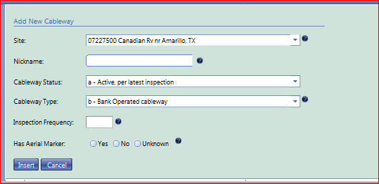
4. Add a New Cableway
4. Add a New Cableway to an Existing Site
Click here to get all possible sites
Chose a site
Update the site information
Notes:
When you select Add New Cableway, CMI lists all cableway sites operated by the WSC starting with the lowest station ID. Click on the expand icon to get the whole list of WSC sites, select the appropriate site. Input the cableway nickname, status, type, frequency, and whether it has an aerial markers or not. Nicknames allow multiple cableways at a site.
Note : In CMI you can only add a new cableway to an existing SIMS site. To add a cableway to a “new” Station you first need to contact the SIMS Development Team to establish the new site in SIMS (gs-w_help_SIMS@usgs.gov).
We have seen how to 1. update cableway status and type; 2. add a new site visit, 3. edit a site visit, and 4. add a new cableway. These are the basic operations. Working in CMI is basically a very simple process.

Slide 15
Notes:
Here are some enhanced reports available in CMI from the National Homepage. Check Cableway Inspection Status

Slide 16
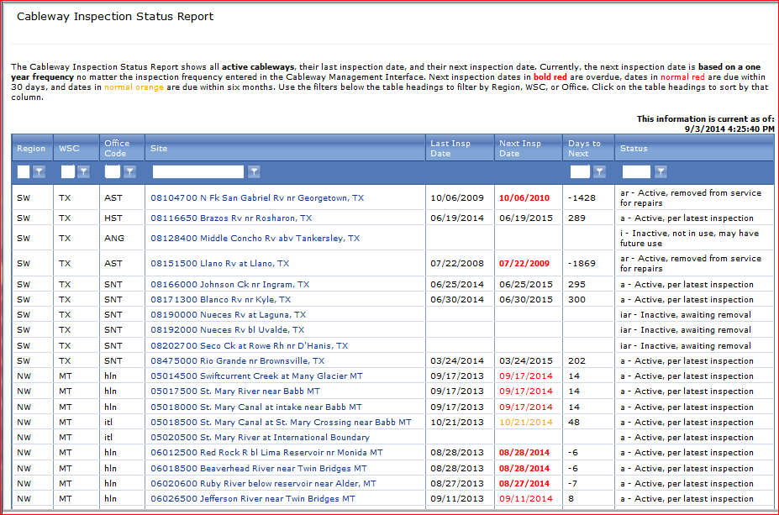
Cableway Inspection Status Report
Notes:
Cableway Inspection Status Reports are available at the national level: http://sims.water.usgs.gov National Status Reports/Cableways/Inspection Status and at the Science Center Level: SC homepage/SIMS/Office Related Information/Cableway Status Report_ NEW!

Slide 17
Notes:
Now look at Other Reports, here you will find map reports that are created monthly.

Slide 18
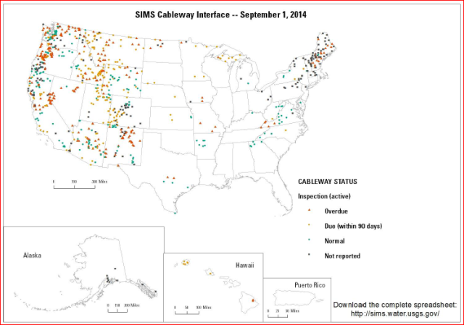
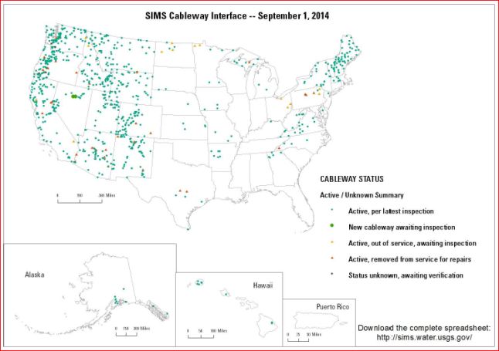
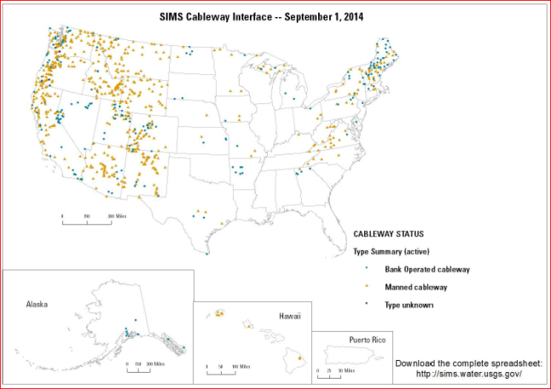
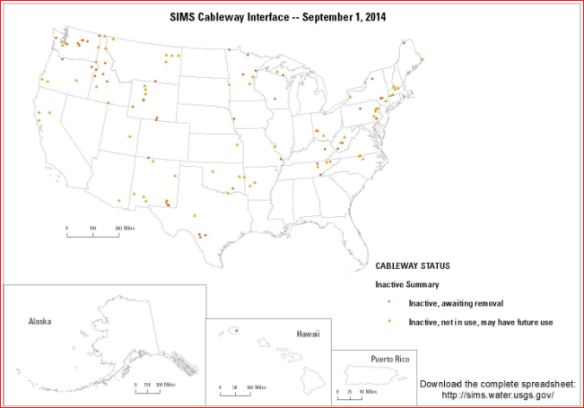
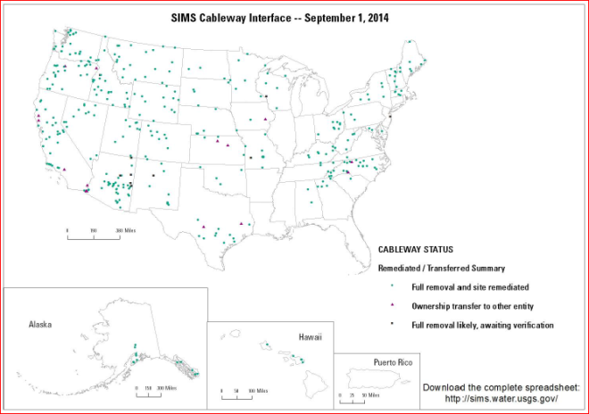
National Status Reports/Cableways:| Other Reports - Maps
sims.water.usgs.gov - /SIMSReports/Cableways/
6/1/2014 3:15 PM 775820 NationwideCablewayMaps_20140601.pdf 7/1/2014 3:23 PM 774959 NationwideCablewayMaps_20140701.pdf 8/1/2014 4:29 PM 778427 NationwideCablewayMaps_20140801.pdf 9/2/2014 7:34 AM 780096 NationwideCablewayMaps_20140901.pdf
Notes:
You can select any monthly report. Here we have the Cableways/Other Reports – “Maps” for Aug 1, 2013. There are five separate maps in this report: 1. Active Cableway Inspections Due, 2. Active Cableways, 3. Active Cableway Type, 4. Inactive Cableways, and 5. Remediated Cableways. These maps are currently being updated monthly and show national trends for managing USGS cableways (inspections, potential training requirements, etc.)

Slide 19

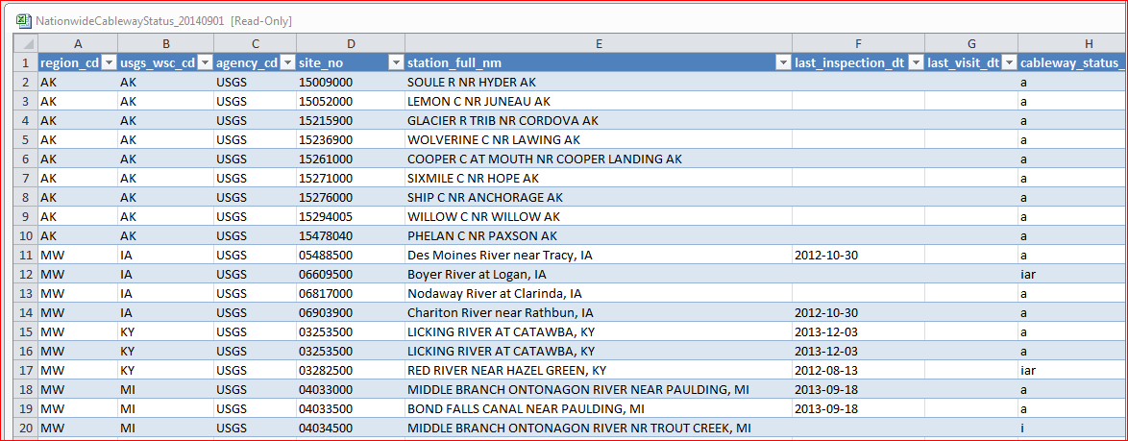
National Status Reports/Cableways: Other Reports - Status
sims.water.usgs.gov - /SIMSReports/Cableways
Notes:
Also from the SIMS homepage, Cableways/ Other Reports – “Status”, we can chose Status by date. This will provide a complete database download for each cableway record. Out to the right of this spreadsheet there is much more data, than can be shown on this slide.
This has been a quick over view of the CMI. If you have future questions look on the CMI homepage for more instructions or give me a call.

Slide 20
Joe Broadus
SW Region Safety Manager
19241 David Memorial Drive
Suite 180
Shenandoah, TX
936-271-5319
936-271-5399 fax
713-560-9619 cell
jbroadus@usgs.gov
gs-w_help_SIMS@usgs.gov
Notes:
I think you will find the system is very straight forward and easy to use. One more item you may be interested in.

Slide 21
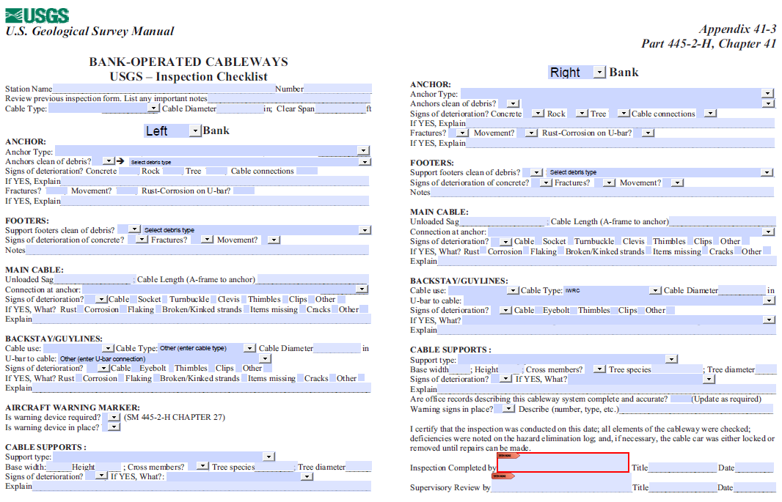
For more info on Cableway Inspection e-Forms contact :
Cameron Marshall, USGS, WA WSC, Tacoma, WA, 98402, 253-552-1618
marshall@usgs.gov
Notes:
This is an electronic version of the Cableway Inspection Checklist for a bank operated cableway. This form and one for manned cableways was developed by Cameron Marshall, in Tacoma WA. He uses a tablet computer to conduct his cableway inspections, downloads the files into his desktop, and then uploads them to CMI.

Slide 22
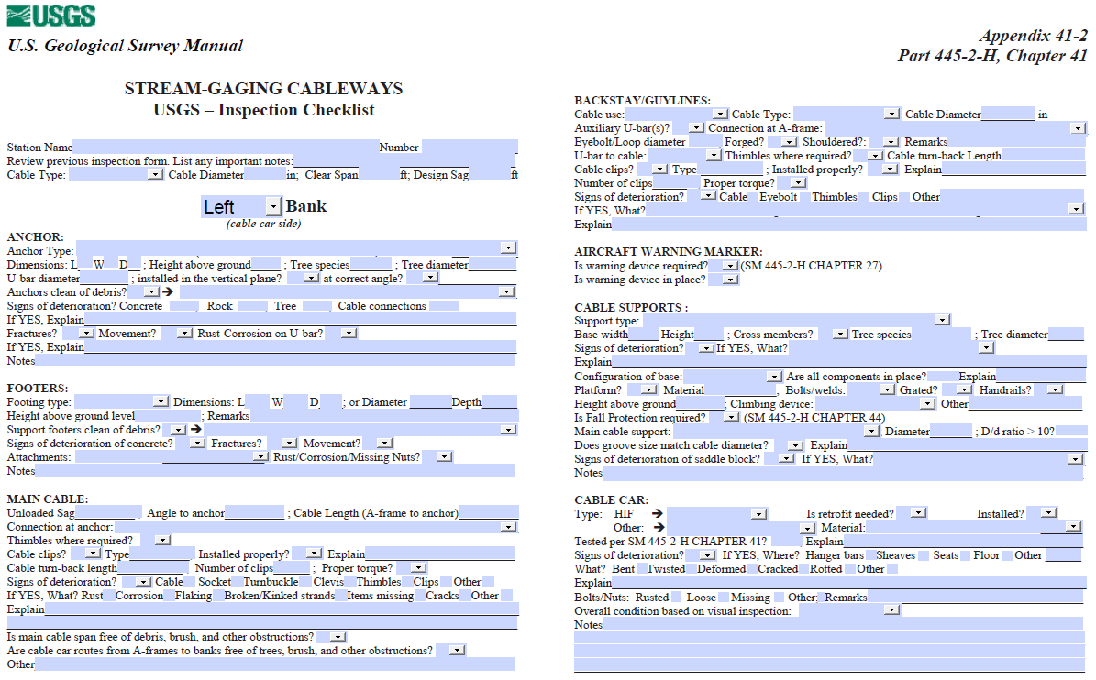
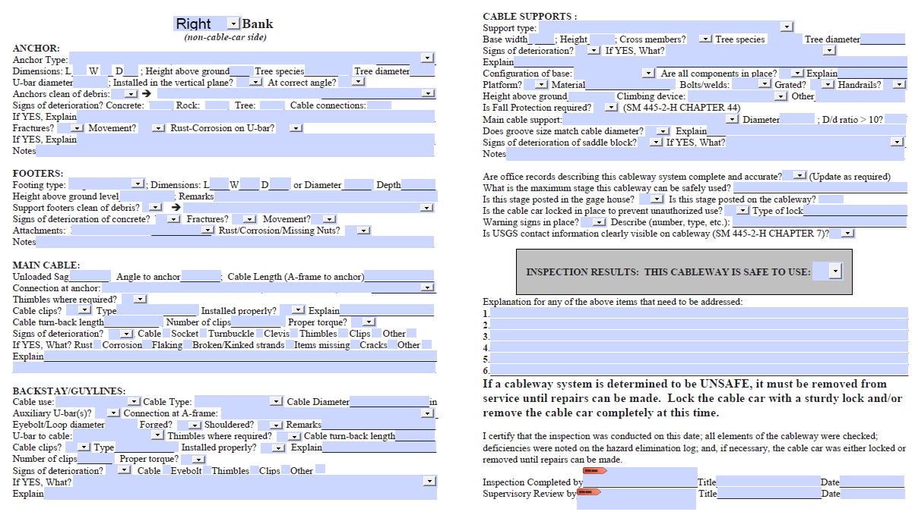
Notes:
Here is the form for a manned cableway. As you can see, most of the responses are dropdowns and there is a sign-off function, using a Smart Card, at the bottom.

Slide 23
Question: - Who is familiar with SIMS? - Has anyone used the Cableway Management Interface?
Notes:
Let’s start with a question.

