Slide 1

BlackTECH Hotel Executive Summary Loan Prediction Presentation
Presenter by:
Patrick Ugheoke Sebastine

Slide 2

Overview
BlackTECH hotel executive summary database was provided by the revenue management team. The data were analysed to provide insights for the hotel's growth. The insights include revenues and shortfalls, with recommendations on how to improve for the directors and shareholders.
In addition, the collections team of BlackTECH financial institution reported their challenges with respect to loans that were granted to management. The cohort 4 analytics team were provided data for the last 6 months and tasked with developing a prediction model that when a customer's information is inputted it can predict whether the loan will be rolled (1) or not rolled (0).

Slide 3
Hotel Executive Summary Observations
3 date entries on the booking table had data integrity/anomaly issues. It was found that the dates were wrongly captured and corrected with the help of the request table.
(Booking_id| Room_#| Check_in_date| check_out_date| Request_id)
(1919| L11| 1/7/1916| 1/17/1916| 938)
(6456| S91| 2/29/1916| 3/9/1916| 3101)
(9516| X75| 3/1/1916| 3/3/1916| 4604)
Inconsistent column names were found during data import in SQL but were corrected to maintain consistency across tables.
The Food Order table had a stable join with the Menu table, but joining with the Booking, Request, and Room tables resulted in too many null values, repetitions of food orders, and order dates.
We split the final table into two, the Restaurant and Reservation tables, as a solution.
281 missing records were found during the join of the Request and Booking tables. Analysis suggests that these were "not confirmed" or "cancelled" bookings, a practice that is normal in hotel management systems.
To visualize accurate time series and trends, we created a new table using DAX on Power BI, linking check-in date, check-out date and order date. (The transaction period is from 1st January 2016 to 13th April 2016)

Slide 4
Hotel Executive Summary Insights
In order to improve the efficiency of data storage and entry, we propose implementing a revamped system for inputting information into the hotel's database that includes a data validation component to notify users of any inaccuracies and incorporating SQL to normalize the data.
Based on our analysis, normal rooms generated the highest revenue at $1,215,280, accounting for 26.08% of total booking revenue. However, Tuesdays were identified as the lowest booking days for normal rooms. We recommend offering discounted rates mid-week to further increase the revenue it generates.
Based on our analysis, we found that the menu item 'steak 'n stuff’ had the highest sales at $9,990, and soft drinks had the lowest sales at $1,365. To increase sales, we recommend offering combo menu specials that combine items from our top 5 and bottom 5 menu categories.
Our data shows that the busiest date was January 30th, 2016, and a similar trend occurs at the end of each month. To meet the increased demand at the end of the month, it would be advisable to offer temp contracts to additional staff.
Given the high demand for both holiday bookings and normal room bookings, it would be beneficial to open an additional branch specifically catering to holiday makers.
To reward our frequent and top paying customers, it would be beneficial to introduce a loyalty program for clients who spend above a certain amount.

Slide 5
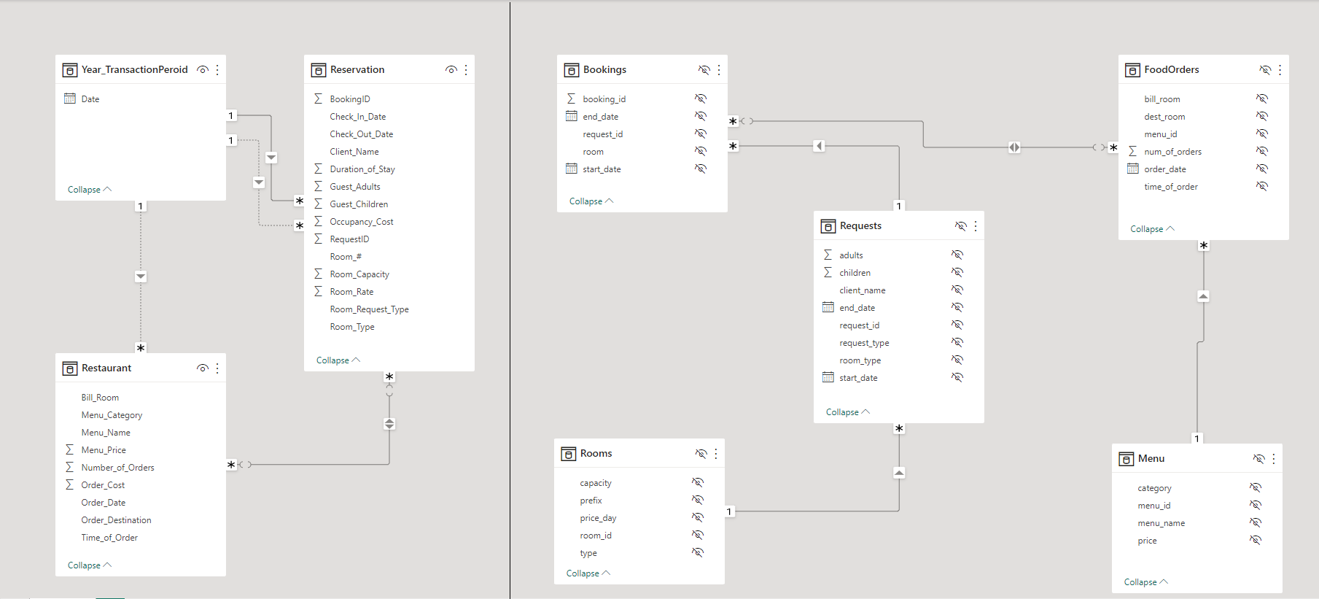
Entity Relationship Diagram (ERD)
Original tables ERD

Slide 6
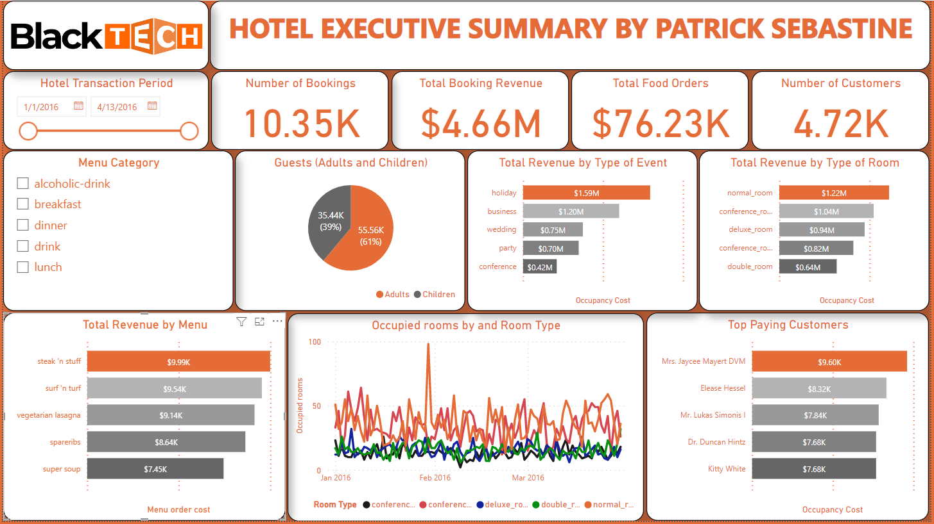
Dashboard

Slide 7
Loan Prediction Observations
Dataframe imported had 5783 records (rows) and 11 fields (columns).
There were 377 records, translating to 6.5% of null values. These null values were subsequently dropped.
There were 533 duplicate values. The first values were retained, and the second values were subsequently dropped from the Dataframe.
The ‘loan_id’ and ‘delq_history’ fields were not needed for our analysis and were therefore dropped.
The following fields were derived to assist our prediction model in making better predictions:
Debt-to-income ratio: This ratio is a measure of a borrower's financial stability, calculated by dividing the borrower's monthly debt payments by their monthly income.
Interest rate: The interest rate on the loan may affect the risk of default. Interest rate can be calculated using the formula ((closing_principal_balance/original_loan_amount)^(1/original_loan_term)-1).
After the data cleaning process, our Dataframe was left with 4873 records and 12 fields.

Slide 8
Loan Prediction Insights (1)
Machine learning prediction using Python.
For our independent features (X), the following fields were used;
'Product' field was converted from an object datatype to float64 datatype using ordinal encoder, as label encoder did not predict the best outcome.
And the 'target' field was used for our dependent features (y)
# | Fields | Non-Null Count | Datatype
1 | monthly_income | 4873 non-null | float64
2 | origination_score_band | 4873 non-null | int64
3 | TOB_months | 4873 non-null | float64
4 | closing_principal_balance | 4873 non-null | float64
5 | original_loan_amount | 4873 non-null | float64
6 | product | 4873 non-null | float64
7 | original_loan_term | 4873 non-null | int64
8 | remaining_loan_term | 4873 non-null | int64
9 | interest_rate | 4873 non-null | float64
# | Fields | Non-Null Count | Datatype
1 | target | 4873 non-null | int64

Slide 9
Loan Prediction Insights (2)
Logistics Regression Classification Model | Fields | Non-Null Count
1 | Test data size and Random state | test_size=15% and random_state=190
2 | Model parameters | C=1.0, penalty=‘12', max_iter=200
3 | Accuracy score | 72.78%
4 | Model score | 69.85%
5 | Precision score | 80.00%
6 | Confusion Matrix | array([[528, 1], [198, 4]], dtype=int64)
Random Forest Classification Model | Fields | Non-Null Count
1 | Test data size and Random state | test_size=0.25, random_state=42
2 | Model parameters | n_estimators=200, random_state=100
3 | Accuracy score | 100.0%
4 | Model score | 100.0%
5 | Precision score | 100.0%
6 | Confusion Matrix | array([[841, 0], [ 0, 378]], dtype=int64
XGBoost (eXtreme Gradient Boosting) Model | Fields | Non-Null Count
1 | Test data size and Random state | test_size=0.2, random_state=42
2 | Model parameters | objective="binary:logistic", random_state=42
3 | Accuracy score | 100.0%
4 | Model score | 100.0%
5 | Precision score | 100.0%
6 | Confusion Matrix | array([[668, 0], [ 0, 307]], dtype=int64)

Slide 10
Thank you
Presented by:
Patrick Ugheoke Sebastine
LinkedIn
https://www.linkedin.com/in/patrickugheokesebastine/
Twitter
https://twitter.com/iamreddsebastin
GitHub
https://github.com/PatrickSebastine
Kaggle
https://www.kaggle.com/patricksebastine

