Slide 1

MyTube (YouTube Clone)
By Patrick sepnio

Slide 2

Part 1: LWC
Single page multi-component app landing page for a YouTube clone
Website does not have the videos, redirects to YouTube.

Slide 3
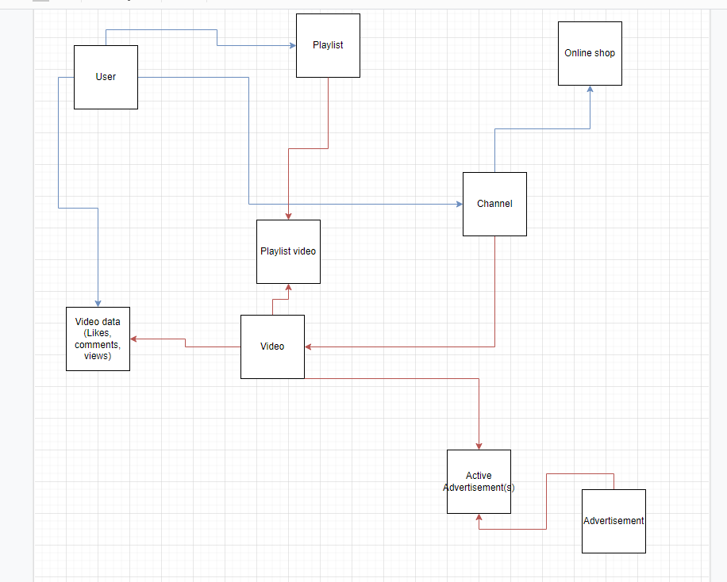
Part 2: Data Model and Security
ERD and Schema Builder has 9 objects. 2 objects are junction objects
3 different users each with their own profile. Customer Service, HR team, and Sales.

Slide 4
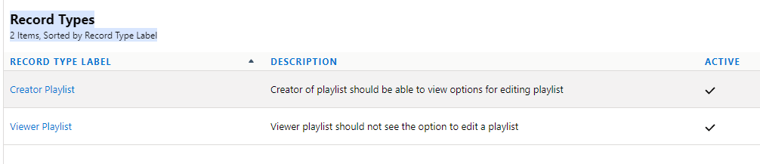
Record Type
2 different types of playlists
One playlist is for the creator of the playlist and the other playlist is for the viewers.

Slide 5
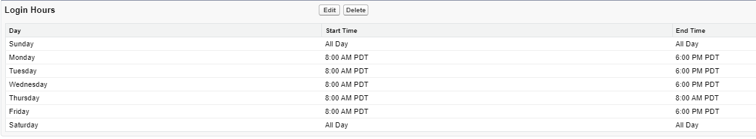
Org Level
Login hours for all profiles set from 8 AM to 6 PM

Slide 6
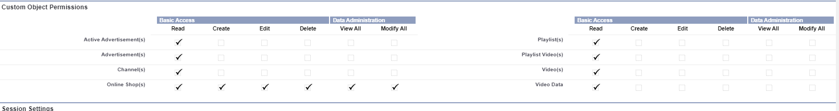
Object level
Different profiles have different permissions for custom objects. Customer Service profile can read all objects, have all permissions to the online shops object.

Slide 7
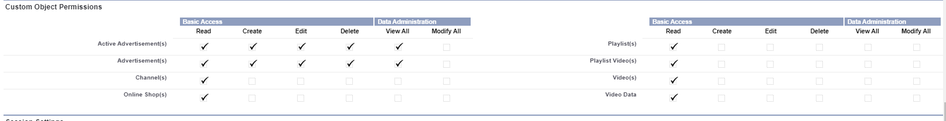
Object Level (cont.)
Sales team has view all permissions to the advertisements and active advertisements.

Slide 8
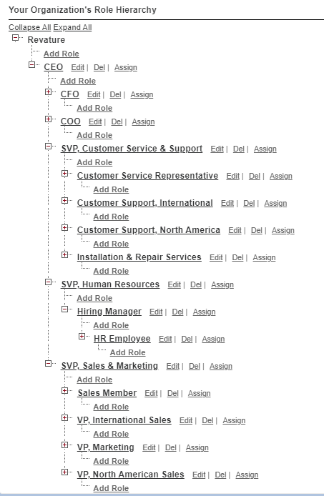
Record Level
Created new roles for the role hierarchy. Customer Service Representative, HR Employee, and Sales Member.

Slide 9
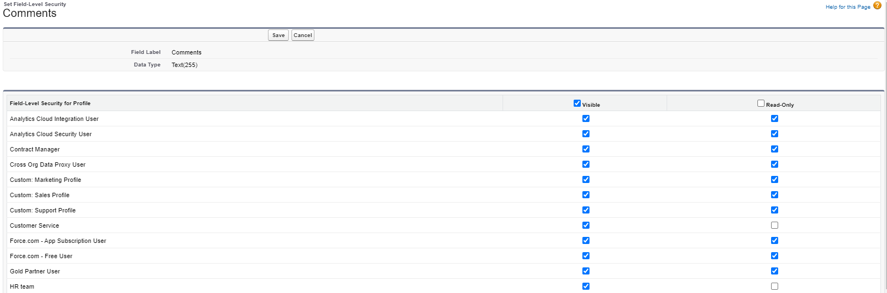
Field Level
Video data comments: Everyone can see but comments but only 3 profiles are not read only

Slide 10
Part 3: Process Automation
2 examples of each process automation tools
Workflows, flows, process builder, approval process, and validation rules

Slide 11
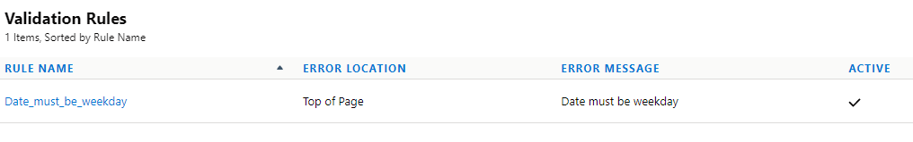
Validation Rules
Videos can only be uploaded on weekdays (Video object)

Slide 12
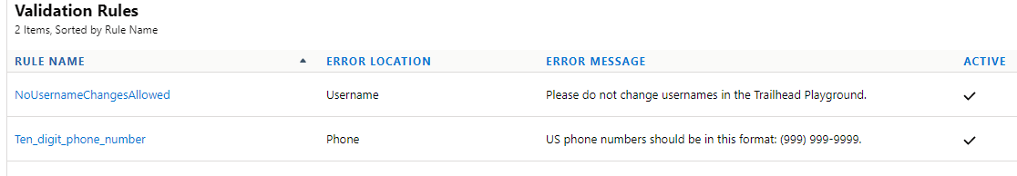
Validation Rules (cont.)
Phone number needs to have 10 digits in the form 555-555-5555 (Standard User object)

Slide 13
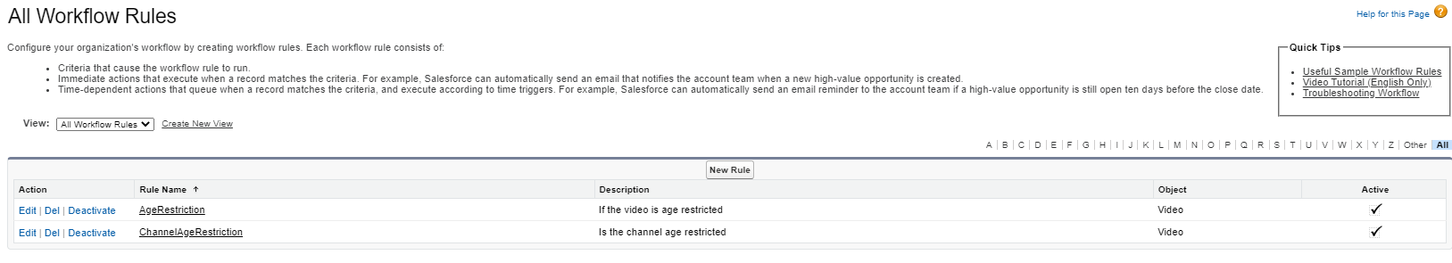
Workflows
If the minimum age for a video is 18, then change IsAgeRestricted field to true
If the channel is age restricted, then all videos for the channel will be age restricted

Slide 14
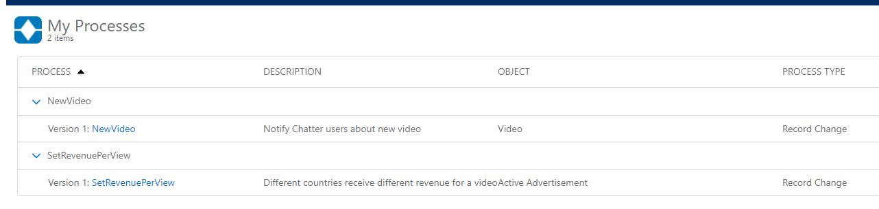
Process Builder
Different countries receive different amount for ad revenue
Users get notification on chatter about new video

Slide 15
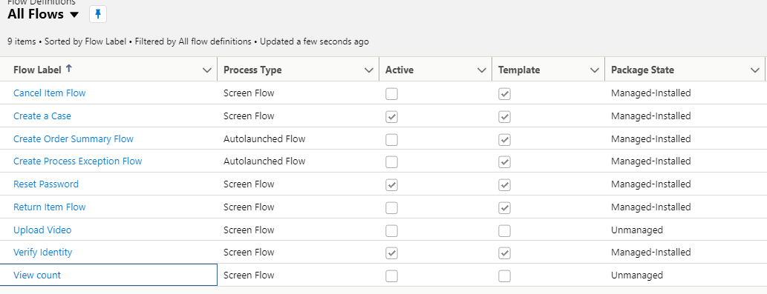
Flows
User uploading a video
User receiving an email about their view count

Slide 16
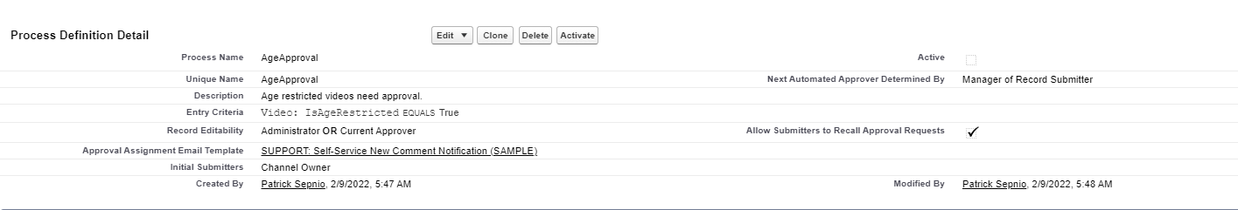
Approval Process
Age restricted videos need approval to be uploaded.

Slide 17
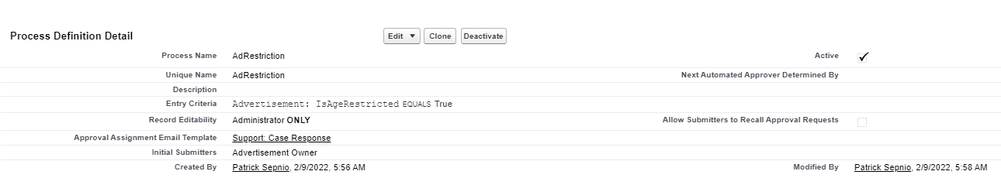
Approval Process Part 2
All advertisements need to be approved

