Slide 1
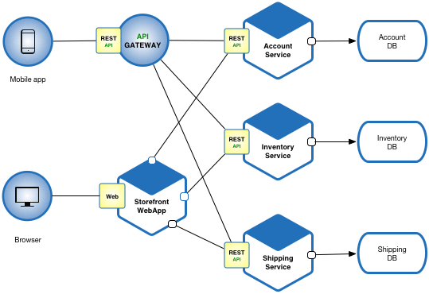
microservices architecture
A microservice architecture is a variant of the service-oriented architecture.
In a microservices architecture, services are fine-grained and the protocols are lightweight.
The goal is that teams can bring their services to life independent of others.
Loose coupling reduces all types of dependencies and the complexities around it, as service developers do not need to

