Slide 1
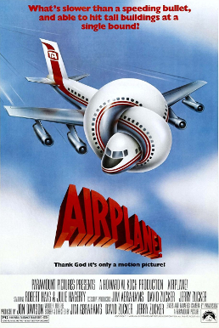
Airplane
An airplane is a fixed-wing aircraft.
Airplanes come in a variety of sizes, shapes, and wing configurations.
The broad spectrum of uses for airplanes includes recreation, transportation of goods and people, military, and research.
Worldwide, commercial

