Slide 1
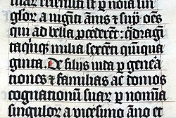
Latin
Latin is a classical language.
Latin was originally spoken in the area around Rome, known as Latium.
Latin has contributed many words to the English language.

