Slide 1
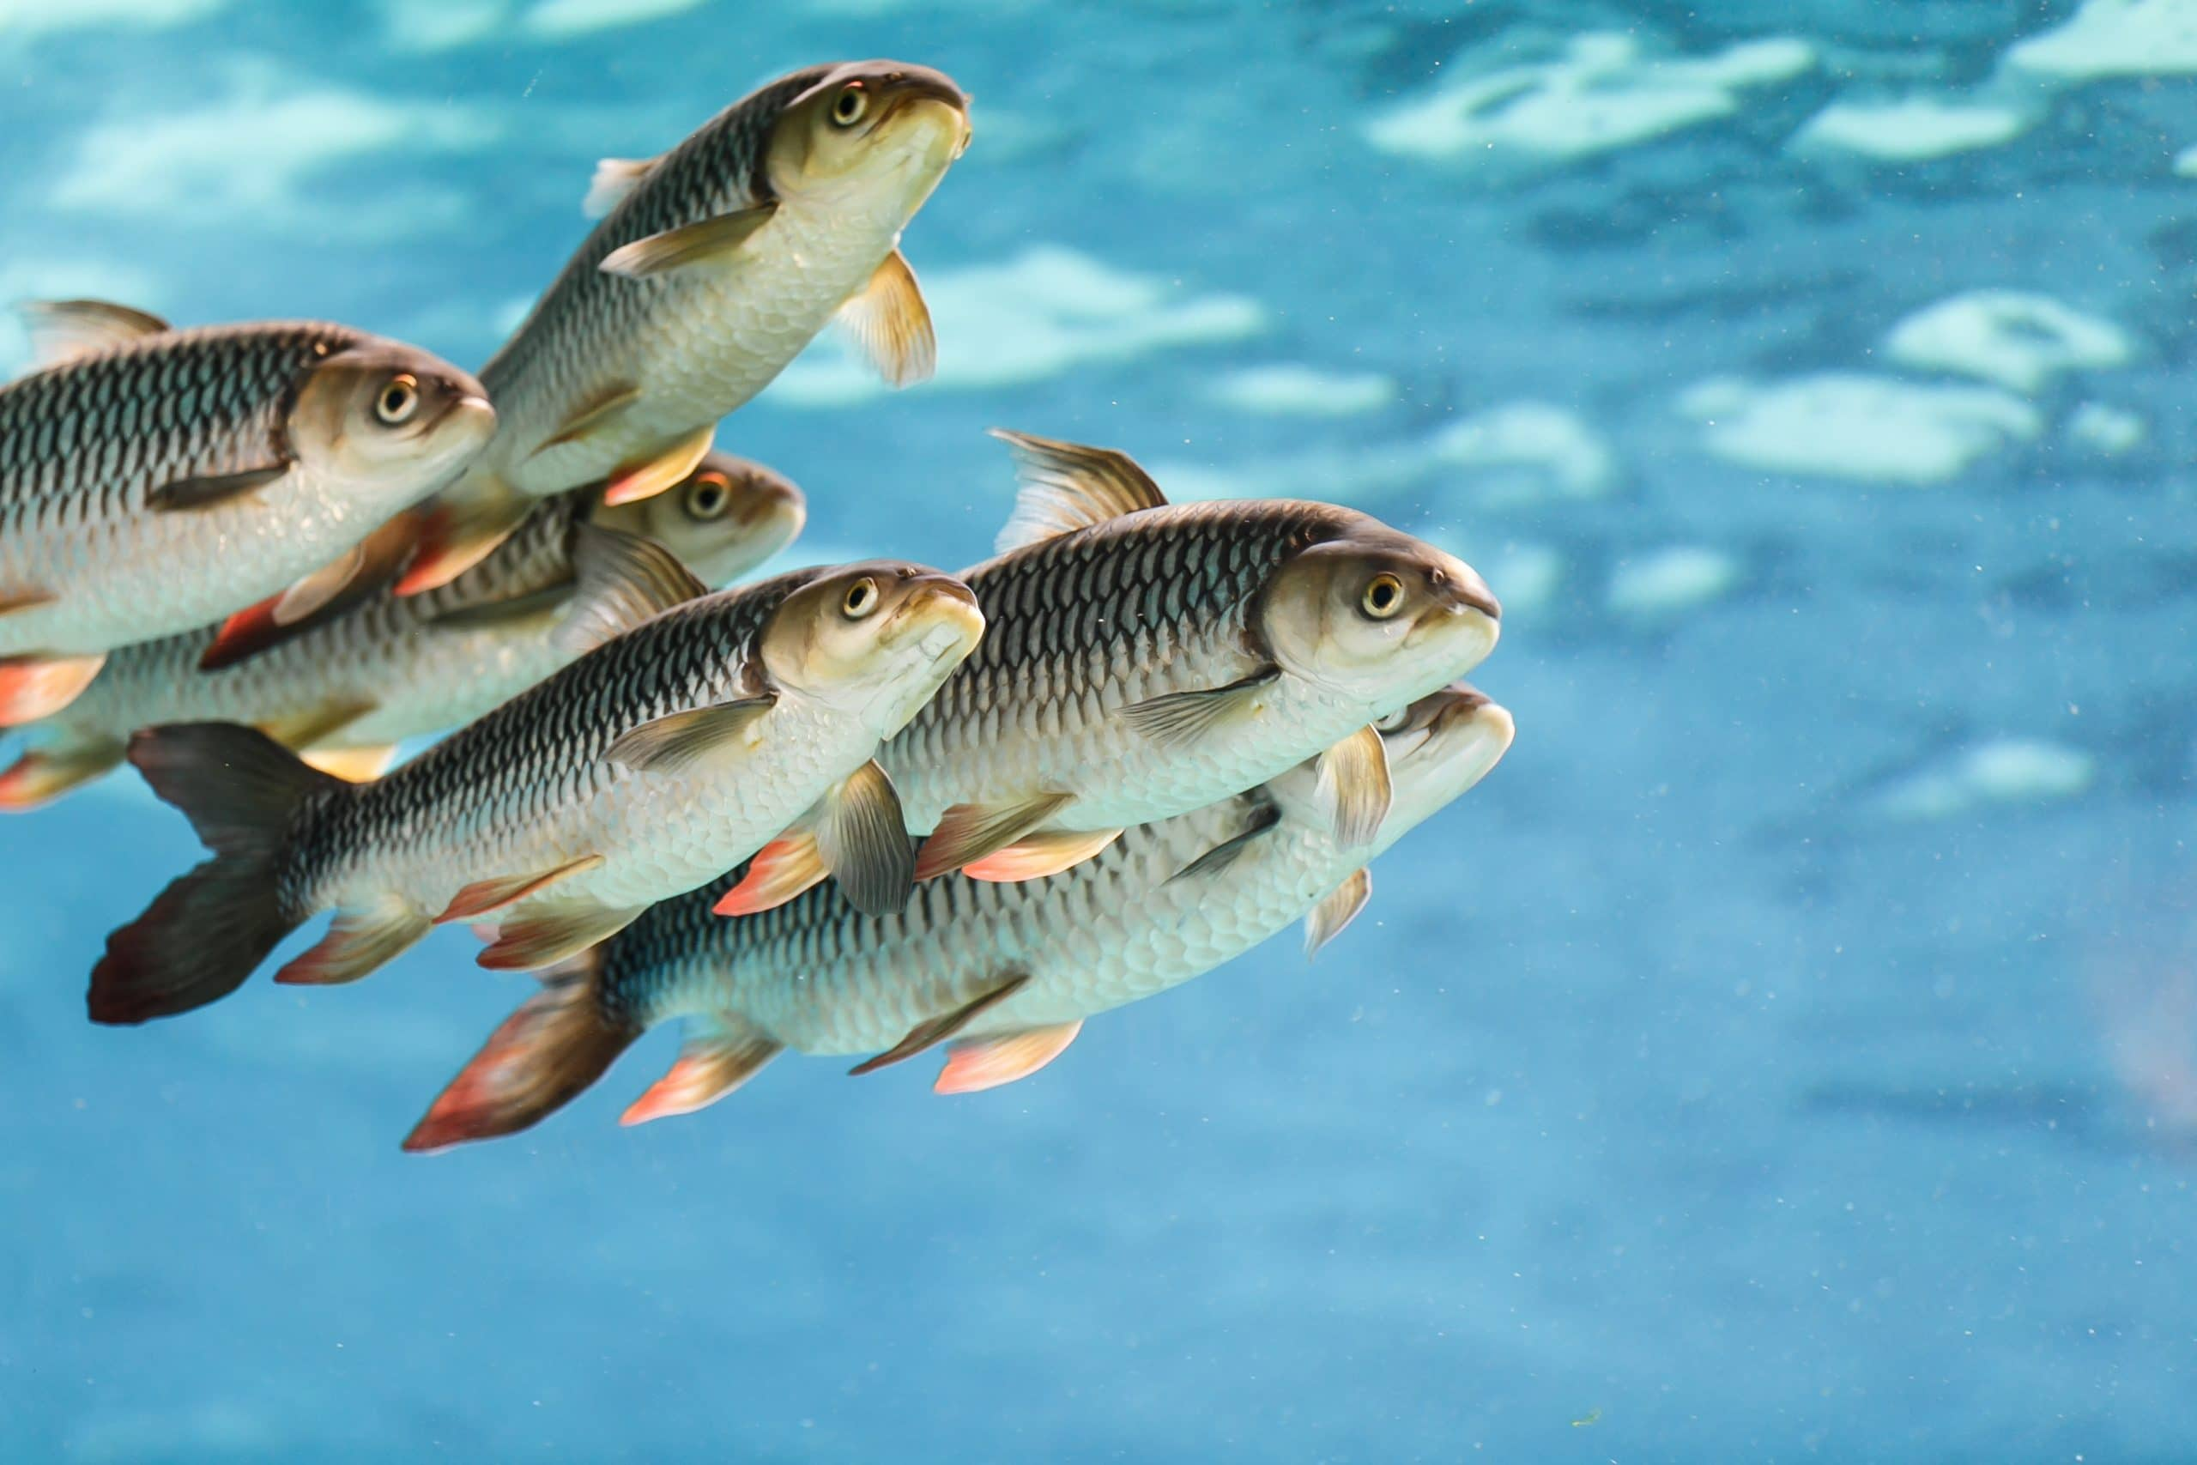
Fish
Fish are aquatic, craniate, gill-bearing animals that lack limbs with digits.
They are the most diverse vertebrate group.

Slide 2
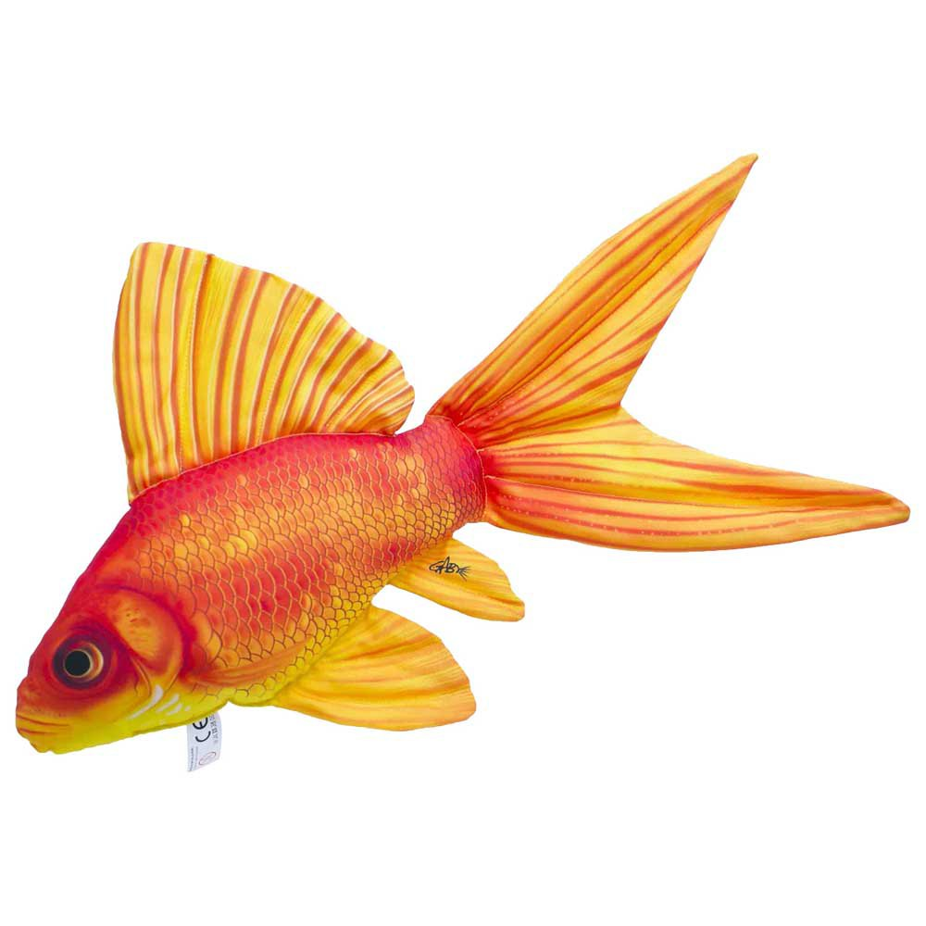
Etymology
The word for fish in English and the other Germanic languages is inherited from Proto-Germanic.

Slide 3
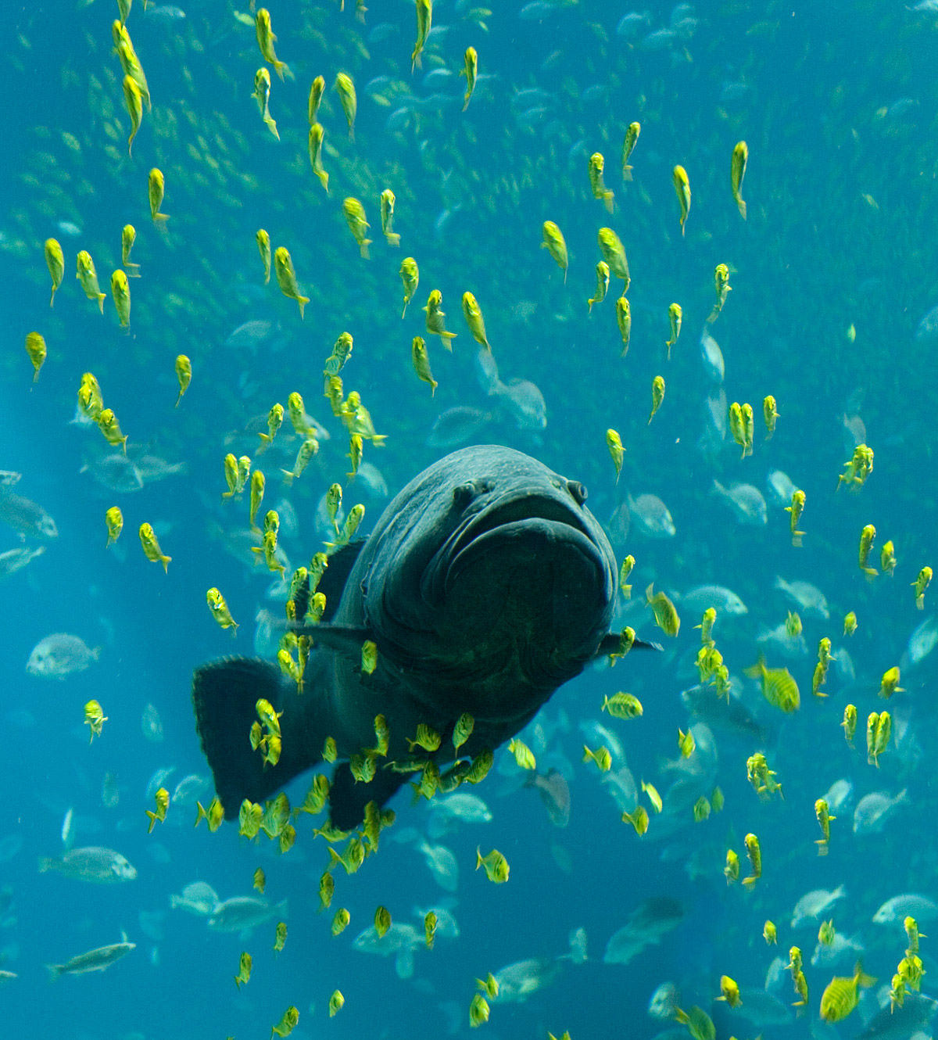
Evolution
Fish, as vertebrata, developed as sister of the tunicata.

Slide 4
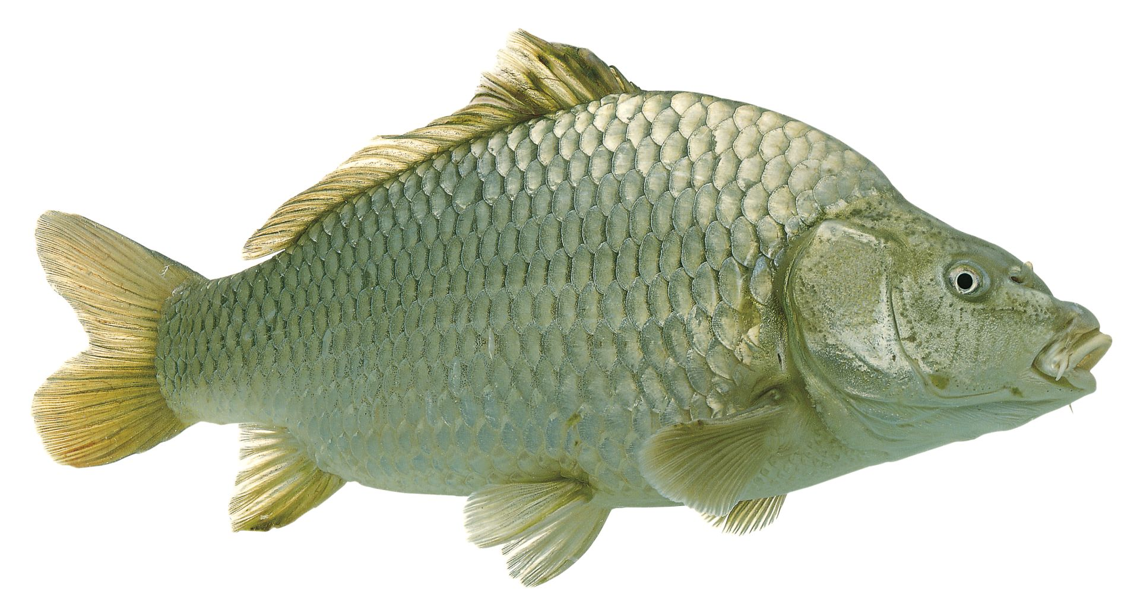
Anatomy and physiology

Slide 5
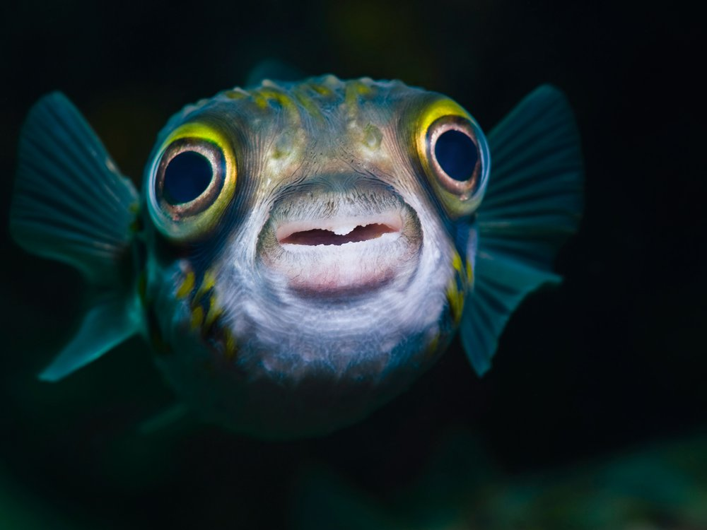
Acoustic communication
Acoustic communication in fish involves the transmission of acoustic signals from one individual of a species to another.

