Slide 1
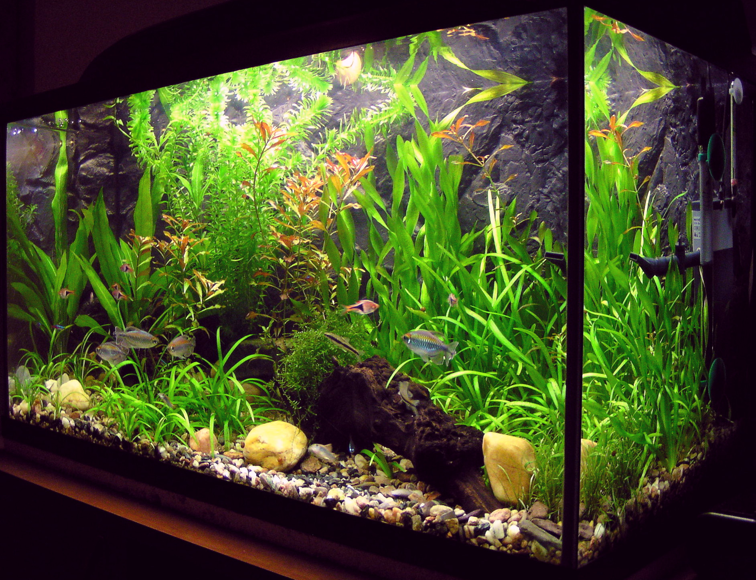
aquarium
An aquarium is an enclosed tank or body of water in which fish, aquatic plants, and other aquatic organisms are kept.

