Slide 1
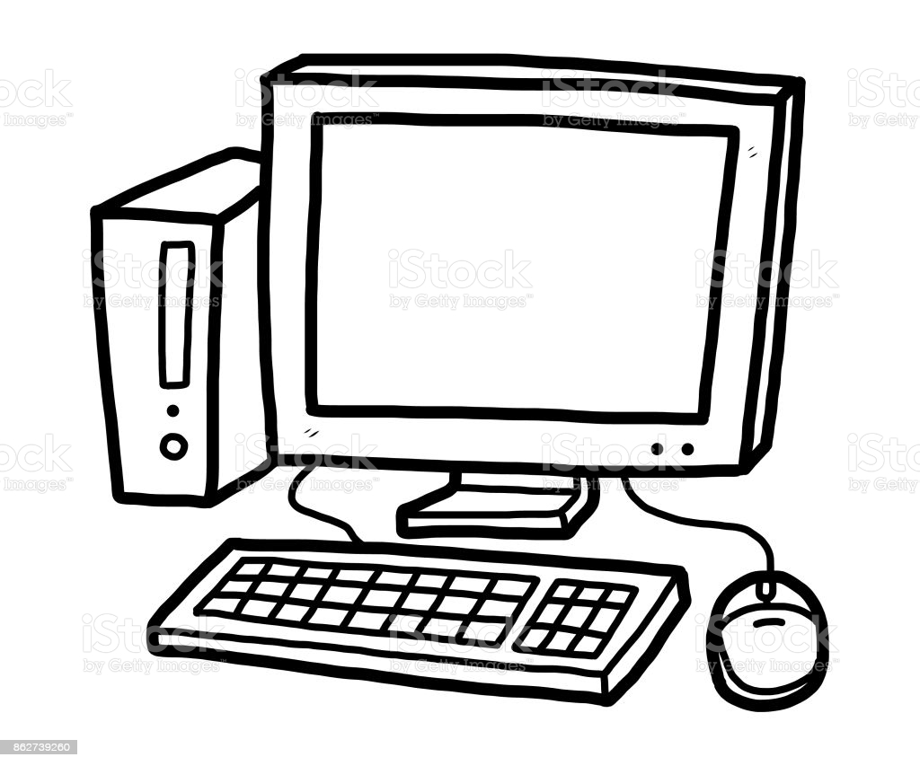
computer
A computer is a programmable machine.
It has a central processing unit.
The program is stored in the memory.

