Slide 1
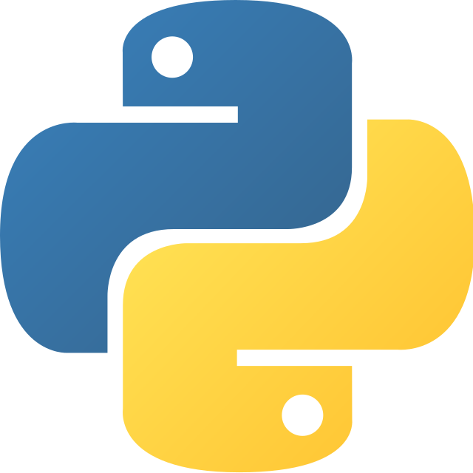
python
Python is a high-level programming language.
It is a general-purpose language.
It is a high-level language.
It is a widely used language.

