Slide 1

Upselling
Upselling is a sales technique where a seller invites the customer to purchase more expensive items, upgrades, or other add-ons to generate more reven

Slide 2
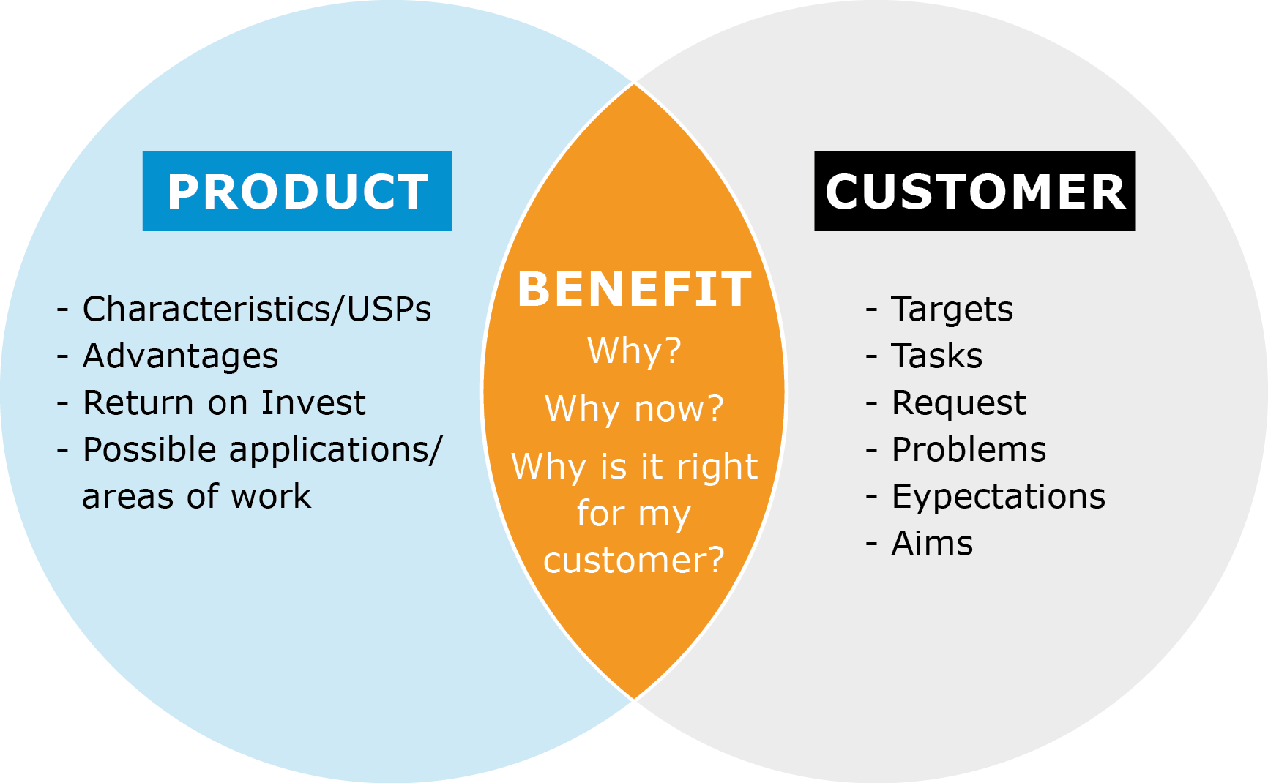
Upselling vs cross-selling
Upselling is the practice in which a business tries to motivate customers to purchase a higher-end product, an upgrade, or an additional item in order

Slide 3
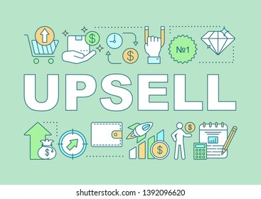
Examples
ng that a customer purchase a more expensive item
Suggesting that a customer purchase a more expensive item
Suggesting that a customer purchase a more

Slide 4

Techniques
Many companies teach their employees to upsell products and services and offer incentives and bonuses to the most successful personnel.

Slide 5

Overlap with cross-selling and add-on sales
ng is a sales technique used by a seller to encourage a customer to buy a more expensive product or service than the one they had initially intended t

Slide 6
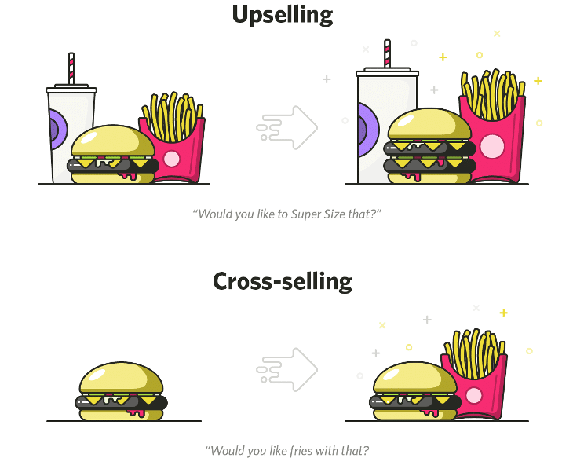
Ethics
When upselling for higher cost items or add ons to customers for goods and services it is advised not to push the sale as it may become unethical.

Slide 7
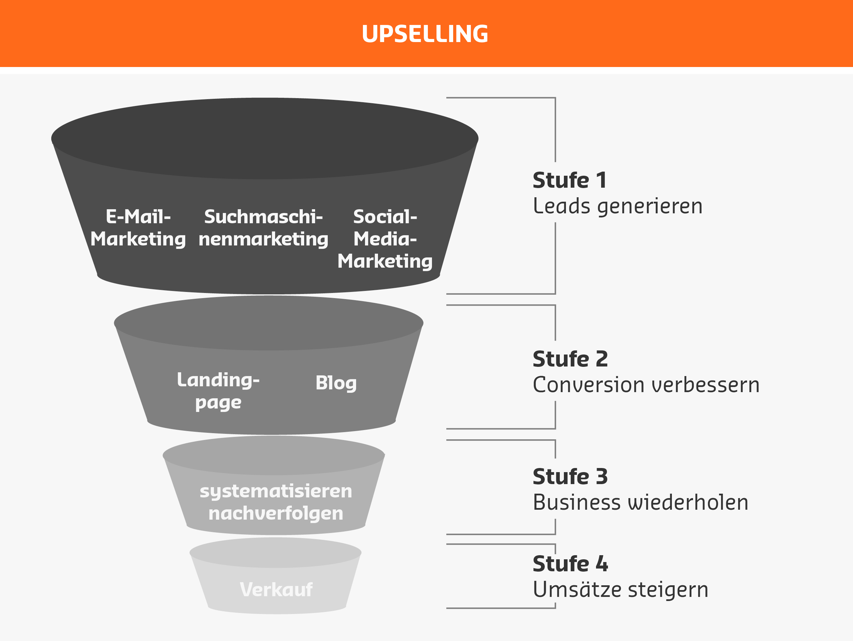
Sources
K.
A.
(2008).
JournalofRelationshipMarketing:Upselling.
Wagner,K.
A.
(2008).
JournalofRelationshipMarketing:Cross-selling.
Wagner,K.
A.

