Slide 1
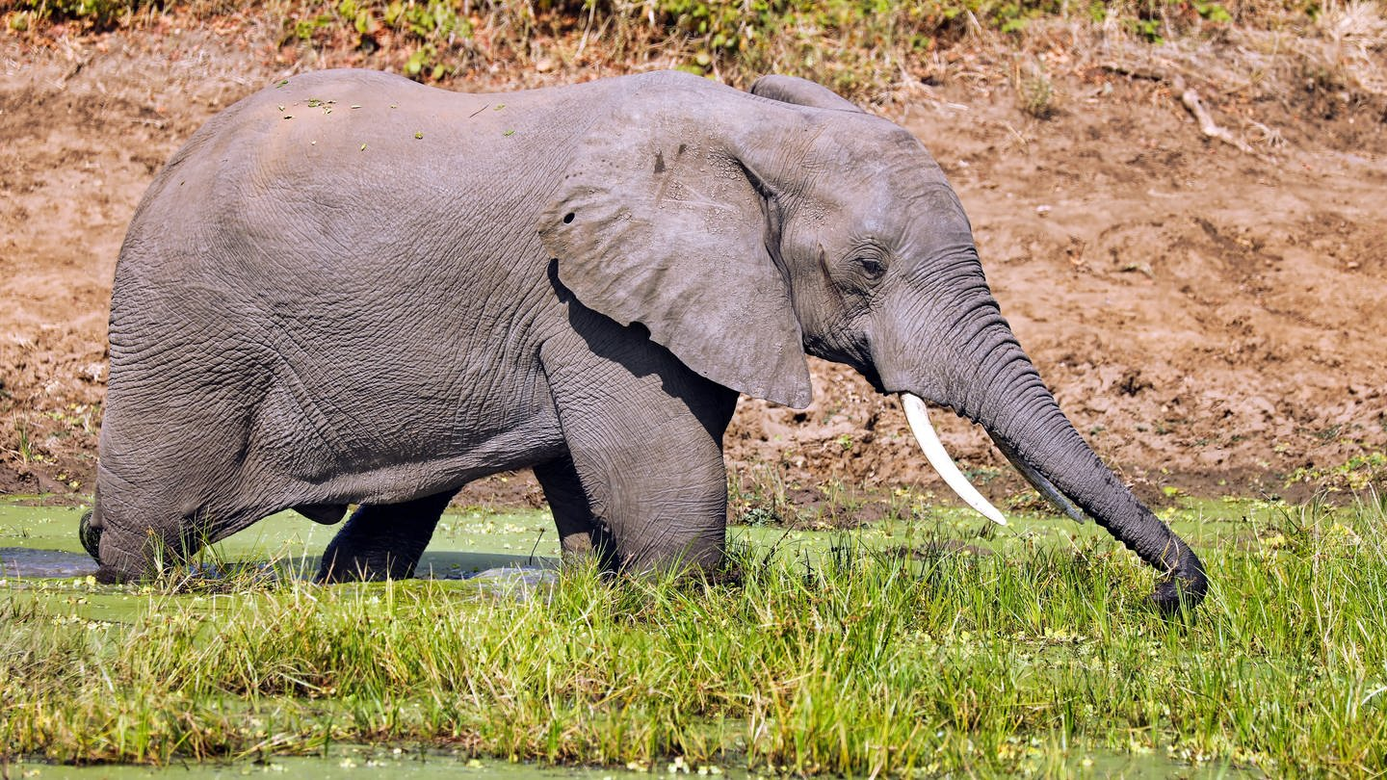
elefant
An elephant is the largest land mammal.
The elephant is the only living species in the genus Loxodonta.

