Slide 1
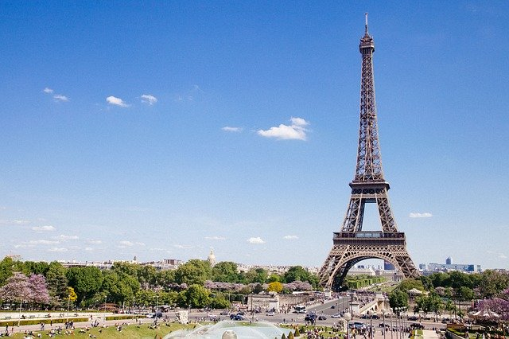
france
France is a country in Western Europe.
It is the largest country in the European Union.
France is also the largest metropolitan area in the EU.

