Slide 1
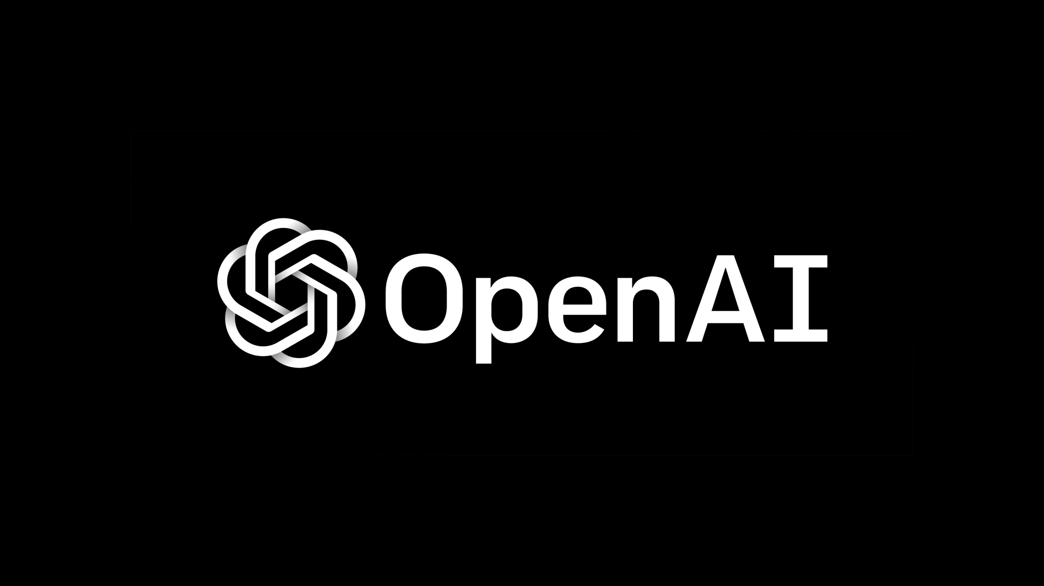
OpenAI
OpenAI is an artificial intelligence research laboratory.
The company conducts research in the field of artificial intelligence.

Slide 2
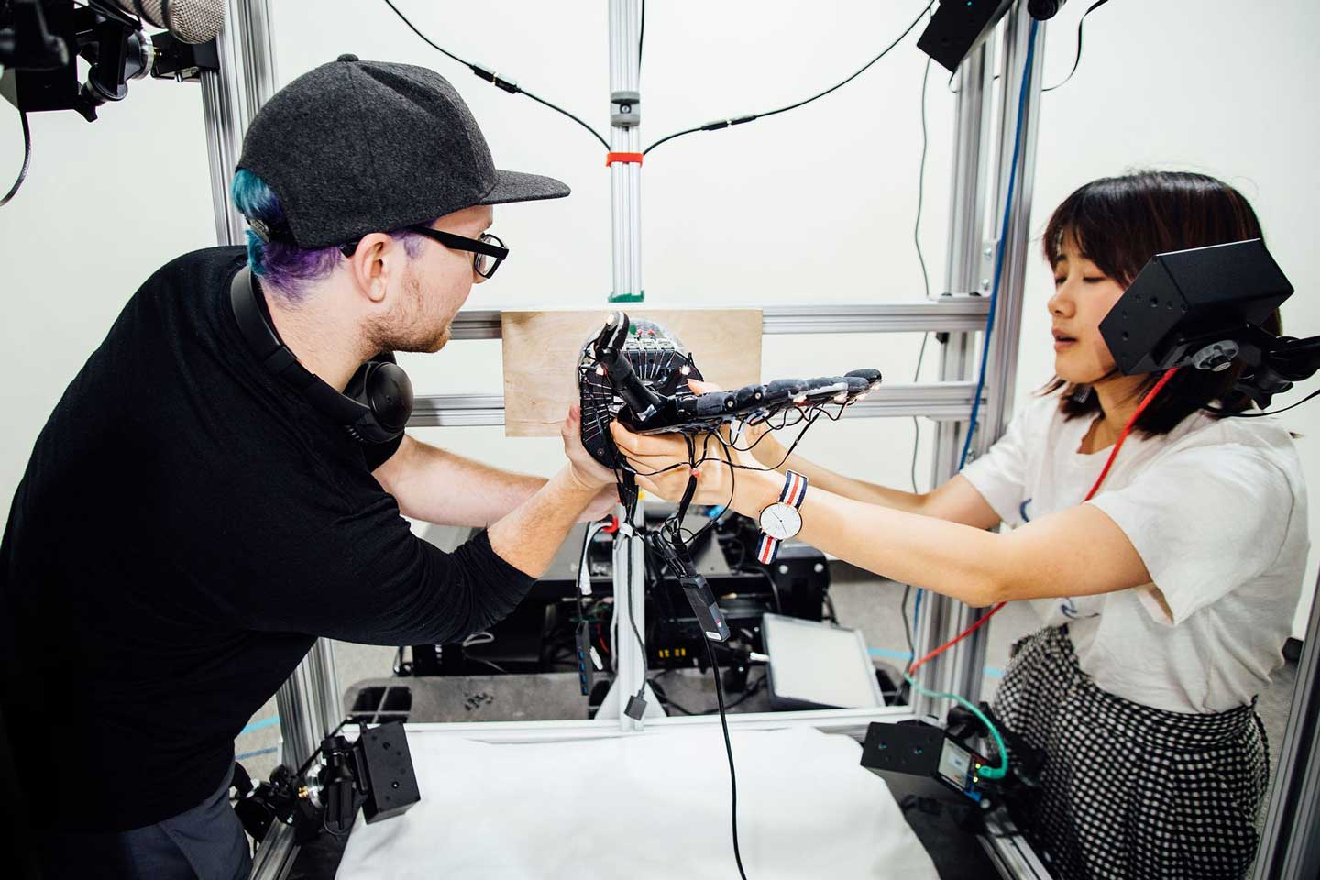
History
In October 2015, Elon Musk, Sam Altman, and other investors announced the formation of OpenAI and pledged over US$1 billion to the venture.

Slide 3

Motives
Some scientists, such as Stephen Hawking and Stuart Russell, have articulated concerns that if advanced AI someday gains the ability to re-design its

Slide 4

Strategy
Musk posed the question: "what is the best thing we can do to ensure the future is good? We could sit on the sidelines or we can encourage regulatory

Slide 5
Products and applications
OpenAI is a non-profit artificial intelligence research company.
OpenAI's research focuses on reinforcement learning.

