Slide 1
The Lin-Rood Finite Volume
(FV) Dynamical Core:
Tutorial
Christiane Jablonowski
National Center for Atmospheric Research
Boulder, Colorado
NCAR Tutorial, May / 31/ 2005

Slide 2
Topics that we discuss today
The Lin-Rood Finite Volume (FV) dynamical core
  History: where, when, who, …
  Equations & some insights into the numerics
  Algorithm and code design
The grid
  Horizontal resolution
  Grid staggering: the C-D grid concept
  Vertical grid and remapping technique
Practical advice when running the FV dycore
  Namelist and netcdf variables variables (input & output)
  Dynamics - physics coupling
Hybrid parallelization concept
  Distributed-shared memory parallelization approach: MPI and OpenMP
Everything you would like to know

Slide 3
Who, when, where, …
FV transport algorithm developed by S.-J. Lin and Ricky Rood (NASA GSFC) in 1996
2D Shallow water model in 1997
3D FV dynamical core around 1998/1999
Until 2000: FV dycore mainly used in data assimilation system at NASA GSFC
Also: transport scheme in ‘Impact’, offline tracer transport
In 2000: FV dycore was added to NCAR’s CCM3.10 (now CAM3)
Today (2005): The FV dycore
  might become the default in CAM3
  Is used in WACCAM
  Is used in the climate model at GFDL

Slide 4
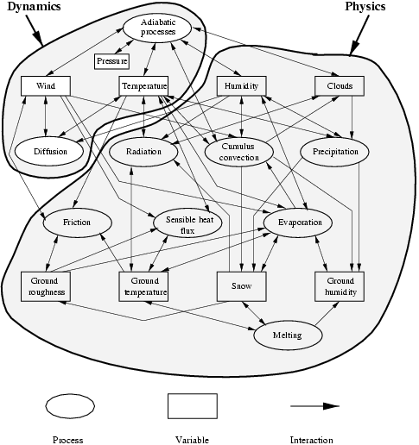
Dynamical cores of General Circulation Models
Dynamics
Physics
FV: No explicit
diffusion (besides
divergence
damping)

Slide 5
The NASA/NCAR finite volume dynamical core
3D hydrostatic dynamical core for climate and weather prediction:
  2D horizontal equations are very similar to the shallow water equations
  3rd dimension in the vertical direction is a floating Lagrangian coordinate: pure 2D transport with vertical remapping steps
Numerics: Finite volume approach
  conservative and monotonic 2D transport scheme
  upwind-biased orthogonal 1D fluxes, operator splitting in 2D
  van Leer second order scheme for time-averaged numerical fluxes
  PPM third order scheme (piecewise parabolic method)
  for prognostic variables
  Staggered grid (Arakawa D-grid for prognostic variables)

Slide 6
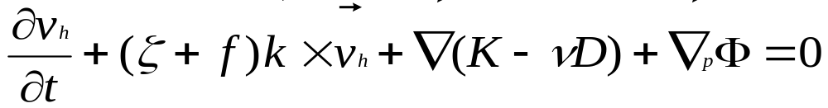
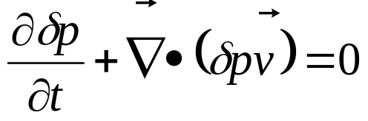
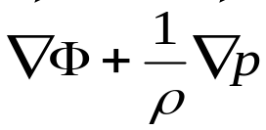
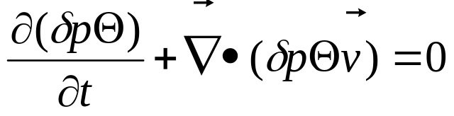

The 3D Lin-Rood Finite-Volume Dynamical Core
Momentum equation in vector-invariant form
Continuity equation
Pressure gradient term
in finite volume form
Thermodynamic equation, also for tracers (replace Θ):
The prognostics variables are:
δp: pressure thickness, Θ=Tp^{-κ}: scaled potential temperature

Slide 7
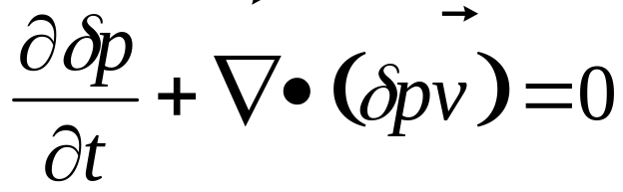
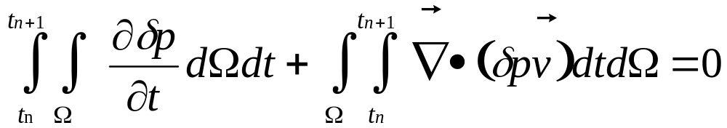

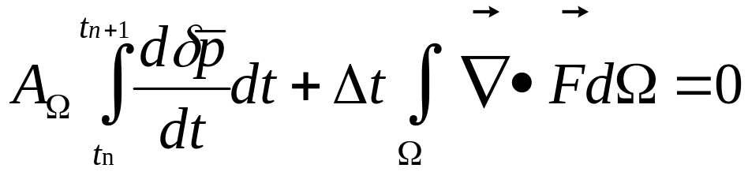

Finite volume principle
Continuity equation in flux form:
Integrate over one time step Δt and the 2D finite volume Ω with area A:
Integrate and rearrange:
Time-averaged
numerical flux
Spatially-averaged
pressure thickness

Slide 8
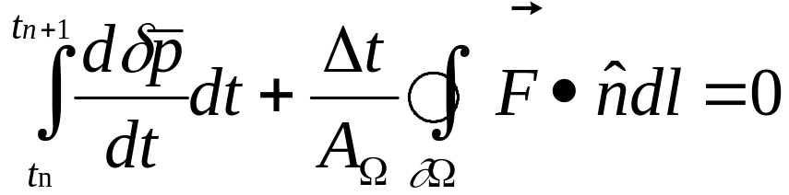

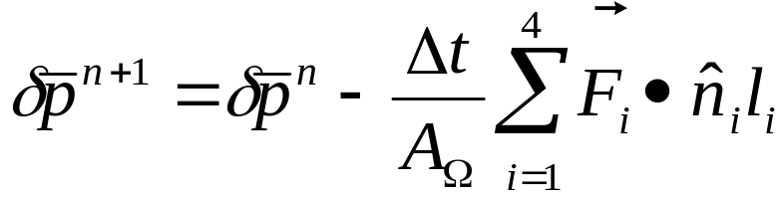
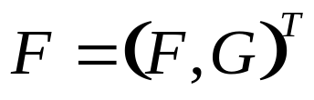
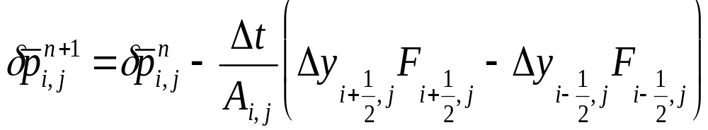
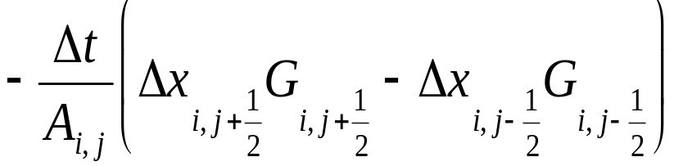
Finite volume principle
Apply the Gauss divergence theorem:
unit normal vector
Discretize:

Slide 9
Orthogonal fluxes across cell interfaces
Flux form ensures mass conservation
G _{i,j+1/2}
F _{i-1/2,j}
(i,j)
F _{i+1/2,j}
G _{i,j-1/2}
Upwind-biased:
Wind direction
F: fluxes in x direction
G: fluxes in y direction

Slide 10
Quasi semi-Lagrange approach in x direction
CFL_{y} = v * Δt/Δy < 1 required
G _{i,j+1/2}
F _{i-5/2,j}
F _{i+1/2,j}
(i,j)
CFL_{x} = u * Δt/Δy > 1 possible:
implemented as an integer shift and fractional flux calculation
G _{i,j-1/2}

Slide 11
Numerical fluxes & subgrid distributions
1st order upwind
  constant subgrid distribution
2nd order van Leer
  linear subgrid distribution
3rd order PPM (piecewise parabolic method)
  parabolic subgrid distribution
‘Monotonocity’ versus ‘positive definite’ constraints
Numerical diffusion
Explicit time stepping scheme:
Requires short time steps that are stable for the fastest waves (e.g. gravity waves)
CGD web page for CAM3:
http://www.ccsm.ucar.edu/models/atm-cam/docs/description/

Slide 12
Subgrid distributions: constant (1st order)
x₁
x₂
x₃
x₄
u

Slide 13
Subgrid distributions: piecewise linear (2nd order)
van Leer
x₁
x₂
x₃
x₄
u
See details in van Leer 1977

Slide 14
Subgrid distributions: piecewise parabolic (3rd order)
PPM
x₁
x₂
x₃
x₄
u
See details in Carpenter et al. 1990 and Colella and Woodward 1984

Slide 15
Monotonicity constraint
Prevents over- and undershoots
Adds diffusion
not
allowed
van Leer
Monotonicity
constraint results
in discontinuities
x₁
x₂
x₃
x₄
u
See details of the monotinity constraint in van Leer 1977

Slide 16
Simplified flow chart
subcycled
stepon
dynpkg
cd_core
c_sw
1/2 Δt only:
compute C-grid time-mean winds
d_p_coupling
trac2d
physpkg
te_map
d_sw
full Δt:
update all D-grid variables
p_d_coupling
Vertical
remapping

Slide 17

Grid staggerings (after Arakawa)
B grid
A grid
u
v
u
v
u
v
u
v
u
v
C grid
v
u
D grid
u
u
v
v
Scalars:
v
u

Slide 18
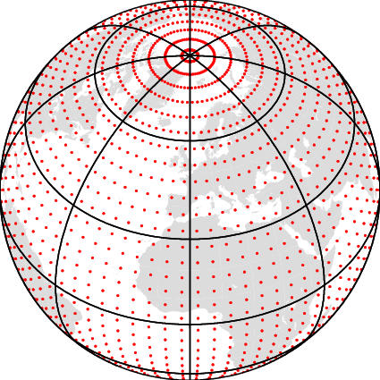
Regular latitude - longitude grid
Converging grid lines at the poles decrease the physical spacing Δx
Digital and Fourier filters remove unstable waves at high latitudes
Pole points are mass-points

Slide 19
Typical horizontal resolutions
Δϕ x Δλ | Lat x Lon | Max. Δx (km) | Δt (s) | ≈ spectral
4º x 5º | 46 x 72 | 556 | 7200 | T21 (32x64)
2º x 2.5º | 91 x 144 | 278 | 3600 | T42 (64x128)
1º x 1.25º | 181 x 288 | 139 | 1800 | T85 (128x256)
Time step is the ‘physics’ time step:
Dynamics are subcyled using the time step Δt/nsplit
‘nsplit’ is typically 8 or 10
CAM3: check (dtime=1800s due to physics ?)
WACCAM: check (nsplit = 4, dtime=1800s for 2ºx2.5º ?)
Defaults:

Slide 20
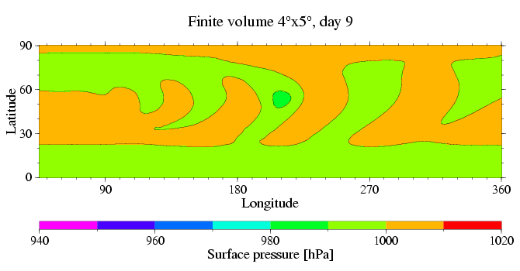
Idealized baroclinic wave test case
The coarse resolution does not capture the evolution of the baroclinic wave
Jablonowski and Williamson 2005

Slide 21
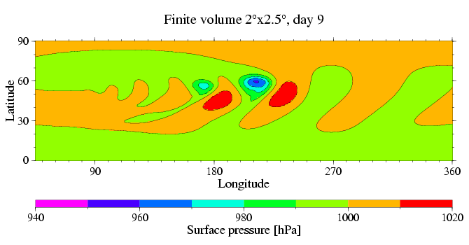
Idealized baroclinic wave test case
Finer resolution: Clear intensification of the baroclinic wave

Slide 22
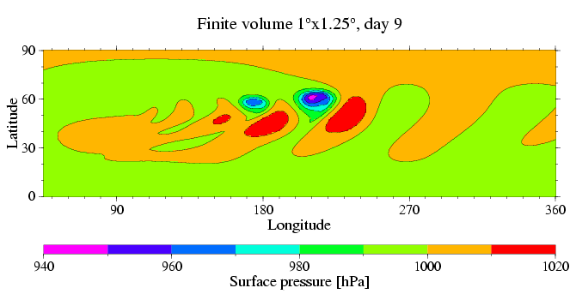
Idealized baroclinic wave test case
Finer resolution: Clear intensification of the baroclinic wave, it starts to converge

Slide 23
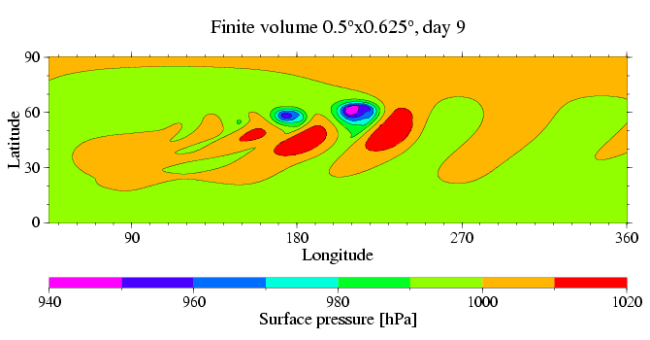
Idealized baroclinic wave test case
Baroclinic wave pattern converges

Slide 24
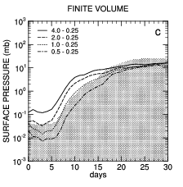
Idealized baroclinic wave test case:
Convergence of the FV dynamics
Global L₂ error
norms of p_{s}
Solution starts
converging at 1deg
Shaded region
indicates the
uncertainty of the
reference solution

Slide 25
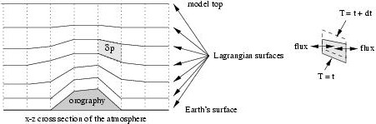
Floating Lagrangian vertical coordinate
2D transport calculations with moving finite volumes (Lin 2004)
Layers are material surfaces, no vertical advection
Periodic re-mapping of the Lagrangian layers onto reference grid
WACCAM: 66 vertical levels with model top around 130km
CAM3: 26 levels with model top around 3hPa (40 km)
http://www.ccsm.ucar.edu/models/atm-cam/docs/description/

Slide 26
Physics - Dynamics coupling
Prognostic data are vertically remapped (in cd_core) before dp_coupling is called (in dynpkg)
Vertical remapping routine computes the vertical velocity ω and the surface pressure p_{s}
d_p_coupling and p_d_coupling (module dp_coupling) are the interfaces to the CAM3/WACCAM physics package
Copy / interpolate the data from the ‘dynamics’ data structure to the ‘physics’ data structure (chunks), A-grid
Time - split physics coupling:
  instantaneous updates of the A-grid variables
  the order of the physics parameterizations matters
  physics tendencies for u & v updates on the D grid are collected

Slide 27
Practical tips
Namelist variables:
What do IORD, JORD, KORD mean?
IORD and JORD at the model top are different (see cd_core.F90)
Relationship between
  dtime
  nsplit (what happens if you don’t select nsplit or nsplit =0,
  default is computed in the routine d_split in dynamics_var.F90)
  time interval for the physics & vertical remapping step
Input / Output:
Initial conditions: staggered wind components US and VS required (D-grid)
Wind at the poles not predicted but derived
User’s Guide:
http://www.ccsm.ucar.edu/models/atm-cam/docs/usersguide/

Slide 28
Practical tips
Namelist variables:
IORD, JORD, KORD determine the numerical scheme
  IORD: scheme for flux calculations in x direction
  JORD: scheme for flux calculations in y direction
  KORD: scheme for the vertical remapping step
Available options:
  - 2: linear subgrid, van-Leer, unconstrained
  1: constant subgrid, 1st order
  2: linear subgrid, van Leer, monotonicity constraint (van Leer 1977)
  3: parabolic subgrid, PPM, monotonic (Colella and Woodward 1984)
  4: parabolic subgrid, PPM, monotonic (Lin and Rood 1996, see FFSL3)
  5: parabolic subgrid, PPM, positive definite constraint
  6: parabolic subgrid, PPM, quasi-monotone constraint
Defaults: 4 (PPM) on the D grid (d_sw), -2 on the C grid (c_sw)

Slide 29
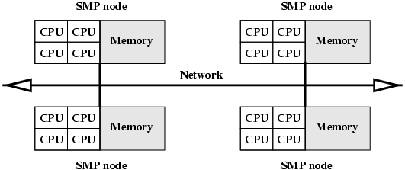
‘Hybrid’ Computer Architecture
SMP: symmetric multi-processor
Hybrid parallelization technique possible:
Shared memory (OpenMP) within a node
Distributed memory approach (MPI) across nodes
Example: NCAR’s Bluesky (IBM) with 8-way and 32-way nodes

Slide 30
Schematic parallelization technique
1D Distributed memory parallelization (MPI) across the latitudes:
Proc.
NP
1
2
Eq.
3
4
SP
0
Longitudes
340

Slide 31
Schematic parallelization technique
Each MPI domain contains ‘ghost cells’ (halo regions):
copies of the neighboring data that belong to different processors
NP
Proc.
2
Eq.
3 ghost
cells for PPM
SP
0
Longitudes
340

Slide 32
Schematic parallelization technique
Shared memory parallelization (in CAM3 most often) in the vertical direction via OpenMP compiler directives:
Typical loop:
do k = 1, plev
…
enddo
Can often be parallelized with OpenMP (check dependencies):
!$OMP PARALLEL DO …
do k = 1, plev
…
enddo

Slide 33
Schematic parallelization technique
Shared memory parallelization (in CAM3 most often) in the
vertical direction via OpenMP compiler directives:
k
CPU
e.g.: assume 4 parallel ‘threads’ and
a 4-way SMP node (4 CPUs)
!$OMP PARALLEL DO …
do k = 1, plev
…
enddo
1
1
4
5
2
8
3
4
plev

Slide 34
Thank you !
Any questions ???
Tracer transport ?
Fortran code
…

Slide 35
References
Carpenter, R., L., K. K. Droegemeier, P. W. Woodward and C. E. Hanem 1990: Application of the Piecewise Parabolic Method (PPM) to Meteorological Modeling. Mon. Wea. Rev., 118, 586-612
Colella, P., and P. R. Woodward, 1984: The piecewise parabolic method (PPM) for gas-dynamical simulations. J. Comput. Phys., 54,174-201
Jablonowski, C. and D. L. Williamson, 2005: A baroclinic instability test case for atmospheric model dynamical cores. Submitted to Mon. Wea. Rev.
Lin, S.-J., and R. B. Rood, 1996: Multidimensional Flux-Form Semi-Lagrangian Transport Schemes. Mon. Wea. Rev., 124, 2046-2070
Lin, S.-J., and R. B. Rood, 1997: An explicit flux-form semi-Lagrangian shallow water model on the sphere. Quart. J. Roy. Meteor. Soc., 123, 2477-2498
Lin, S.-J., 1997: A finite volume integration method for computing pressure gradient forces in general vertical coordinates. Quart. J. Roy. Meteor. Soc., 123, 1749-1762
Lin, S.-J., 2004: A ‘Vertically Lagrangian’ Finite-Volume Dynamical Core for Global Models. Mon. Wea. Rev., 132, 2293-2307
van Leer, B., 1977: Towards the ultimate conservative difference scheme. IV. A new approach to numerical convection. J. Comput. Phys., 23. 276-299

