Slide 1
Hanli Liu’s notes on extending WACCM to 500 km
(WACCM meeting 17 October 2006)
Pomosh!
Imdat!
HELP!

Slide 2
Flow Chart of WACCM Extension
Thermosphere
Ionosphere
Setting cp, cv, R, κ, m as variables in
dynamics and physics modules
Empirical electric field
Major species
diffusion
Photochemistry/photoionization
EUV, UV, Aurora heating.
Transport of ions:
Advection & diffusion
Iondrag
Extend model upper boundary
(3.4x10⁻⁹ hPa)
WACCM w/ thermosphere:
Thermosphere structure & Variability
WACCM w/ thermosphere and ionosphere.

Slide 3
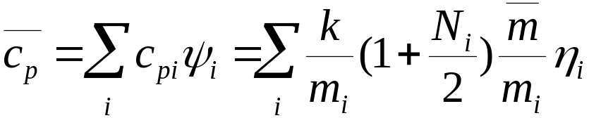
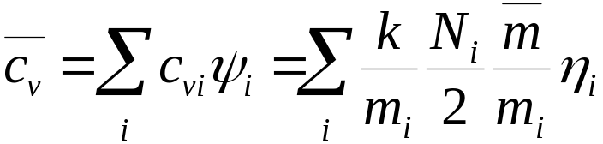
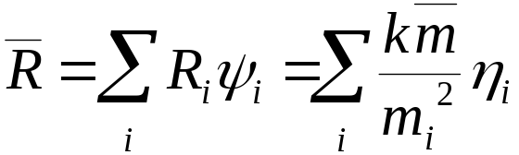

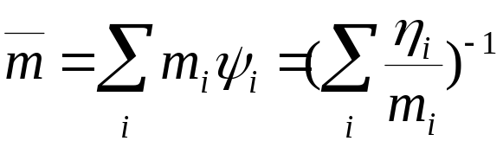
Thermodynamics Parameters for Gas Mixture
Major species begin to separate above the homopause, because
So need to consider them as dependent on the major species: in TIME-GCM: N2, O2 and O are considered. In MOZART mean mass calculation, H is also included. Some version of WACCM/MOZART also has a routine set_cp where H and O3 are also included.

Slide 4
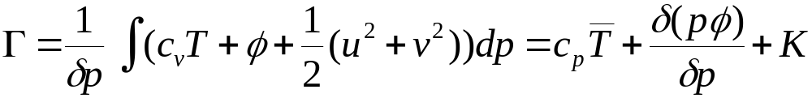

Where are they used?
Dynamics modules (Finite Volume):
  Conserving mapping algorithm.
  It is mapped from Lagrangian to Eulerian and then used to retrieve T. Cp is assumed constant in this mapping.
  Computation/conversion of geopotential, pressure, exner pressure, and potential temperature. Will potential temperature be the same? Adiabatic:
  the last term is 0 and the previous definition of potential temperature should still be valid, because there is no mass exchange in the process,

Slide 5
Where are they used?
Physics modules
  Chemical heating rates.
  NLE routines (heating/cooling rates).
  Dynamical heating in GW module.
  Iondrag calculations.
  Compute temperature and geopotential height from dry static energy.
  Vertical diffusion.
  Dry adiabatic adjustment.
  Other routines that may not be relevant to upper atmosphere.
Used mainly on midpoints, but sometimes on interfaces.

Slide 6
Routines involved
Finite Volume DynCore:
benergy.F90,dp_coupling.F90
dynpkg.F90, p_d_adjust.F90
p_d_adjust.F90, stepon.F90
cd_core.F90, geopk.F90
pkez.F90, te_map.f90
geopotential.F90, gw_drag.F90
nlte_calculation.F90, dadadj.F90
upper_bc.F90, vertical_diffusion.F90
radiation.F90 (diagnostic)
ion*.F90, mo_*.F90
set_cp.F90
varconst.F90
physconst.F90
cldwat.F90, cloud_fraction.F90
cloud_*.F90, convect_*.F90
cpslec.F90, drydep_mod.F90, dust_*.F90
esinti.F90, hk_conv.F90
hpottac.F90, hpottbc.F90
mo_drydep.F90, turbulence.F90
tsinti.F90, wetdep.F90
wv_saturation.F90, zm_conv.F90
Eulerian Dynamical Core
Semi-Lagrangian Dynamical Core
phys_idealized.F90, phys_adiabatic.F90
physidl.F90

Slide 7
Implementation Needs
Molecular mean mass and mean specific heat (constant pressure) are already calculated in some versions of WACCM/MOZART, though only on midpoints.
  Need to calculate R_bar and κ_bar.
  Need to also calculate them on both interfaces and midpoints.
  Need to pass them to dynamics and physics modules.
  Need to make these changes transparent to CAM.
How to proceed?

