Slide 1
Predicting Canadian Consumer Food Prices with Python
Patrick Walter

Slide 2
Background: Canada’s Food Price Report
This year the 8th edition of Canada’s Food Price Report was published as a collaborative effort between Dalhousie University and University of Guelph.
The report looks at factors that affect the future prices seen by consumers for food over the next 12-month period.
Includes the key drivers of the upcoming year’s food prices such as Climate, Energy Costs, Inflation, Policy Context, Food Processing Industry, Consumer Debt and Deleveraging and many more.
The report divides the CPI basket into food categories including Dairy and Eggs, Fruit and Nuts, Meats, Vegetables, and Fish and Seafood.
Beginning in 2017, the report began to employ machine learning approaches using WEKA.
Notes:
This project was based on work done for Canada’s Food Price Report 2017/2018.
Canada’s Food Price Report is on it’s 8th year published here at Dalhousie.
The report aims to be a tool used to determine what factors will have the greatest effect on consumer food prices over the next 12 months.
Some of the key drivers reported for this year, 2018 are Climate, Energy Costs, Inflation, Policy Context, Food Processing, Consumer Debt, ETC.
The report not only looks at the average food price, from the CPI basket, but also looks at individual food categories within the food category.
BEGINNING IN 2017 the report began to employ machine learning approaches to predicting consumer food prices.
Predictive models were developed in WEKA, which is a Machine learning workbench software useful for developing and testing machine learning models.
This is where this work takes off from.

Slide 3
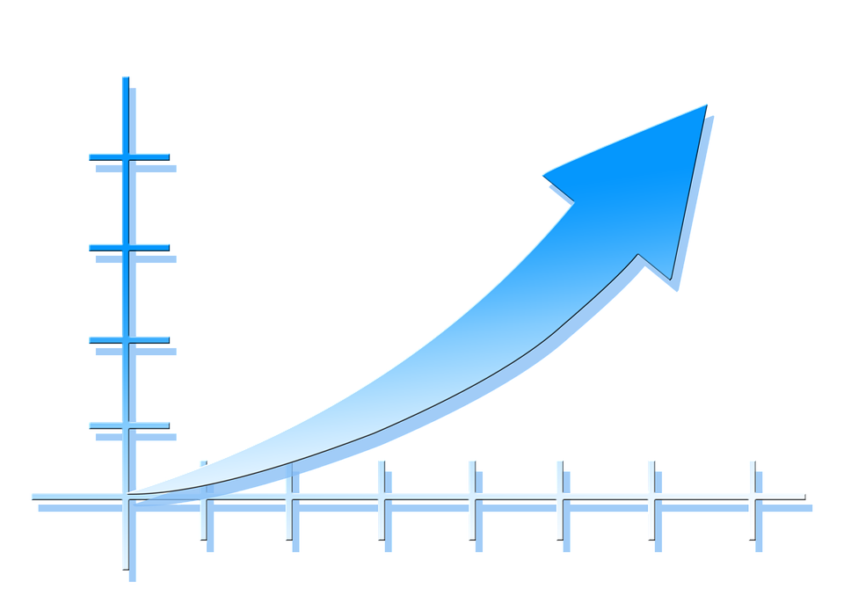
Background: Consumer Price Index
An indicator of the changes in prices experienced by Canadians, obtained by comparing the rising or falling cost of a fixed basket of good and services.
Fixed basket means that products and services are of the same quality and quantity and therefore these changes in cost are a true reflection of the pure price changes.
Data is released monthly and open to the public on Statistics Canada’s website as part of the CANSIM database.
Notes:
The prediction targets for the report and this research are taken from the Canadian Consumer Price Index.
A price for a fixed basket of goods and services which is used as an indicator of real price changes experienced by Canadian consumers.
The CPI is collected and released monthly by Statistics Canada and published through the CANSIM database, and open data project of the Canadian Government
Used for consumers to make their own financial assessments of their own lives by comparing the rate of change of the CPI to the change they experience in their wages
Used by governments and institutions to measure inflation, and to see the effectiveness of government policy, fiscal and monetary policy.

Slide 4
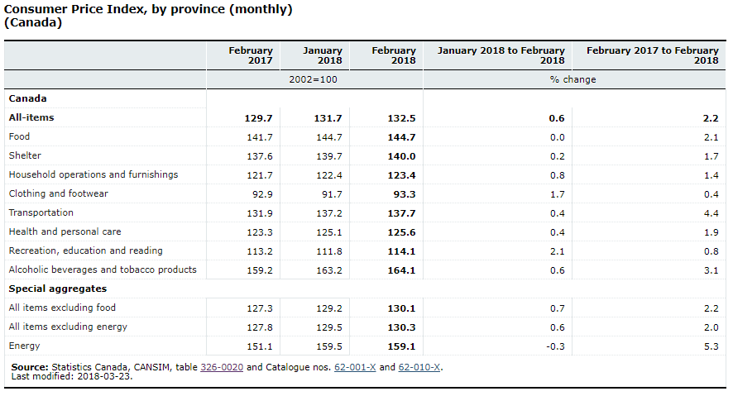
Background: Consumer Price Index
Notes:
Here is what the CPI data looks like on CANSIM website.
We see the average food price target there at the top at 144.70 for February 2018.
Within the CPI are these categories, and within these categories are more subcatergories, especially with the food category.
There are lots of individual food targets within the food target.

Slide 5
Methodology: Research Objectives
Train and test models for predicting the average national food price as reported by the CPI for a twelve month period for 5 years, from 2012 to 2016.
2
Train and test predictive models for predicting 21 other targets in the CPI basket for the years 2016 and 2017.
3
Implement an ensemble method to improve the stability of the models to predict the average national food price for the twelve months reported by the CPI for 2016 and 2017
1
Notes:
So the motivation for this project was that the previous work done in implementing predictive models for this domain was done in WEKA which is a great suite for testing machine learning approaches but has its limitations. I wanted to develop some similar models in a full fledged programming language.
So in doing this a few research objectives came to be.
The first was:
- TRAIN AND TEST MODELS THAT PREDICT THE MONTHLY NATIONAL AVERAGE FOOD PRICE FOR A 12 MONTH PERIOD FOR EACH YEAR IN A 5 YEAR PERIOD FROM 2012 TO 2016
gain insight of how accurately I can predict the national food prices based on historical data
more validation to use multiple years. More testing
The second was:
- TRAIN AND TEST MODELS TO PREDICT 21 OTHER TARGETS, AGGREGATE AND INDIVIDUAL PRODUCTS IN THE BASKET, MOSTLY WITH THE FOOD CATERGORY
Gain insight on what years were difficult to predict, and what products were difficult to predict.
- THE GOAL OF THESE WAS TO GAIN INSIGHT ON WHAT YEARS ARE HARD TO PREDICTS, AND WHAT PRODUCTS ARE HARD TO PREDICT
The last was:
-IMPLEMENT AN ENSEMBLE METHOD, SPECIFICALLY BOOTSTRAP AGGREGATING WHICH IS ALSO CALLED BAGGING, TO IMPOVE STABILITY AND ACCURACY.
Gain insight on how effective ensemble methods are at making stable predictions on average national food price.

Slide 6
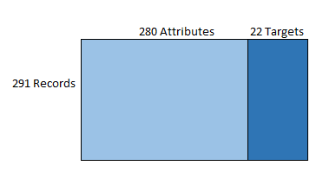
Methodology: Dataset
The original dataset was built by Jay Harris for his work on the 2017 and 2018 Canada Food Price Report and his thesis research titled A Machine Learning Approach to Forecasting Consumer Food Price
It was constructed using a wide range of financial and econometric data from public and private institutions totaling 280 attributes
The data set began at January 1985 with monthly records concluding at August 2017 giving 291 records.
22 targets from the CPI basket, mostly food products.
Notes:
The dataset I started this project with. Was a csv created by jay harris FOR HIS WORK ON A MASTER’S THESIS
CONSTRUCTED FROM A WIDE RANGE OF FINANCIAL AND ECONOMETRIC DATA BOTH FROM BOTH GOVERNMENT AND PRIVATE
ALL OPEN DATA, FREE AND AVAILABLE ONLINE. SO THAT’S GREAT.
THE DATASET BEGINS JANUARY 1985 AND HAS MONTHLY RECORDS, ENDING AT AUGUST 2017 GIVING 291 RECORDS TOTAL
I updated the targets part of the dataset up to 2018. I attempted to build an updated attributes dataset to be up to date to 2018, however I had some troubles with sourcing all the same data and trouble with cleaning the data and retro fitting my code base to the updated dataset. I WOULD HAVE BEEN NICE TO TEST SOME MODELS ON MORE CURRENT DATA. BUT FOR TESTING THE YEARS IN THE DATASET PROVIDED WERE SUFFICIENT. FURTHER WORK COULD BE DONE HERE.

Slide 7
Methodology: Data Preprocessing
Pandas dataframes was used to manipulate the data.
Dataframe is a tabular data structure that has labeled axes.
Dividing the dataset in targets and attributes
Reducing the dataset at 1999 after feature selection.
Removing any columns that were incomplete.
Creating train and test dataframes for each of the five years
Creating dataframes for each of the individual targets
Notes:
I used the python library Pandas for data processing and manipulation. It is a really useful and easy to use library with well great data structures for relational data.
Such as dataframes
DATAFRAME: Two-dimensional size-mutable, potentially heterogeneous tabular data structure with labeled axes (rows and columns). Arithmetic operations align on both row and column labels. Can be thought of as a dict-like container for Series objects.
PANDAS: A data analysis library with easy to use data structures.
PREPROCESSING: fortunately a lot of the data wrangling was done already and the data came pretty clean, some attributes didn’t have complete records are they may not be released monthly. Etc. some were removed due to lacking records.
Lots of dataframes were used for all the different partions of the data for different training and testing. I like dataframes because you can refer to attributes by name.

Slide 8
Tools: Python Scikit Learn
A machine learning library for Python with a wide variety of implementations for popular algorithms.
This research used the ordinary least squares linear regression implementation. Easy to use to train and test linear regression models.
Feature selection, using mutual information and a selector to select the highest scoring features.
Notes:
Scikit learn was the python library used for the predictive models in this research
Scikit Learn is a very popular library for machine learning, data mining, and predictive analytics in python.
Has a very wide range of implementations of virtually every algorithm and every variant of that algorithm.
Linear regression models are very easy to test and train. Once that data is all pre processed into the correct data structures, here data frames used as numpy like arrays.
Very simple, couple of lines of code for each model.
Used feature selection to select features to reduce the dimensionality of the models.
Feature selection is an important step to remove any redundant, misleading, and otherwise noisey data from the modeling.
Feature selection needs a scoring method.
Some use variance of a attribute, this puts bias on attributes with high variance but may not be important.
Other scoring uses covariance between a feature and a target.
A scoring method is used to calculation the dependence of correlation between a feature and the target.
For this I used a implementation of mutual information. This implementation uses a k nearest neighbours estimation of mutual information. I thought this was an interesting method and was different from the previous work done by Jay that used Correlation Feature Selection implemented in WEKA.

Slide 9
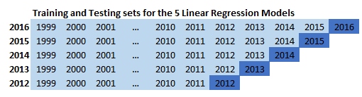
Predicting Average Food Price: 2012 to 2016
Divided the data into training and testing sets for each of the 5 years
Trained 5 individual models, tested each model on its corresponding year
Mean absolute error was calculated across all 12 points for each of the 5 years.
Notes:
FIRST EXPERIMENT:
train and test 5 linear regression models. The objective here is to train and test models that can predict the average national food prices for each of the 12 months of these 5 years between 2012 and 2016.
First I trained and tested model on trying to predict the food price for a year given that year’s attributes, so this isn’t forecasting and no really applicable in real world as the attributes and targets are being release around the same time.
Next I trained and tested models with the targets shifted one year ahead. So we are now doing forecasting, we are predicting the food price for 2017 based on the attributes reported for 2016.
feature selection performed before. K = 7.

Slide 10
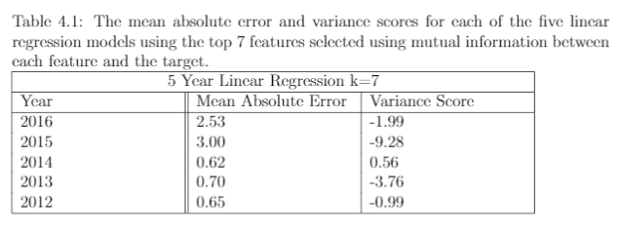
Predicting Average Food Price: 2012 to 2016
Divided the data into training and testing sets for each of the 5 years
Trained 5 individual models, tested each model on its corresponding year
Mean absolute error was calculated across all 12 points for each of the 5 years.
Notes:
FIRST EXPERIMENT:
train and test 5 linear regression models. The objective here is to train and test models that can predict the average national food prices for each of the 12 months of these 5 years between 2012 and 2016.
First I trained and tested model on trying to predict the food price for a year given that year’s attributes, so this isn’t forecasting and no really applicable in real world as the attributes and targets are being release around the same time.
Next I trained and tested models with the targets shifted one year ahead. So we are now doing forecasting, we are predicting the food price for 2017 based on the attributes reported for 2016.
feature selection performed before. K = 7.

Slide 11
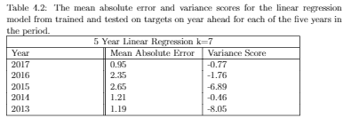
Predicting Average Food Price: 2013 to 2017
Divided the data into training and testing sets for each of the 5 years
Trained 5 individual models, tested each model on its corresponding year
Mean absolute error was calculated across all 12 points for each of the 5 years.
Notes:
FIRST EXPERIMENT:
train and test 5 linear regression models. The objective here is to train and test models that can predict the average national food prices for each of the 12 months of these 5 years between 2012 and 2016.
First I trained and tested model on trying to predict the food price for a year given that year’s attributes, so this isn’t forecasting and no really applicable in real world as the attributes and targets are being release around the same time.
Next I trained and tested models with the targets shifted one year ahead. So we are now doing forecasting, we are predicting the food price for 2017 based on the attributes reported for 2016.
feature selection performed before. K = 7.

Slide 12
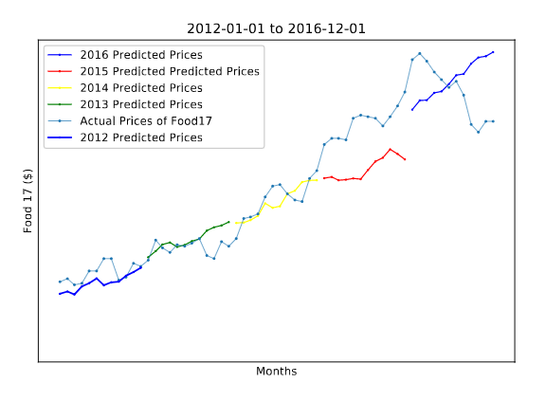
Predicting Average Food Price: 2012 to 2016
Notes:
Here are the predicted values and real vales for each of the 5 years.

Slide 13
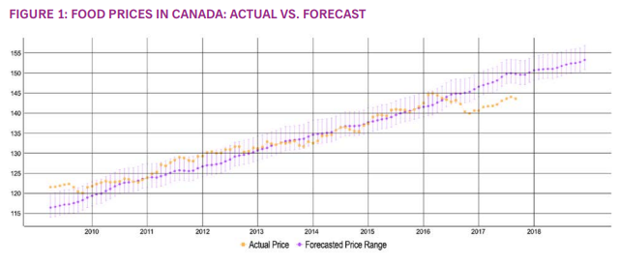
Predicting Average Food Price: Food Price Report 2018

Slide 14
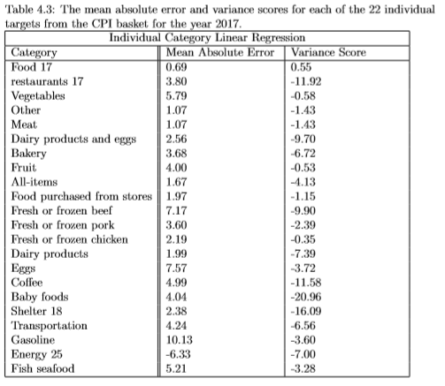
Predicting 22 Individual Targets: 2017
21 other targets were taken from the CPI basket
Mostly products within the food category.
Feature selection was done for each of the targets
New models were trained and tested with each of the new targets with their selected feature.

Slide 15
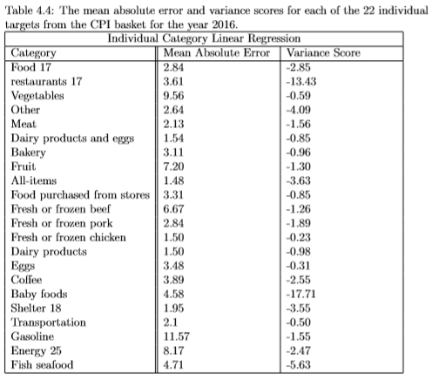
Predicting 22 Individual Targets: 2016
21 other targets were taken from the CPI basket
Mostly products within the food category.
Feature selection was done for each of the targets
New models were trained and tested with each of the new targets with their selected feature.

Slide 16
Ensembles: Bootstrap Aggregating
Normally for bootstrap aggregating (bagging) the training dataset is randomly sampled, with replacement, to create a set of training sets to train individual models.
For a timeseries dataset, randomly sampling the training data cannot be applied.
Need a different method of creating samples or partitions of the dataset to be used to train the individual models.

Slide 17
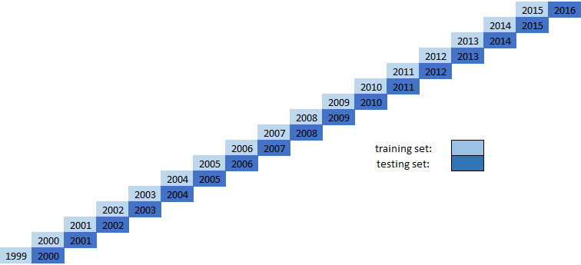
Bootstrap Aggregating: Sampling
First Idea was to simply partition the data by each year.
Each model would only have 12 records to be trained on.
Not enough examples to train stable models.

Slide 18
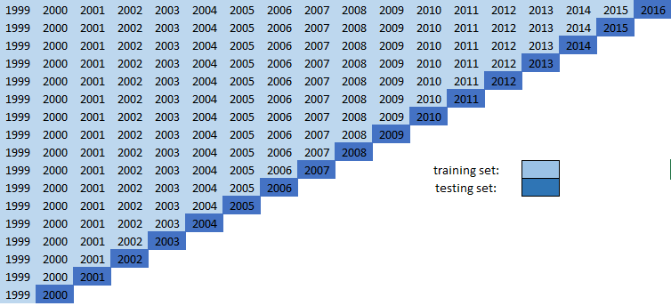
Bootstrap Aggregating: Sampling
The first sample contains January 1999 to December 2015.
The second sample contains January 1999 to December 2014.
…..
The seventeenth sample contains January 1999 to December 2000.
All together there are now 17 training sets, and 17 testing sets.

Slide 19
Bootstrap Aggregating: Training
Each model is trained and tested on it’s training year.
Each model is then trained and tested on one year ahead.
This created 17 individual linear regression models each with different coefficients.
Unlike some implementations of bagging, each model used the same selected features.
Results for each model’s testing varied in mean absolute error
M₁
X₁
M₂
X₂
M₁₇
X₁₇

Slide 20
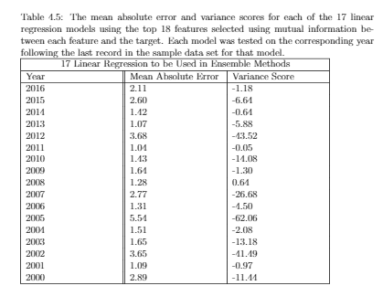
Bootstrap Aggregating: Testing
Each model is trained and tested on it’s training year.
Each model is then trained and tested on one year ahead.
This created 17 individual linear regression models each with different coefficients.
Unlike some implementations of bagging, each model used the same selected features.
Results for each model’s testing varied in mean absolute error

Slide 21

Bootstrap Aggregating: Training and Testing
Each model is trained and tested on it’s training year.
Each model is then trained and tested on one year ahead.
Results for predicting one year ahead were somewhat better.

Slide 22
Bootstrap Aggregating: Aggregating
M₁
X_{p}
M₂
X_{p}
M₁₇
X_{p}
Use the target year’s features in each of the models to produce predictions as output.
For regression models we take the mean of the individual models as the aggregate output.
Results for this were poor.
Reduced to last 10 models
Came up with a weighted average that gives decreasing weights to years further back.
Next used a 1% inflation before taking the mean of the models.
Y₁
Y₂
Y₁₇

Slide 23
Bootstrap Aggregating: Aggregating
Y₁
Y₁₇
_{Y}
Y₂
Use the target year’s features in each of the models to produce predictions as output.
For regression models we take the mean of the individual models as the aggregate output.
Results for this were poor.
Reduced to last 10 models
Came up with a weighted average that gives decreasing weights to years further back.
Next used a 1% inflation before taking the mean of the models.

Slide 24
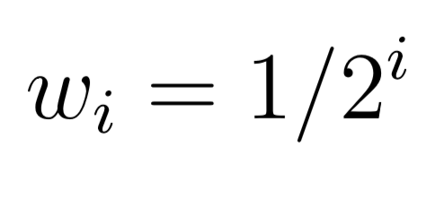
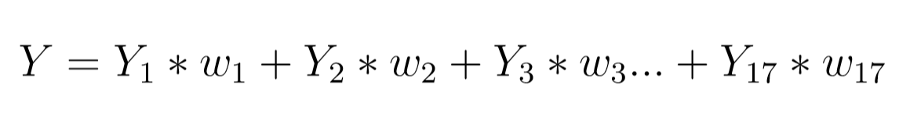
Bootstrap Aggregating: Aggregating
Use the target year’s features in each of the models to produce predictions as output.
For regression models we take the mean of the individual models as the aggregate output.
Results for this were poor.
Reduced to last 10 models
Came up with a weighted average that gives decreasing weights to years further back.
Next used a 1% inflation before taking the mean of the models.

Slide 25
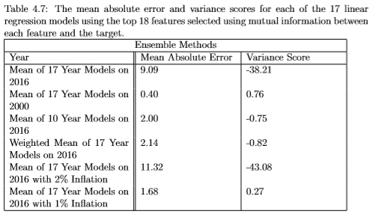
Bootstrap Aggregating: Results
Each of the different bootstrap aggregating methods were trained and tested.
The results were varied.
Best predictive power for the year 2016 was inflation adjusted average.
Both 10 year average and 17 year weighted average were significantly better than 17 year average.
The normal single model for 2016 has MAE of 2.11

Slide 26
References
Charlebois, S., Jabez, H., Tyedmers, P., Bailey, M., Keselj, V., Conrad, C., . . . Chamberlain, S. (2017). Canada's Food Price Report. Halifax: Dalhousie University.
Harris, J. (2017, August). A Machine Learning Approach to Forecasting Consumer Food Prices. Halifax, Nova Scotia, Canada.
Hunter, J., Dale, D., Firing, E., & Droettboom, M. (2012). Matplotlib. Retrieved from Matplotlib: https://matplotlib.org/
Kraskov, A., Stögbauer, H., & Grassberger, P. (2004). Estimating Mutual Information. Physical Review, E(69).
Pandas. (2017, December). Python Data Analysis Library. Retrieved from Pandas: https://pandas.pydata.org/
Scikit Learn. (2017). Generalized Linear Models. Retrieved from Scikit Learn: http://scikitlearn.org/stable/modules/linear_model.html
Scikit Learn. (2017). sklearn.feature_selection.mutual_info_regression. Retrieved from Scikit Learn: http://scikitlearn.org/stable/modules/generated/sklearn.feature_selection.mutual_info_regression.html#sk learn.feature_selection.mutual_info_regression
Statistics Canada. (2018, March). Consumer Price Index (CPI). Retrieved from Statistics Cnada: http://www23.statcan.gc.ca/imdb/p2SV.pl?Function=getSurvey&SDDS=2301
Notes:
In conclusion:
I was able to develop a large code base in python for work in this area, with lots of room for futher work.
Data:
Updating the data
Getting more attributes
Feature selection
Optimzing feature selection, the value of k, a hyper parameter
Ensembles
More work with ensembles, other methods such as boosting with ada boost,
Other methods of weightd averaging, beter use of inflation.
Other:
Analysis on what features were selected, understanding why they are important.
Beta-hat analysis on the models, meaning looking at coefficients of each selected feature.

