Slide 1
Predicting Canadian Consumer Food Prices with Python
Patrick Walter

Slide 2
Background: Canada’s Food Price Report
This year the 8th edition of Canada’s Food Price Report was published as a collaborative effort between Dalhousie University and University of Guelph.
The report looks at factors that affect the future prices seen by consumers for food over the next 12-month period.
Includes the key drivers of the upcoming year’s food prices such as Climate, Energy Costs, Inflation, Policy Context, Food Processing Industry, Consumer Debt and Deleveraging and many more.
The report divides the CPI basket into food categories including Dairy and Eggs, Fruit and Nuts, Meats, Vegetables, and Fish and Seafood.
Notes:
So I will start with the background of this research. This research is based off work done for Canada’s Food Price Report.
2018 marks the 8th year that this report has been published. I began at the university of guelph and is now published here at dalhousie.
The main goal of the report is to be a tool used to look at the factors that are expected to affect the future of food prices seen by Canadian consumers over the next one year period. In the 2018 report some of these key drivers for the upcoming year’s food prices include climate, energy costs, inflation, policy context, food processing industry, consumer debt and deleveraging and many more. The report not only makes predictions of the overall price of food, but also looks at different food categories as they often are effected by different factors and therefore may see different changes.

Slide 3
Background: Consumer Price Index
An indicator of the changes in prices experienced by Canadians, obtained by comparing the rising or falling cost of a fixed basket of good and services.
Fixed basket means that products and services are of the same quality and quantity and therefore these changes in cost are a true reflection of the pure price changes.
Data is released monthly and open to the public on Statistics Canada’s website as part of the CANSIM database.

Slide 4
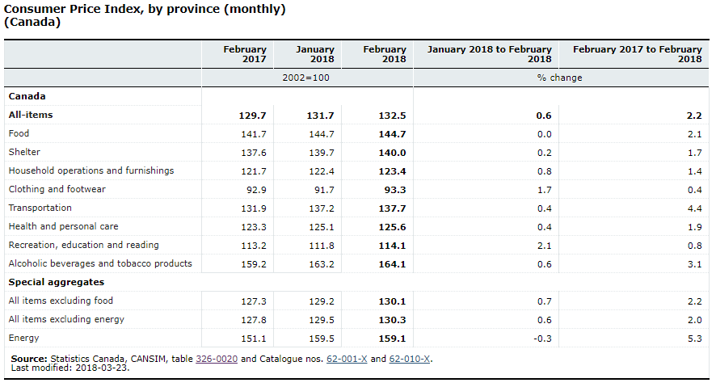
Background: Consumer Price Index

Slide 5
Methodology: Research Objectives
Train and test models for predicting the average national food price as reported by the CPI for a twelve month period for 5 years, from 2012 to 2016.
Train and test predictive models for predicting 21 other targets in the CPI basket for the years 2016 and 2017.
Gain insight on what years were difficult to predict, and what products were difficult to predict.
Implement an ensemble method to improve the stability of the models to predict the average national food price for the twelve months reported by the CPI for 2016 and 2017
Gain insight on how effective ensemble methods are at making stable predictions on average national food price.
Notes:
- TRAIN AND TEST MODELS TO PREDICT THE FOOD PRICE FOR A 12 MONTH PERIOD FOR EACH YEAR IN A 5 YEAR PERIOD
- TRAIN AND TEST MODELS TO PREDICT 21 OTHER TARGETS, AGGREGATE AND INDIVIDUAL PRODUCTS IN THE BASKET, MOSTLY WITH THE FOOD HEADING
- THE GOAL OF THESE WAS TO GAIN INSIGHT ON WHAT YEARS ARE HARD TO PREDICTS, AND WHAT PRODUCTS ARE HARD TO PREDICT
-IMPLEMENT AN ENSEMBLE METHOD, BOOTSTRAP AGGREGATING, TO IMPOVE STABILITY AND ACCURACY.

Slide 6
Methodology: Dataset
The original dataset was built by Jay Harris for his work on the 2017 and 2018 Canada Food Price Report and his thesis research titled A Machine Learning Approach to Forecasting Consumer Food Price
It was constructed using a wide range of financial and econometric data from public and private institutions totaling 280 attributes
The data set began at January 1985 with monthly records concluding at August 2017 giving 291 records.
22 targets from the CPI basket, mostly food products.
Notes:
The dataset I started this project with. Was a csv created by jay harris.
CONSTRUCTED FROM A WIDE RANGE OF FINANCIAL AND ECONOMETRIC DATA BOTH FROM BOTH GOVERNMENT AND PRIVATE
ALL OPEN DATA, FREE AND AVAILABLE ONLINE. SO THAT’S GREAT.
THE DATASET BEGINS JAN 1985 AND HAS MONTHLY RECORDS, ENDING AT AUGUST 2017 GIVING 291 RECORDS TOTAL
I updated the targets part of the dataset up to 2018. I attempted to build an updated attributes dataset to be up to date to 2018, however I had some troubles with sourcing all the same data and trouble with cleaning the data and retro fitting my code base to the updated dataset.

Slide 7
Methodology: Data Preprocessing
Pandas dataframes was used to manipulate the data.
Dataframe is a tabular data structure that has labeled axes.
Dividing the dataset in targets and attributes
Capping the dataset at 1999 after feature selection.
Removing any columns that were incomplete
Creating train and test dataframes for each of the five years
Creating dataframes for each of the individual targets
Notes:
DATAFRAME: Two-dimensional size-mutable, potentially heterogeneous tabular data structure with labeled axes (rows and columns). Arithmetic operations align on both row and column labels. Can be thought of as a dict-like container for Series objects.
PANDAS: A data analysis library with easy to use data structures. Such as dataframes.

Slide 8
Tools: Python Scikit Learn
A machine learning library for Python with a wide variety of implementations for popular algorithms.
This research used the ordinary least squares linear regression implementation. Easy to use to train and test linear regression models.
Feature selection, using mutual information and a selector to select the highest scoring features.
Notes:
Scikit learn: very popular library for machine learning, data mining, and predictive analytics in python.
Has a very wide range of implementations of virtually every algorithm and every variant of that algorithm.
Linear regression models are very easy to test and train. Once that data is all pre processed into the correct data structures, here data frames used as numpy like arrays.
Very simple, couple of lines of code for each model.
Used feature selection to select features to reduce the dimensionality of the models.
Feature selection needs a scoring method to calculation the dependence of correlation between a feature and the target.
For this I used a implementation of mutual information. This implementation uses a k nearest neighbours estimation of mutual information.

Slide 9
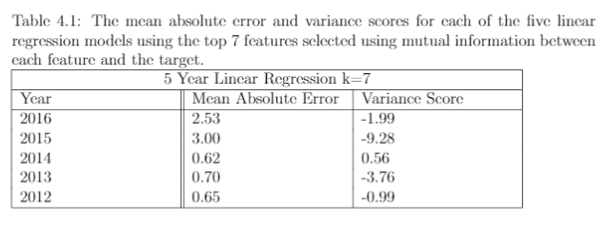
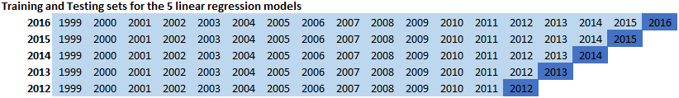
Predicting Average Food Price: 2012 to 2016
Divided the data into training and testing sets for each of the 5 years
Trained 5 individual models, tested each model on its corresponding year
Mean absolute error was calculated across all 12 points for each of the 5 years.
Notes:
FIRST EXPERIMENT:
train and test 5 linear regression models.
what the testing and training sets looked like.
feature selection performed before. K = 7.

Slide 10
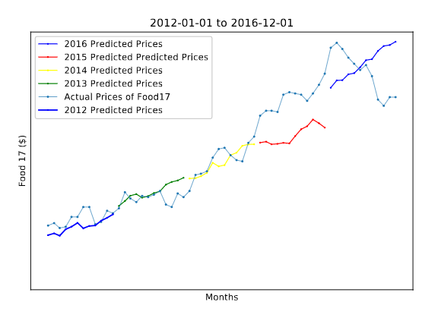
Predicting Average Food Price: 2012 to 2016

Slide 11
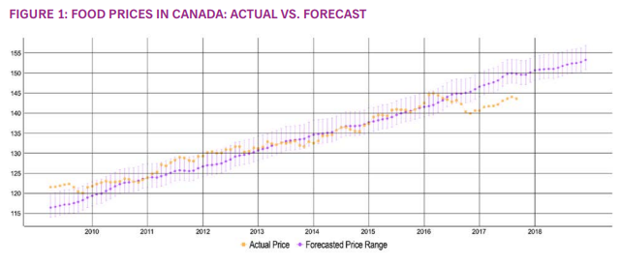
Food Price Report 2018

Slide 12
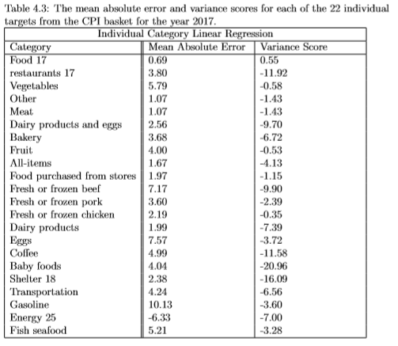
Predicting 22 Individual Targets:
21 other targets were taken from the CPI basket
Mostly products within the food category.
Feature selection was done for each of the targets
New models were trained and tested with each of the new targets with their selected feature.

Slide 13
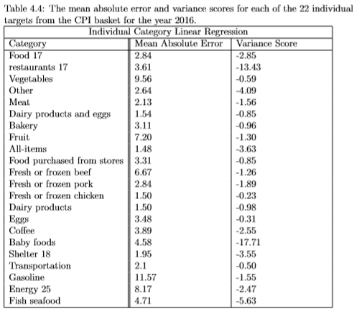
Predicting 22 Individual Targets:
21 other targets were taken from the CPI basket
Mostly products within the food category.
Feature selection was done for each of the targets
New models were trained and tested with each of the new targets with their selected feature.

Slide 14
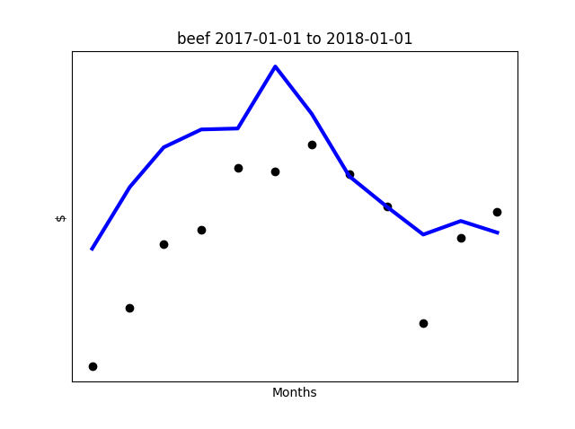
Individual Foods

Slide 15
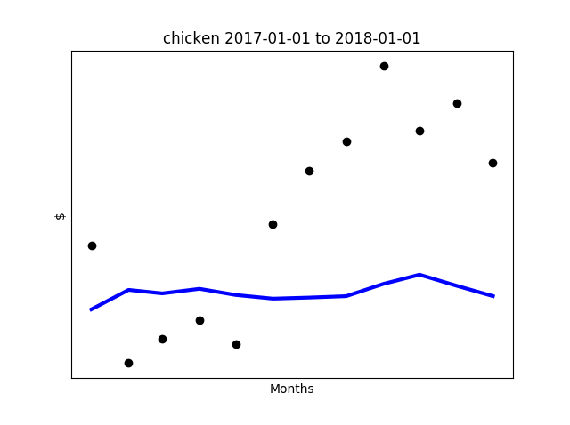
Individual Foods

Slide 16
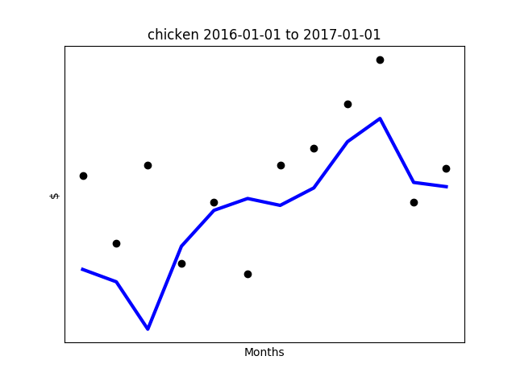
Individual Foods

Slide 17
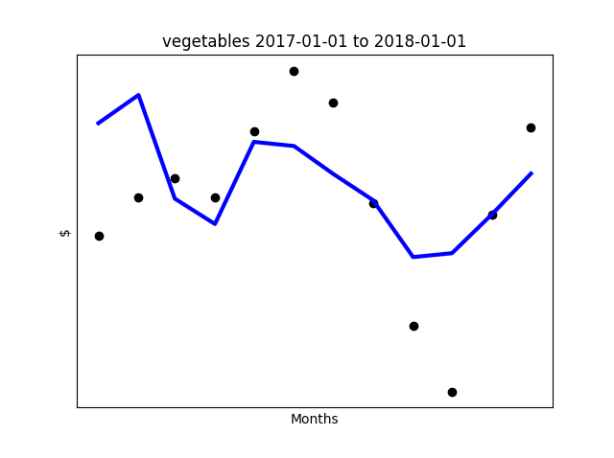
Individual Foods

Slide 18
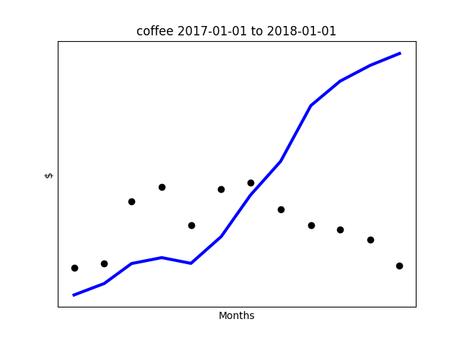
Individual Foods

Slide 19
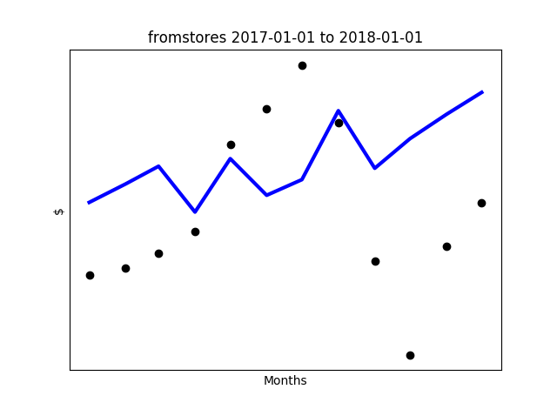
Individual Foods

Slide 20
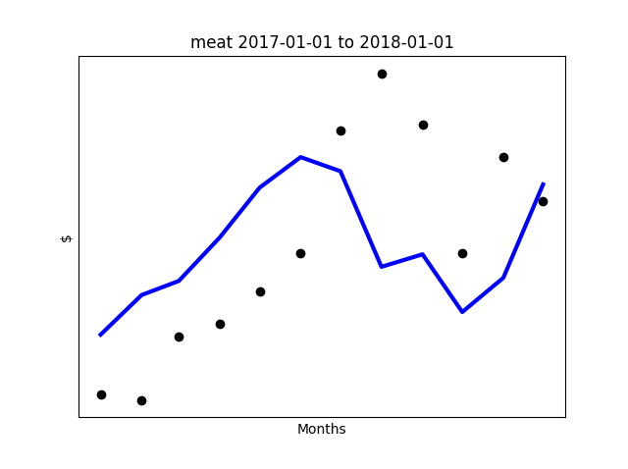
Individual Foods

Slide 21
Ensembles: Bootstrap Aggregating
Normally for bootstrap aggregating (bagging) the training dataset is randomly sampled, with replacement, to create a set of training sets to train individual models.
For a timeseries dataset, randomly sampling the training data cannot be applied.
Need a different method of creating samples or partitions of the dataset to be used to train the individual models.

Slide 22
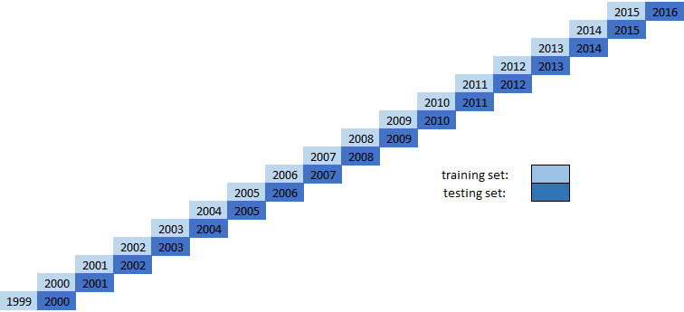
Bootstrap Aggregating: Sampling
First Idea was to simply partition the data by each year.
Each model would only have 12 records to be trained on.
Not enough examples to train stable models.

Slide 23
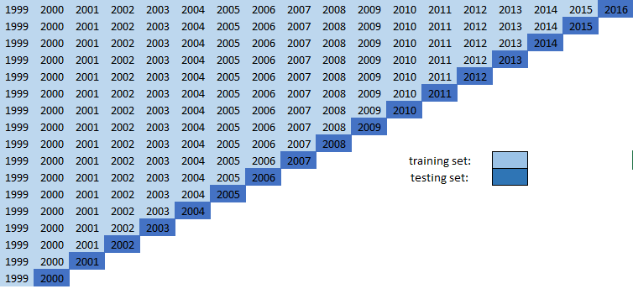
Bootstrap Aggregating: Sampling
The first sample contains January 1999 to December 2015.
The second sample contains January 1999 to December 2014.
…..
The seventeenth sample contains January 1999 to December 2000.
All together there are now 17 training sets, and 17 testing sets.

Slide 24
Bootstrap Aggregating: Training
M₁
X₁
M₂
X₂
M₁₇
X₁₇
Each model is trained and tested on it’s testing year.
Each model is then trained and tested on one year ahead.

Slide 25
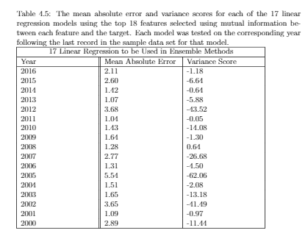
Bootstrap Aggregating: Testing
Each model is trained and tested on it’s training year.
Each model is then trained and tested on one year ahead.

Slide 26

Bootstrap Aggregating: Training and Testing
Each model is trained and tested on it’s training year.
Each model is then trained and tested on one year ahead.
Results for predicting one year ahead were somewhat better.

Slide 27
Bootstrap Aggregating: Aggregating
M₁
X_{p}
M₂
X_{p}
M₁₇
X_{p}
Use the target year’s features in each of the models to produce predictions as output.
For regression models we take the mean of the individual models as the aggregate output.
Results for this were poor.
Reduced to last 10 models
Came up with a weighted average that gives decreasing weights to years further back.
Next used a 1% inflation before taking the mean of the models.
Y₁
Y₂
Y₁₇

Slide 28
Bootstrap Aggregating: Aggregating
Y₁
Y₁₇
_{Y}
Y₂
Use the target year’s features in each of the models to produce predictions as output.
For regression models we take the mean of the individual models as the aggregate output.
Results for this were poor.
Reduced to last 10 models
Came up with a weighted average that gives decreasing weights to years further back.
Next used a 1% inflation before taking the mean of the models.

Slide 29
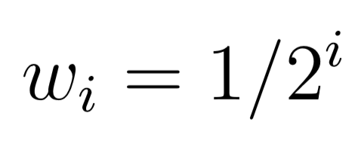
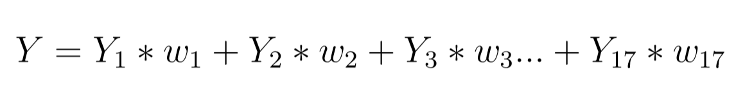
Bootstrap Aggregating: Aggregating
Use the target year’s features in each of the models to produce predictions as output.
For regression models we take the mean of the individual models as the aggregate output.
Results for this were poor.
Reduced to last 10 models
Came up with a weighted average that gives decreasing weights to years further back.
Next used a 1% inflation before taking the mean of the models.

Slide 30
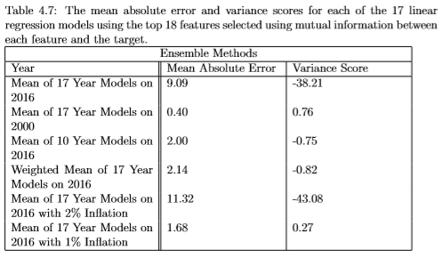
Bootstrap Aggregating: Results
Each of the different bootstrap aggregating methods were trained and tested.
The results were varied.
Best predictive power for the year 2016 was inflation adjusted average.
Both 10 year average and 17 year weighted average were significantly better than 17 year average.
The normal single model for 2016 has MAE of 2.11

Slide 31
References
Charlebois, S., Jabez, H., Tyedmers, P., Bailey, M., Keselj, V., Conrad, C., . . . Chamberlain, S. (2017). Canada's Food Price Report. Halifax: Dalhousie University.
Harris, J. (2017, August). A Machine Learning Approach to Forecasting Consumer Food Prices. Halifax, Nova Scotia, Canada.
Hunter, J., Dale, D., Firing, E., & Droettboom, M. (2012). Matplotlib. Retrieved from Matplotlib: https://matplotlib.org/
Kraskov, A., Stögbauer, H., & Grassberger, P. (2004). Estimating Mutual Information. Physical Review, E(69).
Pandas. (2017, December). Python Data Analysis Library. Retrieved from Pandas: https://pandas.pydata.org/
Scikit Learn. (2017). Generalized Linear Models. Retrieved from Scikit Learn: http://scikitlearn.org/stable/modules/linear_model.html
Scikit Learn. (2017). sklearn.feature_selection.mutual_info_regression. Retrieved from Scikit Learn: http://scikitlearn.org/stable/modules/generated/sklearn.feature_selection.mutual_info_regression.html#sk learn.feature_selection.mutual_info_regression
Statistics Canada. (2018, March). Consumer Price Index (CPI). Retrieved from Statistics Cnada: http://www23.statcan.gc.ca/imdb/p2SV.pl?Function=getSurvey&SDDS=2301

