Slide 1
Project 6: Small Modular Reactors
William Gerding CJ Oldham Austin Stanford
Zack Taylor Patrick Williams

Slide 2
Outline
Background
Properties
Methods
(Some) Results
Conclusion

Slide 3
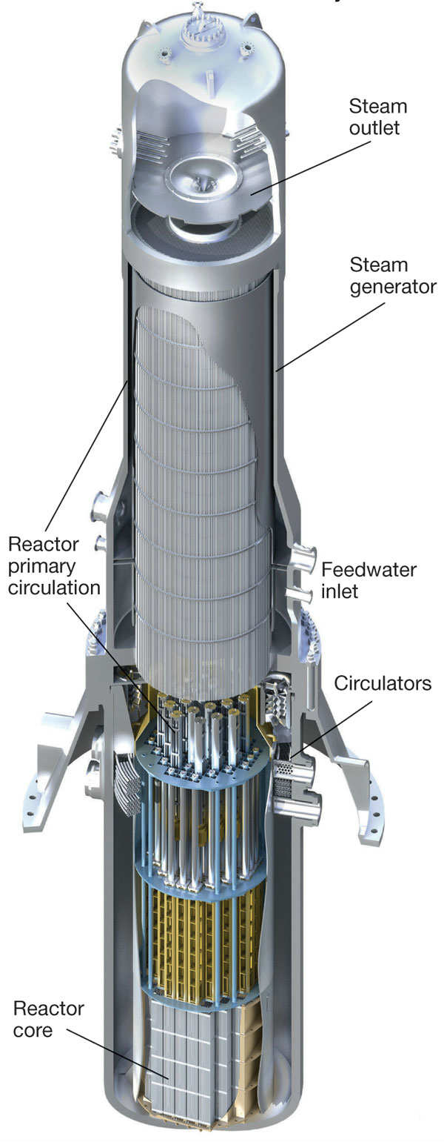
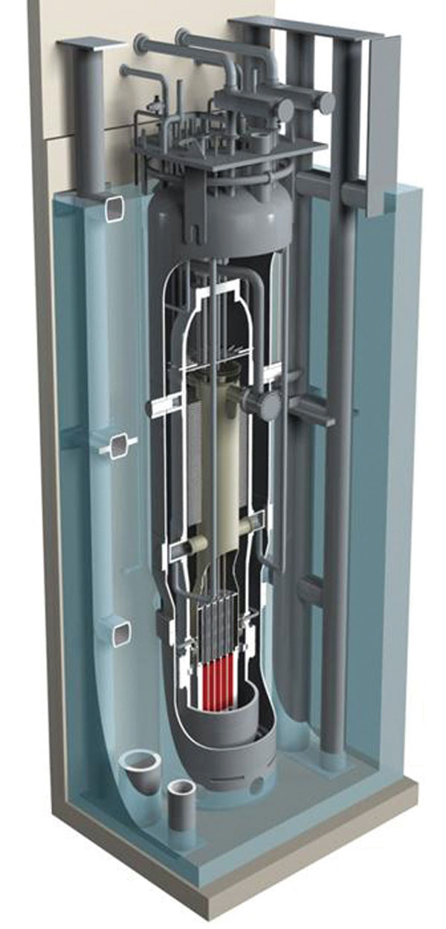
Background
Diffusion Approximation vs. Transport Theory
Why SMRs?
B&W mPower
NuScale NuScale
Our code
[1]http://www.modernpowersystems.com/features/featurenuscale-joins-bw-on-the-smr-bench-4264827/featurenuscale-joins-bw-on-the-smr-bench-4264827-2.html
[2]http://www.modernpowersystems.com/features/featurenuscale-joins-bw-on-the-smr-bench-4264827/featurenuscale-joins-bw-on-the-smr-bench-4264827-1.html
B&W mPower reactor assembly^{[1]}
NuScale Reactor Assembly^{{2]}

Slide 4
Properties (mPower)
Shortened PWR fuel Assemblies (2.4 m vs. 4 m)
69 assemblies in core
Less than 5% Enrichment
More than 40 GWd/MT burnup
48 Month Cycle
530 MW_{th}

Slide 5
Properties (NuScale)
Shortened PWR fuel assemblies (2 m vs. 4 m)
37 Fuel Assemblies
Less than 4.95% Enrichment
Burnup is not yet determined
24 Month Cycle
160 MW_{th}

Slide 6

Methods
Used a SCALE simulation based on previous properties to determine input cross sections
Python was used for determining flux
Selected for flexibility and speed
Flux was normalized based on reactor power
$A=\frac{3.63P}{vΣ_{f}V}$
Cases were ran for both reactor types with their respective cross sections

Slide 7
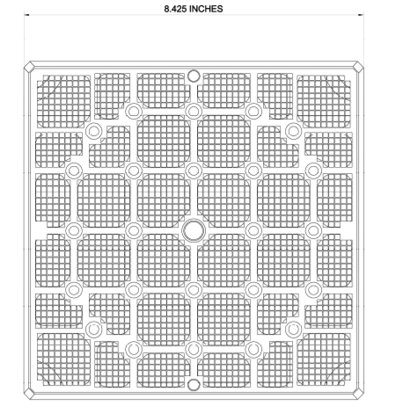
Methods (SCALE)
For obtaining the cross-sections we made a SCALE model based off the 17x17 PWR array. Both SMRs use the same bundles as you would find in a PWR. The only major difference is the height of the core.
We ran two different steady state and
depletion models for the reactor design.
NuScale Reactor
Mpower Reactor
Cross-Section for 17x17 bundle.

Slide 8
Methods (SCALE)
mPower Reactor
NuScale Reactor
4.95 % Enrichment
Close to the 5% enrichment we saw online.
530 MWth
Burnup
0, 15, 30, 45 GWD/MTHIM
3.1% Enrichment
Also ran it with 4.05, 4.55, and 2.6% enrichment.
160 MWth
Burnup
0, 15, 30, 45 GWD/MTHIM

Slide 9
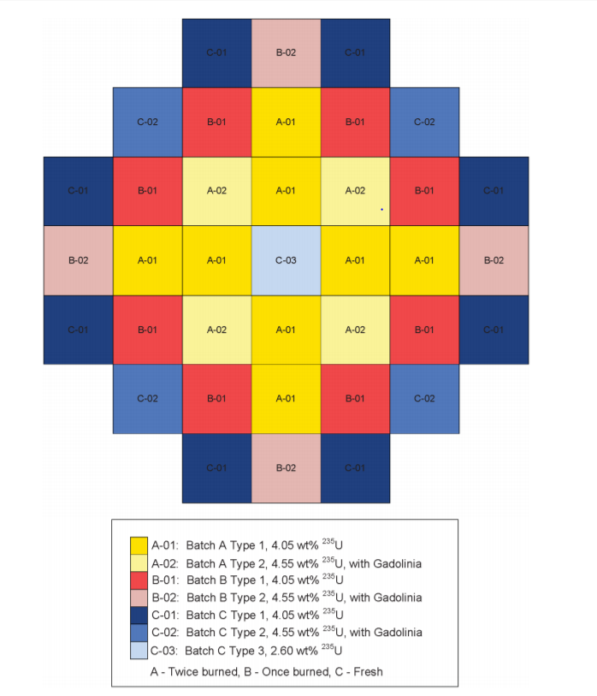
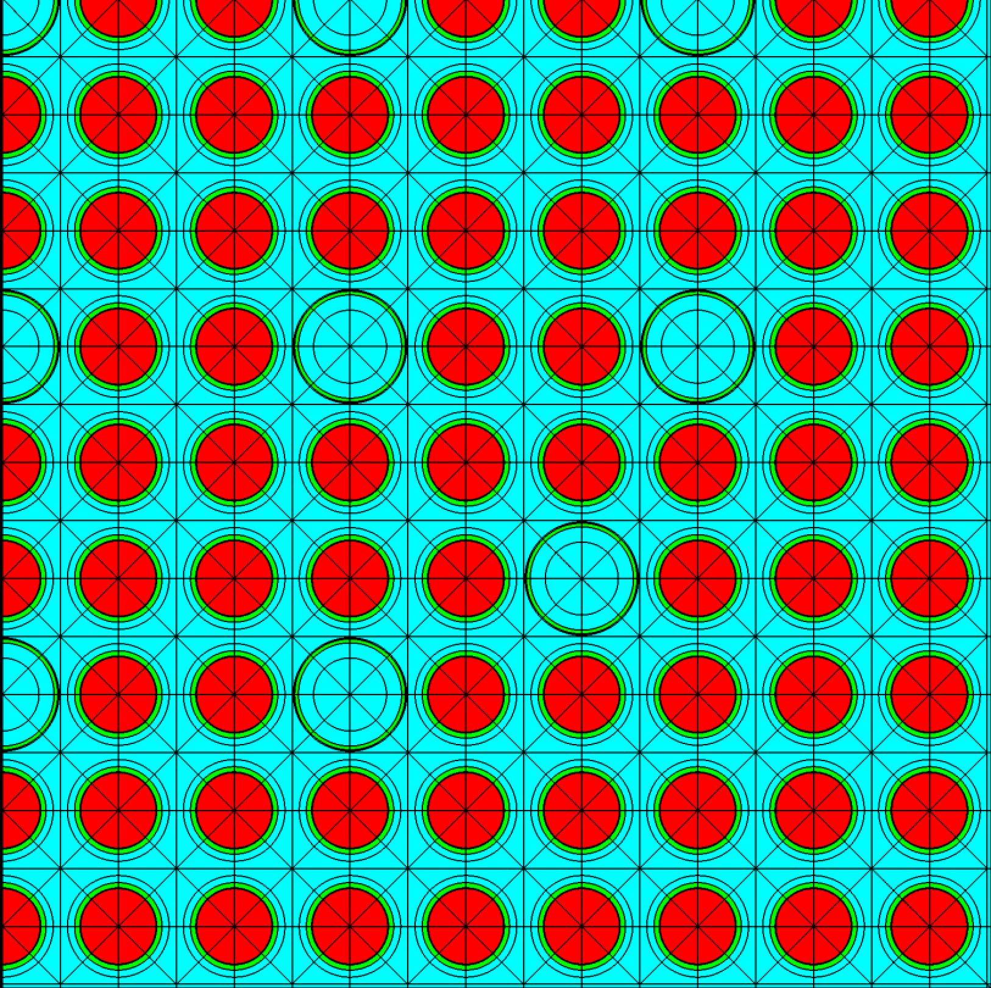
Methods (SCALE)
Cutout of the SCALE file showing ¼ of the 17x17 fuel bundle.
The basic core loading pattern for the NuScale reactor with 37 total bundles spread across the core.

Slide 10
Scale Results
Results showing the cross sections obtained by the two depletion models.
mPower Cross Sections
Burnup (GWd/MT) | Group | Total | Transport | Removal | Eff Abs | Nu-Fission | Scatter Down
0 | 1 | 5.32E-01 | 2.26E-01 | 2.53E-02 | 9.94E-03 | 8.73E-03 | 1.55E-02
 | 2 | 1.38E+00 | 8.89E-01 | 1.11E-01 | 1.10E-01 | 1.98E-01 | 1.71E-03
15 | 1 | 5.39E-01 | 2.28E-01 | 2.63E-02 | 1.07E-02 | 7.46E-03 | 1.56E-02
 | 2 | 1.40E+00 | 9.09E-01 | 1.21E-01 | 1.19E-02 | 1.86E-01 | 1.82E-03
30 | 1 | 5.44E-01 | 2.29E-01 | 2.69E-02 | 1.12E-02 | 6.41E-03 | 1.56E-02
 | 2 | 1.40E+00 | 9.19E-01 | 1.17E-01 | 1.15E-01 | 1.69E-01 | 1.75E-03
45 | 1 | 5.48E-01 | 2.31E-01 | 2.74E-02 | 1.17E-02 | 5.50E-03 | 1.57E-02
 | 2 | 1.40E+00 | 9.23E-01 | 1.09E-01 | 1.08E-01 | 1.46E-01 | 1.63E-03
NuScale Cross Sections
Burnup (GWd/MT) | Group | Total | Transport | Removal | Eff Abs | Nu-Fission | Scatter Down
0 | 1 | 5.35E-01 | 2.27E-01 | 2.61E-02 | 1.05E-02 | 8.80E-03 | 1.56E-02
 | 2 | 1.37E+00 | 8.81E-01 | 1.22E-01 | 1.20E-01 | 1.93E-01 | 2.22E-03
15 | 1 | 5.43E-01 | 2.29E-01 | 2.65E-02 | 9.95E-03 | 5.50E-03 | 1.66E-02
 | 2 | 1.38E+00 | 9.08E-01 | 9.27E-02 | 9.13E-02 | 1.32E-01 | 1.43E-03
30 | 1 | 5.48E-01 | 2.31E-01 | 2.72E-02 | 1.07E-02 | 4.73E-03 | 1.65E-02
 | 2 | 1.39E+00 | 9.17E-01 | 8.97E-02 | 8.82E-02 | 1.17E-01 | 1.37E-03
45 | 1 | 5.52E+00 | 2.32E-01 | 2.78E-02 | 1.13E-02 | 4.19E-03 | 1.65E-02
 | 2 | 1.38E+00 | 9.20E-01 | 8.49E-02 | 8.36E-02 | 1.01E-01 | 1.28E-03

Slide 11
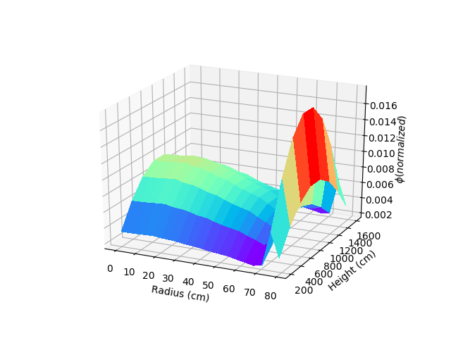
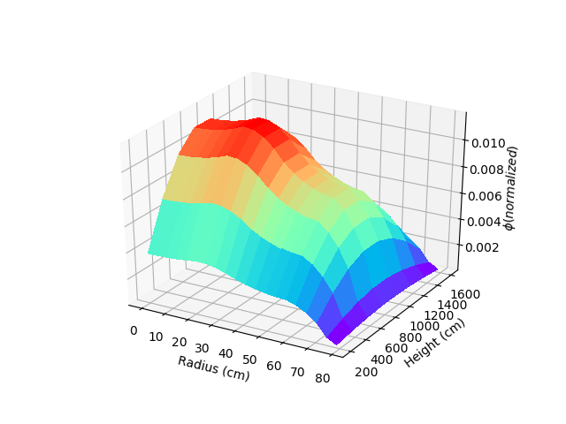
Results
Thermal
Fast
K_{eff} = 1.0025367
Z = 2000cm
D_{fuel} = 18cm
D_{water} = 15cm
5 Mesh per Element
10 Mesh per ln(z)
Loading Pattern = [Fuel B, Fuel A, Fuel B, Fuel C, Water

Slide 12
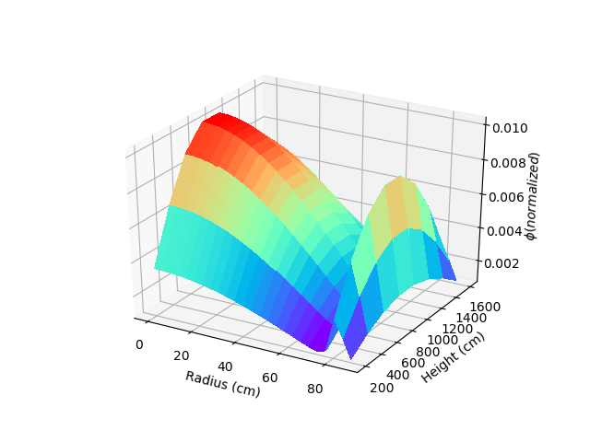
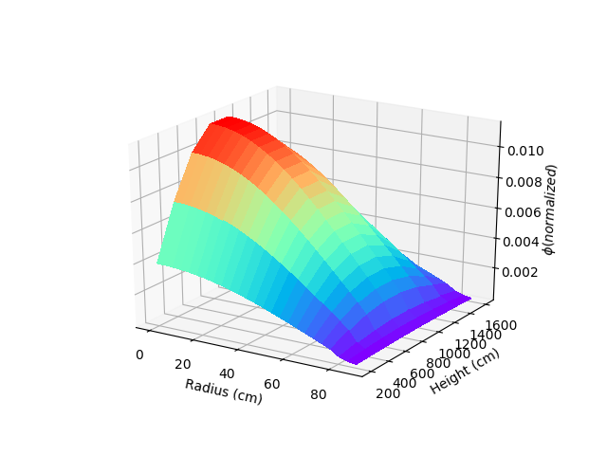
Results (Mostly Burnt)
Thermal
K_{eff} = .967264
Z = 2000cm
D_{fuel} = 18cm
D_{water} = 15cm
Fast
5 Mesh per Element
10 Mesh per ln(z)
Loading Pattern = [Fuel B, Fuel B, Fuel B, Fuel B, Water

Slide 13
Conclusion
Reactor simulations are essential
Cost, time, etc
Too complex for one software
Many codes must be used interdependently
Many assumptions to simplify
Steady-state, just the core

