Slide 1

Prepared by group NEUTRO - PATRICK WONG JUN WEN
DAX ASSISTANT
GrabBuddy – Your Trip-Aware AI Assistant
Empowering Grab Drivers with Safe, Hands-Free Navigation
12 April, 2025

Slide 2
PROBLEM STATEMENTS
Unsafe to touch app while driving
Voice commands fail in noisy conditions (e.g., traffic, rain)
Poor recognition of local SEA accents
No context-aware driver support
No smart assistant for trip phases

Slide 3
OBJECTIVES
Enable safe, hands-free voice interaction
Provide info based on trip context
Understand incomplete and accented speech
Give positive feedback and safety tips

Slide 4
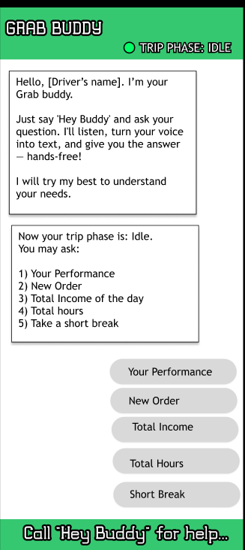
SOLUTION
GrabBuddy Core Modules
ASR (Speech Input): Captures voice using Vosk
Intent Recognition: Detects driver commands
Context Awareness: Adapts to trip stages (Idle, Pickup)
TTS (Speech Output): Replies using natural voice
Companion Logic: Gives summaries, tips, and alerts
User Interface: Built with Kivy (buttons + feedback)

Slide 5

CURRENT & FUTURE KEY FEATURES
Trip-Aware Voice Assistant
Accent Personalization
Noise-Aware Listening Mode
Partial Input Recovery (Smart Guessing)
Companion Personality
Driver Performance Tips
Safety Voice Alerts
User Interface (UI)

Slide 6

DATA UTILIZATION
Voice Data
Trip Context
User Interaction
Performance Stats (Mock)
Noise Levels (Planned)

Slide 7
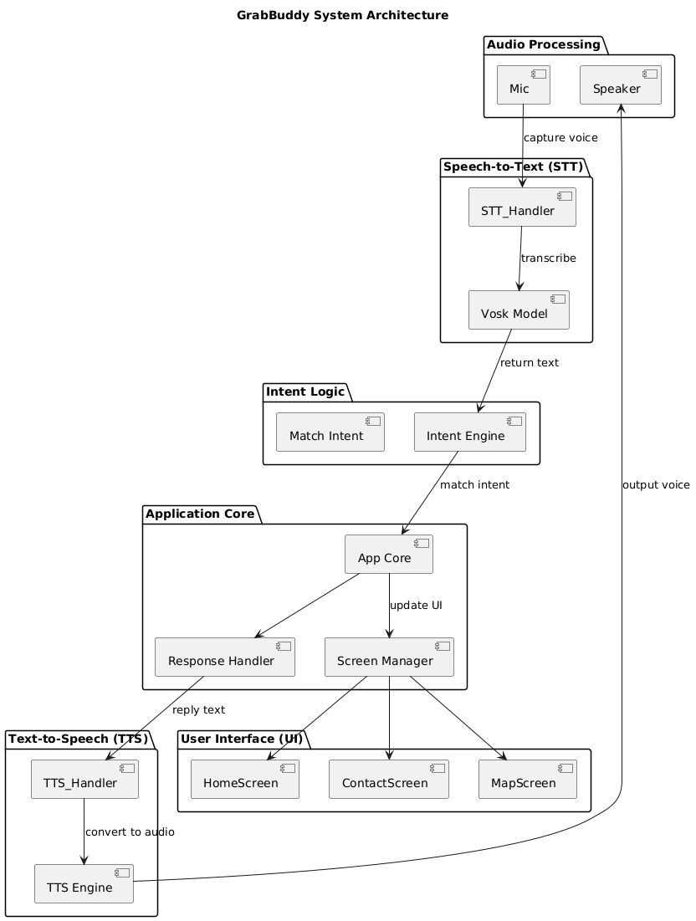
SYSTEM ARCHITECTURE DIAGRAM
Mic Input → Driver speaks
Speech-to-Text (Vosk) → Converts voice to text
Intent Logic → Detects driver’s command
App Core → Processes intent & prepares reply
Text-to-Speech (TTS) → Speaks response aloud
User Interface (Kivy) → Updates screen (Home, Contact, Map)
Designed for hands-free, real-time interaction during all trip phases.

Slide 8
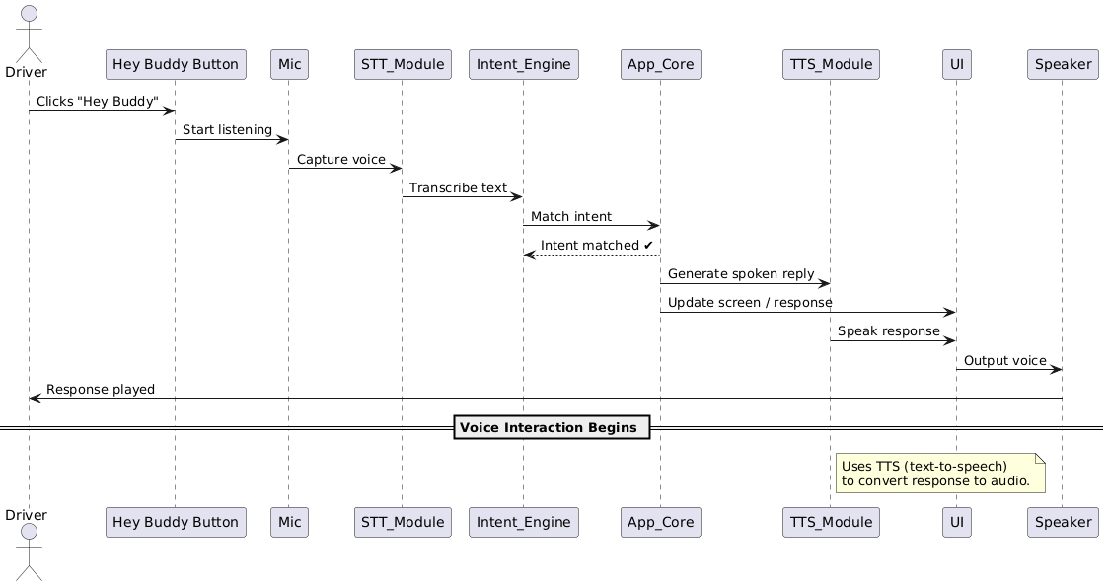
USER INTERACTION FLOW
1) Driver taps "Hey Buddy" button
Simulates a wake word, Starts voice listening
2) Mic captures voice input
Waits for spoken command
3) STT Module (Vosk)
Converts speech to text
4) Intent Engine
Detects user command (e.g., ETA, income)
5) App Core
Generates reply, Updates UI
6) TTS Module
Speaks the response aloud

Slide 9
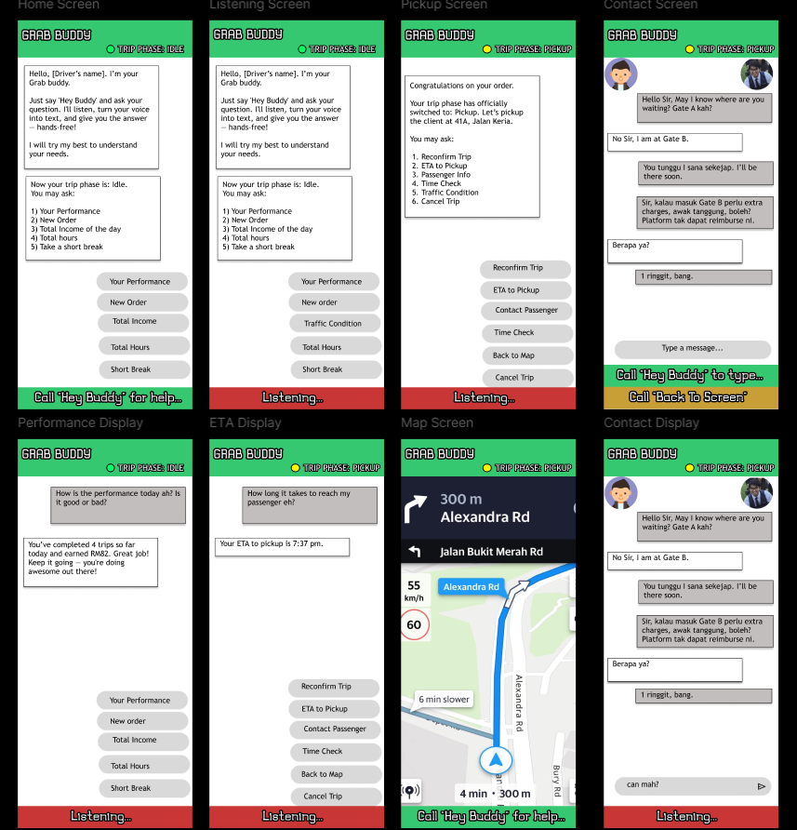
FIGMA PROTOTYPE

Slide 10
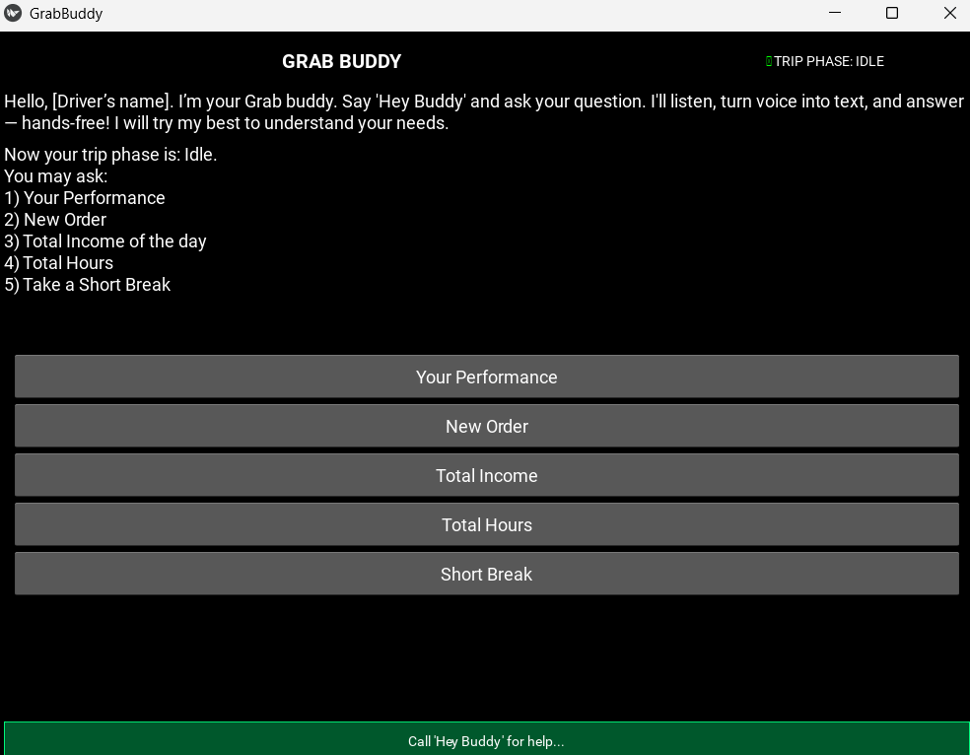
CURRENT FUNCTIONAL PROTOTYPE

Slide 11
TECHNOLOGY STACK
Layer | Tool/Library | Purpose
Audio Input | sounddevice | Captures and processes microphone input
ASR (Speech-to-Text) | Vosk | Transcribes spoken commands into text
NLP / Intent Matching | re, Python dicts | Recognizes user intent from partial or accented input
Noise Detection | sounddevice, NumPy | Analyses ambient noise to trigger adjustments
Text-to-Speech | pyttsx3, gTTS (fallback) | Speaks assistant responses aloud
UI (optional) | Kivy | Simulated car dashboard interface
Data Handling | JSON | Stores user trips, summaries, preferences

Slide 12
FUTURE WORK
1.Wake Word Activation ("Hey Buddy")
2.Multilingual/Mixed Input Support (e.g., English + BM)
3.UI Refinement Based on Figma

Slide 13
IMPACT POTENTIAL
GrabBuddy is a smart, voice-first assistant that keeps drivers safe, focused, and productive — built for real roads, real voices, and real impact.

Slide 14
Thank you

