Slide 1
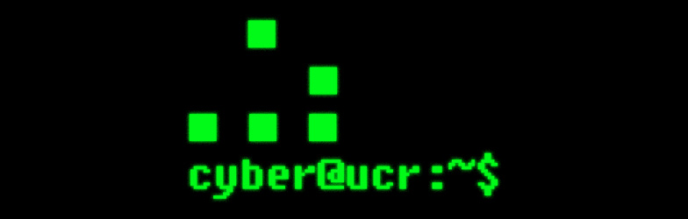

Slide 2
cyber@ucr:~$ whoami
cyber@ucr is a club at UCR which advances the study of cybersecurity.
We explore topics like:
Secure Design
Internet Safety
Network Security and Defense (Blue)
Cyberethics
Exploitation and Social Engineering (Red)
--more--

Slide 3
cyber@ucr:~$ whoami
We develop these skills by practicing in and participating in cybersecurity-related competitions.
- Collegiate Cyber-Defense Competition (CCDC)
- National Cyber League (NCL)
We also develop relationships with faculty and staff who work on security-related projects.
--more--

Slide 4
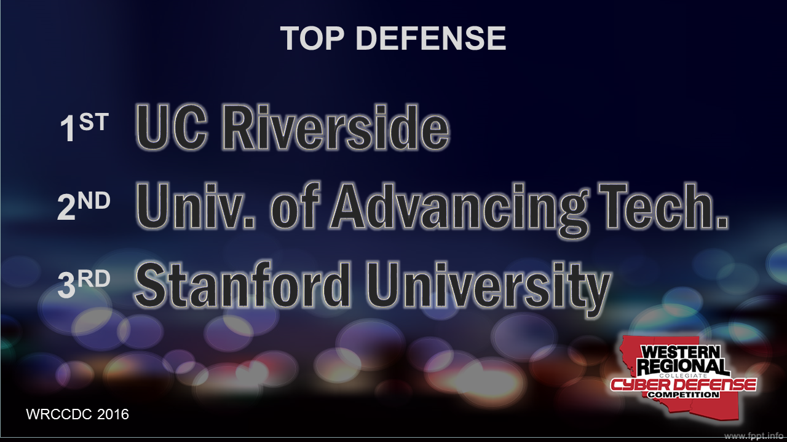
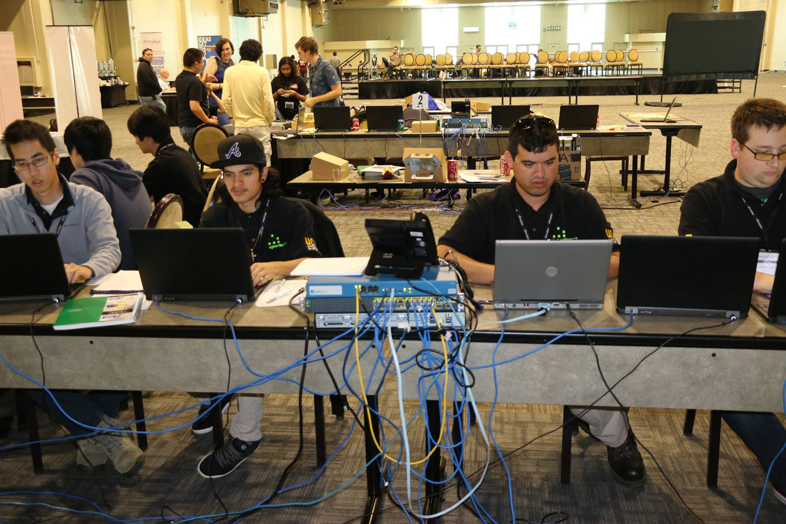
cyber@ucr:~$ whoami
In Summary:
WE COMPETE.
We connect competitors
to resources.
We help people build
competing teams.
We help facilitate
training.
Build our reputation.
--more--
wrccdc2016_results.jpg
wrccdc2016_hacking.jpg

Slide 5
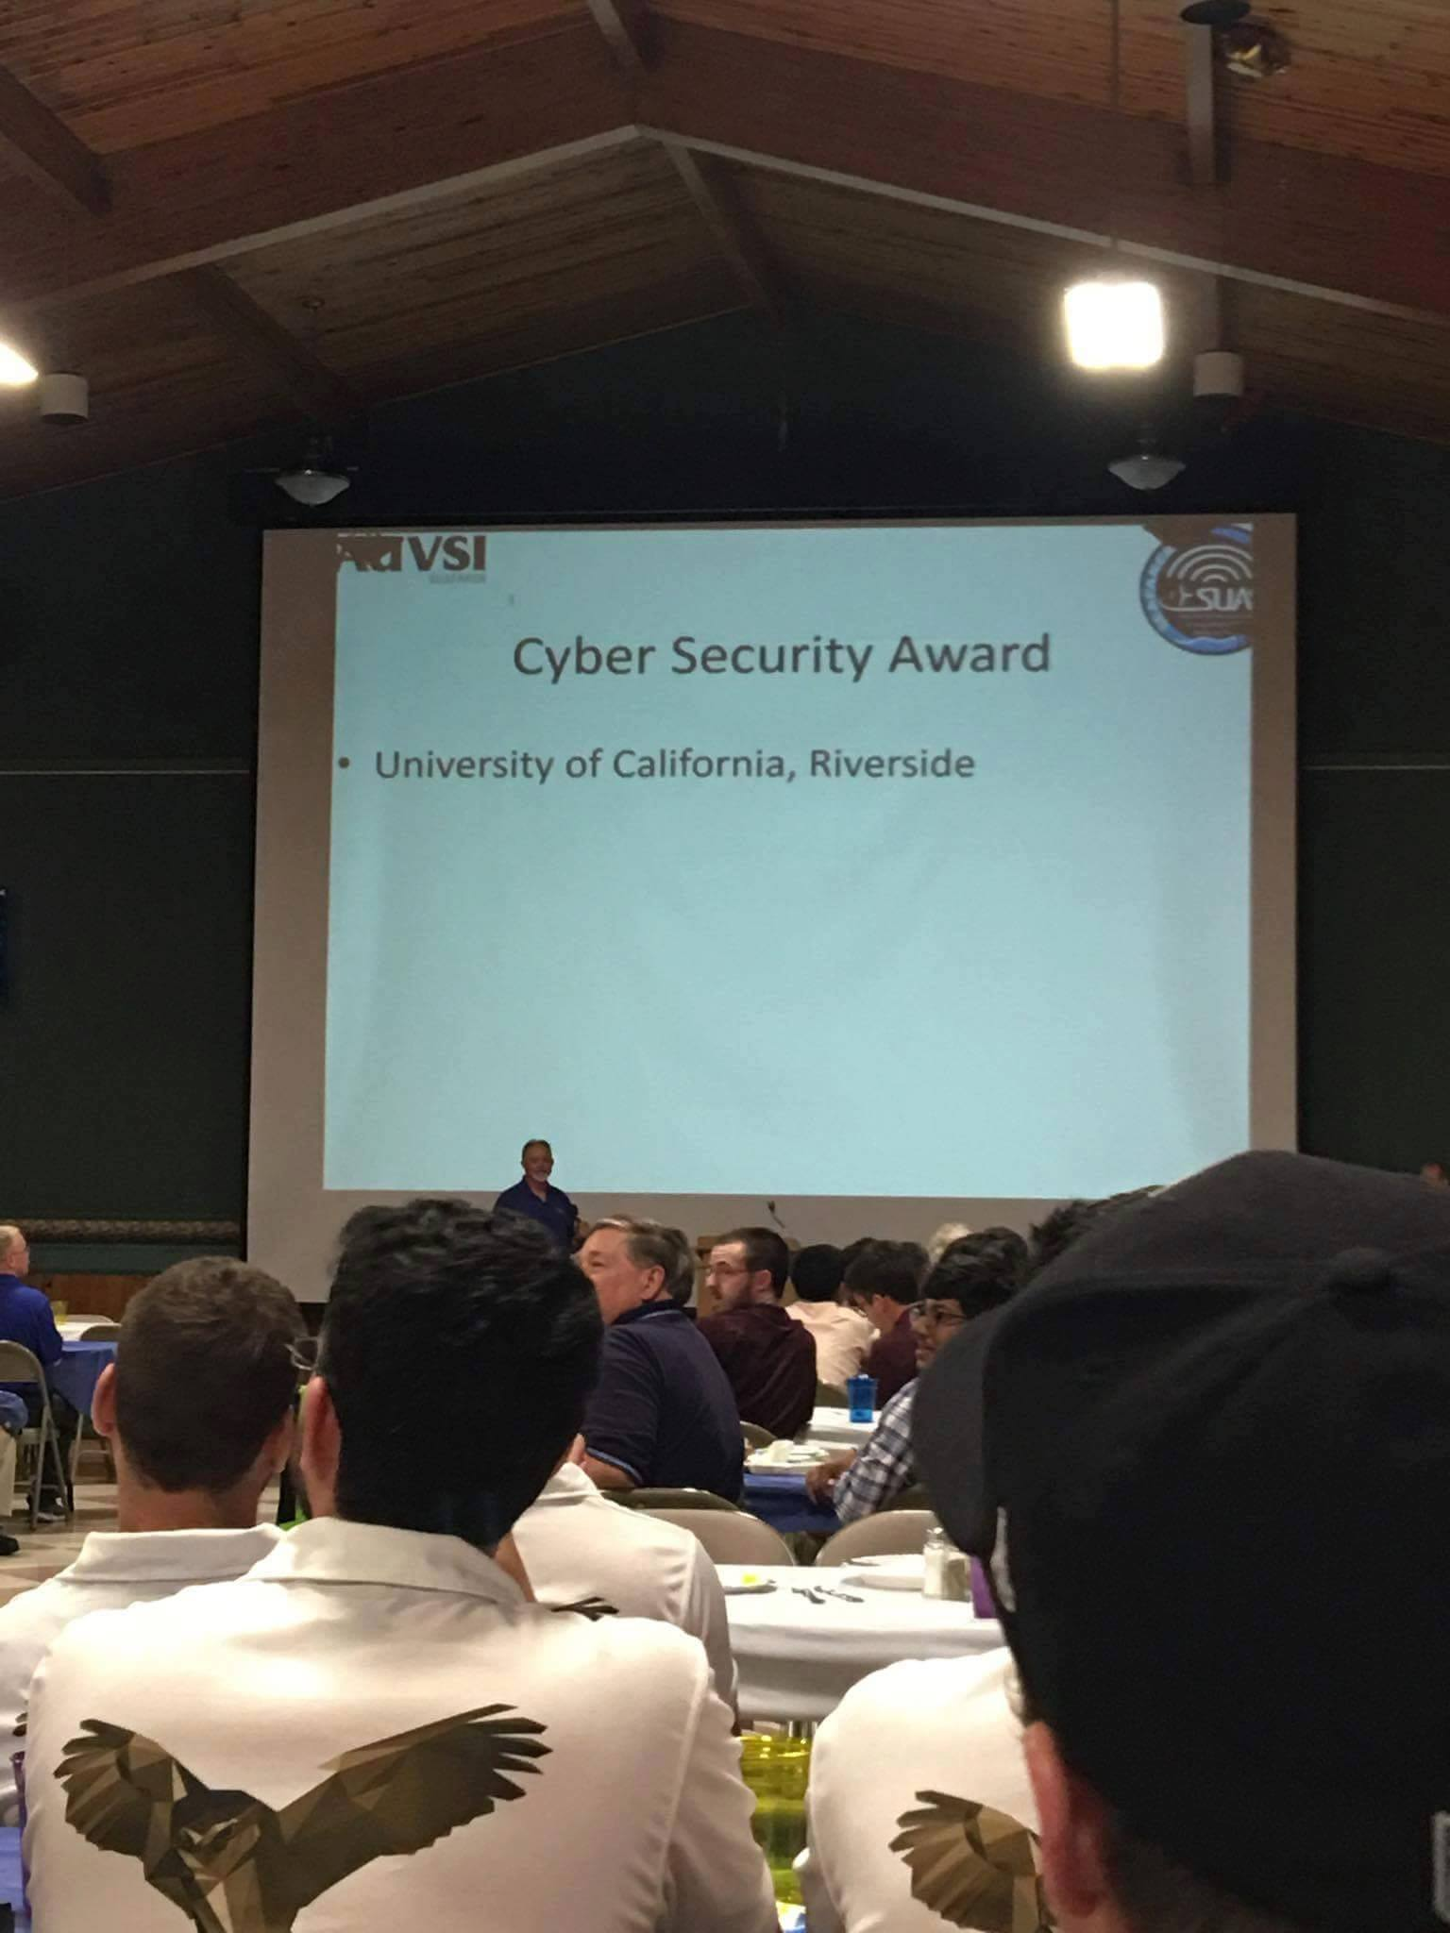
cyber@ucr:~$ whoami
In Summary:
WE CONSULT. WE TEST.
We help other teams consider
security in their designs.
We help advance secure
practices.
Do you have a project you
would like to secure?
--more--
uavuas.jpg

Slide 6
cyber@ucr:~$ whoami
In Summary:
WE RESEARCH.
We connect students interested in
security research to faculty
investigating those topics.
--end--

Slide 7
cyber@ucr:~$ whoami
In Summary:
WE EDUCATE.
We are building faculty and industry
relationships that will help us hold
workshops and discussions related
to security.
--end--

Slide 8
cyber@ucr:~$ cat faq.txt
I don`t know what I`m doing!
That`s okay. None of us do.
What sort of commitment?
Treat this like another class.
Our best team members `self-study.`
What will I learn?
You get out of it what you put into it.
--more--

Slide 9
cyber@ucr:~$ cat faq.txt
Will I have support?
Absolutely. That is what we are here for.
Cybersecurity isn`t my `thing.`
Cybersecurity is everyone`s problem.
--end--

Slide 10

cyber@ucr:~$ man national_cyber_league
The National Cyber League (NCL) is the nation`s largest collegiate security competition.
- Regular Season: Individual.
- Two events. Nov 5th, Nov 9th.
- Focuses on individual skills from CompTIA Security+, Network+, and Certified Ethical Hacker.
--more--

Slide 11
cyber@ucr:~$ man national_cyber_league
The National Cyber League (NCL) is the nation`s largest colligate security competition.
- Postseason: Team Event
- Must have participated in Regular
Season.
- $25 entry fee for Regular and
Postseason.
--end--

Slide 12
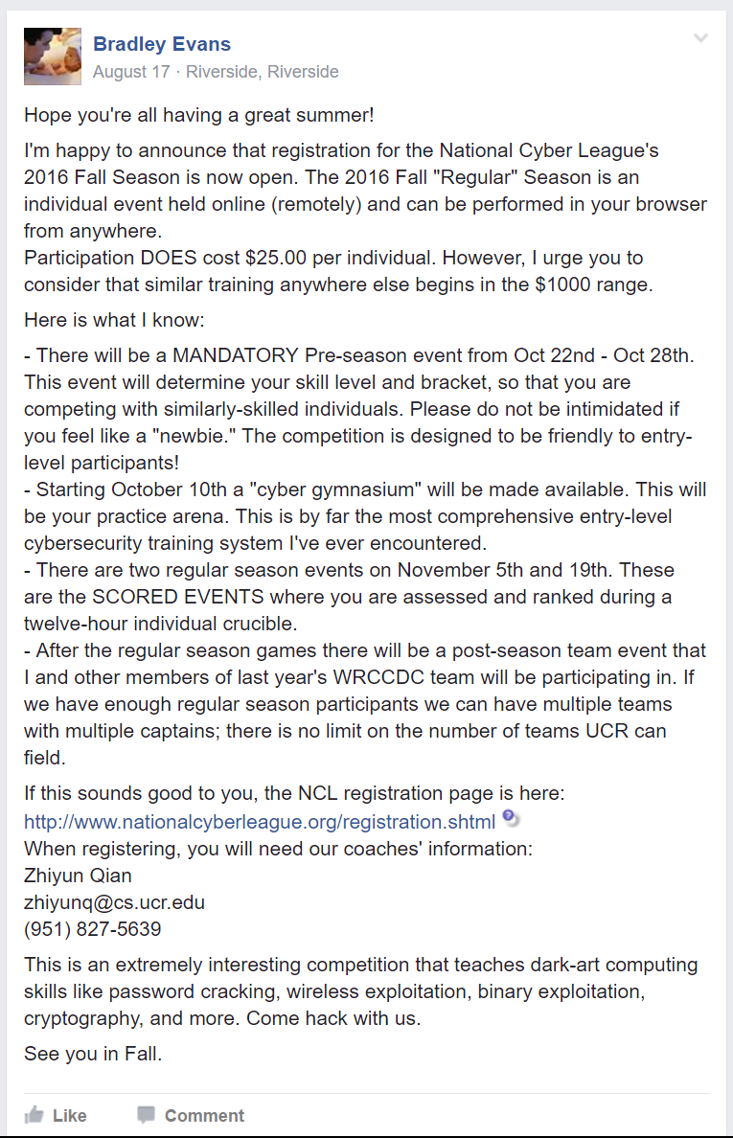
cyber@ucr:~$ useradd new_ncl_competitor
https://www.facebook.com/groups/ucrcyber
https://ucrcyber.slack.com/
http://www.nationalcyberleague.org/player-coach-registration
Coach Information:
Zhiyun Qian zhiyunq@cs.ucr.edu (951) 827-5639
$25 per individual [regular season]
$25 per team [postseason]

Slide 13

cyber@ucr:~$ man wrccdc
The Western Regional Collegiate Cyber Defense Competition (WRCCDC)
- Network Defense Competition
- Systems Administration
- Two invitationals, unlimited team
size.
- Qualifier event.
- In-person regional event.
--more--

Slide 14
cyber@ucr:~$ man wrccdc
The Western Regional Collegiate Cyber Defense Competition (WRCCDC)
- Nov 5th: Invitational
- Dec 3rd: Invitational
- Jan 3rd: Qualifiers
- All these events are at UCR.
--more--

Slide 15
cyber@ucr:~$ man wrccdc
The Western Regional Collegiate Cyber Defense Competition (WRCCDC)
- Regionals: March 23rd thru 26th
- Limited team size.
8 active, additional 4 reserve.
- Only one team allowed.
--more--

Slide 16
cyber@ucr:~$ diff wrccdc ncl
Scheduling Conflicts:
- Nov 5: NCL Reg. Season event + WRCCDC
Invitational
- Dec 3: NCL Postseason Team Event +
WRCCDC Invitational
NCL allows an unlimited number of teams from a university, but we cannot use everyone on the WRCCDC team.
--end--

Slide 17
cyber@ucr:~$ diff wrccdc ncl
WRCCDC
More technical
Adversarial
Set event times
Team oriented
Requires specialties
More prestigious
Need to be okay with failure
NCL
Individual exercises
Lab-style
Better preparatory exercises (in NCL Gymnasiums
More entry-level
Scored more objectively
--end--

Slide 18
cyber@ucr:~$ cat why.log
Cybersecurity is one of the fastest growing computing fields.
Regulatory compliance requires testing.
Security standards. DISA, HIPPA, FERPA.
$70 billion industry.
>200k unfilled positions.
Projected shortfall of 1.5mil workers by 2019.
[Source: Forbes `One Million Cybersecurity Job Openings in 2016`]

Slide 19
cyber@ucr:~$ cat why.log
Getting Pwned All Over The Place
DCCC / DNC hack
Exploited poor user practices, lack of awareness.
Yahoo! Hack
Over a half billion compromised attacks.
Microsoft `Golden Key` Hack
ThinkPwn
The list goes on. New hacks every day.
Just yesterday: attacks on election systems.

Slide 20
cyber@ucr:~$ cat why.log
Getting Pwned All Over The Place
We can no longer ignore security as computer scientists and engineers.

Slide 21
cyber@ucr:~$ cat why.log
Need for security professionals at all levels.
Test engineers who audit code for vulnerabilities before release.
Penetration testers to audit new webapps.
Systems administrators who harden networks.
Managers who understand IT risks.
Engineers who don`t push insecure products.

Slide 22
cyber@ucr:~$ cat why.log
Need for security professionals at all levels.
Forensic analysts, investigators, and incident responders.
Cyberwarfare officers.

Slide 23
cyber@ucr:~$ cat why.log
At present, only one course at UCR explicitly discusses security.
We have to find a way to learn it ourselves.

Slide 24
(just beat Berkeley)

