Slide 1
Data Science Hw 5
Julian Garcia

Slide 2
Classification
For the homework, we have decided to choose classification. For the data set we have chosen the tic-tac-toe dataset. This data set has no missing values and has all categorical variables. The attributes correlate to the position of the tic-tac-toe board. Columns 1-3 are the top three squares and the rest of the columns follow the same pattern.

Slide 3
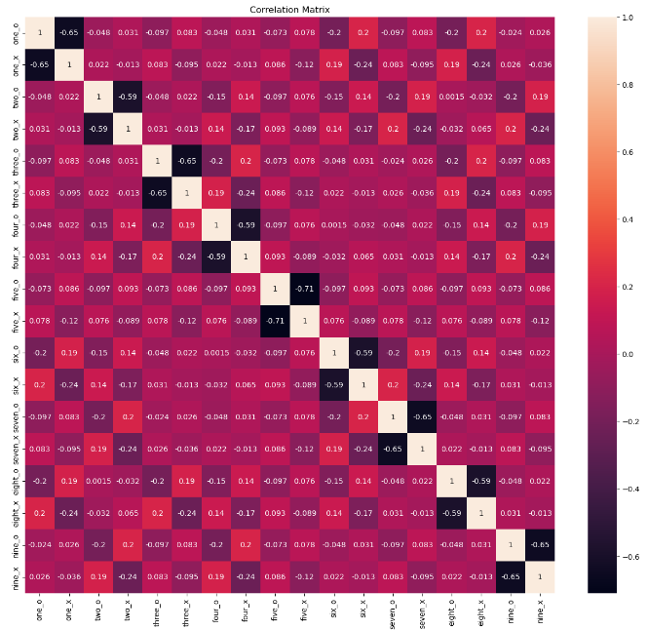
Data Preprocessing
Since all the variables are categorical variables, we used one hot encoding on all the variables to properly analyze the data. This adds extra collinearity due to the nature of one hot encoding. However, the other columns do not have high collinearity as seen on the heat map on the right. Also, since all the attributes are categorical there is no need to do scaling after one hot encoding because all the variables are either 0's or 1's.

Slide 4
Train Test Split
After data preprocessing, we then split the data into training and testing data sets. Training set being 70 percent of all the data so that we can implement different models for classification.

Slide 5
Methods
For this data, the models we used are logistic regression, K nearest neighbor, and Decision Trees.

Slide 6
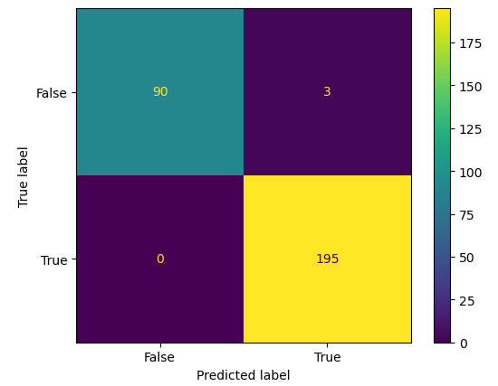
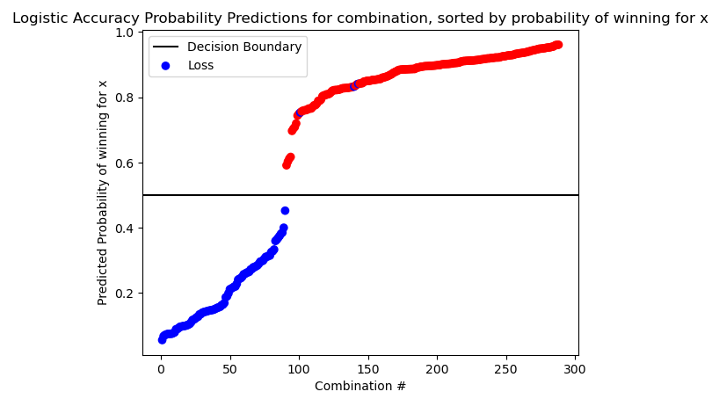
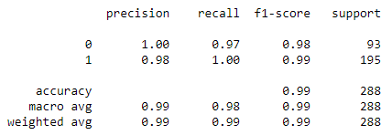
Logistic Regression
The first model we used is logistic regression. The results we have gotten can be seen on the bottom. We only got three false positives and zero false negatives. We can also see the visualization of the model below. This model works very well on the data with a 99 percent accuracy on the testing data set with the model being trained on the training data set. This means that for a new variable, the model will accurately classify it 99 percent of the time.

Slide 7
Results – Logistic Regression
As stated in the slide before, the model is accurate 99 percent of the time. The pros of this model are its simplicity, interpretability, and robustness. However, the cons are that it does not handle outliers well and does not work as well with multicollinearity. Unfortunately, in the data set we chose there are not outliers and there is not much multicollinearity. Even though we did add some multi collinearity with the one hot encoding it was not enough to severely affect the model.

Slide 8
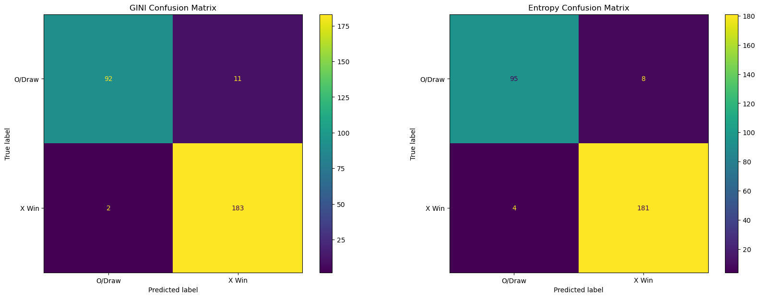
Decision Trees
Another model used was the Decision Tree. The GINI and Entropy criterions were used in two separate Decision Trees and produced similar results. The models were not as accurate as the Logistic Regression model, but the Decision Tree can be visually interpreted much easier than Logistic Regression. There was a slight increase in misclassification for both trees. Both GINI and Entropy trees had an accuracy of 95.9%.

Slide 9
Results – Logistic Regression
Both models average an accuracy score of almost 96%. For this data set it is not as accurate as other of the classification models, however the decision tree is very easy to interpret and understand the logic behind the model. One issue of decision trees is that they are prone to overfitting, however since this data set has all the possible combinations of a Tic-Tac-Toe endgame there is not a high risk of overfitting.

Slide 10
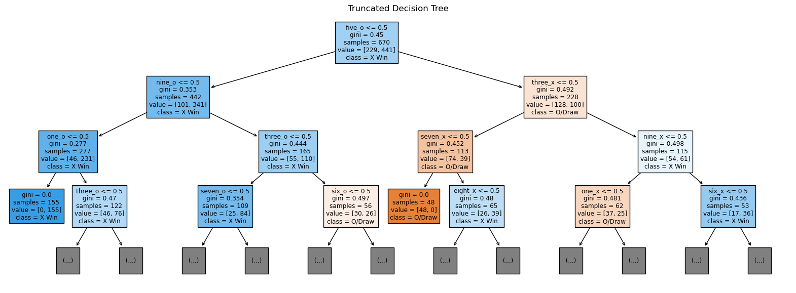
GINI Decision Tree

Slide 11
K nearest Neighbor
The next method we use is K nearest neighbor, First we build the model with k equals two to start with, we obtain a 0.94 accuracy score, then we find out the best k values by trial and error with k range from 1 to 25, with the best we found at 2. But to avoid overfitting we use 5-fold cross validation, and find out the mean score is only 0.78, so we put the model that was cross validated into gridsearchCV to do the Hyperparameter Tuning
And verify that the best k value for this dataset is 2 with 0.944 accuracy score. Out of 384 data, we only have 19 FP and 4 FN.

Slide 12
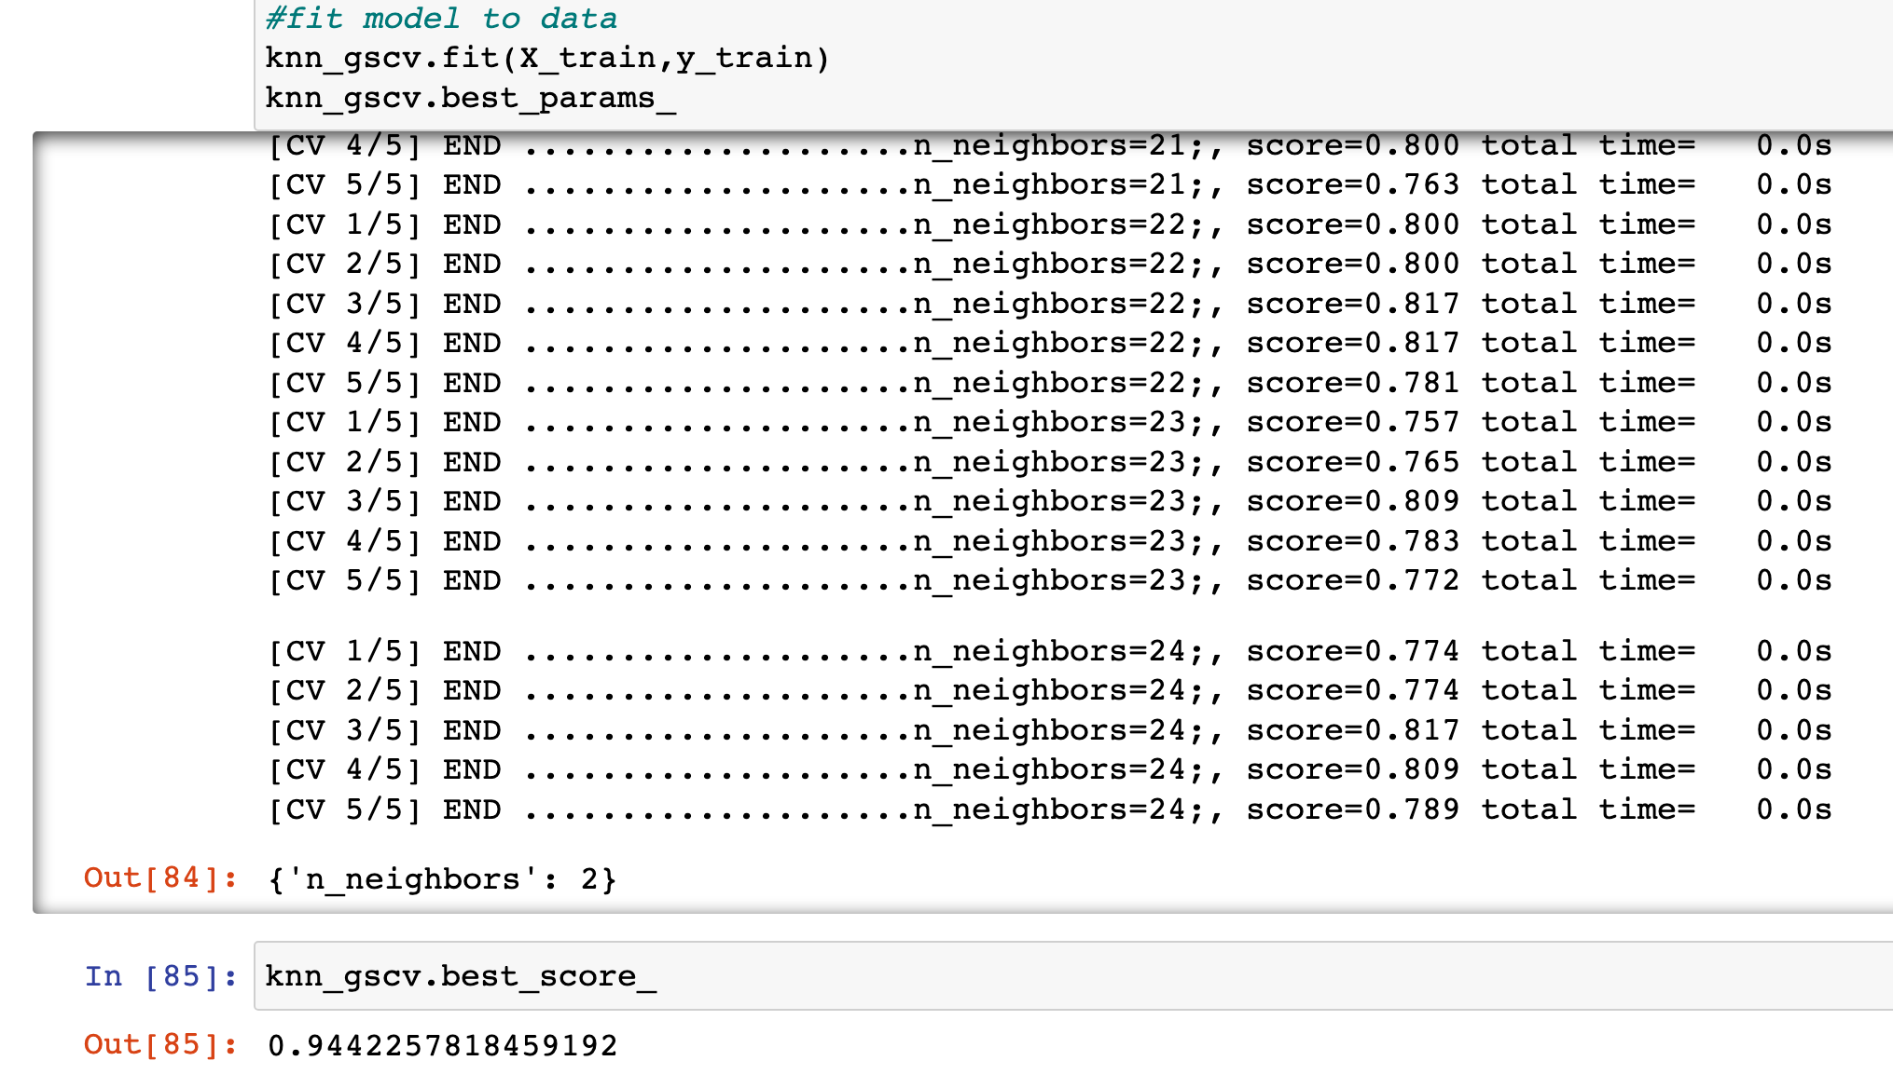
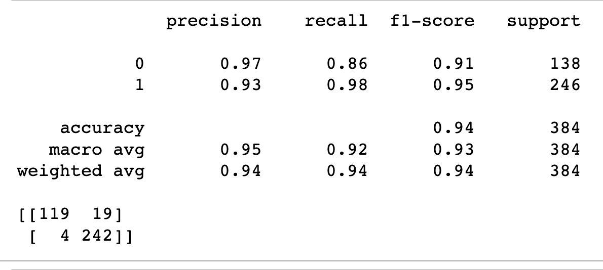

Slide 13
