Slide 1

Elektrický koncept robotizovaného meracieho pracoviska ME-Inspection SK
20. 12. 2020, Version 1.4
Prepared by: Patrik Herčút

Slide 2

Version
Version | Description of change | Person
1.0 | Creation of document | Patrik Herčút
1.1 | Add more PLC options | Patrik Herčút
1.2 | Add ethernet for LLT sensor Change of robot control unit Manageable switch Safety scheme | Patrik Herčút
1.3 | Revision PLC order number Add safety shut down scheme | Patrik Herčút
1.4 | Camera calibration version | Patrik Herčút

Slide 3
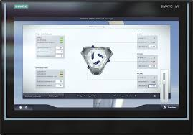
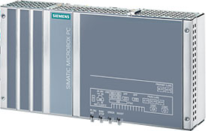
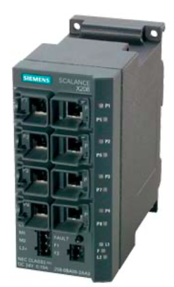
Electrical concept: Main cabinet, TIA portal concept
Plant network
SIMATIC IFP1900 PRO 19”
Flat panel monitor
6AV7466-6MA02-0CS0
SIMATIC IPC427E
64 Bit Version
6AG4141-1AA17-0FA0
Runtime software
Windows 10 IoT Enterprise
SIMATIC WinCC Basic V15.1
Profinet
Ethernet
SCALANCE X208
6GK5208-0BA10-2AA3

Slide 4
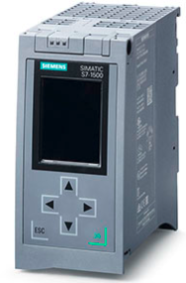
Electrical concept: #Option – HW PLC
1.)
HW PLC CPU 1516F-3 PN/DP
6ES7516-3FN01-0AB0
(PROFIsafe, SIMATIC ProDiag S7-1500, Runtime License(s))
+ no need safety relay
- price
2.)
HW PLC CPU 1516-3 PN/DP
6ES7516-3AN01-0AB0
SIMATIC S7-1500
+ price
- need safety relay

Slide 5
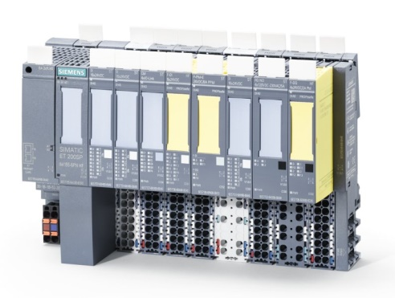
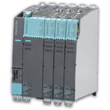
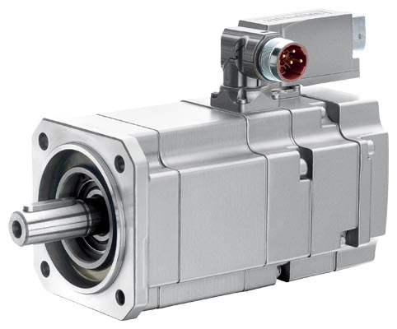
Electrical concept: Rotary table control (Tire testing)
I/O control
ET200SP
Rotary table
Motor control
Sinamics S120
SIMOTICS 3 1FK7042
PN=0.59kW

Slide 6
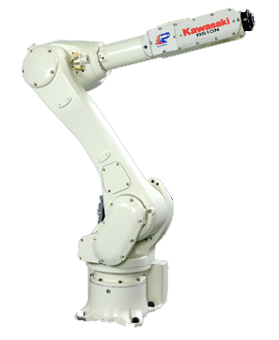
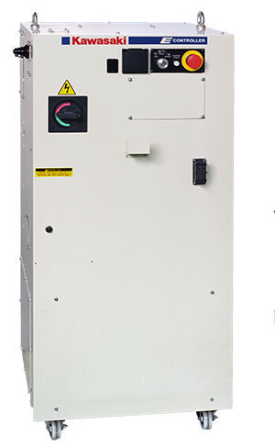
Electrical concept: Robot
LLT
Laser Line Triangulation Sensor
Controller E40
Communication:
Profinet, Ethernet/IP (100BASE-TX), USB, RS-232C
Kawasaki RS010N
Articulated robot
6 axis

Slide 7
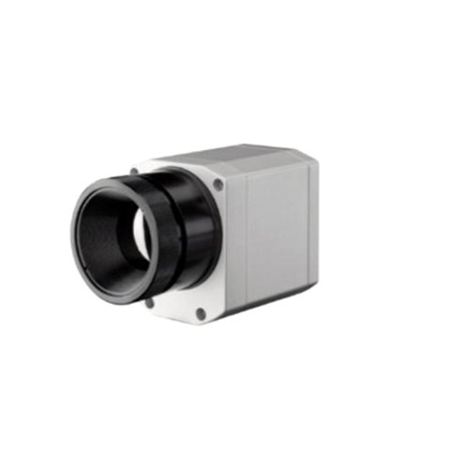

Electrical concept: Robot (Camera calibration)
Camera
for testing
Calibration pattern
fixed position
Controller E40
Communication:
Profinet, Ethernet/IP (100BASE-TX), USB, RS-232C
Kawasaki RS010N
Articulated robot
6 axis

Slide 8
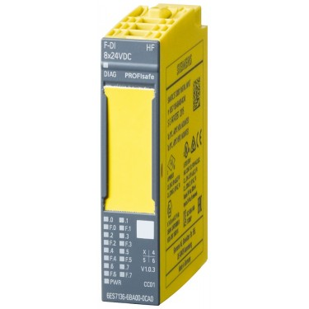
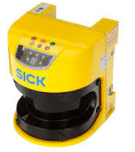
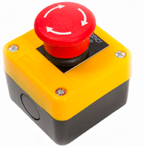
Electrical concept: Safety components safety PLC
SICK
S30A-4011BA
Safety scanner laser
EMERGENCY Stop1
Other safety
devices
F-DI 6ES7
ET200SP module
136-6BA00-0CA0

Slide 9
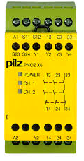
Electrical concept: Safety components without safety PLC
PILZ PONZ X6
Safety relay
SICK
S30A-4011BA
Safety scanner laser
EMERGENCY Stop

Slide 10
Electrical concept: Shut down during safety event
Rotary table
pneumatic pistons
rotation
ect. outputs
Robot
current movement

