Slide 1

Elektrický koncept robotického pracoviska ME-Inspection SK
PM000932
Q345/2019/01
26. 08. 2019, Version 1.0
Prepared by: Marian Sramek

Slide 2

Version
Version | Description of change | Person
1.0 | Creation of document | Marian Sramek

Slide 3
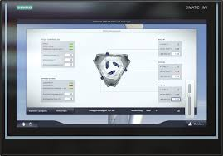
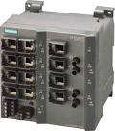
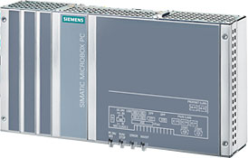
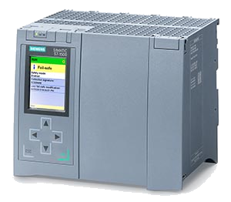
Electrical concept: Main cabinet, TIA portal concept
SIMATIC IFP1900 PRO 19”
Flat panel monitor
(Continental version)
6AV7466-6MA02-0CS0
Remote access / plant network
LCC iPC
Datalogic M410
SIMATIC IPC427E
64 Bit Version
6AG4141-5BG47-0FA0
Profinet
Runtime software
SIMATIC WinCC Runtime Advanced V15
SIMATIC NET PC Software V15 SOFTNET-IE S7
(OPC UA/DA server)
Windows 10 IoT Enterprise
SIMATIC ProDiag for WinCC Runtime Advanced, Controls
HW PLC
CPU 1518F-4 PN/DP
6ES7318-3FL01-0AB0
(PROFIsafe, SIMATIC ProDiag S7-1500, Runtime License(s))

Slide 4
Electrical concept: Option #1 - Main cabinet LCC iPC
Flat Panel IFP1900 PRO
6AV7863-3MA16-1AA0
SIMATIC IPC427E
64 Bit Version
6AG1141-5BG37-4FA0
LCC iPC

Slide 5
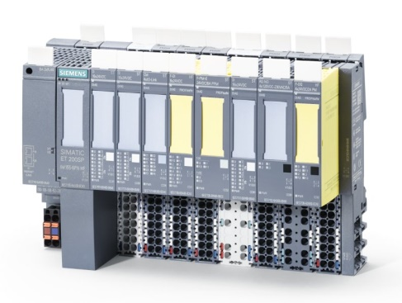
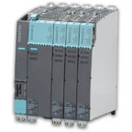
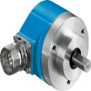
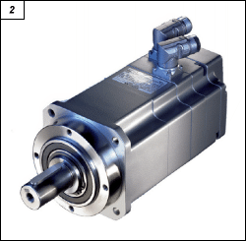
Electrical concept: Main cabinet
ET200SP
Sinamics S120
CH092A-11-1105
Kollmorgen
Spindle motor
1FK7103-2AF71-1BB0
Upper tooling
1FK7080-2AF71-1CG0
Machine conveyor
1FK7034-2AK71-1CA0
Marker conveyor
All origin parts will
be reused
Delivery of new motors and cables. Gears, pulleys, installation and adaption is not part of delivery!

Slide 6
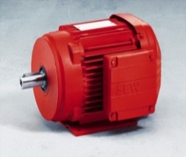
Electrical concept: Main cabinet
ET200SP
All motors, gears, pulleys are not part of delivery! Reused origin ones.
Sinamics S120
Sorter lift
Sorter conveyor
Infeed roller
0,25kW
Contact control
Lubber tire rotation
0,12kW
Lubber tire rotation
0,12kW
Machine conv
Width adjust
0,25kW
All motors, gears, pulleys are not part of delivery! Reused origin ones.

Slide 7
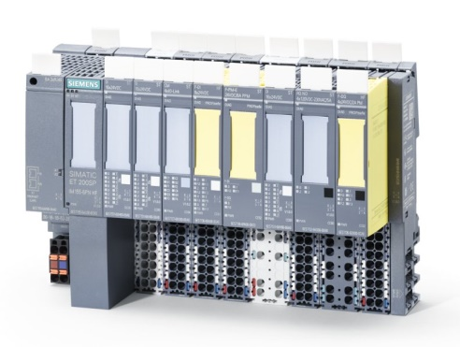
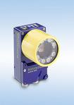
Electrical concept: Lubrification station
ET200SP
Matrix M410
Ethernet
communication
Delivery of plant

Slide 8
Electrical concept: Service, marker conveyor and lift
ET200SP

