Slide 1
PROJECT
Amir Abd-El Zaher, Bauer Patrik, Kovács Kristóf

Slide 2
Content
I. Task Distribution
II. Project manager tool
III. Text Editors
IV. The structure of the code
V. Testing the algorithm
VI. Presentation of the program

Slide 3
I. Task Distribution
Amir: Document Scanner
Patrik: Number Plate Detector
Krissz: Virtual Paint

Slide 4
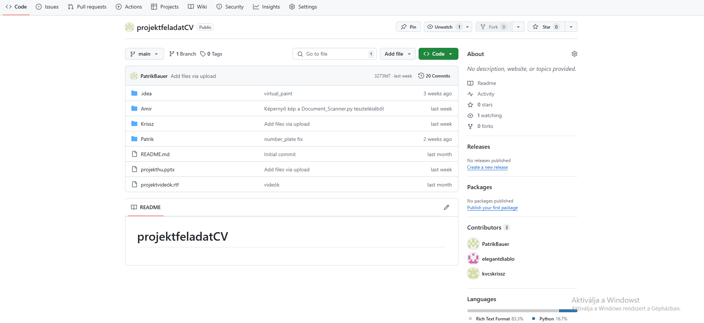
II. Project manager tool
- Github

Slide 5


III. Text Editors
PyCharm Community Edition
Python 3.12

Slide 6
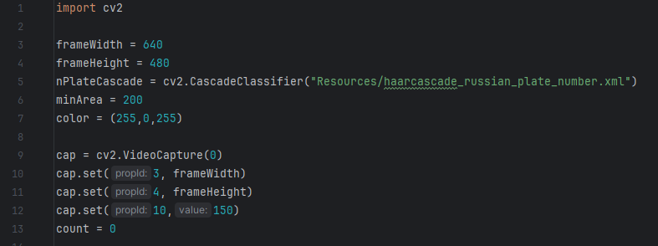
IV./1. The structure of the code: License Plate
cv2: The extension used to obtain computer vision
frameWidth, frameHeight: 640 px wide and 480px tall
The variable „PlateCascade” is going to obtain the model used to recognise the license plate.
cv2.VideoCapture: One of cv2’s methods that saves the data of the image into the „cap” variable.
It sets the image size of the image saved to „cap” with the variables frameWidth and frameHeight.

Slide 7
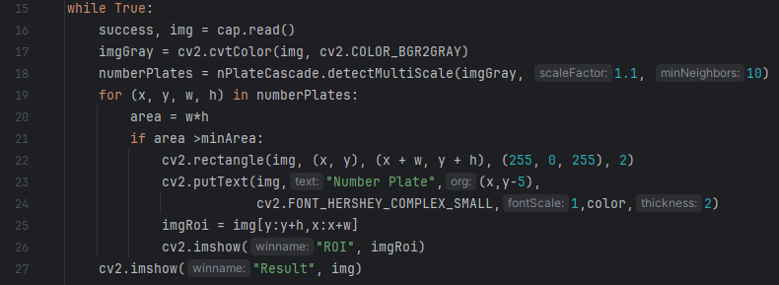
IV./1. The structure of the code: License Plate
The img variable gets the saved image frames from the variable cap
It converts the saturation of the image
It searches the license number in the image using the license plate reader.
The cycle goes through all the license plates, calculates the area, checks if its bigger than the minArea variable
If it’s bigger: it draws a rectangle on the perimeter of the license plate and displays the text „Number Plate”, crops the the license plate number and displays it in another window.
Constantly refreshes the main
window with the processed image

Slide 8
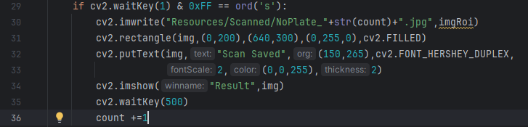
IV./1. The structure of the code: License Plate
Surveys the pressing of the „s” key
On pressing the key, it saves the cropped license plate image and the name contains a timer.
It draws a rectangle around the image and makes it the background of the displayed text.
Displays wether the image has been saved or not.
Refreshes the image.
Increases the timer, so that the next image can get another number.

Slide 9
V./1. Testing the algorithm : License Plate
Testing opportunities:
License plate reading
license plate reading upside down
license plate reading while the image is inverted
license plate reading while the image is rotated

Slide 10
VI./1. Presetnation of the program: Number Plate

Slide 11
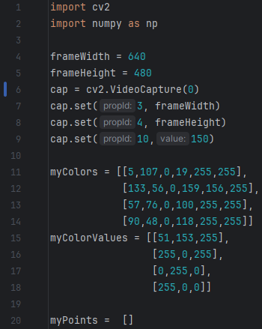
IV./2. The structure of the code : Virtual Paint
cv2, np: used packages for computer vision and calculations
cv2.VideoCapture: One of cv2’s methods that saves the data of the image into the „cap” variable.
myColors: It contains a list about the HSV color parameters which the program will try to find in the image
myColorValues: It assigns RGB colors to the color parameters
myPoints: Later it will store the detected points

Slide 12
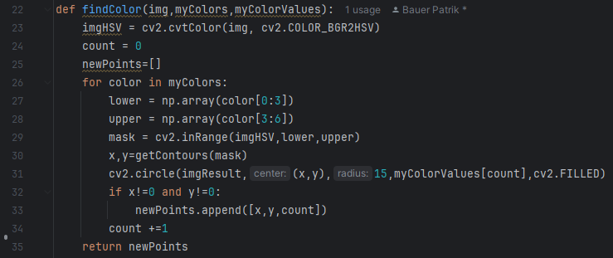
IV./2. The structure of the code : Virtual Paint
findColor: It identifies certain points using the given colors from an image, then returns it
It converts the original image into HSV parameters
The for cycle goes thrrough the list and produces the upper and lower borders of the image
mask: A binary mask in which the given pixels are white, while the rest are black
getContours: searches for the central point of the biggest contour
Draws a 15 pixel circle
If x and y are not zero, it appends it to the list of new points.
Returns the points.

Slide 13
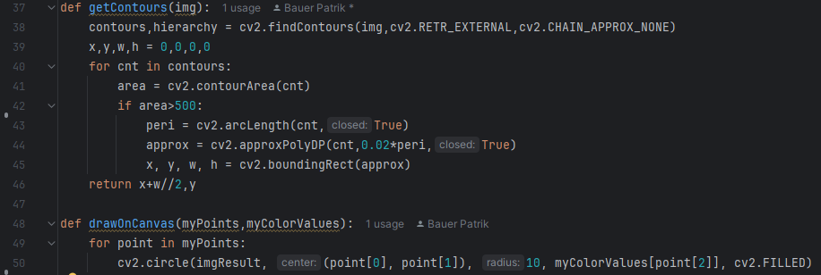
IV./2. The structure of the code : Virtual Paint
It finds the object in the image and only takes the outer contours into consideration
The for cycles goes through the contour, then it calculates the area
It only takes the ones bigger than 500 pixels into consideration.
Determines the rectangle around the contour and reads 4 values
Returns the center point of the
rectangle
It displays the points previously found onto a single image
It draws 10 pixel circles and colors it using the appropriate colors.

Slide 14
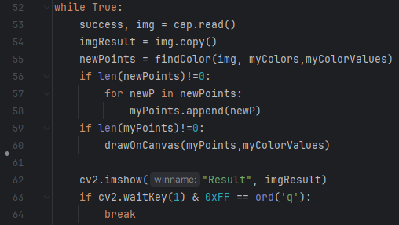
IV./2. The structure of the code : Virtual Paint
Infinite while cycle which constantly reads the camera image, processes it and displays the final product
findColor: Finds the colors previously given and determines the coordinates
If there’s a new point, it appends it to the myPoints list.
If there’s a point, it displays it
It displays the current image ina window
Surveys the key „Q”. Upon pressing it, it exits the program.

Slide 15
V./2. Testing the algorithm : Virtual Paint
Testing Opportunities:
Testing with different colors

Slide 16
VI./2. Presentation of the program: Virtual Paint

Slide 17
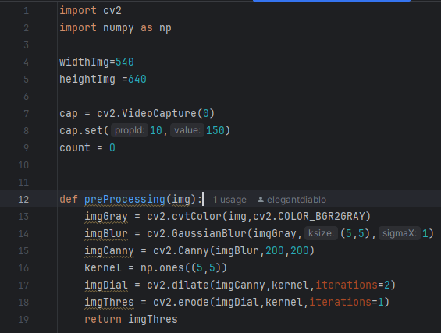
IV./3. The structure of the code : Document Scanner
cv2, np: Exentension used for computer vision and calculations
cv2.VideoCapture: One of cv2’s methods that saves the data of the image into the „cap” variable.
preProcessing: Applies different types of transformations and filters to the image
Saturation, image sharpness, edge detection, edge highlighting and edge refining.
Returns the processed image

Slide 18
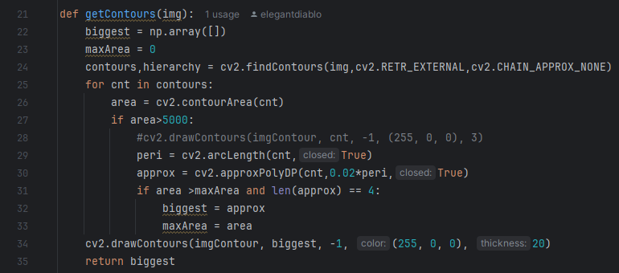
IV./3. The structure of the code: Document Scanner
It searches for contours in the image and chooses the biggest quadrilateral shaped object it finds
Searches for the outer contours
It only takes into consideration images bigger than 5000 pixels,calculates the area and simplifies the shape.
If it’s bigger than the previous rectangle shape than it will save it
It displays it with the given color
Returns the coordinates

Slide 19
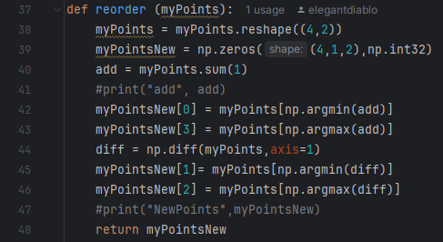
IV./3. The structure of the code: Document Scanner
It arranges coordinate sets containing 4 different coordinates in a logical order
Its purpose: bal felső, jobb felső, bal alsó, jobb alsó sorrendbe állítani a pontokat To arrange the points into the order upper left, upper right, lower left and lower right .
Returns the coordinates

Slide 20
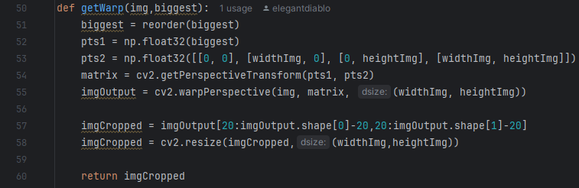
IV./3. The structure of the code: Document Scanner
creates a straight-view version from an image using a perspective transformation
It arranges the 4 corner points in a logical sequence
it fits the image into a rectangle using new corner coordinates
The matrix displays the distorted image in a clear way
It cuts 20 pixels off the edge of the image
It resizes the image to the previously given size
Returns the streamlined picture

Slide 21
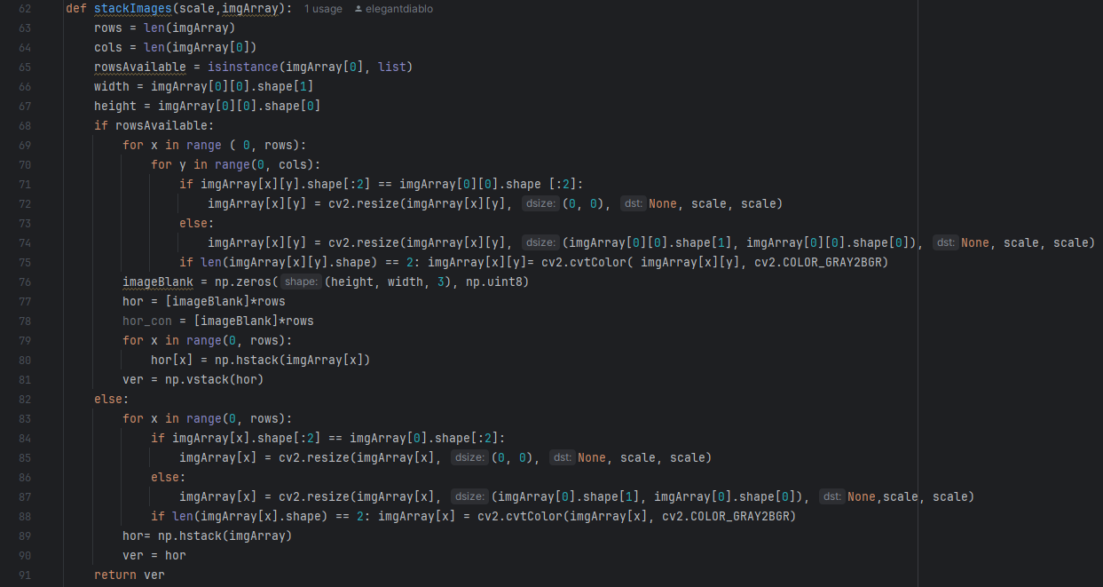
IV./3. The structure of the code: Document Scanner
A function that puts images next to each other
It rearranges the images proportionally and arranges them as a single image

Slide 22
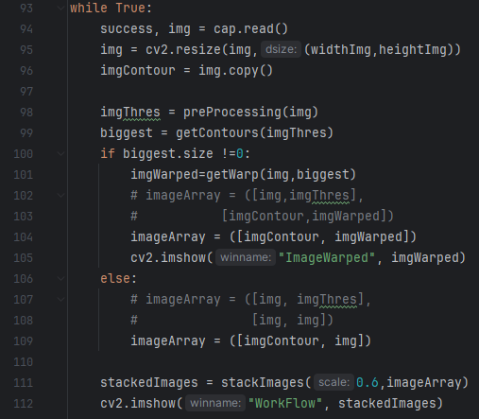
IV./3. The structure of the code : Document Scanner
executes a real time image processing
resizes to the given size
creates a copy
preprocessing
search for the biggest contour
Perspective correction
Compilation of images
displaying

Slide 23
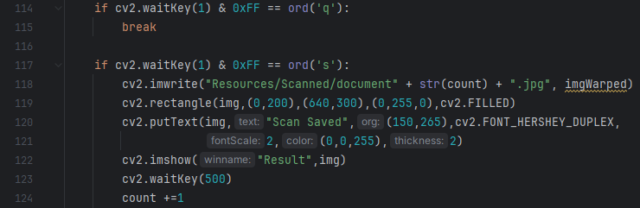
IV./3. The structure of the code: Document Scanner
Uppon pressing the „q” key, the program terminates the cycle
Uppon pressing the „s” key, the program saves the current image
Displays a green rectangle, displays the text „Scan Saved”, shows the saved image in a different window

Slide 24
V./3. Testing the algorithm : Document Scanner
Testing opportunities:
document reading
document reading while the picture is upside down
document reading while the picture is inverted
document reading while the picture is rotated.

Slide 25
VI./3. Presentation of the program : Document Scanner

Slide 26
Thank you for the attention!

