Slide 1

Research Industry: Healthcare
By: Patrick Ha

Slide 2
About
Healthcare has one crucial business process which is financial. In 2020, the U.S. spent 4.1 trillion dollars 19.7% of gross domestic product on Healthcare (Laffer et al., pg. 5).
A study found that the average U.S. hospital prices are 247% of the rate Medicare pays.
Notes:
Shows that the US is spending almost 20% of its GDP for healthcare. Hospital prices are paid higher.

Slide 3
Focus Question 1) How to reduce time for contacting doctors between doctors and patient by implementing mobile software to reduce wait time?
Implementing a mobile app to facilitate a faster and safer way to contact healthcare personnel, thereby looking into which methods would be best on how to get in contact with a healthcare personnel.

Slide 4
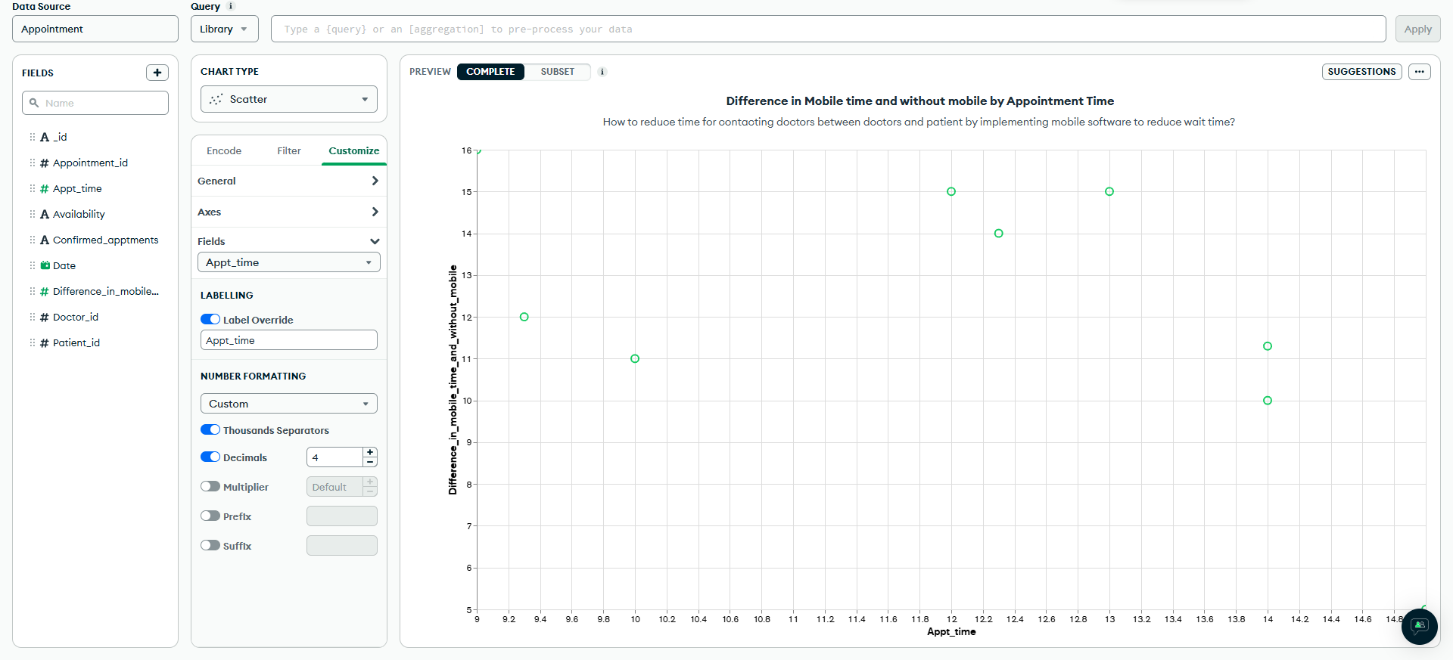

Slide 5


Slide 6
Focus Question 2: How do we lower the prescription drugs prices by making a deal between insurance and markets for patients to pay lower drug prices?
Implementing a computer software to easier keep track of prescription drugs' prices including input fields for users to add the market price of the drug, the price it cost to make the drug, and a notes field.

Slide 7
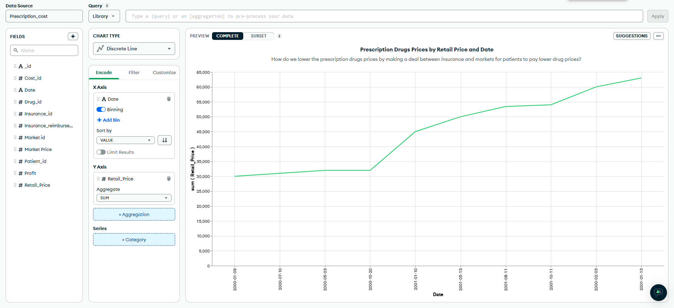

Slide 8


Slide 9
Focus Question 3) How to reduce overall health expenditures between health sectors by using software to reduce health costs for the country?
Developing an AI data gathering software to easily search for health sectors that are contributing to the healthcare costs and convenient way to analyze the data by including automated queries and automated data gathering.

Slide 10
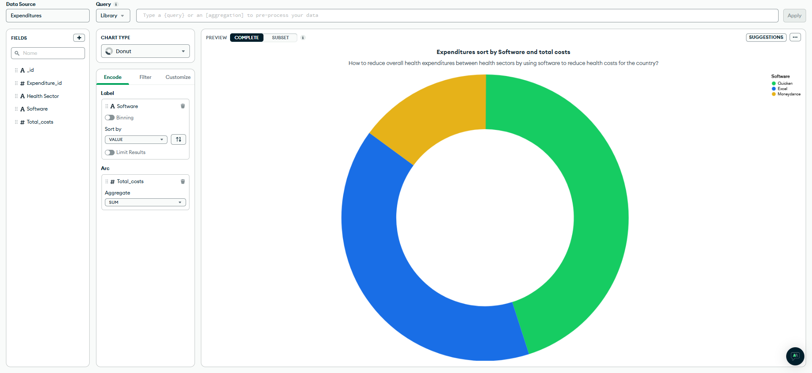

Slide 11


Slide 12
Focus Question 4: Which health sectors give patients the most accurate price transparency?
Developing a software application to easily gather data and convenient analyzation of price transparency including features such as input data, upload images, and input notes.

Slide 13
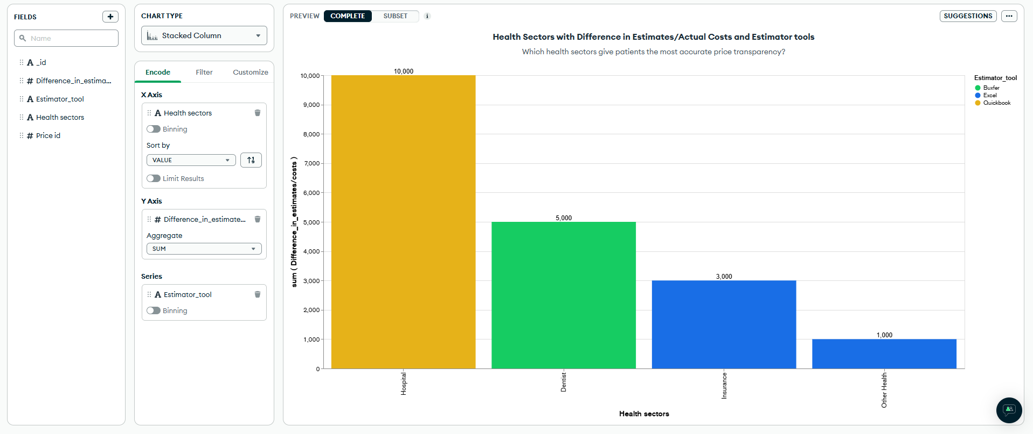

Slide 14


Slide 15
References
Amalia, R., Susanti, A. (2020). Transforming healthcare: user-friendly digital health technologies in the era of Society 5.0, Journal of the Neurological Sciences, (Vol. 463).
https://doi.org/10.1016/j.jns.2024.123171. (https://www.sciencedirect.com/science/article/pii/S0022510X2400306X)
Hsiao, W. C. (2020). How to fix american health care: what other countries can--and can’t--teach the united states. Foreign affairs, 99(1), 96–106. https://research.ebsco.com/c/lua7fp/viewer/pdf/sbnyfbvwf5
Laffer, A. B., Van Horn, L., & Fisher, C. A. (2022). Employers can revolutionize american healthcare and accelerate economic growth by embracing price transparency. The Independent Review, 27(1), 5–22. https://www.jstor.org/stable/48736361

