Slide 1
MSB7215 | MACHINE LEARNING IN BIOMEDICINE
Blood Smear Sickle Cell
Classification
Classical Machine Learning with HOG Feature Extraction
Applied to Ugandan Clinical Microscopy Data
Okidi Patrovas Gabriel | 2025/HD07/26020U | Makerere University, Kampala, Uganda
github.com/Patro331/blood-smear-sickle-cell-classification
Notes:
30 sec. Introduce yourself, the project title, and institution.

Slide 2
Background
Sickle cell disease (SCD) is a hereditary blood disorder caused by a mutation in the HBB gene. Under low oxygen conditions, the mutated haemoglobin S causes red blood cells to deform into a rigid, crescent shape — blocking blood vessels and damaging organs over time.
13.3%
19.8%
20,000+
Sickle cell trait
prevalence nationally
Prevalence in
Kampala alone
Children born with
SCD per year in Uganda
Despite this burden, diagnosis depends on haemoglobin electrophoresis and manual microscopic examination — both requiring specialist laboratory infrastructure that is largely absent outside Uganda's major urban hospitals. Children in rural areas frequently go undiagnosed for years, missing early prophylactic treatment that prevents life-threatening crises.
Notes:
1.5 min. Set the scene — what is sickle cell disease, why Uganda, what is the current diagnostic reality.

Slide 3
Related Work
2005
Dalal & Triggs
Introduced HOG features for shape-based image recognition. Established the foundation for hand-crafted gradient features used in classical computer vision.
2017
Esteva et al.
Demonstrated deep learning achieving dermatologist-level accuracy for skin cancer classification — a landmark study establishing DL viability in medical imaging.
2018
Poostchi et al.
Reviewed machine learning approaches for malaria parasite detection in blood smears and validated mobile-phone microscopy as a feasible imaging platform for automated analysis.
2020
Acevedo et al.
Published a benchmark dataset of 17,092 annotated peripheral blood cell images and demonstrated automated classification across eight cell types using deep learning.
2026
Okidi Patrovas Gabriel
Applied deep learning (ResNet-50, EfficientNet-B0) to the Tushabe (2024) Ugandan clinical dataset to detect sickle cell disease from blood smear images taken using phone miscroscope , achieving 98.57% accuracy — the first deep learning study on this dataset.
Notes:
1.5 min. Walk through what has been done. Foundation studies first, then more recent work. Be brief on each.

Slide 4
Problem Statement
Sickle cell disease remains largely undiagnosed in rural Uganda because current diagnostic methods require trained laboratory personnel and specialist equipment that most district health facilities do not have. Community health workers lack the tools to identify affected patients at the point of care, delaying treatment and contributing to preventable morbidity and mortality among children who could otherwise be managed effectively with early intervention.
Notes:
1 min. Read the statement clearly and deliberately. Pause after it. Let it land.

Slide 5
Research Gap
→
All prior sickle cell detection studies used datasets collected under controlled laboratory conditions in high-income countries — none used mobile-phone microscopy from real Ugandan clinical settings.
→
No classical machine learning study had been applied to the Tushabe et al. (2024) dataset — the only published blood smear dataset collected from Ugandan patients.
→
It remains unknown whether classical ML, which requires no GPU infrastructure, can produce clinically useful results on this task — a critical question for deployment in resource-limited Ugandan health facilities.
→
No study had directly compared classical ML and deep learning performance on the same Ugandan clinical microscopy dataset.
Notes:
1 min. This is the pivot slide. Everything before led here. Speak confidently about what had not been done.

Slide 6
Research Objectives
Main Objective
To develop an automated sickle cell detection system from peripheral blood smear images captured using mobile phone cameras on basic microscopes, enabling non-specialist health workers in rural Ugandan settings to screen patients without laboratory expertise.
Specific Objectives
1.
Extract numerical features from blood smear images using HOG feature extraction to create a tabular features matrix suitable for classical ML
2.
Train and evaluate SVM and Random Forest classifiers following standard supervised learning practice including preprocessing pipelines and cross-validation
3.
Optimise both models using GridSearchCV and analyse overfitting through training versus test accuracy comparison
4.
Compare classical ML performance against deep learning models from a prior study on the same dataset
5.
Assess the viability of classical ML as a low-resource alternative to deep learning for sickle cell screening in Uganda
Notes:
1 min. Read each objective clearly. The first is the clinical one — emphasise it.

Slide 7
Dataset
Primary Dataset — Positive Class
Tushabe et al. (2024) Ugandan Sickle Cell Microscopy Dataset. Blood smear images collected from patients in Soroti and Kumi districts, Uganda, using mobile phone cameras placed on the eyepiece of basic optical microscopes. Published in Acta Scientific Microbiology, Vol. 7, Issue 12.
https://www.kaggle.com/datasets/florencetushabe/sickle-cell-disease-dataset
Supplementary Dataset — Normal Class
BCCD Dataset (Shenggan et al.). 364 normal peripheral blood smear images captured under controlled laboratory conditions. MIT licence — freely usable for research.
https://github.com/Shenggan/BCCD_Dataset
Data Challenges Encountered
Mendeley dataset replaced — found to contain white blood cells, not red blood cell smear images. 422 labelled Tushabe images excluded — bounding box annotations were burned directly into the image pixels.
Notes:
1.5 min. Describe both datasets. Tell the story of the two data challenges.

Slide 8
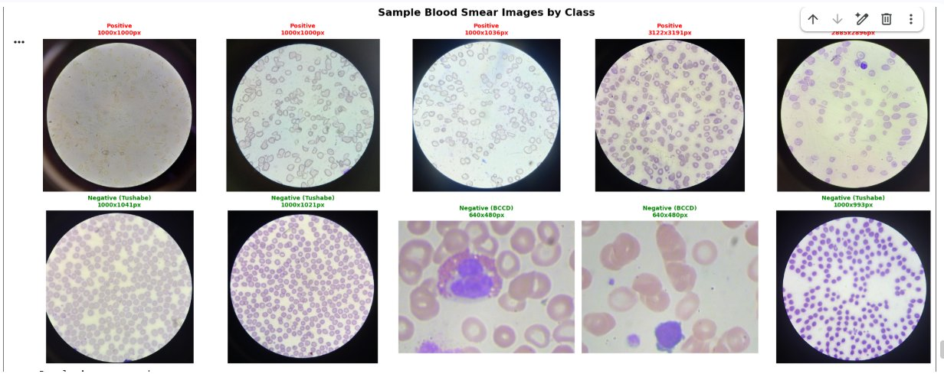
Dataset — Sample Blood Smear Images
Top row: Positive (sickle cell) images — elongated crescent-shaped cells visible within circular microscope field. Bottom row: Negative images — Tushabe normal smears (circular border) and BCCD laboratory images (rectangular).
Notes:
1 min. Let the images speak. Point out the circular border, the elongated cells in positive images, the difference between Tushabe and BCCD negative images.

Slide 9
Dataset — Composition and Split
Source
Class
Images
Camera Type
Tushabe (2024) — unlabelled
Positive
422
Mobile phone microscope
Tushabe (2024)
Negative
147
Mobile phone microscope
BCCD Dataset
Negative
364
Laboratory camera
Total
Both
933
Mixed
Train / Validation / Test Split
Training: 746 images (80%)
Test: 187 images (20%)
Stratified split — class proportions preserved in both sets. Mild class imbalance of 1.21:1 addressed using class_weight=balanced.
Notes:
30 sec. Quick numbers. Class distribution, split, and domain gap note.

Slide 10
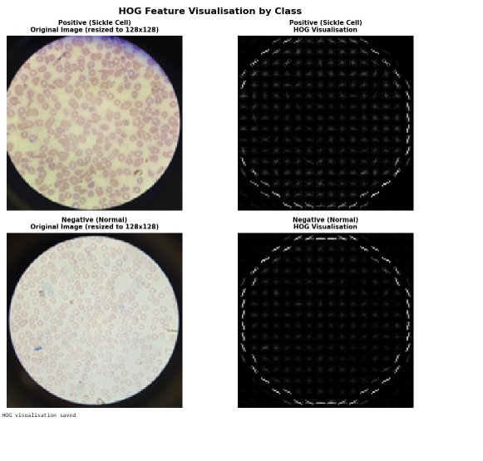
Methodology — Feature Extraction
From Image to Features Matrix
Classical machine learning requires a numerical features matrix as input — raw images cannot be fed directly. Each image was resized to 128×128 pixels and converted to grayscale before Histogram of Oriented Gradients (HOG) extraction, which captures the distribution of edge orientations across local image regions. Each image produces a fixed vector of 8,100 numerical values representing the shape and texture of the cells visible in the smear.
HOG representation of positive and negative images
Preprocessing Pipeline
The train-test split was applied before fitting the StandardScaler to prevent data leakage. The scaler was fitted on training data only and used to transform both training and test sets, standardising all 8,100 features to zero mean and unit variance.
Notes:
1.5 min. Explain HOG visually — show the image. Then explain the pipeline steps briefly.

Slide 11
Methodology — Classifiers
Support Vector Machine (SVM)
SVM finds the optimal decision boundary separating the two classes with maximum margin in the 8,100-dimensional feature space. The RBF kernel maps features into a higher-dimensional space to handle non-linear boundaries. class_weight=balanced was set to address the class imbalance. GridSearchCV tuned C (0.1, 1, 10, 100), kernel (rbf, linear), and gamma (scale, auto) using 5-fold cross-validation with F1 scoring.
Random Forest
Random Forest builds multiple decision trees on random subsets of the training data and features, then combines predictions by majority vote. This ensemble approach reduces the variance of individual trees. class_weight=balanced was used. GridSearchCV tuned n_estimators (100, 200), max_depth (10, 20, None), min_samples_split (2, 5, 10), and min_samples_leaf (1, 2).
Evaluation
Accuracy, AUC-ROC, F1 score, sensitivity, specificity, and precision. Overfitting assessed through training vs test accuracy gap and 5-fold cross-validation.
Notes:
1 min. Describe each classifier briefly. Do not go deep into maths. Explain GridSearchCV as the optimisation tool.

Slide 12
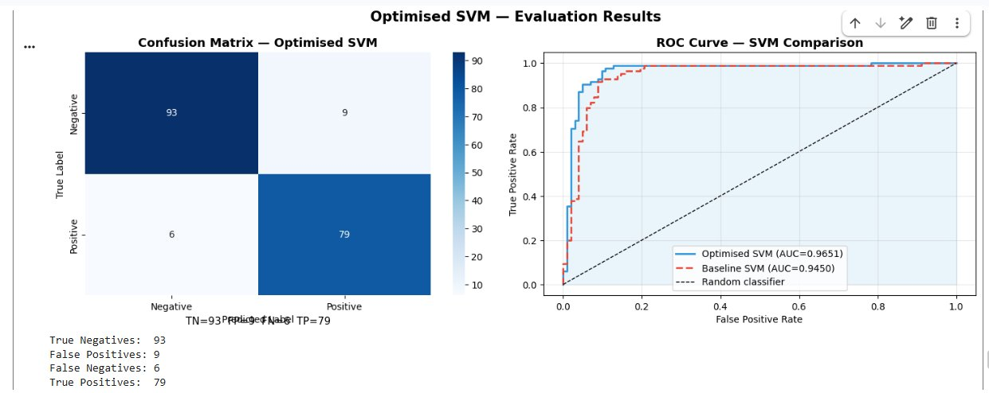
Results — Support Vector Machine
Optimised Parameters: C=10, kernel=RBF, gamma=scale
Test Accuracy
91.98%
AUC-ROC
0.9651
Sensitivity
92.94%
Specificity
91.18%
F1 Score
0.9133
Total Errors
15 / 187
Overfitting check: Training accuracy 100.0% | Test accuracy 91.98% | Gap 8.02% | CV mean 85.12%
Notes:
1.5 min. Walk through the SVM numbers. Point out the confusion matrix — 15 errors. Mention the mild overfitting gap.

Slide 13
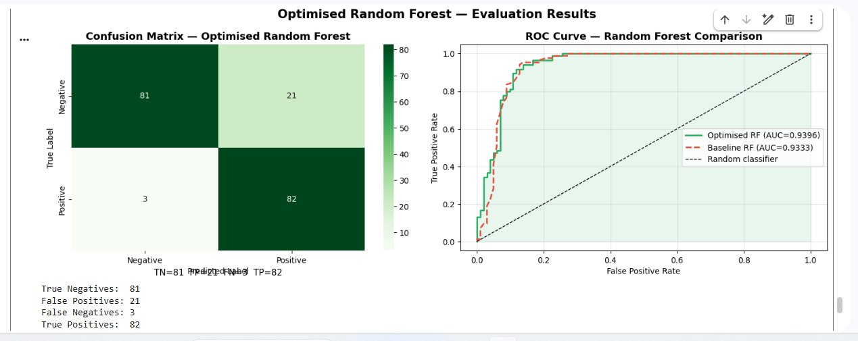
Results — Random Forest
Optimised Parameters: max_depth=20, min_samples_split=5, n_estimators=200
Test Accuracy
87.17%
AUC-ROC
0.9396
Sensitivity
96.47% ★ highest
Specificity
79.41%
F1 Score
0.8723
Total Errors
24 / 187
Overfitting check: Training accuracy 100.0% | Test accuracy 87.17% | Gap 12.83% | CV mean 85.12%
Notes:
1.5 min. Walk through RF results. Point out higher sensitivity vs SVM. Acknowledge the larger overfitting gap.

Slide 14
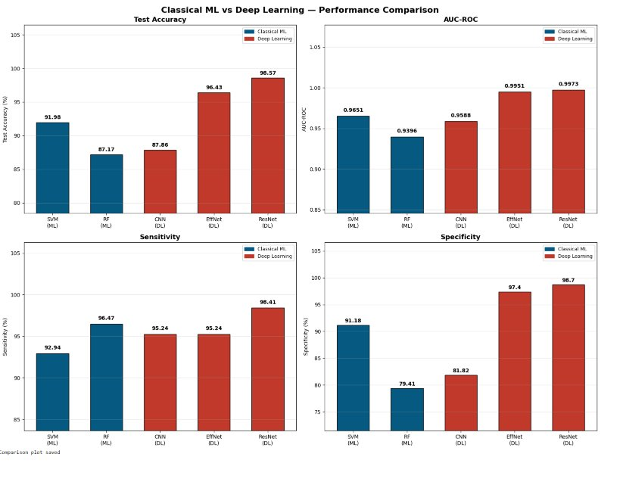
Results — Classical ML vs Deep Learning
Model
Type
Accuracy
AUC-ROC
Sensitivity
SVM
Classical ML
91.98%
0.9651
92.94%
Random Forest
Classical ML
87.17%
0.9396
96.47% ★
Baseline CNN †
Deep Learning
87.86%
0.9588
95.24%
EfficientNet-B0 †
Deep Learning
96.43%
0.9951
95.24%
ResNet-50 †
Deep Learning
98.57% ★
0.9973 ★
98.41% ★
† Results from prior deep learning study: github.com/Patro331/sickle-cell-detection
Notes:
2 min. This is the key slide. Walk through the table. Then point to the comparison chart. Deep learning wins overall. Classical ML remains viable without GPU.

Slide 15
Conclusion
1. First classical ML study applied to the Tushabe (2024) Ugandan clinical mobile-phone microscopy dataset
2. SVM achieves 91.98% accuracy and AUC-ROC of 0.9651 — clinically useful results without GPU infrastructure
3. Random Forest achieves the highest sensitivity of 96.47% — fewest missed sickle cell cases
4. Deep learning (ResNet-50, 98.57%) significantly outperforms classical ML and should be preferred where GPU is available
5. Where GPU infrastructure is absent, SVM with HOG features offers a deployable, low-resource screening tool for rural Uganda
Notes:
1 min. Five clear points. State the novelty first. End with the practical takeaway for Uganda.

Slide 16
Thank You
Questions?
github.com/Patro331/blood-smear-sickle-cell-classification
Research Paper: reports/Sickle_Cell_ML_Paper.pdf
Okidi Patrovas Gaabriel | 2025/HD07/26020U | Makerere University
Notes:
30 sec. Thank you. Pause. Invite questions.

