Slide 1
MSB7216 | DEEP LEARNING FOR HEALTH DATA
Deep Learning for Automated
Sickle Cell Detection
An Explainable Approach Using African Clinical Microscopy Data
Okidi Patrovas Gabriel | 2025/HD07/26020U | Makerere University, Kampala, Uganda
github.com/Patro331/sickle-cell-detection | huggingface.co/spaces/Patrovas/sickle-cell-detection
Notes:
30 sec. Introduce yourself and the project.

Slide 2
Background
Sickle cell disease (SCD) is a hereditary blood disorder caused by a mutation in the HBB gene. Under low oxygen conditions, the mutated haemoglobin S causes red blood cells to deform into a rigid crescent shape, blocking blood vessels and causing progressive organ damage over time (Piel et al., 2013).
13.3%
19.8%
20,000+
Sickle cell trait
prevalence nationally
Prevalence in
Kampala alone
Children born with
SCD per year in Uganda
(Tushabe et al., 2024)
(Tushabe et al., 2024)
(Tushabe et al., 2024)
Current diagnosis depends on haemoglobin electrophoresis and manual microscopic examination — both requiring specialist laboratory infrastructure absent from most rural Ugandan district hospitals (Tushabe et al., 2024). Children in rural areas frequently go undiagnosed for years, missing early prophylactic treatment that prevents life-threatening crises (WHO, 2023).
Notes:
1.5 min. Set the clinical scene. Statistics first, then the human cost.

Slide 3
Related Work
2017
Esteva et al.
Demonstrated deep learning achieving dermatologist-level accuracy for skin cancer classification — establishing DL viability in medical imaging.
2018
Poostchi et al.
Reviewed automated image analysis approaches for malaria parasite detection in blood smears and validated mobile-phone microscopy as a feasible imaging platform for deep learning.
2020
Acevedo et al.
Published 17,092 annotated peripheral blood cell images and demonstrated automated classification across eight cell types using deep learning.
2026
Okidi Patrovas Gabriel — This Study
First deep learning study to detect sickle cell disease from the Tushabe (2024) dataset — the only sickle cell images collected from Ugandan patients using mobile phone microscopes under real clinical conditions. ResNet-50 achieved 98.57% accuracy.
Notes:
1.5 min. Walk through what has been done. Foundation first, then recent work.

Slide 4
Research Gap
→
All prior sickle cell detection studies used datasets from controlled laboratory settings in high-income countries — none used mobile-phone microscopy from real Ugandan clinical settings.
→
No deep learning study had been applied to the Tushabe et al. (2024) dataset — the only published sickle cell blood smear dataset collected from Ugandan patients.
→
No study had used Grad-CAM explainability to verify that a sickle cell model attends to genuine cell morphology rather than imaging artefacts.
→
No deployed screening tool existed for non-specialist health workers in low-resource African settings using mobile-phone microscopy.
Notes:
1 min. Four clear gaps. Speak confidently — these are genuine missing pieces.

Slide 5
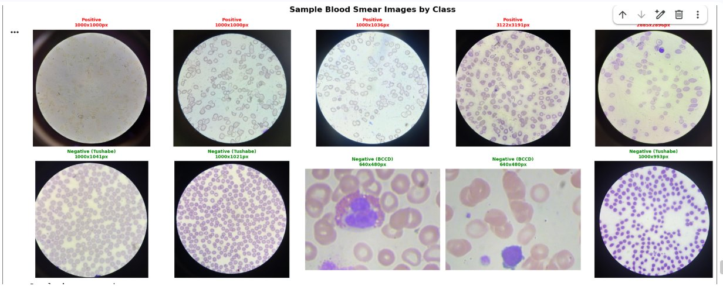
Problem Statement
Sickle cell disease remains largely undiagnosed in rural Uganda because current diagnostic methods require trained laboratory personnel and specialist equipment that most district health facilities do not have. Community health workers lack the tools to identify affected patients at the point of care, delaying treatment and contributing to preventable morbidity and mortality among children who could otherwise be managed effectively with early intervention.
Notes:
30 sec. Read it slowly and clearly. Pause after it. Let it land.

Slide 6
Research Objectives
Main Objective
To develop an automated, explainable sickle cell detection system from peripheral blood smear images captured using mobile phone cameras on basic microscopes, enabling early identification of sickle cell disease in rural Ugandan health settings.
Specific Objectives
1.
Develop and evaluate a baseline CNN trained from scratch as a performance floor
2.
Apply transfer learning using EfficientNet-B0 and ResNet-50 pretrained on ImageNet
3.
Compare frozen versus unfrozen backbone strategies across both transfer learning models
4.
Apply Grad-CAM explainability to verify model decisions are biologically meaningful
5.
Deploy the best model as a Gradio application accessible to non-specialist health workers
Notes:
1 min. Main objective first — it is clinical. Specific objectives are technical.

Slide 7
Dataset
Primary Dataset — Positive Class
Tushabe et al. (2024) Ugandan Sickle Cell Microscopy Dataset. Blood smear images collected from patients in Soroti and Kumi districts, Uganda, using mobile phone cameras placed on basic optical microscopes. Published in Acta Scientific Microbiology, Vol. 7, Issue 12.
https://www.kaggle.com/datasets/florencetushabe/sickle-cell-disease-dataset
Supplementary Dataset — Normal Class
BCCD Dataset (Shenggan et al.). 364 normal peripheral blood smear images captured under controlled laboratory conditions. MIT licence — freely usable for research.
https://github.com/Shenggan/BCCD_Dataset
Data Challenges
Mendeley dataset replaced — found to contain white blood cells, not red blood cell smear images. 422 labelled Tushabe images excluded — bounding box annotations burned directly into image pixels, which would cause the model to learn artefacts rather than cell morphology.
Notes:
1.5 min. Describe both datasets. Tell the data challenge story honestly.

Slide 8
Dataset — Sample Blood Smear Images
Figure 1. Sample peripheral blood smear images. Top row: positive (sickle cell) images showing elongated crescent-shaped cells within the circular mobile phone microscope field. Bottom row: negative (normal) images — Tushabe Uganda samples (circular border) and BCCD laboratory images (rectangular format). Source: Tushabe et al. (2024) and Shenggan et al.
Notes:
1 min. Let the images speak. Point out the circular border and the cell morphology difference.

Slide 9
Dataset — Composition and Split
Source
Class
Images
Camera Type
Tushabe (2024) — unlabelled
Positive
422
Mobile phone microscope
Tushabe (2024) — labelled
Positive
422 excluded
Burned-in annotations
Tushabe (2024)
Negative
147
Mobile phone microscope
BCCD Dataset
Negative
364
Laboratory camera
Total used
Both
933
Mixed
Train / Validation / Test Split
653 training images (70%) | 140 validation images (15%) | 140 test images (15%) | Stratified split — class proportions preserved across all three sets.
Class imbalance addressed using WeightedRandomSampler and weighted BCEWithLogitsLoss (pos_weight = 1.2061).
Notes:
30 sec. Quick numbers — 933 images, split, class distribution.

Slide 10
Methodology — Model Architecture
Three architectures were developed in sequence, each building on the lessons of the previous.
01 Baseline CNN
02 EfficientNet-B0
03 ResNet-50
Trained from scratch
Transfer learning
Transfer learning ★ Best
• 3 convolutional blocks
• Pretrained on ImageNet
• Pretrained on ImageNet
• 25.8M parameters
• 4.0M parameters
• 23.5M parameters
• No pretrained knowledge
• Compound scaling design
• Residual connections
• Establishes the performance floor
• Unfrozen fine-tuning
• 98.57% accuracy
Why transfer learning? Only 653 training images — pretrained ImageNet features bridge the data scarcity gap and eliminate the need to learn visual representations from scratch.
Notes:
1.5 min. Three models in sequence. Explain why transfer learning is necessary on 653 images.

Slide 11
Methodology — Training Configuration
Preprocessing
All images resized to 224×224 pixels and normalised using ImageNet mean and standard deviation. Augmentation applied to training set only: horizontal and vertical flips, rotation up to 180°, colour jitter to simulate mobile phone camera variation, and random resized cropping.
Training Parameters
Optimiser
Adam — adaptive learning rate suited to medical imaging tasks
Learning rate
0.001 for baseline and frozen models; 0.0001 for unfrozen fine-tuning
Loss function
Weighted BCEWithLogitsLoss — addresses class imbalance explicitly
Early stopping
Patience of 10 epochs — saves best model on minimum validation loss
Scheduler
ReduceLROnPlateau — halves learning rate after 5 epochs without improvement
Evaluation metrics: Accuracy, AUC-ROC, F1 score, Sensitivity, Specificity, and Precision. Sensitivity is the most clinically critical — missing a sickle cell case is the worst outcome.
Notes:
1 min. Key training decisions. Keep it brief.

Slide 12
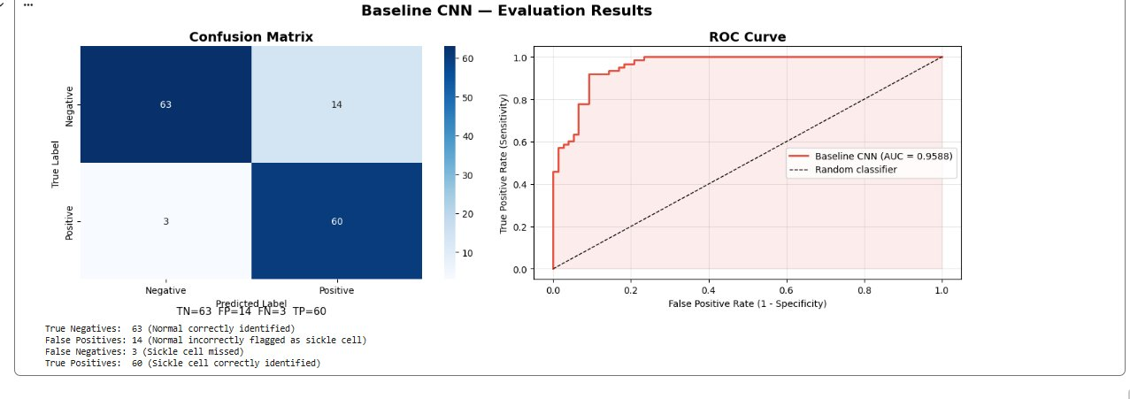
Results — Baseline CNN
3 convolutional blocks — 25.8M parameters — trained from scratch, no pretrained weights
Test Accuracy
87.86%
AUC-ROC
0.9588
Sensitivity
95.24%
Specificity
81.82%
F1 Score
0.8759
Total Errors
17 / 140
Figure 2. Baseline CNN evaluation results (n=140). Left: confusion matrix — 17 total errors including 14 false positives. Right: ROC curve, AUC = 0.9588.
Notes:
1 min. Sets the floor. 87.86% from scratch. 17 errors. Unstable training.

Slide 13
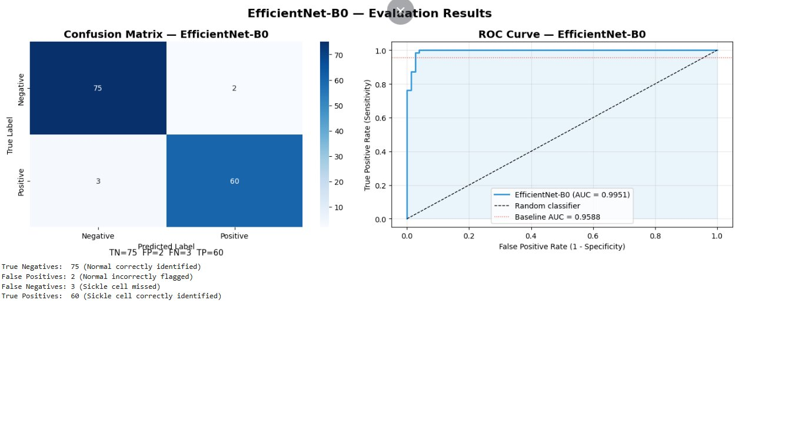
Results — EfficientNet-B0
4.0M parameters — ImageNet pretrained — unfrozen fine-tuning
Test Accuracy
96.43%
AUC-ROC
0.9951
Sensitivity
95.24%
Specificity
97.40%
F1 Score
0.9600
Total Errors
5 / 140
Figure 3. EfficientNet-B0 evaluation results (n=140). Left: confusion matrix — 5 total errors, false positives reduced from 14 to 2. Right: ROC curve, AUC = 0.9951.
Notes:
1 min. First transfer learning model. Point out the dramatic drop in false positives from 14 to 2.

Slide 14
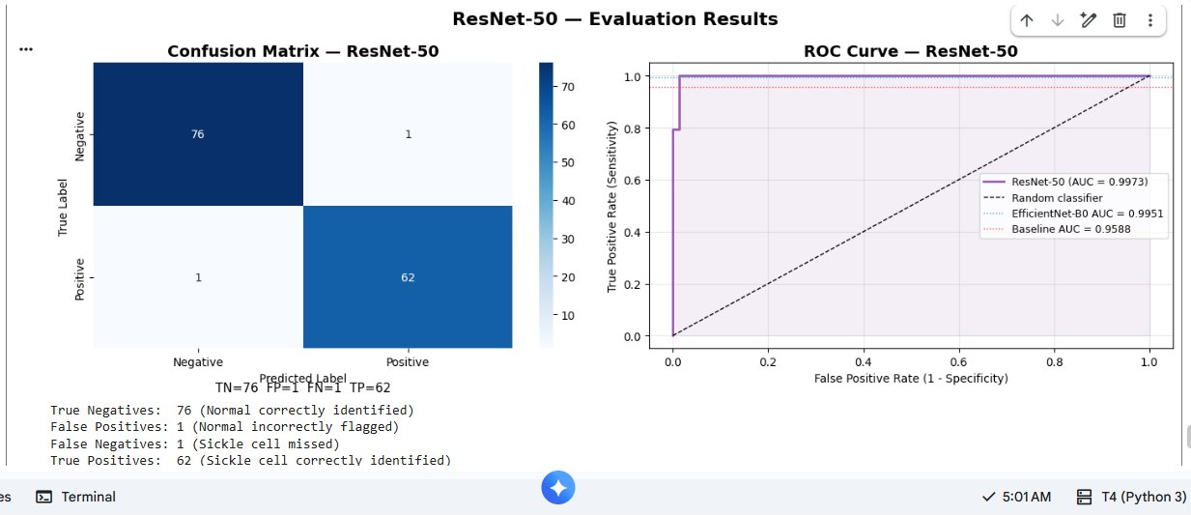
Results — ResNet-50
23.5M parameters — ImageNet pretrained — residual connections — unfrozen fine-tuning
Test Accuracy
98.57% ★
AUC-ROC
0.9973 ★
Sensitivity
98.41% ★
Specificity
98.70% ★
F1 Score
0.9841 ★
Total Errors
2 / 140 ★
Figure 4. ResNet-50 evaluation results (n=140). Left: confusion matrix — only 2 total errors, 1 false positive and 1 false negative. Right: ROC curve, AUC = 0.9973.
Notes:
1.5 min. Best model. Only 2 errors. Point to the ROC hugging the top-left corner.

Slide 15
Results — Model Comparison
Model
Accuracy
AUC-ROC
Sensitivity
Specificity
Errors / 140
Baseline CNN (scratch)
87.86%
0.9588
95.24%
81.82%
17
EfficientNet-B0
96.43%
0.9951
95.24%
97.40%
5
ResNet-50 ★
98.57%
0.9973
98.41%
98.70%
2
Transfer learning from ImageNet accounts for the 10.71 percentage point accuracy improvement from baseline CNN to ResNet-50. The improvement is not marginal — it is the difference between a viable screening tool and an unreliable one.
Sensitivity is the most clinically important metric. ResNet-50 sensitivity of 98.41% means only 1 in 64 sickle cell patients would be missed in a screening setting.
Notes:
1 min. Full comparison. Let the table speak.

Slide 16
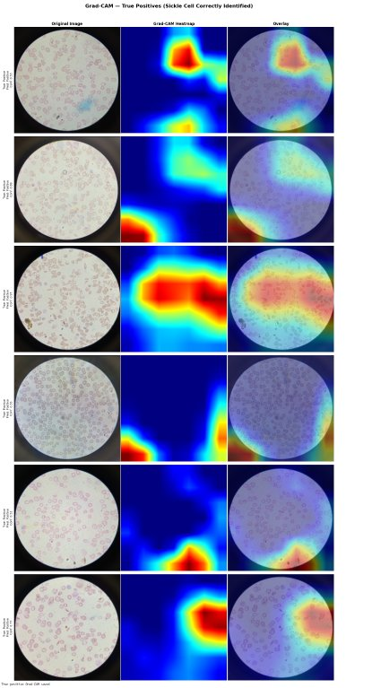
Grad-CAM — True Positive Predictions
Grad-CAM computes the gradient of the predicted class score with respect to the final convolutional layer feature maps, producing a heatmap showing which image regions most influenced the model's prediction.
Figure 5. Grad-CAM true positive predictions — sickle cell images correctly identified by ResNet-50. Each row shows the original image (left), Grad-CAM heatmap (centre), and overlay (right). Warm colours indicate regions of highest model attention. Activation is consistently concentrated within cell-dense regions of the circular microscope field.
Notes:
1.5 min. One sentence on Grad-CAM. Then show true positive activation. Point out the consistent focal pattern.

Slide 17
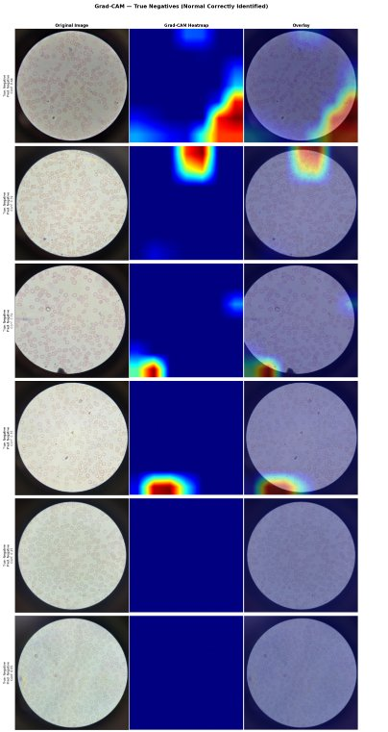
Grad-CAM — True Negative Predictions
True negative predictions show a markedly different activation pattern from true positives, confirming the model has learned a biologically meaningful distinction between the two classes.
Figure 6. Grad-CAM true negative predictions — normal images correctly identified by ResNet-50. Activation is diffuse and unfocused with no strong focal point, consistent with the absence of distinctive pathological features. The contrast with Figure 5 confirms the model attends to genuine morphological differences rather than imaging artefacts.
Notes:
1 min. Contrast with true positives — diffuse activation confirms the model learned a genuine biological asymmetry.

Slide 18
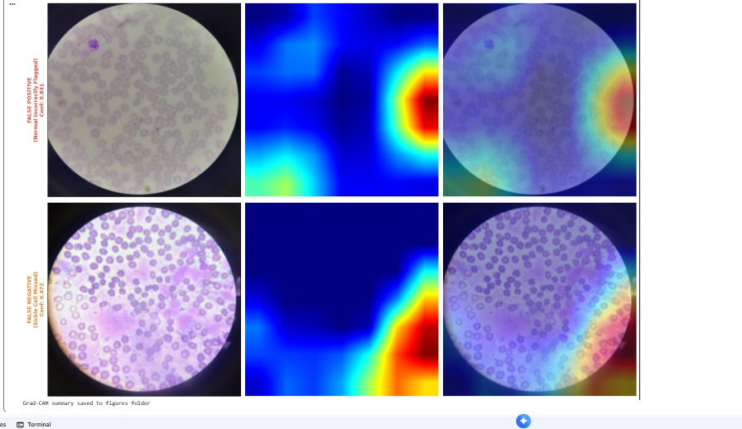
Grad-CAM — Error Analysis
ResNet-50 made only 2 errors on 140 test images. Grad-CAM reveals the specific cause of each.
Figure 7. Grad-CAM analysis of both ResNet-50 misclassified test images. Top row: false positive — model activation concentrated on a staining artefact (dust particle) rather than cell morphology, confidence 0.841. Bottom row: false negative — diffuse activation with confidence 0.472, caused by unusually dense cell packing and atypical staining. Both errors have identifiable, fixable causes — not fundamental model failure.
Notes:
1.5 min. Spend most time here. The errors are the most interesting part — they are honest about what the model cannot do.

Slide 19
🔬
LIVE DEMO
Upload a blood smear → prediction + Grad-CAM heatmap
huggingface.co/spaces/Patrovas/sickle-cell-detection
ResNet-50 | 98.57% Accuracy | AUC-ROC 0.9973 | Only 2 errors on 140 test images
Notes:
2 min. Open the browser BEFORE presenting. Have the Space loaded. Upload a real test image. Show prediction and Grad-CAM. Do not narrate the interface.

Slide 20
Lessons Learned
Inspect your data before writing any code
Transfer learning is not optional on small datasets
01
02
Both dataset problems were invisible until manual inspection. No amount of modelling would have fixed a fundamentally flawed training set.
The gap between 87% and 98% accuracy quantifies the benefit. It is clinically meaningful — fewer missed patients.
Explainability reveals what accuracy hides
Domain gaps within a class matter too
03
04
Grad-CAM showed the false positive was caused by a dust particle. Without it we would not have known the model was responding to noise.
BCCD and Tushabe images look different within the negative class. A model can exploit that visual difference as an unintended shortcut.
Notes:
1 min. Four honest lessons. The data inspection lesson is your strongest.

Slide 21
Conclusion
🎯
First deep learning study to detect sickle cell disease from the Tushabe (2024) Ugandan clinical mobile-phone microscopy dataset
📈
ResNet-50 achieves 98.57% accuracy and AUC-ROC of 0.9973 — only 2 errors on 140 test images
🔍
Grad-CAM confirms the model learns genuine cell morphology — not imaging artefacts — and both errors have fixable causes
🌍
Deployed Gradio application demonstrates a viable mobile-first screening tool for non-specialist health workers in rural Uganda
📚
Transfer learning bridges the data scarcity challenge that makes medical AI difficult in low-resource settings
Notes:
1 min. Five points. State the novelty confidently. End with the clinical takeaway.

Slide 22
Thank You
Questions?
github.com/Patro331/sickle-cell-detection
huggingface.co/spaces/Patrovas/sickle-cell-detection
Okidi Patrovas Gabriel | 2025/HD07/26020U | Makerere University
Notes:
30 sec. Thank you. Pause. Invite questions.

