Slide 1
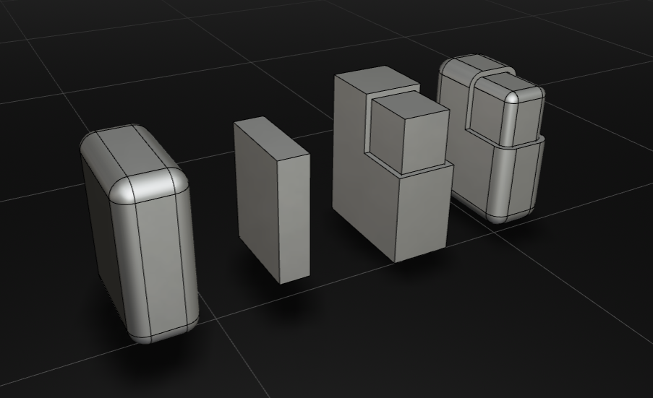
Offset(shape,-2)
Offset(shape,5)
let testBox = Offset(largeBox,-2)
let smallBox = Box(10,30,40));
let roundedBox = Offset(smallBox,5)

