Slide 1
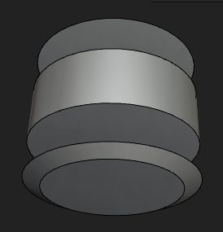
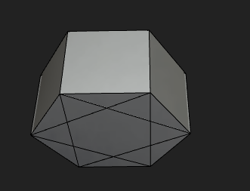
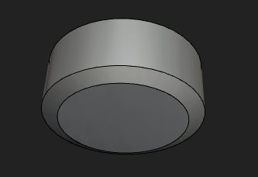
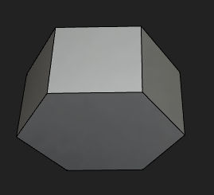
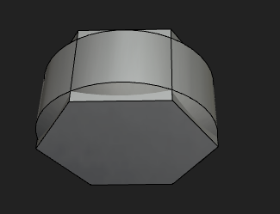
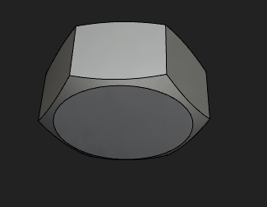
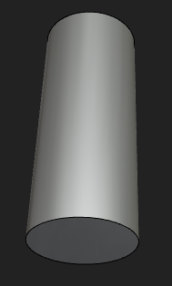
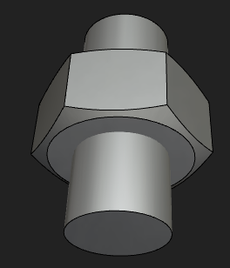
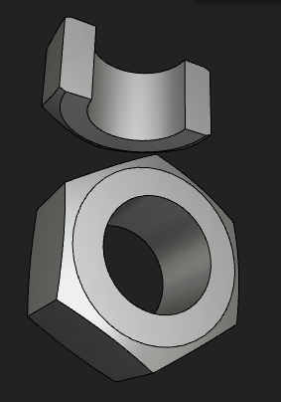
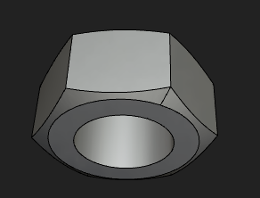
let nutBody = Cylinder(g/2,0.8*h,true)
let nutChamferT = Translate([0,0,0.8*h/2],Cone(g/2 ,0.8*g/2, 0.1*h,false))
let nutChamferB = Translate([0,0,-0.8*h/2],Rotate([1,0,0],180,Cone(g/2,0.8*g/2,0.1*h, false)))
let box1 = Box(g/2,f,1.1*h,true)
let box2 = Rotate([0,0,1],60,Box(g/2,f,1.1*h,true))
let box3 = Rotate([0,0,1],120,Box(g/2,f,1.1*h,true))
Union
let nutBodyBase =
Union([ nutBody,
nutChamferT,
nutChamferB], false)
let hexagon = Union([ box1,
box2,
box3], false, 0.01, false);
Intersection
let nutShape = Intersection([
nutBodyBase,
hexagon],false, 0.01,false)
let cutterHole = Cylinder(d/2,h*3,true)
Difference
let nut = Difference(nutShape, [cutterHole])

Slide 2
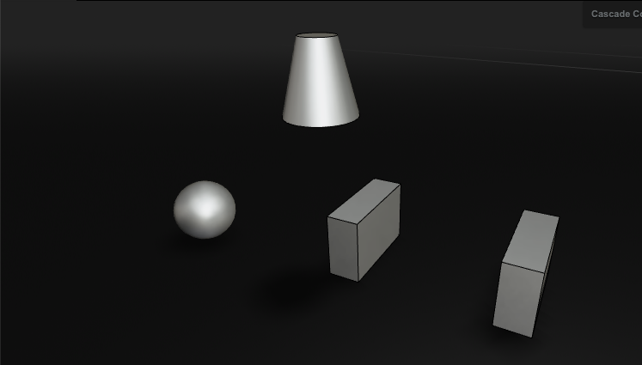
Translate([0,0,50],Cone(10,5,20))
Translate([-50,0,10],Sphere(10))
Box(10,30,20)
Translate([50,0,0],Box(10,30,20))

Slide 4
