Slide 1
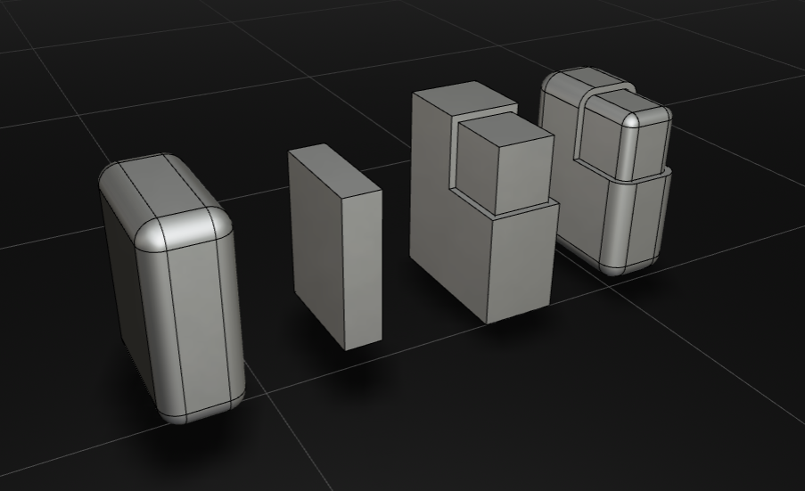
Offset(shape,-2)
Offset(shape,5)
let testBox = Offset(largeBox,-2)
let smallBox = Box(10,30,40));
let roundedBox = Offset(smallBox,5)

Slide 2
p1 = Dy(p0,5)
5
-6.5
p0
10
p1 = Dx(p0,10)
-5
p1 = Dxy(p0,-6.5,-5)

Slide 3
p1 = Polar(p0,12,42)
12
42 deg
p0

Slide 4
p2
10
clockwise = false
p1 = RadiusArc(p0,p2,10,false)
p0

Slide 5
p2
clockwise = false
3
p1 = SagArc(p0,p2,3,false)
p0

