Slide 1
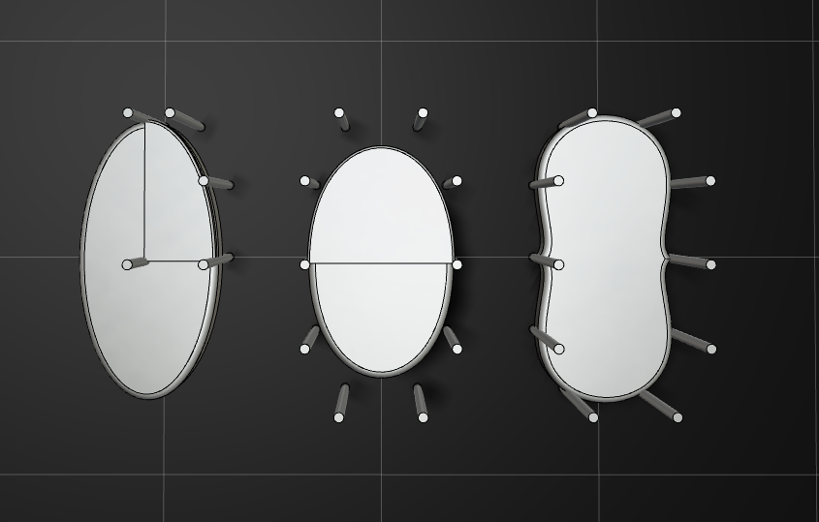
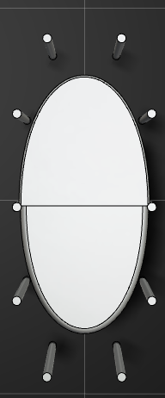
0.5522*xmax
ymax * 1.25
ymax * 1.25
ymax
xmax
ymax * 0.69
0.5522*ymax
Bezier
half
Bezier
quarter
BSpline
Bezier
full
Ellipse

