Slide 1
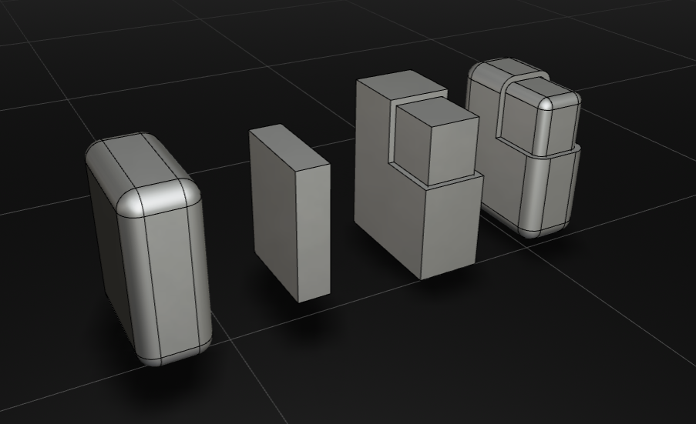
Offset(shape,-2)
Offset(shape,5)
let testBox = Offset(largeBox,-2)
let smallBox = Box(10,30,40));
let roundedBox = Offset(smallBox,5)

Slide 2
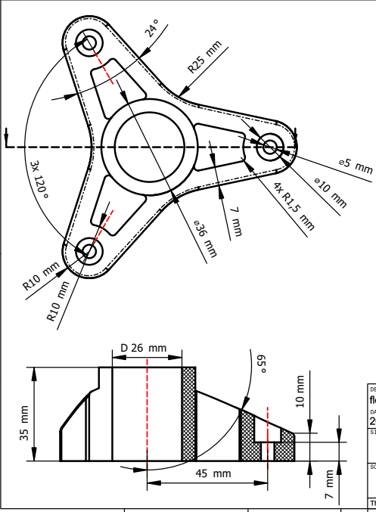
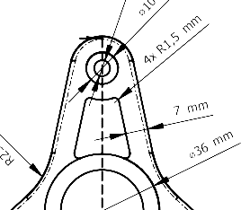
p4 = RadiusArc(p2,p3,r0,false)
p3= MirrorY(p2,0)
p2 = Polar(p1,r0,12)
r0
p1 = Dy(p0,D)
D
p5 = PolarY(p2,D1,-78)
p6= MirrorY(p5,0)
p0 = [0,0]
D1 = D + r0.Math.sin(a)

Slide 3
p1 = Dy(p0,5)
5
-6.5
p0
10
p1 = Dx(p0,10)
-5
p1 = Dxy(p0,-6.5,-5)

Slide 4
p1 = Polar(p0,12,42)
12
42 deg
p0

Slide 5
p2
beta
10
clockwise = false
p1 = RadiusArc(p0,p2,10,false)
alpha
p0

Slide 6
p2
clockwise = false
3
p1 = SagArc(p0,p2,3,false)
p0

