Slide 1
Case study: overstymulation behavior analysis
https://overstimulation-behavior.streamlit.app/
Authors: Kinga, Kasia, Patrycja, Maciej

Slide 2

Project objectives
Understanding the phenomenon of overstimulation Identify lifestyle factors, behaviors, and habits that influence the likelihood of overstimulation in individuals.
Data analysis using data science techniques Conduct exploratory data analysis and apply various statistical and machine learning methods to:
assess the importance of individual features,
identify correlations between variables,
discover patterns linked to overstimulation.
Building a predictive model Develop a model that can predict whether a person is overstimulated based on input data.
Creating a prototype application
Applying insights in practice

Slide 3
Features
1. Demographic 2. Lifestyle & Daily Routine 3. Environmental Exposure 4. Mental Health & Psychological Traits 5. Habits & Coping Mechanisms 6. Target Variable

Slide 4
Data and preprocessing
Number of observations: 2,000+
Syntetic data
Key preprocessing steps:
Checked for missing values and handled incomplete data
Performed data visualization (correlation matrices, distribution plots, comparisons)
Standardized variables:
Adjusted data types
Bucketed numerical values where appropriate
Encoded categorical variables
Detected and analyzed feature correlations

Slide 5
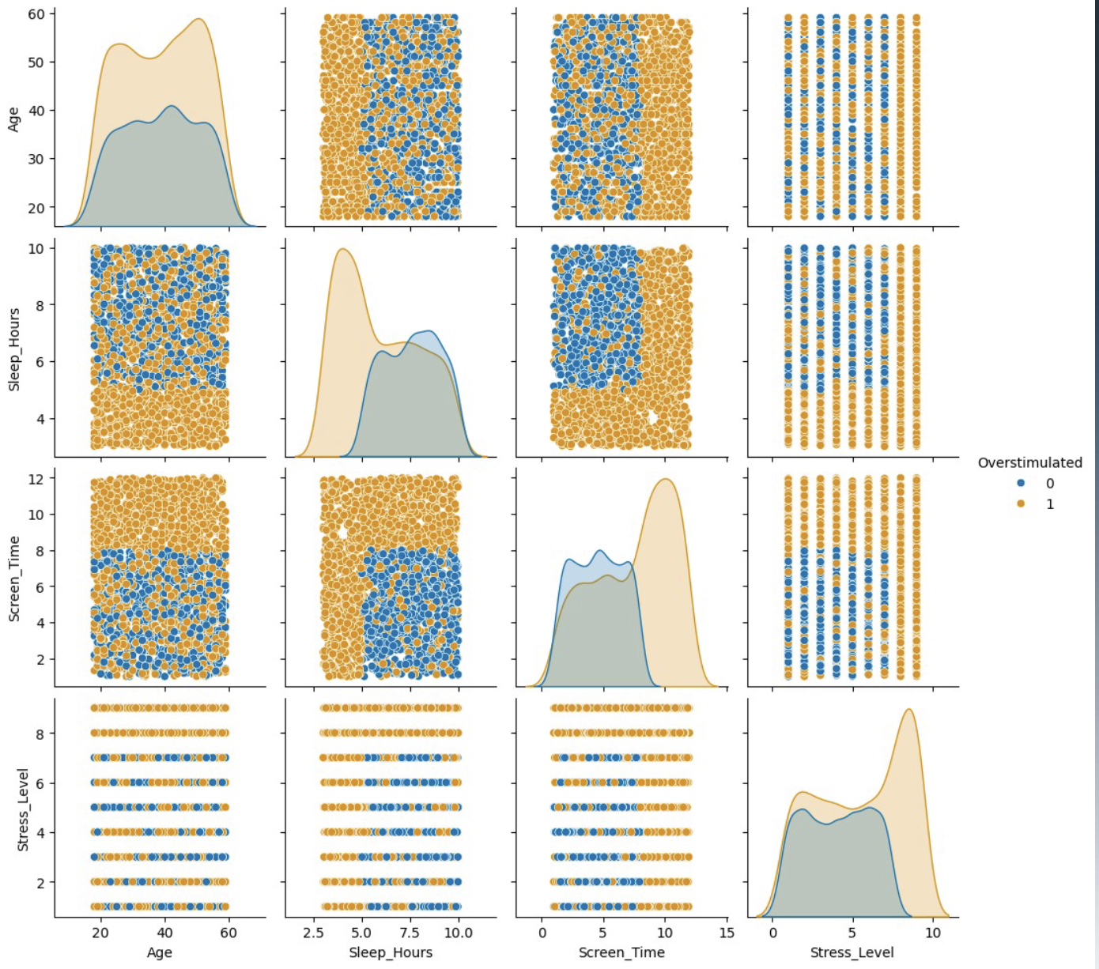
Data exploration

Slide 6
Evaluated models
Model | Accuracy | Precision | Comments
Logistic regression | 0.83 | 0.87 | Selected
Decision tree | 0.99 | 0.99 | Rejected
Random forest | 1.00 | 1.00 | Rejected

Slide 7
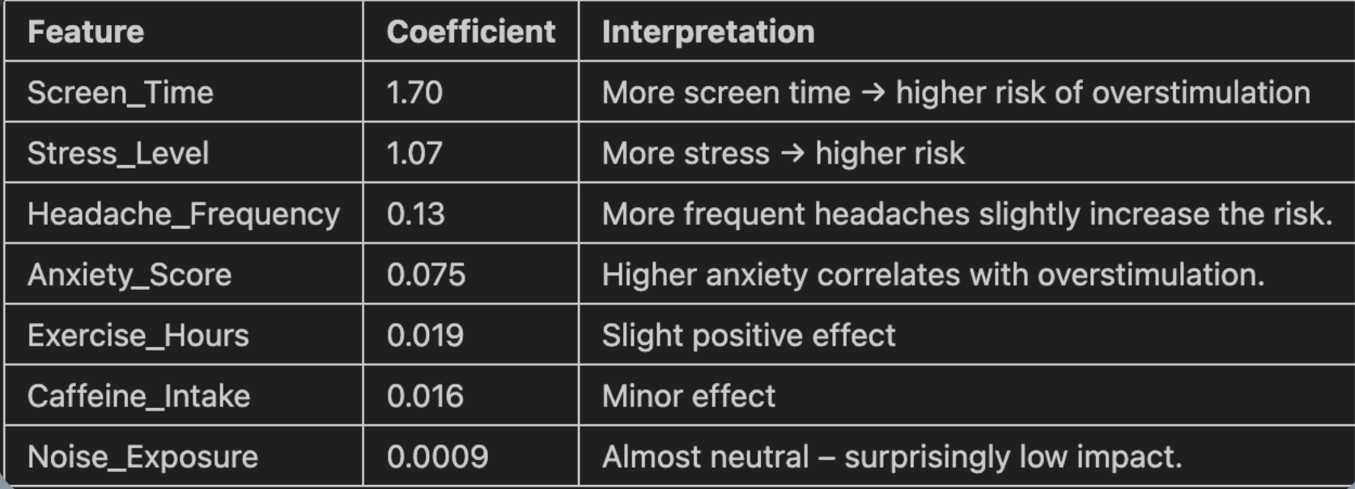
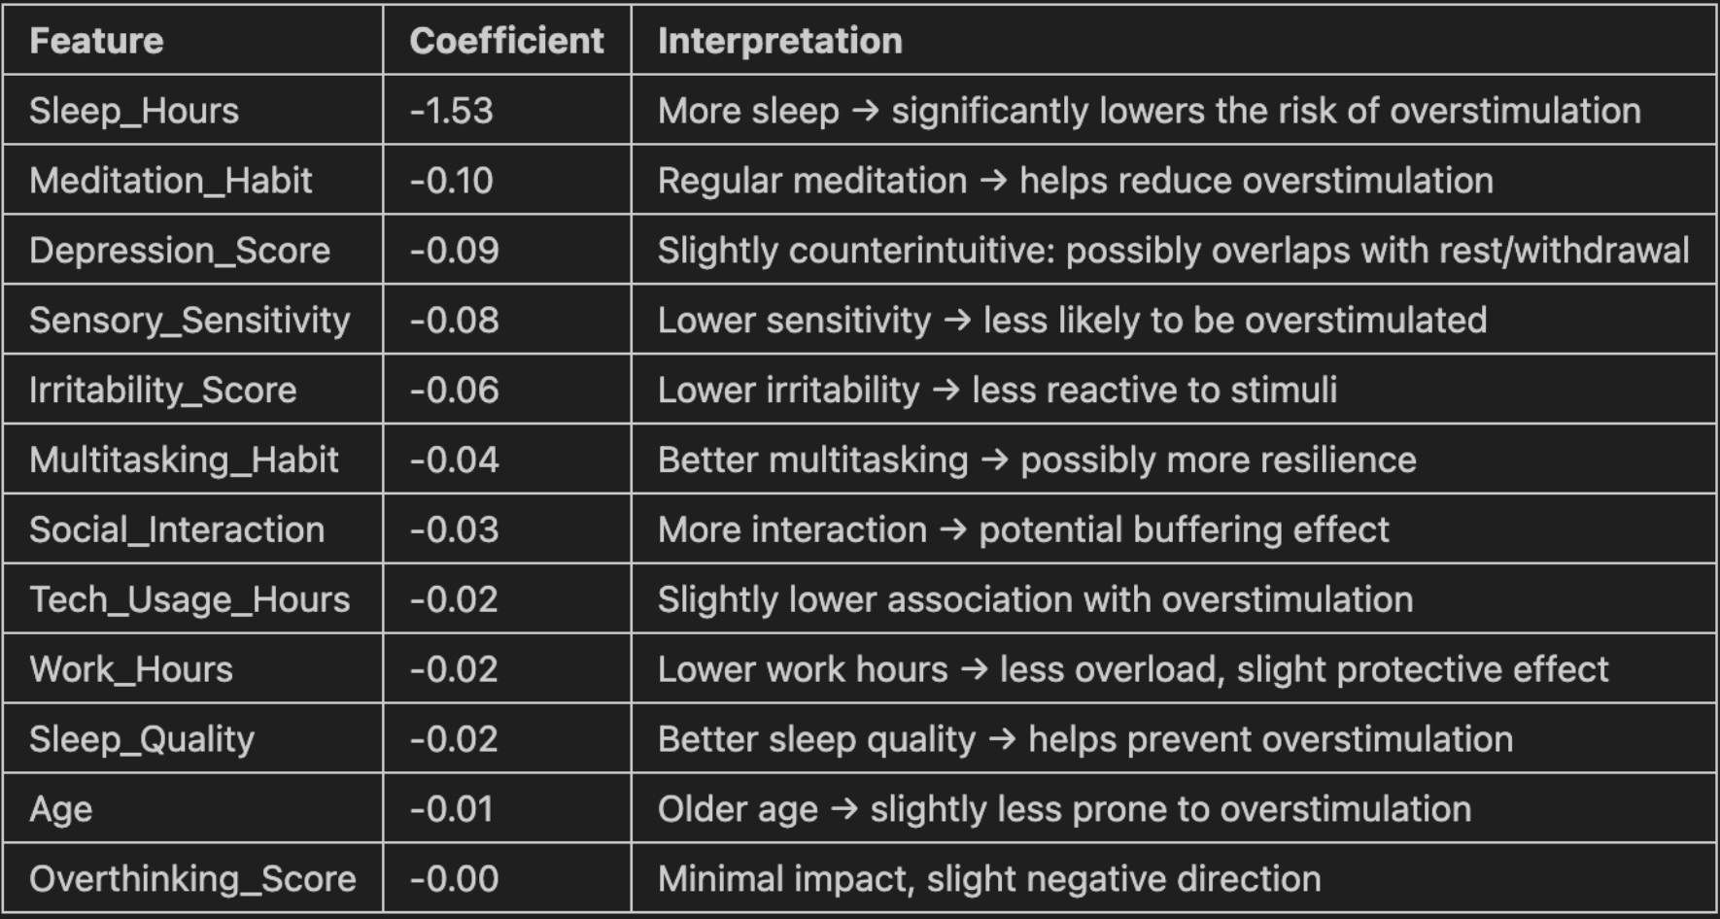
Results: Logistic regression

Slide 8
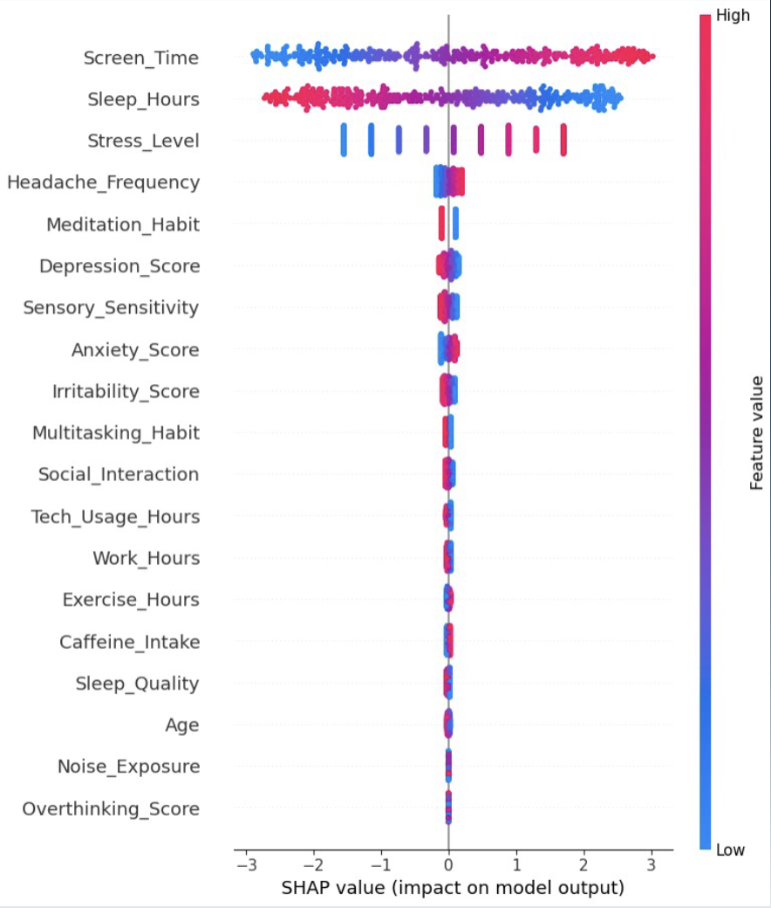

Slide 9
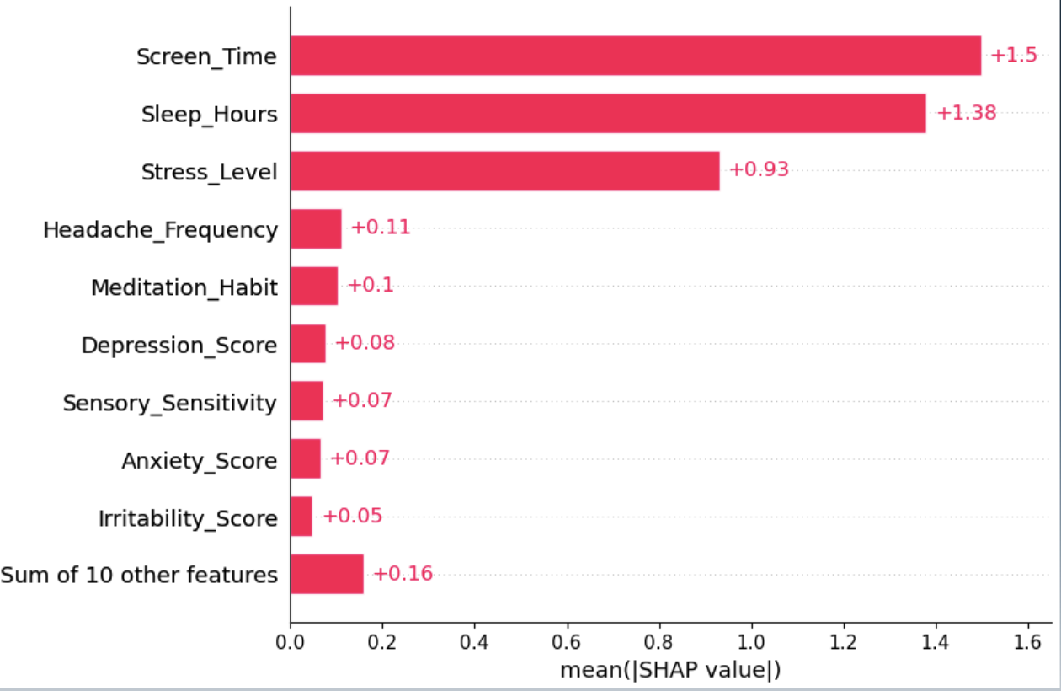

Slide 10
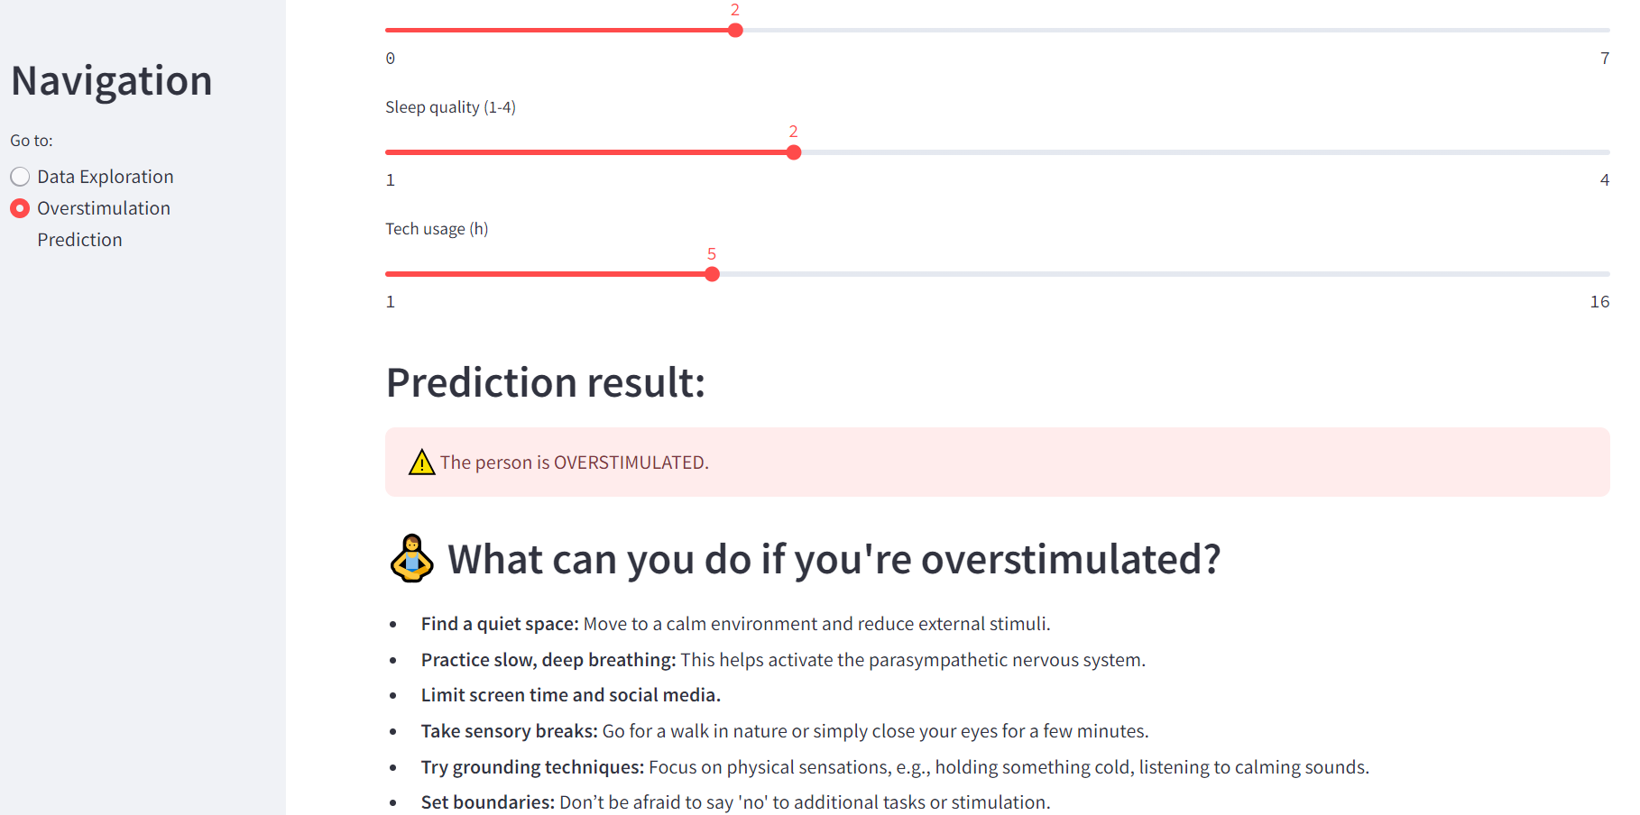
App – how to use the results
We developed a Streamlit-based application that allows users to input personal data related to key lifestyle features identified in our model, such as:
hours of sleep,
time spent in front of a screen,
physical activity,
exposure to noise and social interaction, ...and more.
How it works:
The user enters their daily habits via a simple interface.
The model analyzes the inputs and provides a prediction: - Are you currently overstimulated? Yes or No.
Based on the result, the app provides personalized feedback.
https://overstimulation-behavior.streamlit.app/

Slide 11
Scientific recommendations included To support users in improving their well-being, the application also includes science-backed tips and recommendationsbased on academic research. These suggestions focus on:
improving sleep hygiene,
reducing screen time,
balancing social and sensory input,
incorporating restorative breaks and mindfulness.
Our goal is not only to detect overstimulation, but also to promote healthier habits and prevention strategies.
itmedicalteam.pl
Stress, anxiety and depression levels: High levels of stress and anxiety are strongly linked to overstimulation. Chronic stress can lead to an overreaction to external stimuli, which increases the risk of sensory overload.
https://healyournervoussystem.com/effects-of-overstimulation/
The article identifies factors such as constant notifications, multitasking, and exposure to loud environments as primary contributors to nervous system overload. Individuals experiencing overstimulation may face anxiety, depression, sleep disturbances, irritability, and cognitive challenges like poor memory and concentration.
https://www.henryford.com/blog/2023/12/how-to-identify-and-manage-overstimulation
Engaging in multiple activities simultaneously, such as checking emails during meetings or juggling work and personal tasks, can overwhelm the brain. Constant exposure to screens, notifications, and digital media increases cognitive load. Bright lights, loud noises, and lack of quiet spaces contribute to sensory overload. Chronic stress, insufficient sleep, excessive caffeine intake, and continuous news consumption exacerbate overstimulation.

Slide 12
Aspect | Our data | IT Medical Team Article Insights | Henry Ford Healthy Article
Primary Focus | Broad overstimulation factors (noise, light, digital) | Environmental noise in urban settings | Modern lifestyle-induced overstimulation
Mental Health effects | Anexity, stress, sleep distrubances, cognitive issues | Depression, anexity, cognitive decline | Irritability, fatigue, concentration difficulties
Demographic considerations | Age and occupation-related sensitivity | Urban populations exposed to chronic noise | Individuals in high-tech, multitasking environments
Mitigation Strategies | Reducing screen time, improving sleep hygiene | Urban planning, public awareness, personal protection | Mindfulness, structured breaks, digital detox

