Slide 1
Regression with Feed-Forward Neural Networks
Exercises in PyTorch
Marco Forgione, Dalle Molle Institute for Artificial Intelligence, USI-SUPSI, Lugano, Switzerland

Slide 2
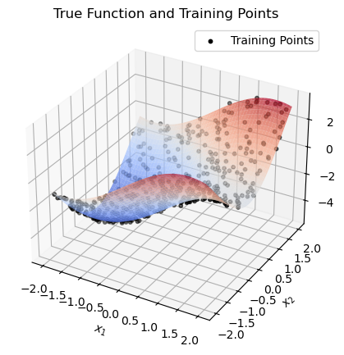
2D regression on synthetic data (synthetic_2d folder)
Consider the 2D function
Training and test datasets: 500 points uniformly sampled in the domain.
Additive noise with standard deviation 0.1

Slide 3
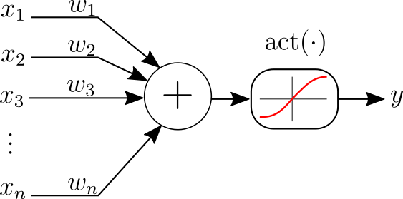
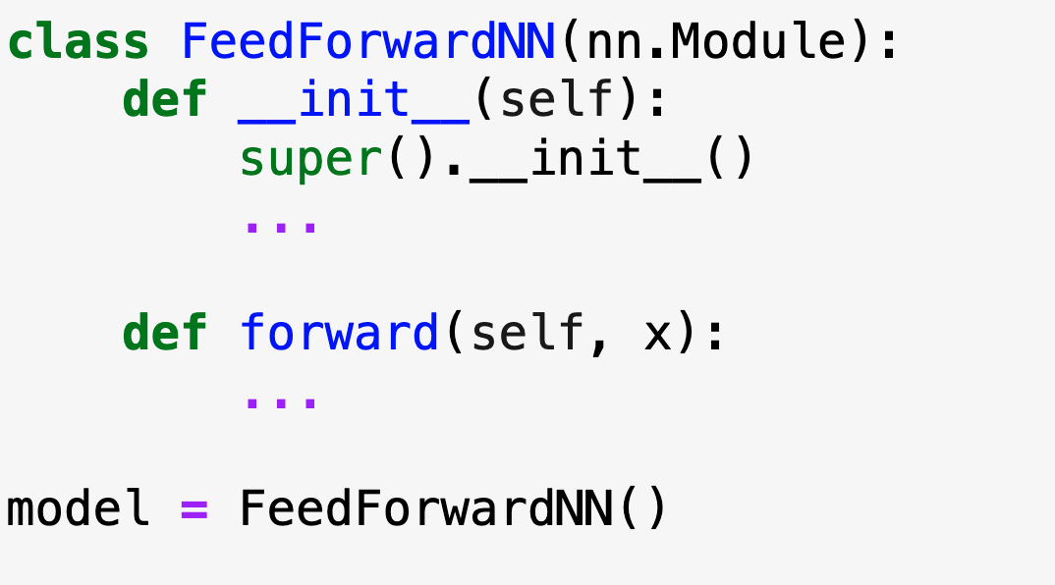

Feed-forward neural network model
2 inputs, 1 output - this is the structure of $f(x)$
2 hidden layers with [16, 8] neurons
tanh non-linearities

Slide 4
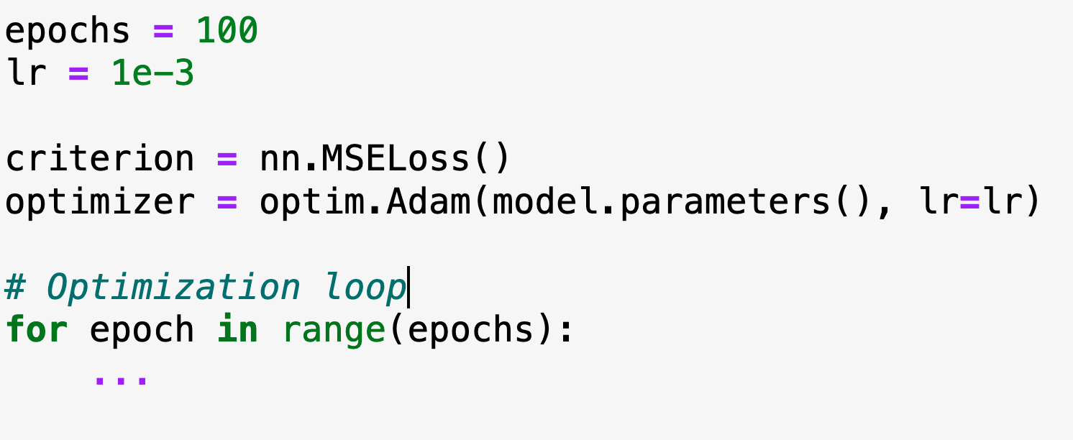
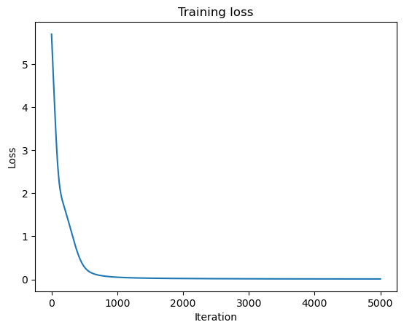
Model training

Slide 5
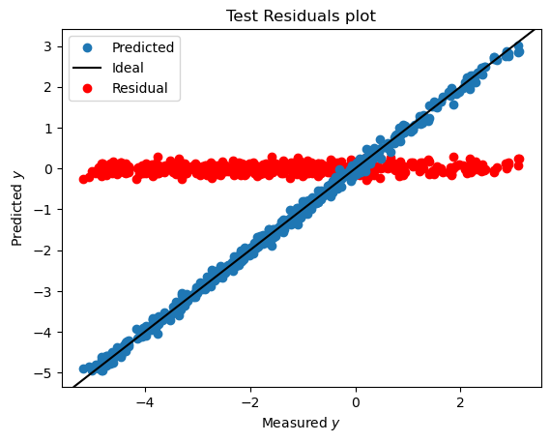
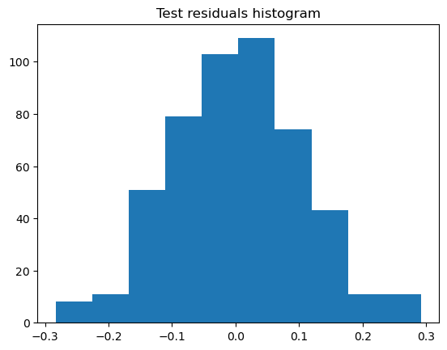
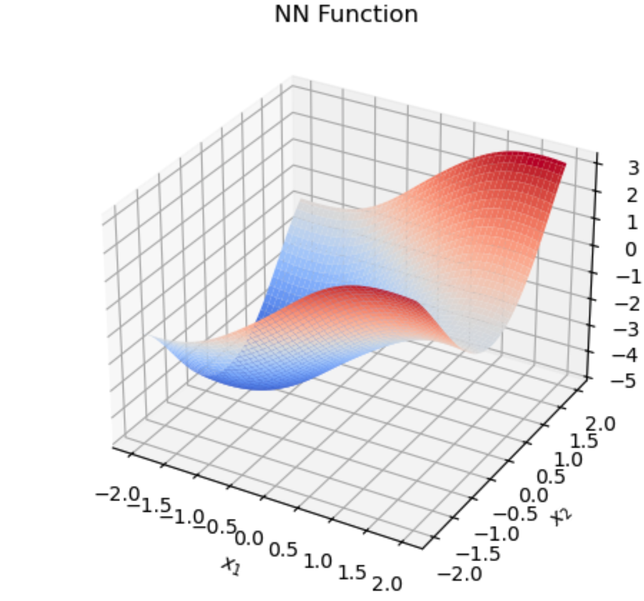
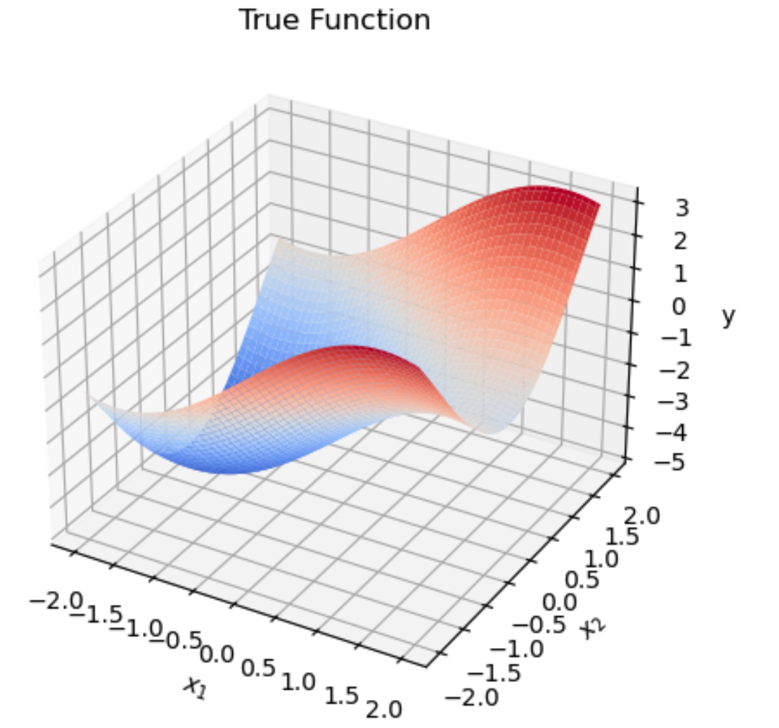
Model evaluation
It is common to inspect, on the test dataset:
Predictions and residuals vs measured y (top left)
Histogram of residuals (top right)
In this toy example:
The input is only 2D. We can visualize the learned function (bottom left)
The true function is known. We can visualize also visualize it in 2D (bottom right)

Slide 6
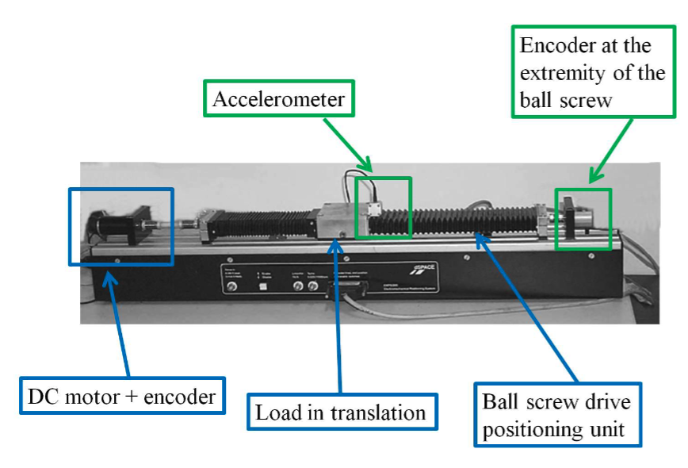

Inverse Dynamical Modeling on the EMPS benchmark (emps folder)
Real dataset from a (simple) mechanical system: the Electro-Mechanical Positioning System
Prismatic joint, 1-DoF mechanical system
$q(t)$: measured position (m)
$τ\left(t\right):$ known applied force (N)
$τ_{f}(t)$: unknown friction (N)
$M$: unknown mass (kg)
$b$: force measurement bias (N)
We want an inverse dynamical model (IDM):

Slide 7
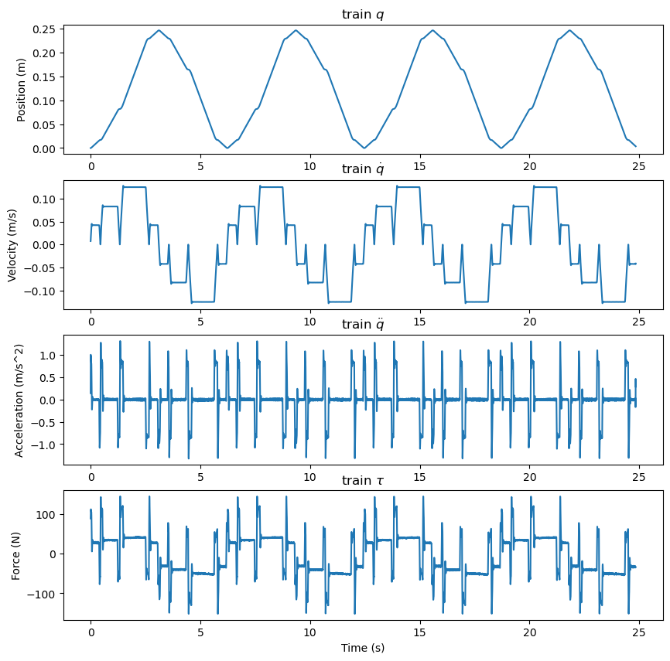
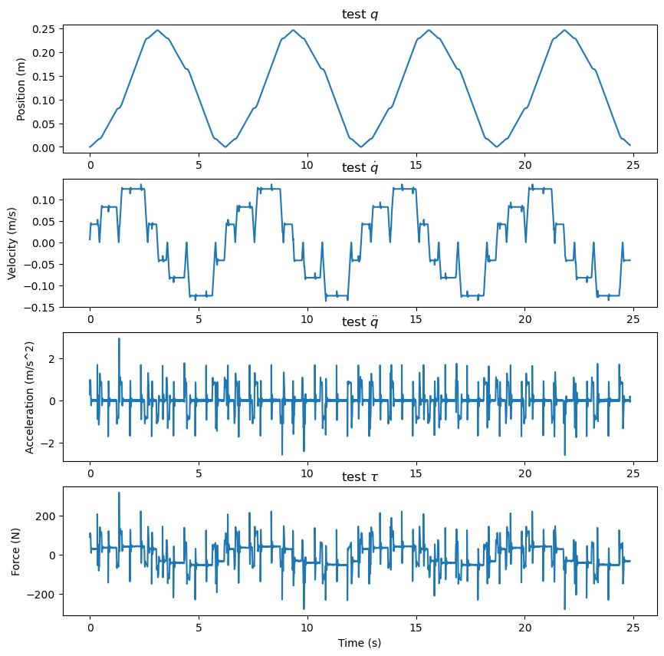
Training and test datasets

Slide 8
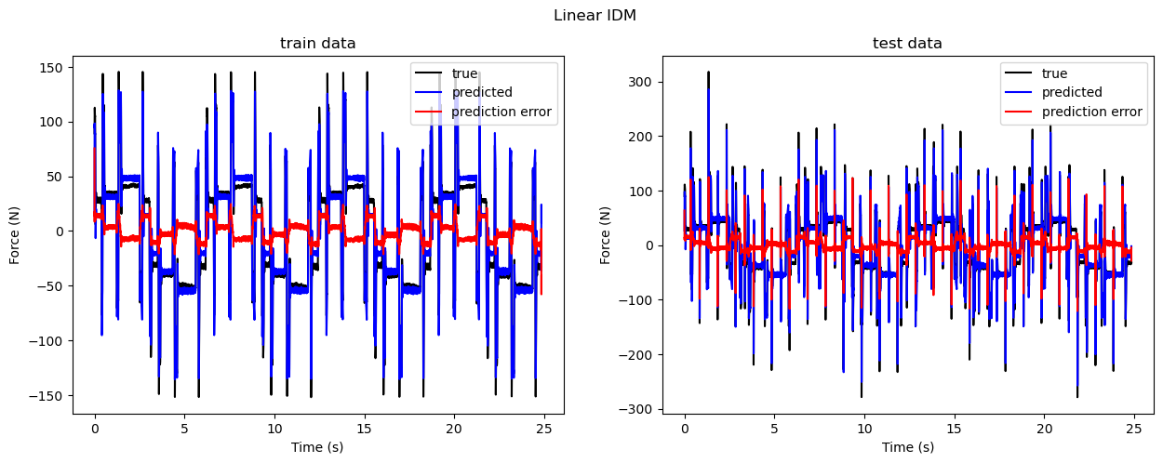
Linear model
We assume a linear friction model:
Then, the IDM is: . We can fit the IDM with a linear regression:

Slide 9
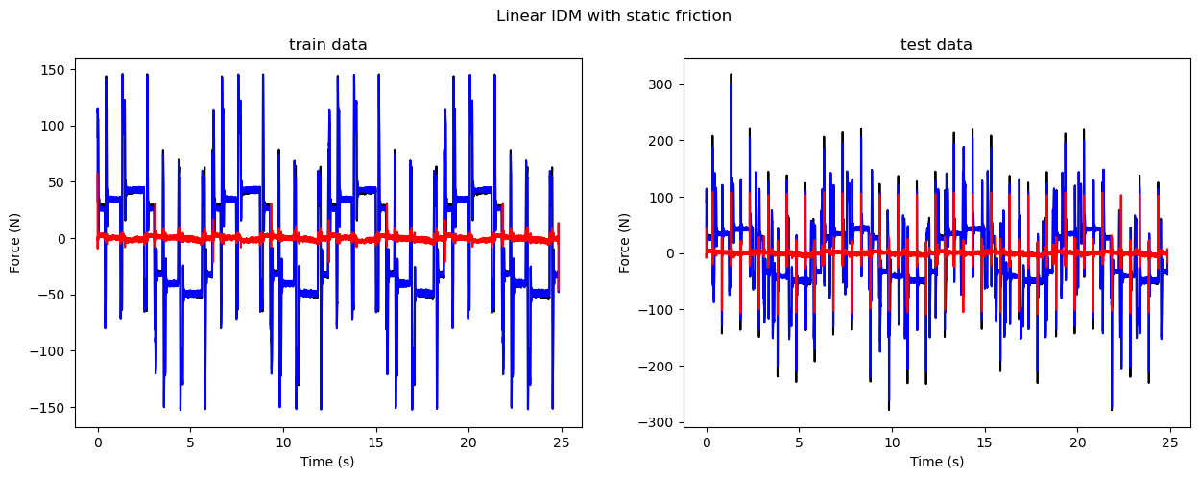
Linear model with static friction
We use a more sophisticated friction model:

Slide 10
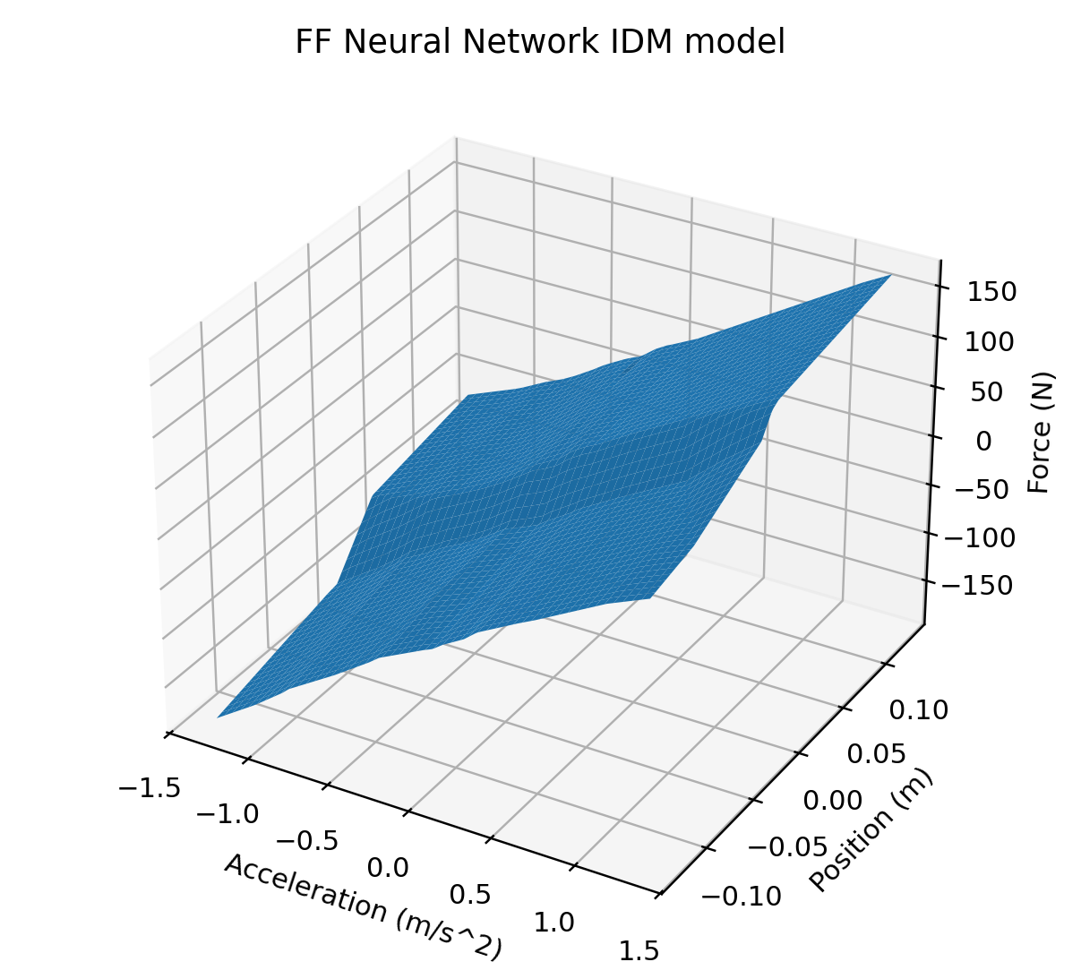
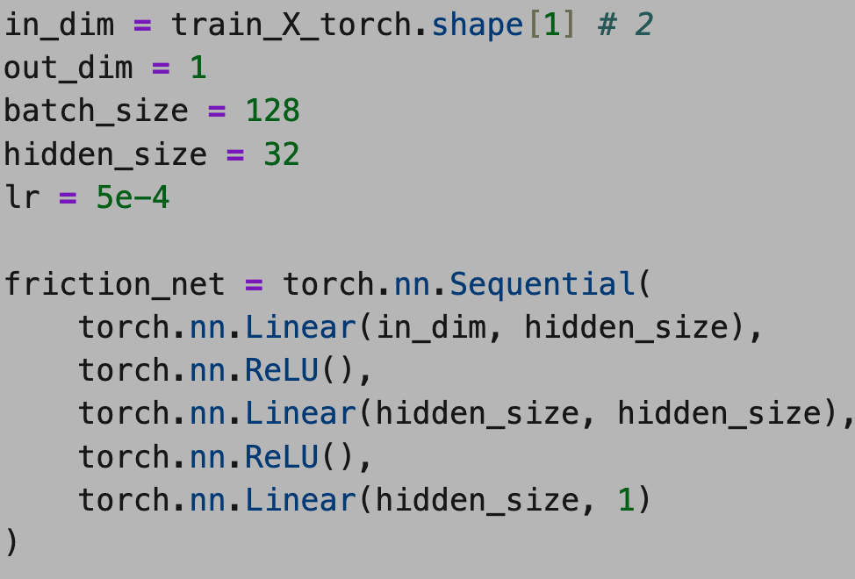
Feed-forward neural network
We ignore all physics and fit a feed-forward neural network instead:
Train it yourself!

Slide 11
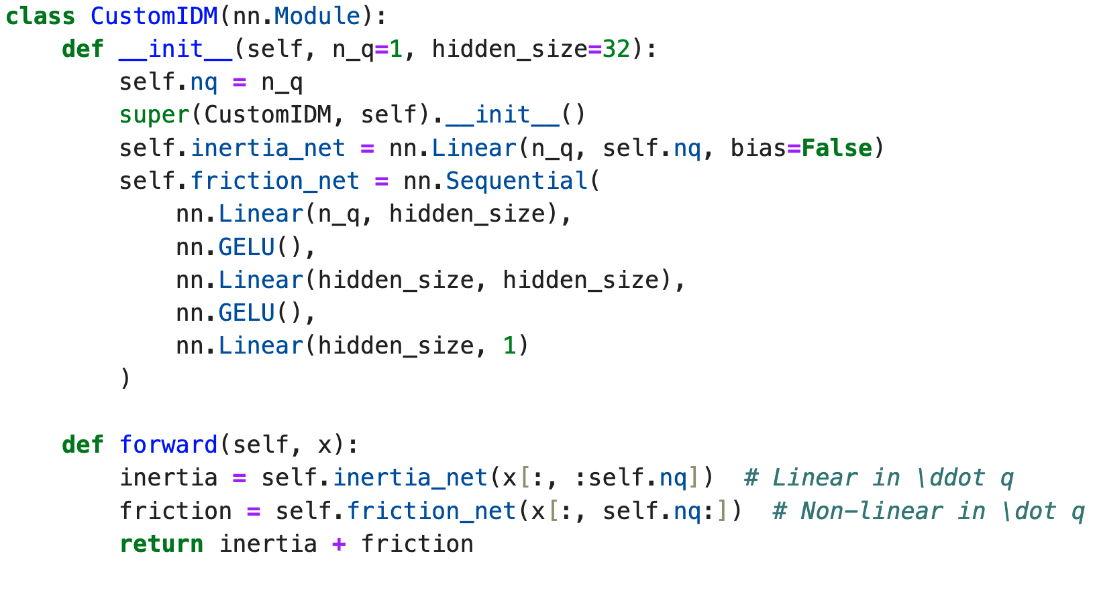
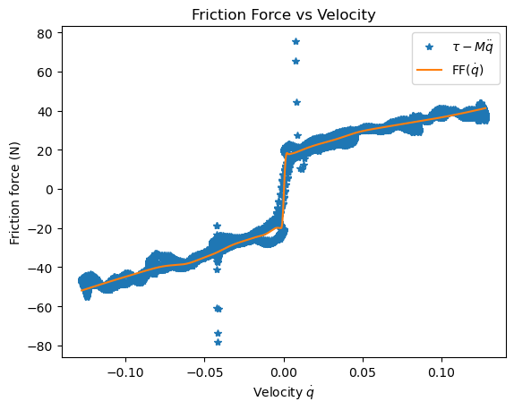
Physics-inspired neural network
We trust Newton’s law, but nothing else:
Train it yourself!

