Slide 1



Deep learning for state-space identification Theory
Marco Forgione, Dalle Molle Institute for Artificial Intelligence, Lugano, Switzerland
Milano, July 3rd, 2025

Slide 2
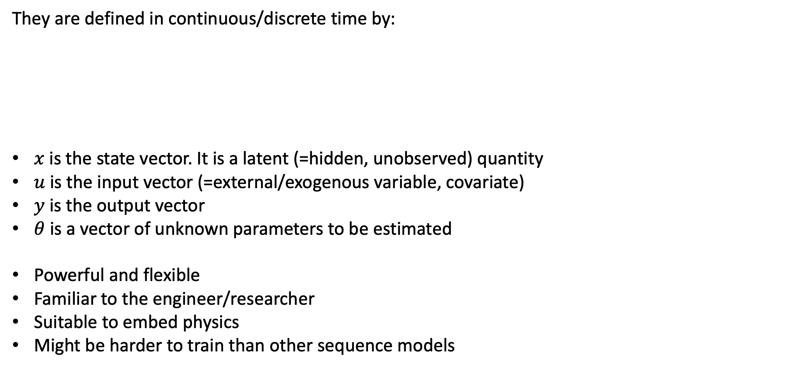
State-space models
They are defined in continuous/discrete time by:
$x$ is the state vector. It is a latent (=hidden, unobserved) quantity
$u$ is the input vector (=external/exogenous variable, covariate)
$y$ is the output vector
$θ$ is a vector of unknown parameters to be estimated
Powerful and flexible
Familiar to the engineer/researcher
Suitable to embed physics
Might be harder to train than other sequence models

Slide 3
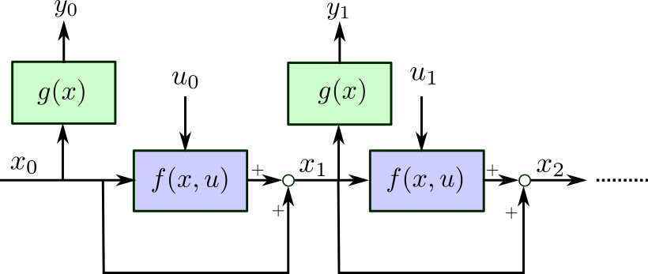
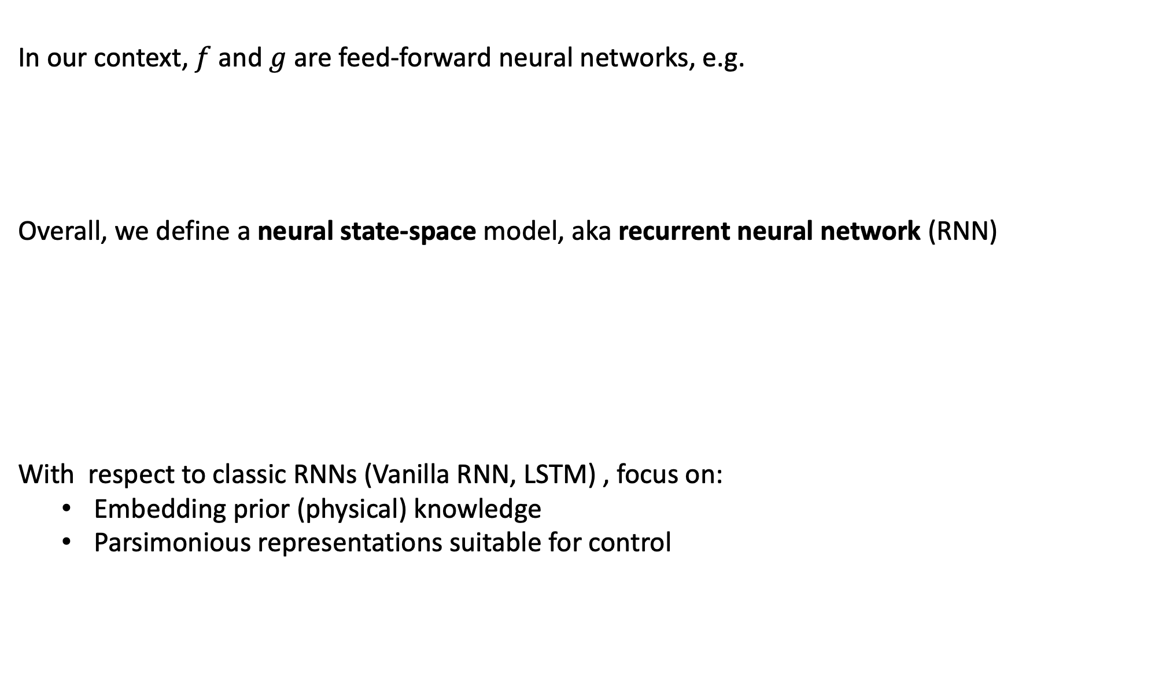
Neural state-space models
In our context, $f$ and $g$ are feed-forward neural networks, e.g.
Overall, we define a neural state-space model, aka recurrent neural network (RNN)
With respect to classic RNNs (Vanilla RNN, LSTM) , focus on:
Embedding prior (physical) knowledge
Parsimonious representations suitable for control

Slide 4
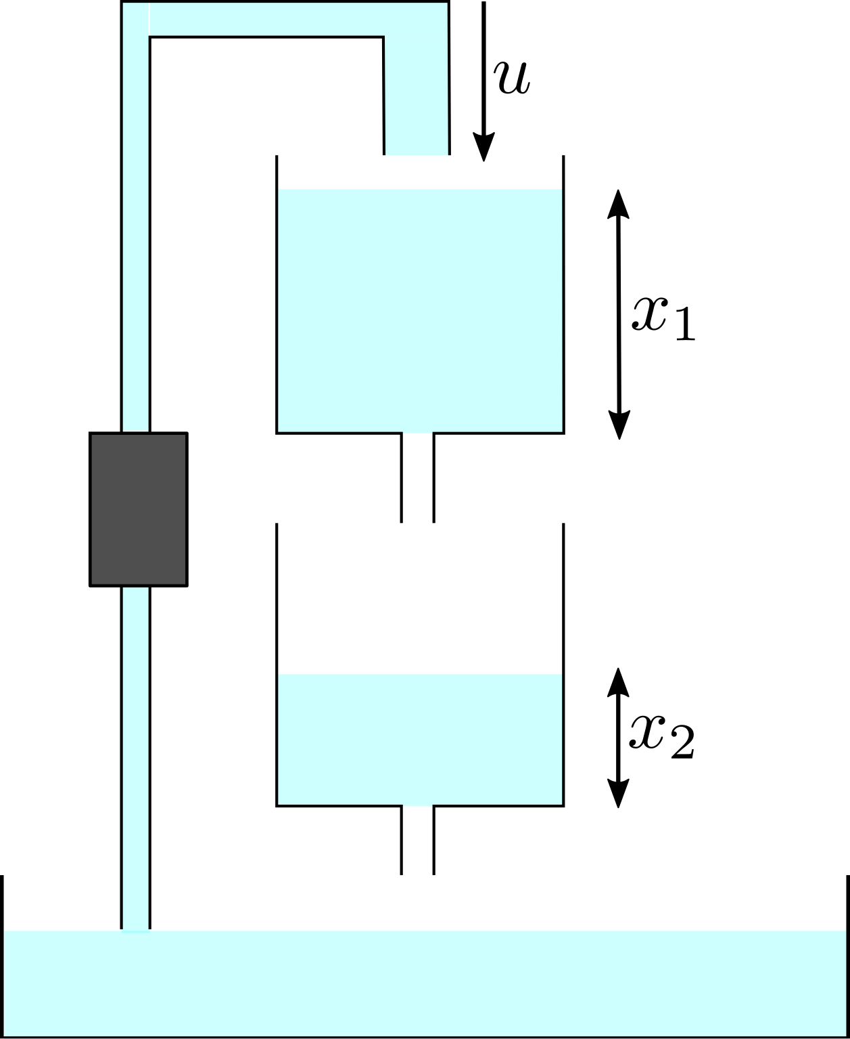
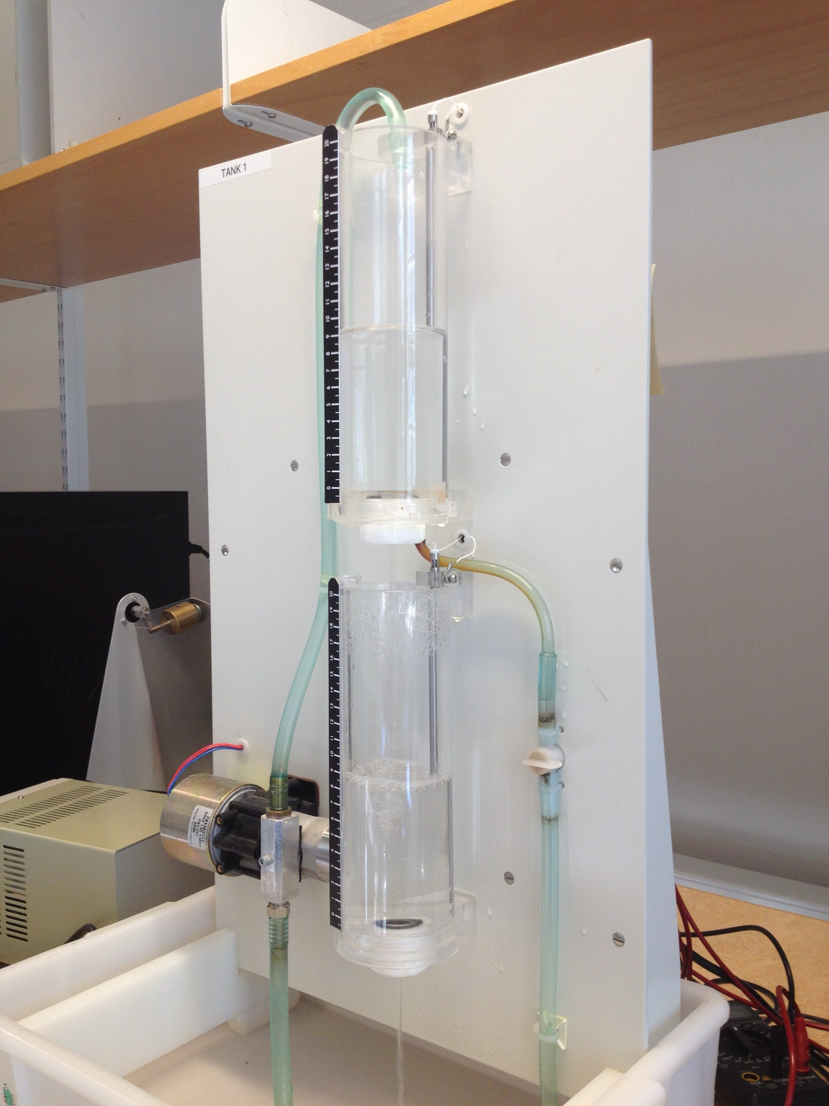
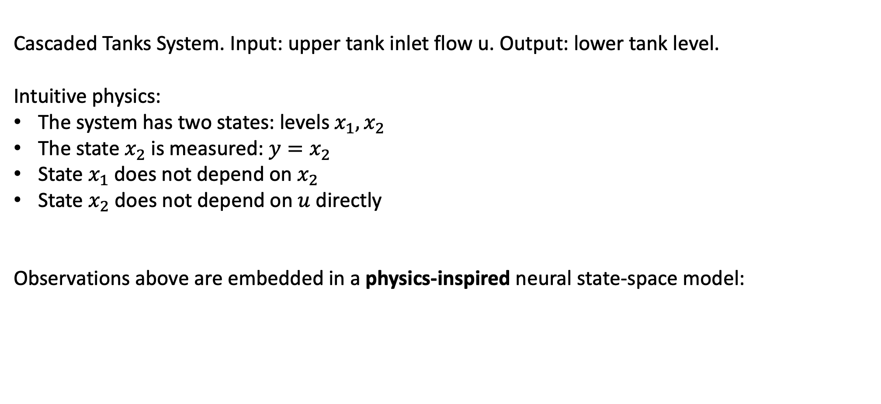
Physics-inspired neural state-space models
Cascaded Tanks System. Input: upper tank inlet flow u. Output: lower tank level.
Intuitive physics:
The system has two states: levels $x_{1},x_{2}$
The state $x_{2}$ is measured: $y=x_{2}$
State $x_{1}$ does not depend on $x_{2}$
State $x_{2}$ does not depend on $u$ directly
Observations above are embedded in a physics-inspired neural state-space model:
Schoukens, M. et al. "Cascaded tanks benchmark combining soft and hard nonlinearities." Workshop on nonlinear system identification benchmarks, 2016.
Identification results in Forgione, M. and Piga, D. "Continuous-time system identification with neural networks: Model structures and fitting criteria.” European Journal of Control, 2021

Slide 5
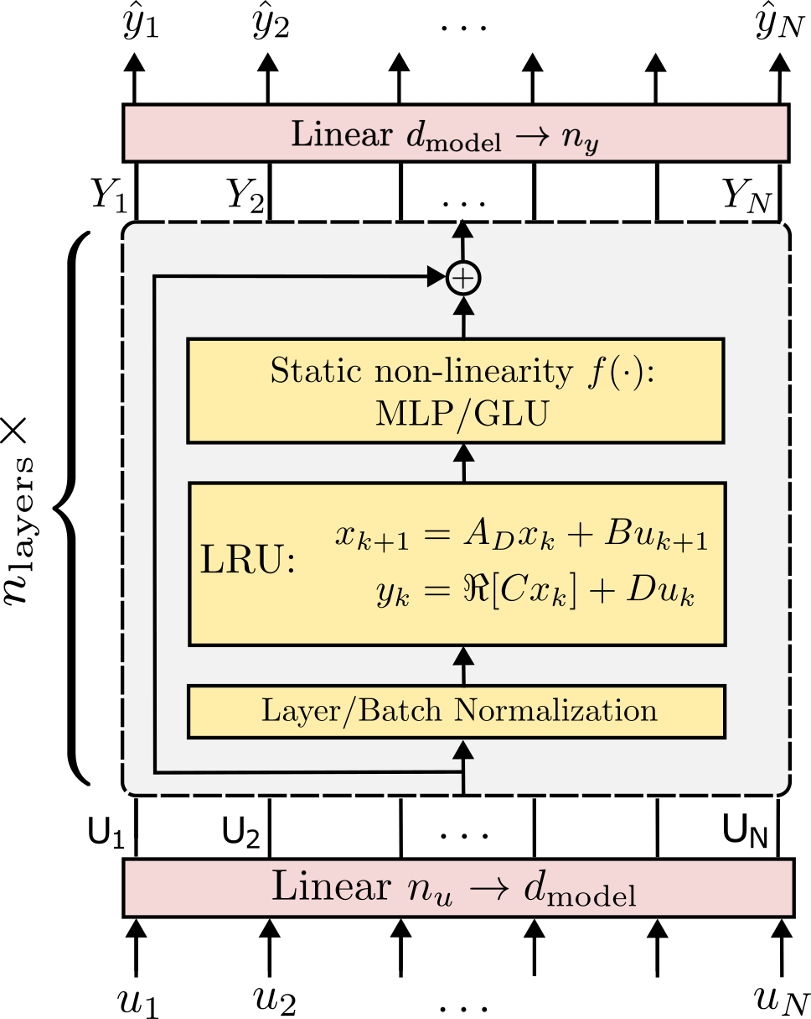
Physics-inspired neural state-space models
Several contributions aim at embedding prior knowledge in the architecture.
Lagrangian neural networks
M. Cranmer et al., Lagrangian Neural Networks, 2020
Hamiltonian neural networks S. Greydanus et al., Hamiltonian Neural Networks, 2019
Structured state-space sequence models A. Gu et al., Efficiently Modeling Long Sequences with Structured State Spaces, 2022
… and many, many more!
From M. Forgione, M. Mejari, and D. Piga Model order reduction of deep structured state-space models: A system-theoretic approach, 2024

Slide 6
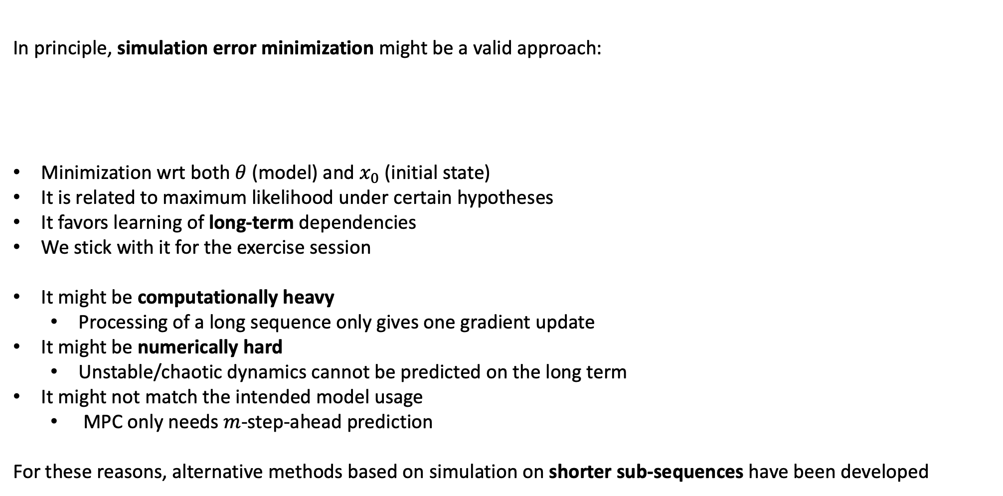
Simulation error minimization
In principle, simulation error minimization might be a valid approach:
Minimization wrt both $θ$ (model) and $x_{0}$ (initial state)
It is related to maximum likelihood under certain hypotheses
It favors learning of long-term dependencies
We stick with it for the exercise session
It might be computationally heavy
Processing of a long sequence only gives one gradient update
It might be numerically hard
Unstable/chaotic dynamics cannot be predicted on the long term
It might not match the intended model usage
MPC only needs $m$-step-ahead prediction
For these reasons, alternative methods based on simulation on shorter sub-sequences have been developed

Slide 7

Truncated simulation error minimization
Different $m$-step-ahead error minimization schemes have been developed:
Simulate $b$ (batch size) shorter sequences of length $m$ extracted from the longer (length-$N$) trainign dataset.
Main variation is: how do we deal with all possible initial conditions?

Slide 8

Truncated simulation error minimization
Different $m$-step-ahead error minimization schemes have been developed:
Start from an arbitrary initial state and discard a few initial samples from the loss computation
Make the full state sequence learnable (and regularize it with the model)
Learn a state estimator together with the state-space matrices
Truncated back-propagation through time

Slide 9

Zero initialization strategy
Initialize from arbitrary (ZERO) state and discard a few initial samples from the loss
Described as a baseline in M.Forgione, M.Mejari, and D.Piga, Learning neural state-space models: do we need a state estimator?, 2022
Very simple, yet effective when the system memory is short (wrt sequence length $m$)

Slide 10

Learn the hidden state sequence
Learn the sequence of states along with the system mappings $f$ and $g$
Regularize the learned state sequence with the systep mapping
Described in M.Forgione and D.Piga, Continuous-time system identification with neural networks, 2021

Slide 11
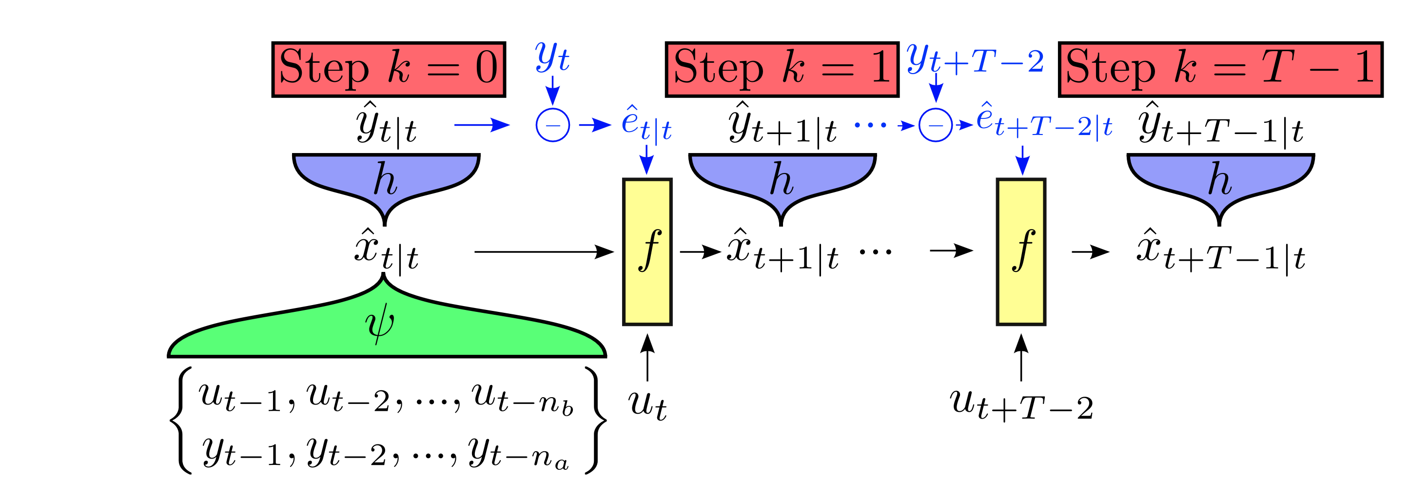
Learn a state estimator along with the model (SUBNET)
Use the initial samples of each sequence to learn a mapping that reconstruct the initial state
See G. Beintema, M. Schoukens, R.Tóth Deep subspace encoders for nonlinear system identification, 2022
From G. Beintema, M. Schoukens, R.Tóth Deep subspace encoders for nonlinear system identification, 2022

Slide 12


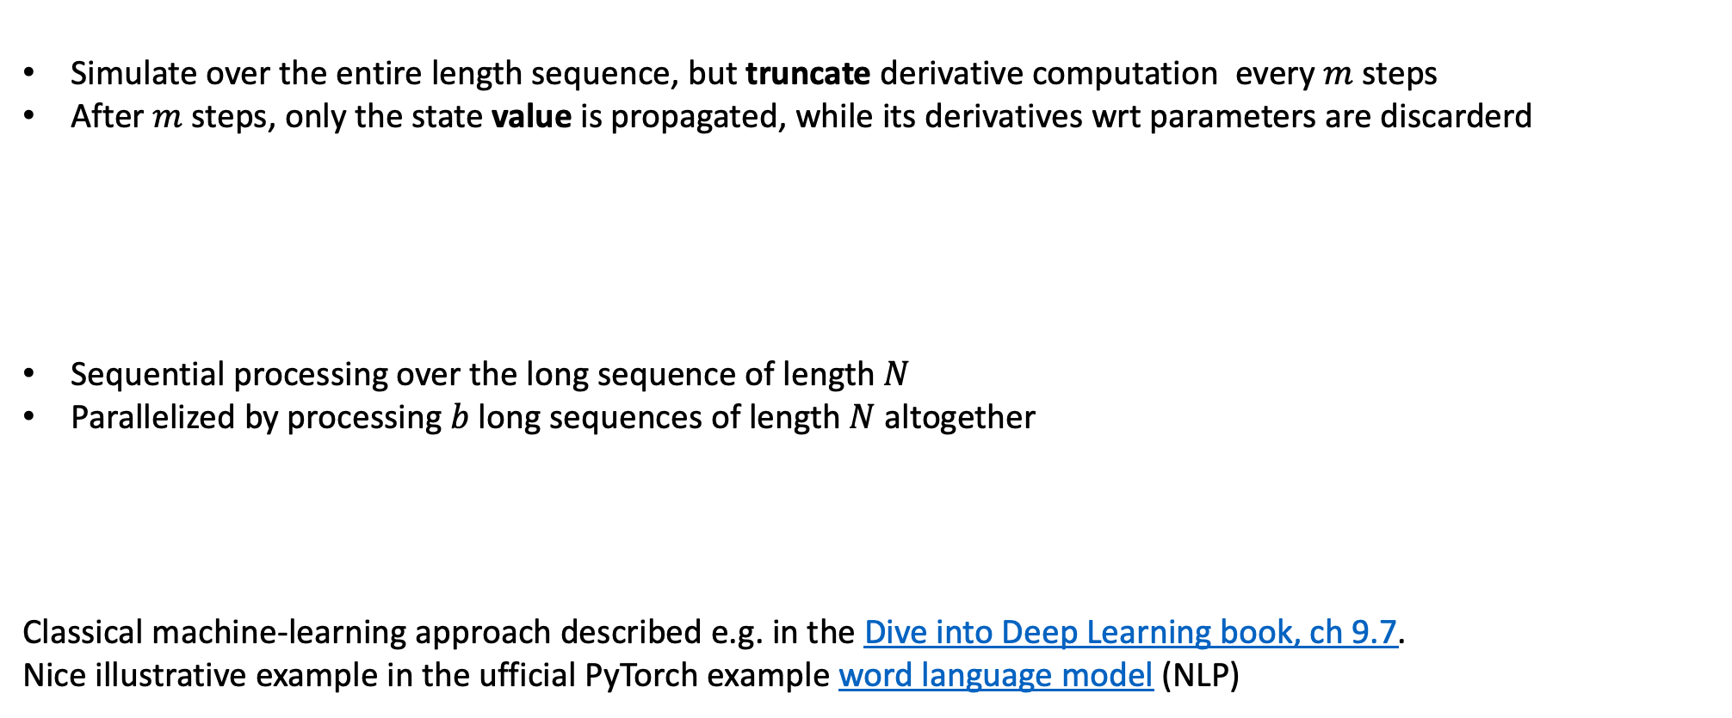
Truncated back-propagation through time
Simulate over the entire length sequence, but truncate derivative computation every $m$ steps
After $m$ steps, only the state value is propagated, while its derivatives wrt parameters are discarderd
Sequential processing over the long sequence of length $N$
Parallelized by processing $b$ long sequences of length $N$ altogether
Classical machine-learning approach described e.g. in the Dive into Deep Learning book, ch 9.7. Nice illustrative example in the ufficial PyTorch example word language model (NLP)
$m$ steps
$N$ steps
Notes:
https://github.com/pytorch/examples/blob/main/word_language_model/main.py

Slide 13
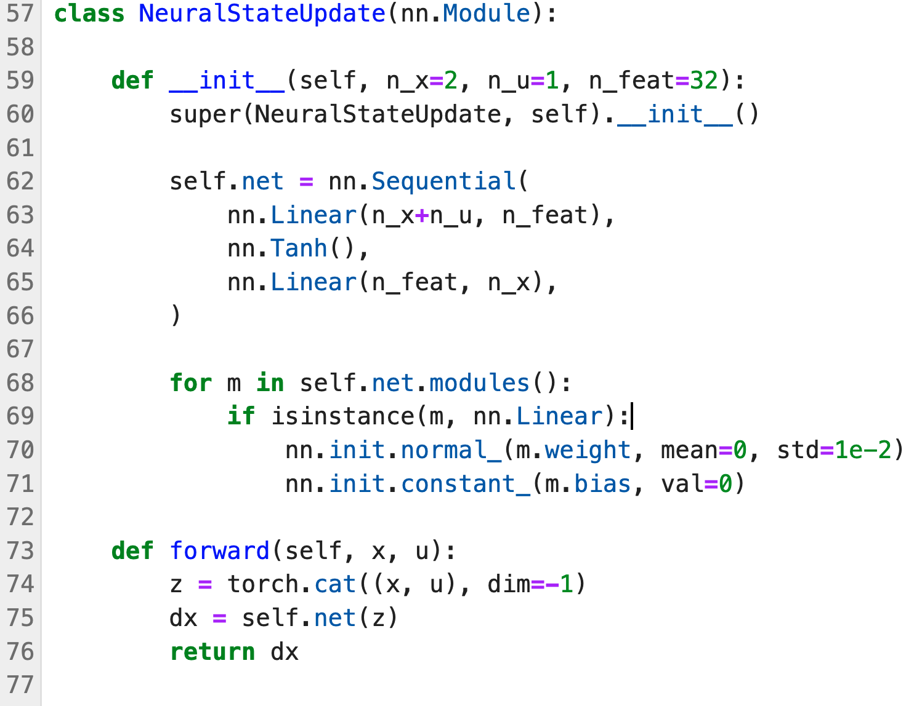
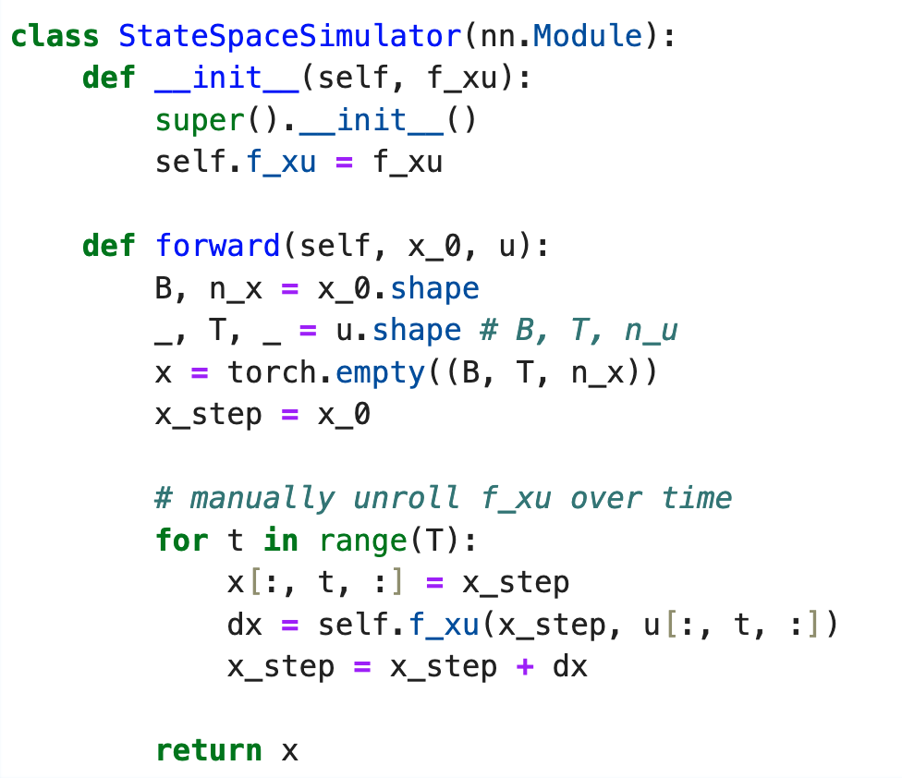


PyTorch Implementation
Unlike with standard RNNs, we must work at a slightly lower level
Note:
we actually implement:
we make a custom weight initialization
Code adapted from https://github.com/forgi86/pytorch-ident
Custom state-update function $f(x,u)$
Custom code to unroll $f(x,u)$ over time
Notes:
https://github.com/pytorch/examples/blob/main/word_language_model/main.py

Slide 14
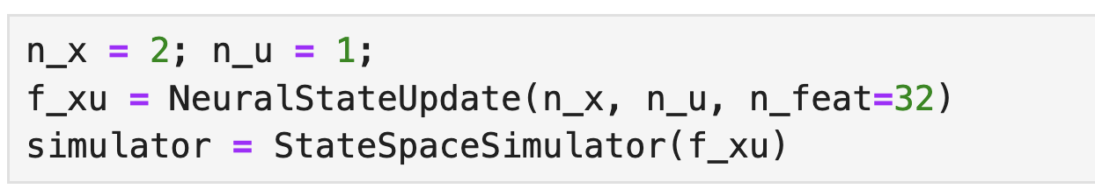
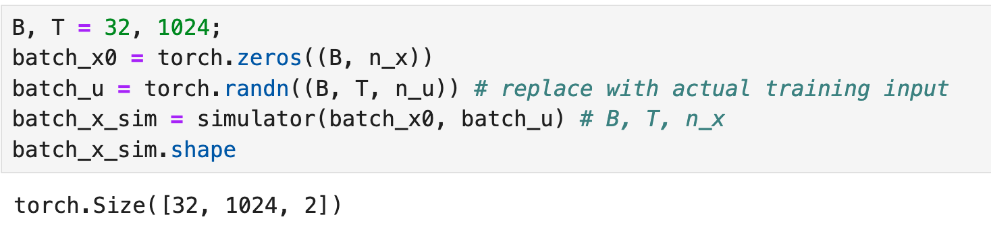

PyTorch Implementation
We can then instantiate a model that behaves very similarly to a standard PyTorch RNN
The model accepts a batch of initial states (B, n_x) and input sequences (B, T, n_u) and returns a batch of simulated states (B, T, n_x)
We may finally process batch_x_sim through a feed-forward network to simulate the output
equation $y=g(x)$. Alternatively, we may set the output to a subset of the simulated states.
Notes:
https://github.com/pytorch/examples/blob/main/word_language_model/main.py

Slide 15
Thank you for your attention

