Slide 1
Exercise: Meta Learning for Static Regression

Slide 2
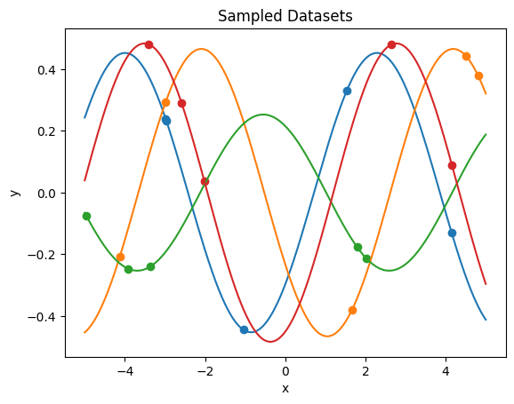

The “sine” meta learning example
Sines of varying phase and amplitude
Simple dependency, but just $K=5$ points per dataset!
Taken from the famous MAML paper
The “Hello World” Meta Learning problem!

Slide 3
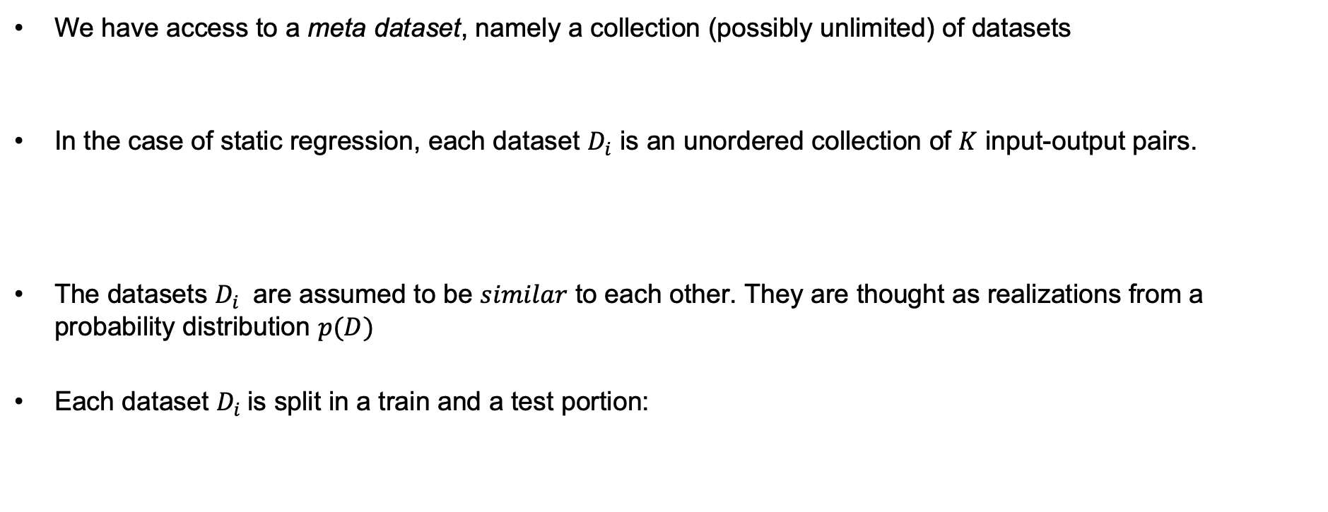
Meta Learning Setting
We have access to a meta dataset, namely a collection (possibly unlimited) of datasets
In the case of static regression, each dataset $D_{i}$ is an unordered collection of $K$ input-output pairs.
The datasets $D_{i}$ are assumed to be $similar$ to each other. They are thought as realizations from a probability distribution $p(D)$
Each dataset $D_{i}$is split in a train and a test portion:

Slide 4
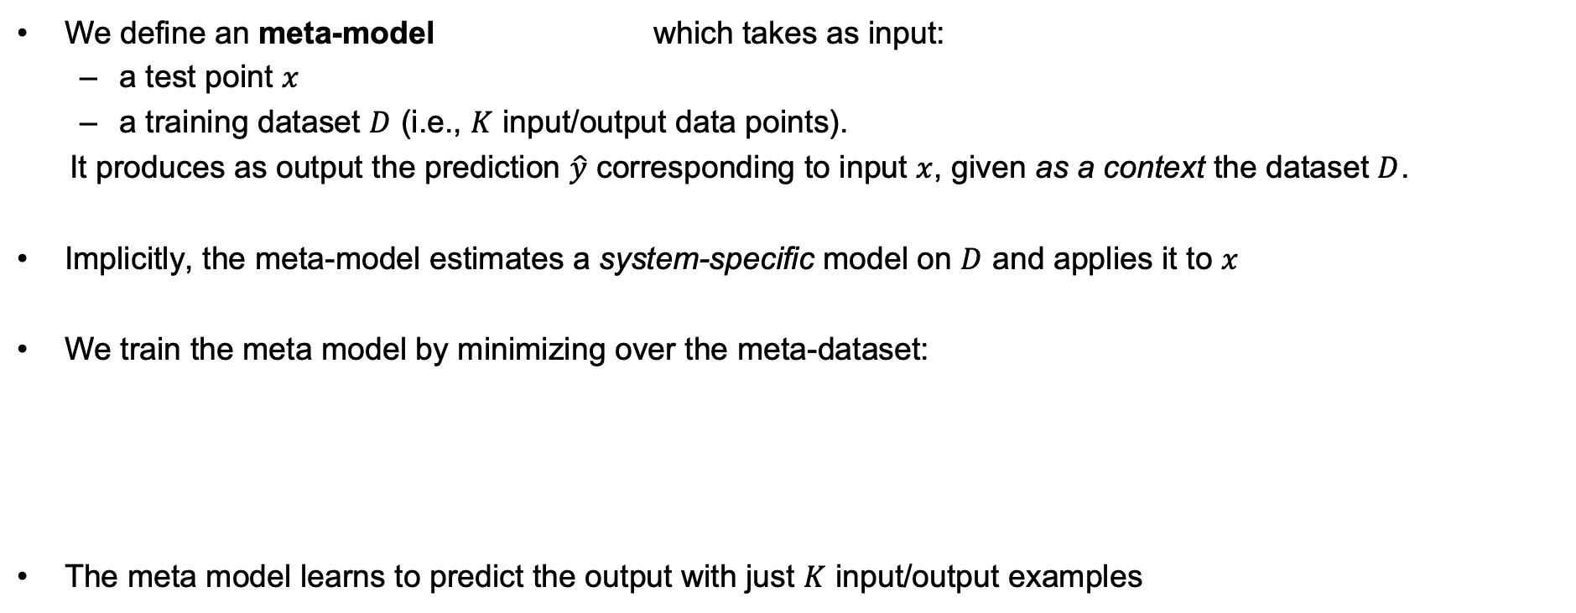
Meta Learning: In-context learning
We define an meta-model which takes as input:
a test point $x$
a training dataset $D$ (i.e., $K$ input/output data points).
It produces as output the prediction $\hat{y}$ corresponding to input $x$, given as a context the dataset $D$.
Implicitly, the meta-model estimates a system-specific model on $D$ and applies it to $x$
We train the meta model by minimizing over the meta-dataset:
The meta model learns to predict the output with just $K$ input/output examples

Slide 5
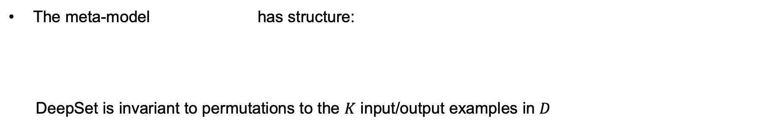
In-context learning architecture for static regression
The meta-model has structure:
DeepSet is invariant to permutations to the $K$ input/output examples in $D$
MLP_DS
MLP
MLP_DS
mean
MLP_DS

Slide 6
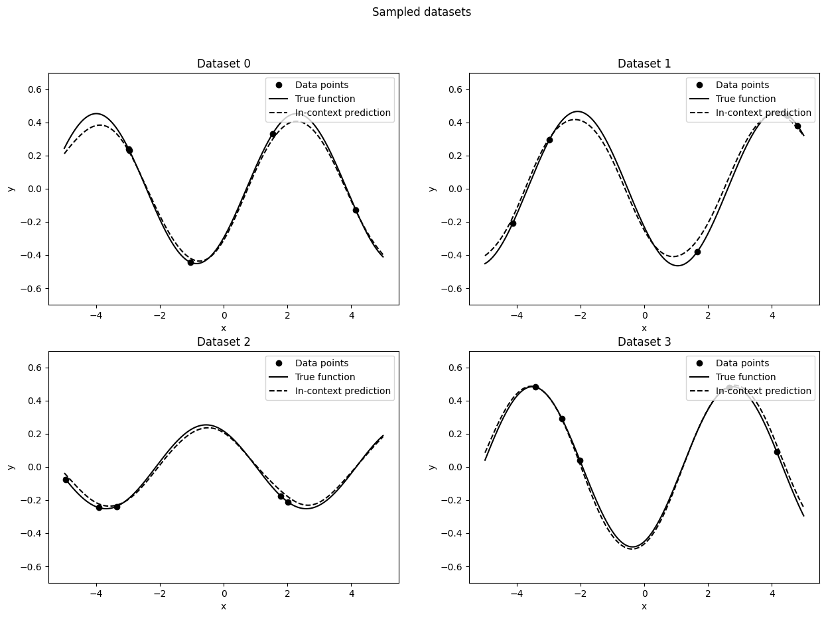
Performance with meta learning (in-context learning)
The meta model learns to make pretty good predictions with $K=5$ data points

Slide 7
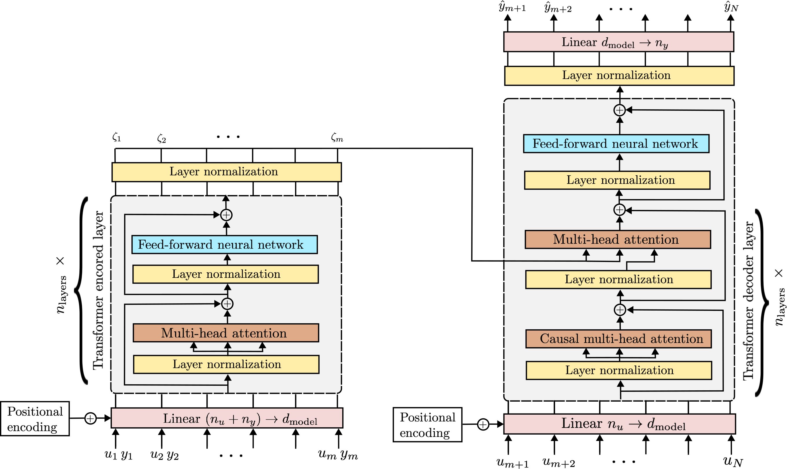
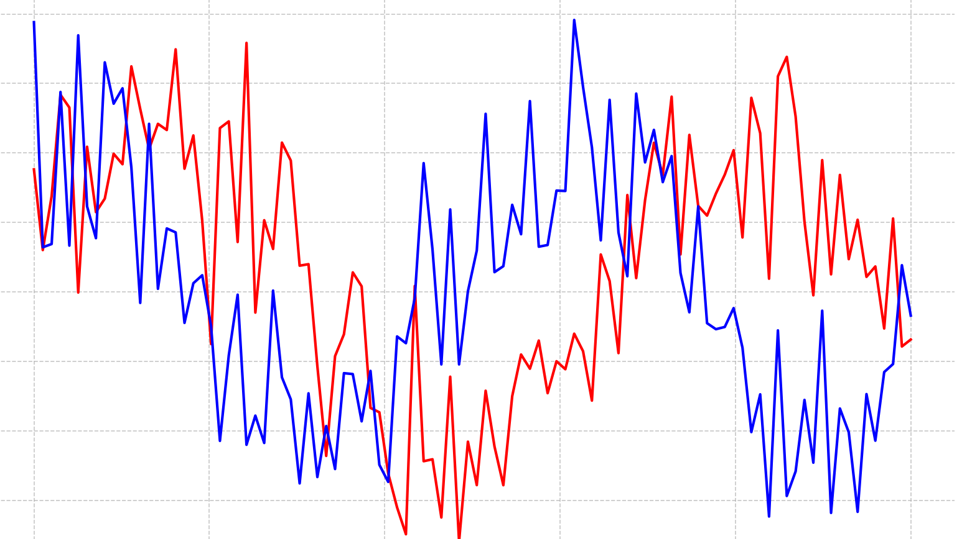
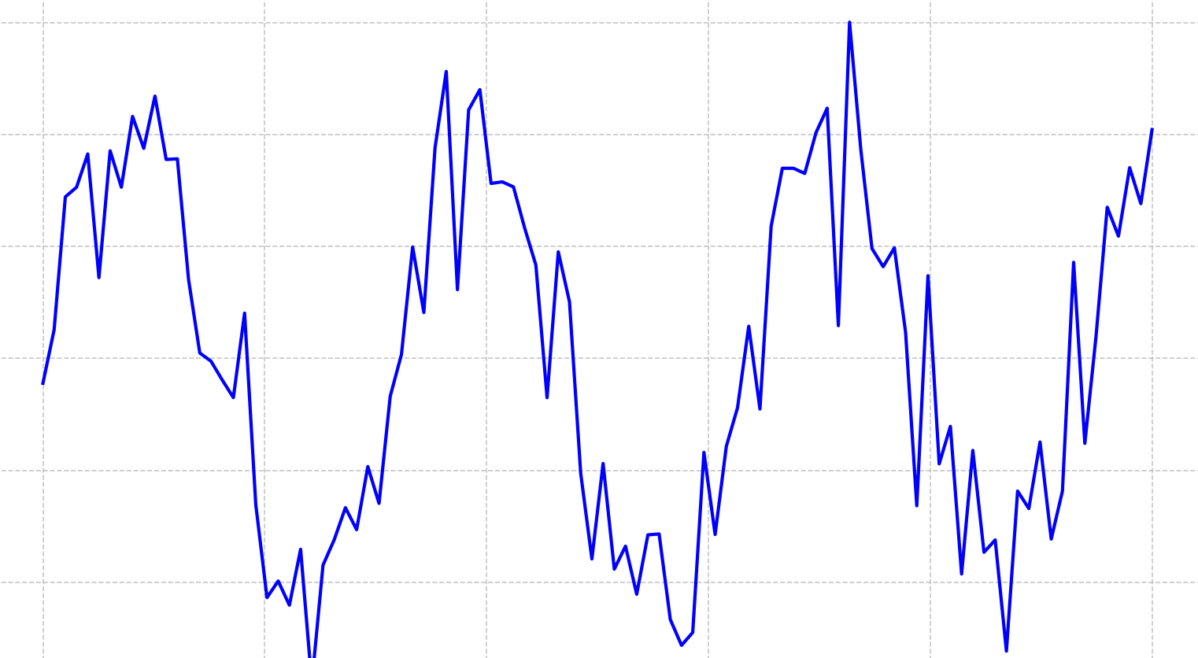
In-context learning architecture for system identification
May be seen as a simplification of the encoder-decoder Transformer for system identification
The Transformer’s attention layers are ideal to deal with intricate temporal dependencies of SYSID.
For the sines example, the simple DeepSet+MLP architecture is more than enough…
M. Forgione, F. Pura, D. Piga, In-context learning for model-free system identification, IEEE Control Systems Letters, September 2023

Slide 8
Exercise
Implementation of the in-context learning architecture for static regression DeepSet + MLP is sketched in in_context_learning_sketch.ipynb
Use it to tackle the meta learning exercise (meta_learning_exercise.ipynb)
Optionally, apply hyper-networks and MAML (sketched in maml_hypernet_sketch.ipynb, described in the next slides…)

Slide 9

Meta Learning with Hyper-Nerworks
A hyper-network provides weight and biases of the model MLP describing the relation $x→y$
The hyper-network may be seen as a learned system identification algorithm
MLP_DS
MLP_DS
MLP
mean
MLP_DS

Slide 10
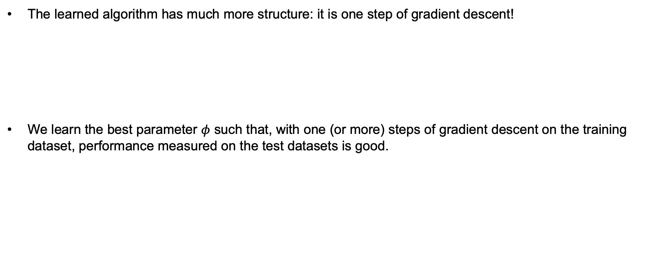
Gradient-Based Meta Learning (MAML)
The learned algorithm has much more structure: it is one step of gradient descent!
We learn the best parameter $φ$ such that, with one (or more) steps of gradient descent on the training dataset, performance measured on the test datasets is good.
Finn, Chelsea, Pieter Abbeel, and Sergey Levine. "Model-agnostic meta-learning for fast adaptation of deep networks.” International conference on machine learning. PMLR, 2017.

