Slide 1
Deep Learning

Slide 2
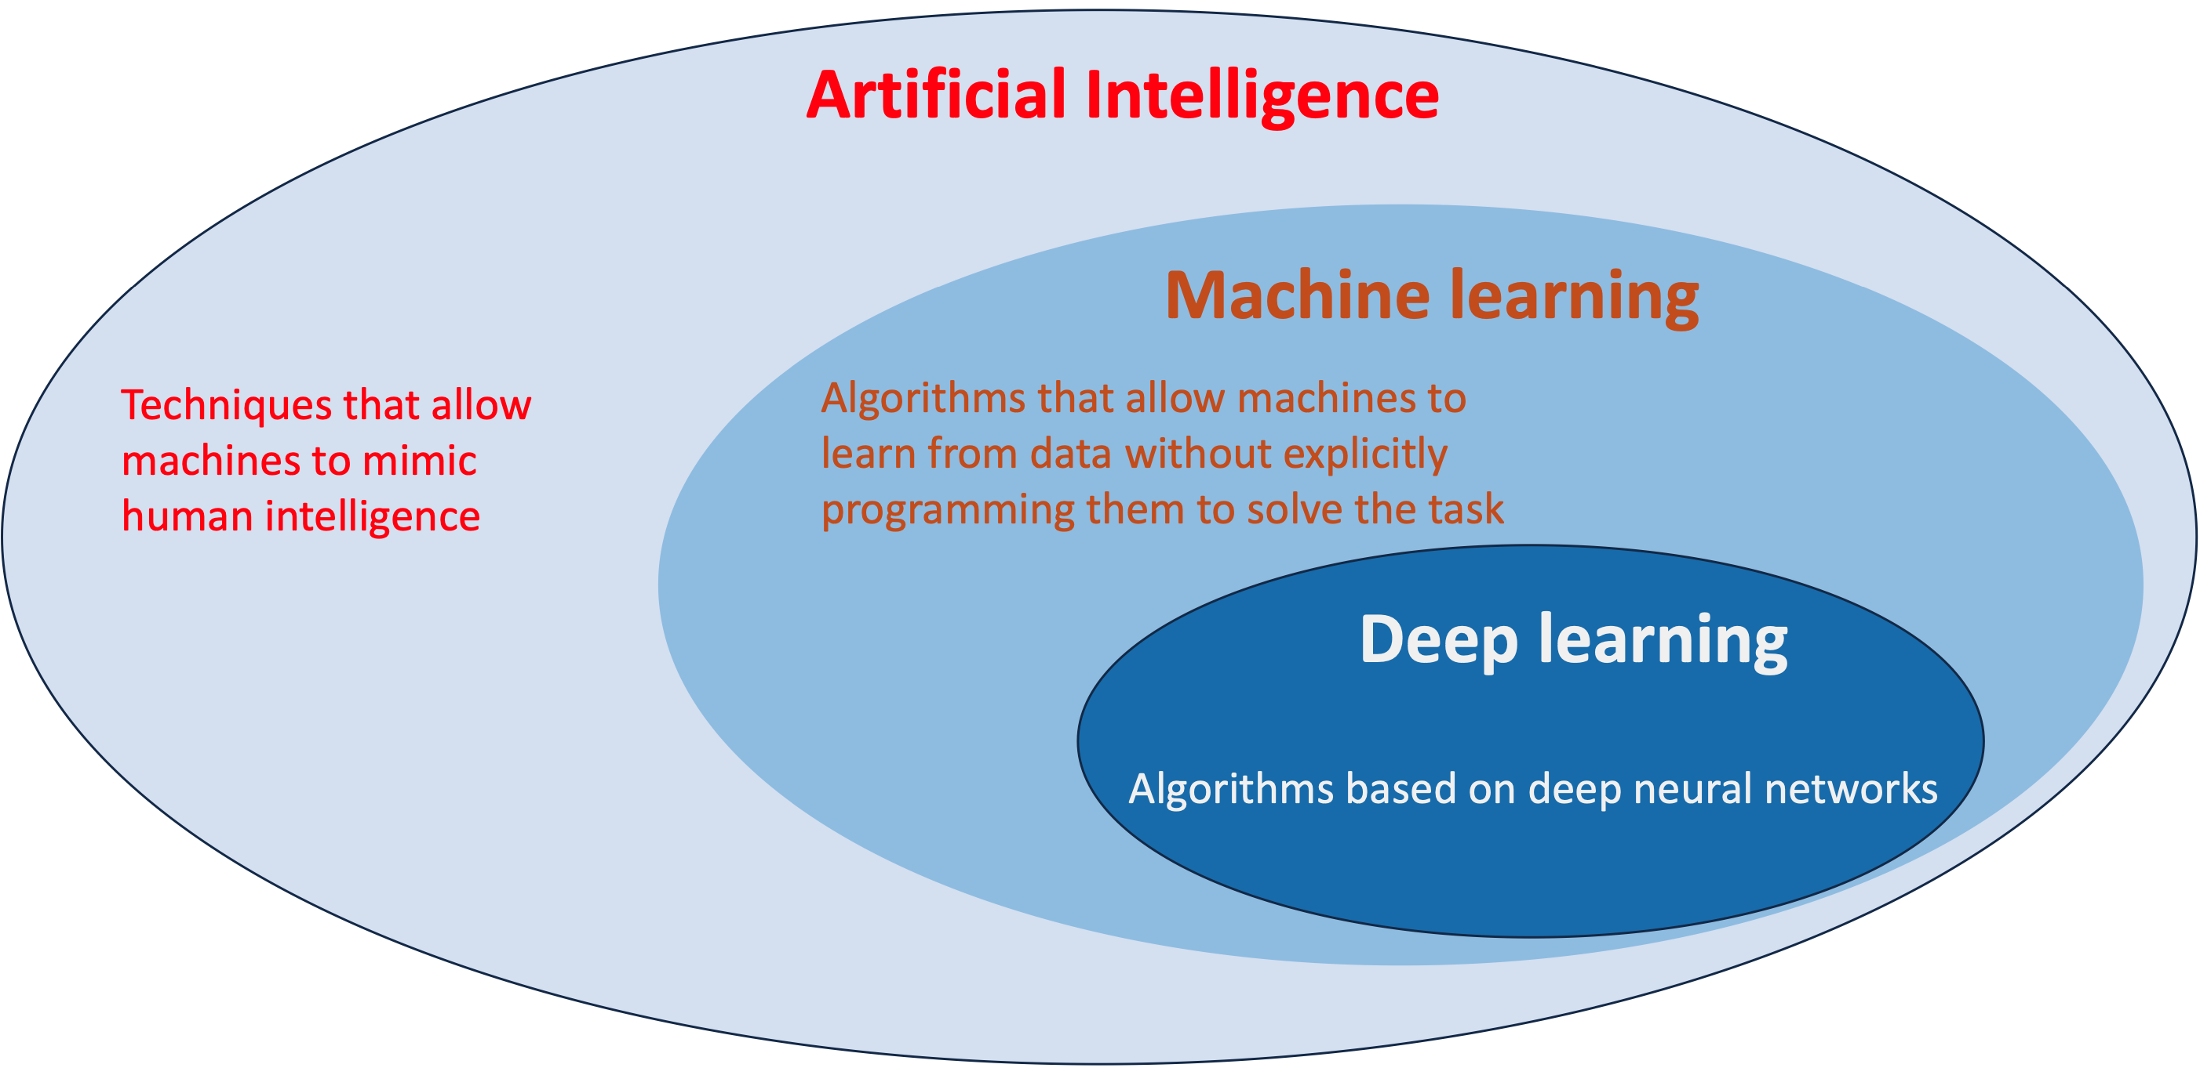
Artificial Intelligence, Machine Learning, Deep Learning

Slide 3
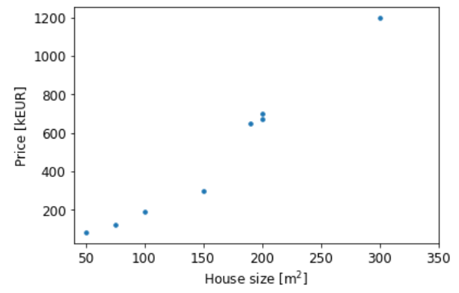
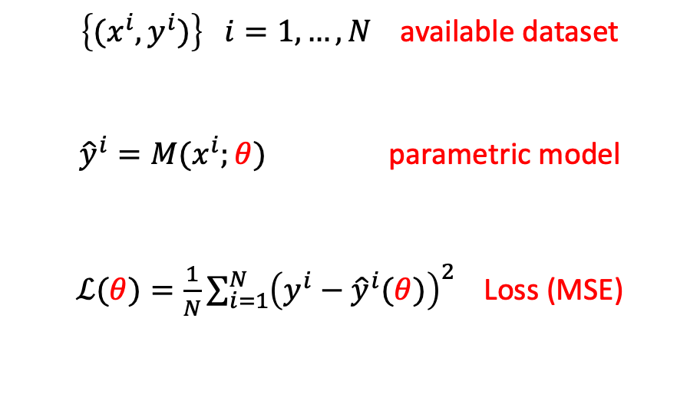

Machine Learning: Regression
Real estate application
$\left\{{(x}^{i},y^{i})\right\} i=1,…,N$ available dataset
${\hat{y}}^{i}=M(x^{i};θ)$ parametric model
$ℒ(θ){=\frac{1}{N}\sum_{i=1}^{N}{{\left(y^{i}−{\hat{y}}^{i}(θ)\right)}^{2}}}_{ }$ Loss (MSE)
$$θ^{∗}=arg\min_{θ}{ℒ(θ)}$$

Slide 4
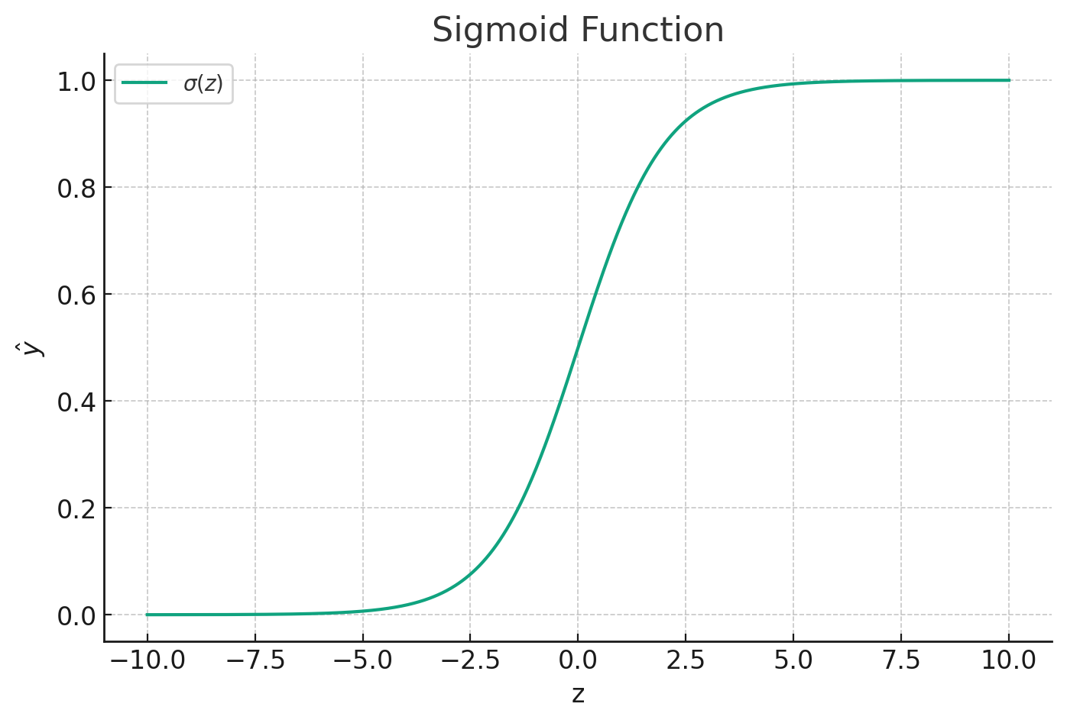
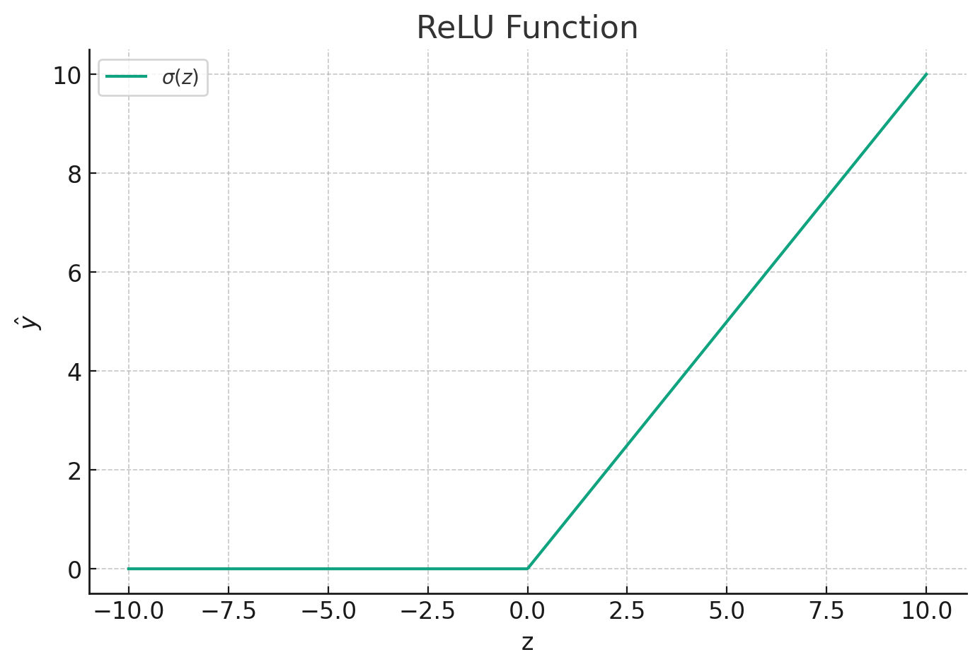

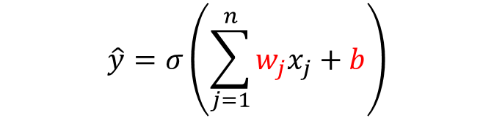



Basic units for Neural Networks
x₁
w₁
nonlinear activation function
Σ
$$\hat{y}$$
x₂
w₂
z
$$σ$$
w_{d}
x_{d}
b
1
$$\hat{y}=σ\left(\sum_{j=1}^{n}{w_{j}x_{j}}+b\right)$$
$$σ\left(z\right)=\frac{1}{1+e^{−z}}=\frac{e^{z}}{1+e^{z}}$$
$$σ\left(z\right)= \left\{\begin{aligned}z if z≥0 \\ 0 if z<0\end{aligned}\right.$$
We have a non-linear relation between inputs and outputs!

Slide 5
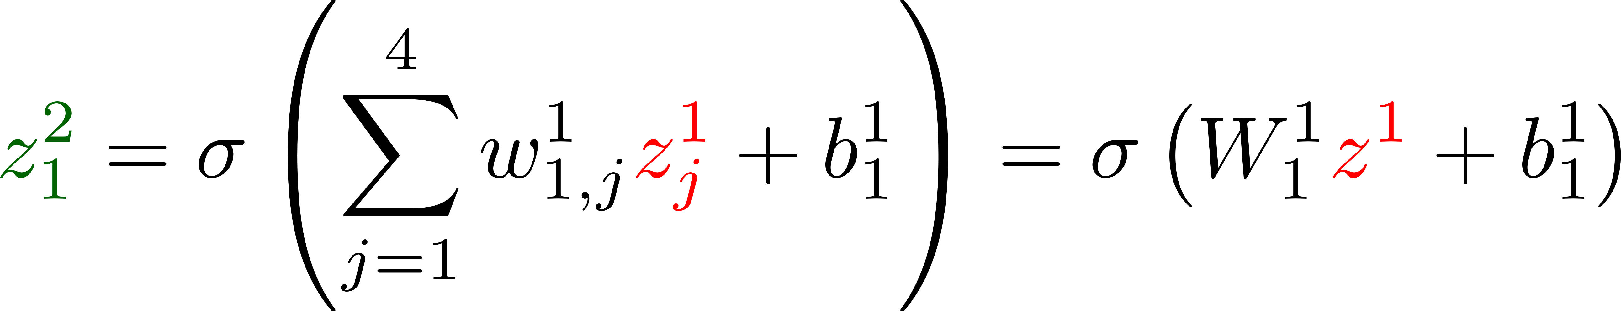
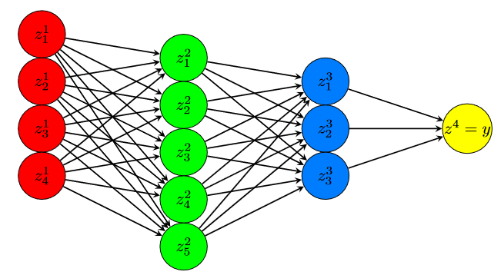
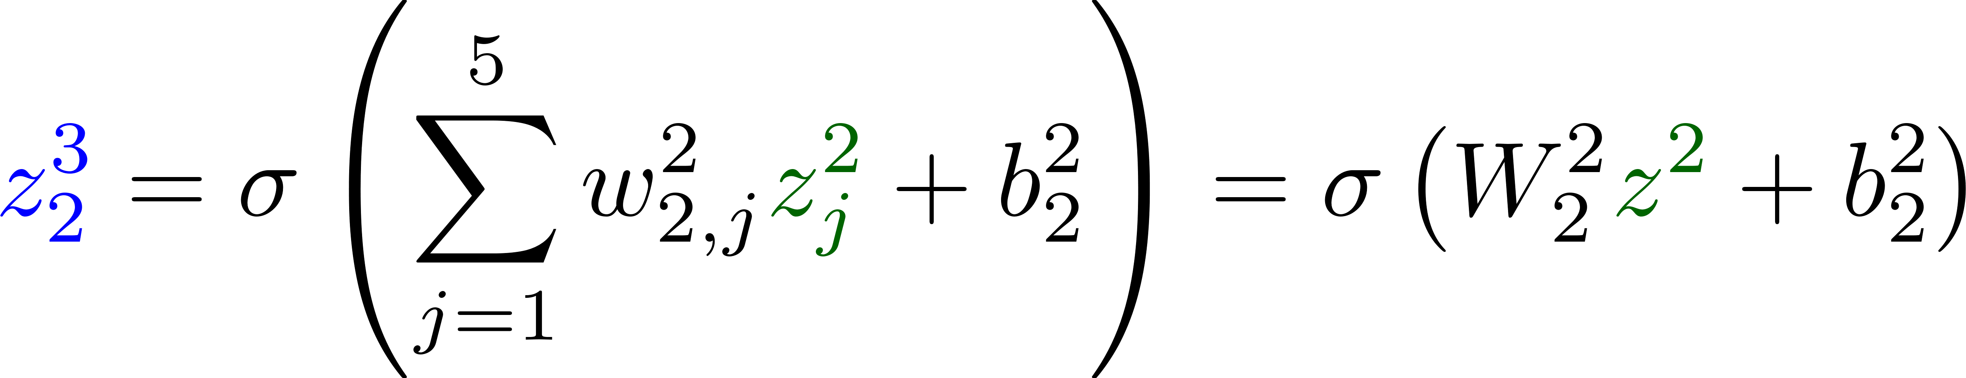
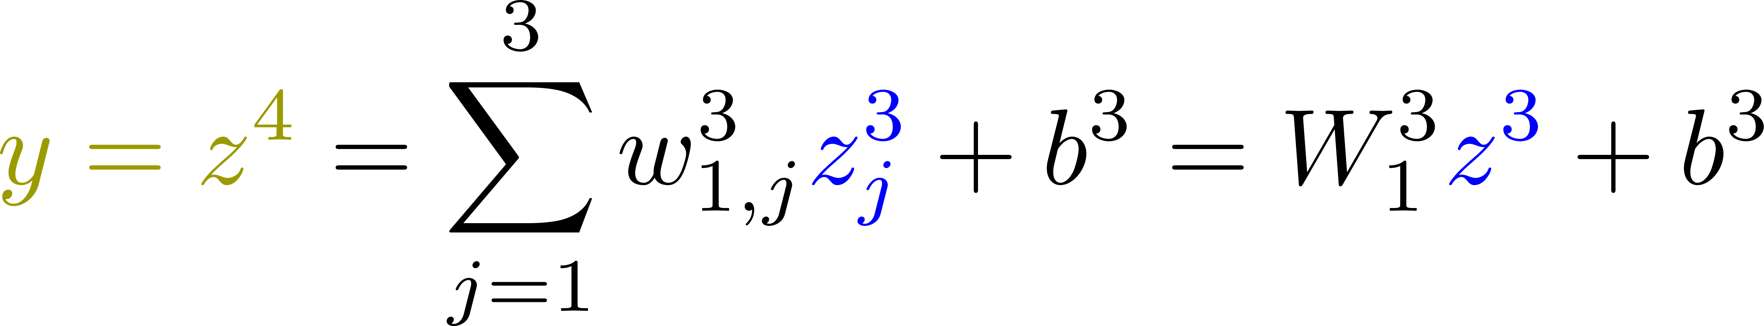
Fully-connected Feedforward Neural Networks
Move from one neuron to a hierarchical structure with fully connected neurons
Input layer
Output layer
Hidden layer 2
(Layer 3)
Hidden layer 1
(Layer 2)
We can easily define a NARX structures parameterized by the weights (and biases) of the network

Slide 6
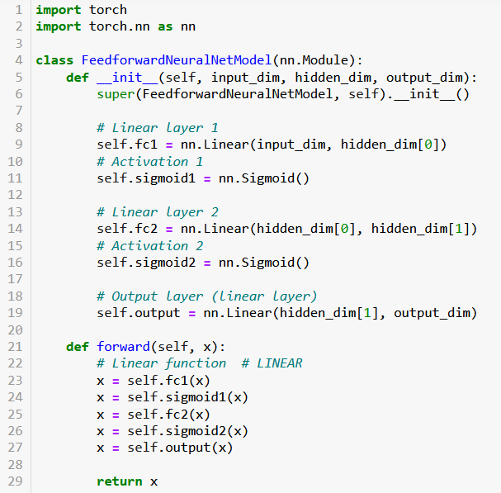
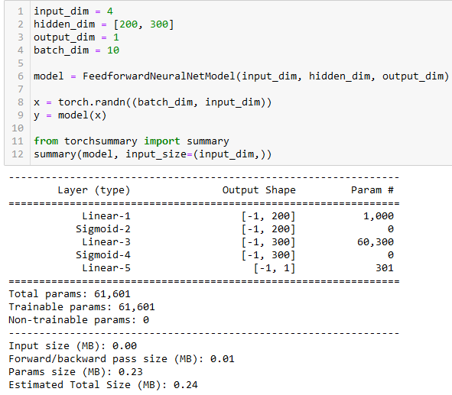
FFN: PyTorch
Definition of the model class
Instantiate the model class, run and show model

Slide 7
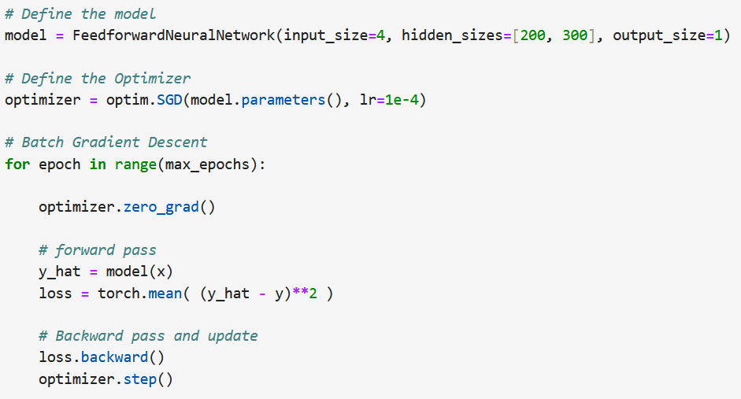
FFN: Training in PyTorch

Slide 8
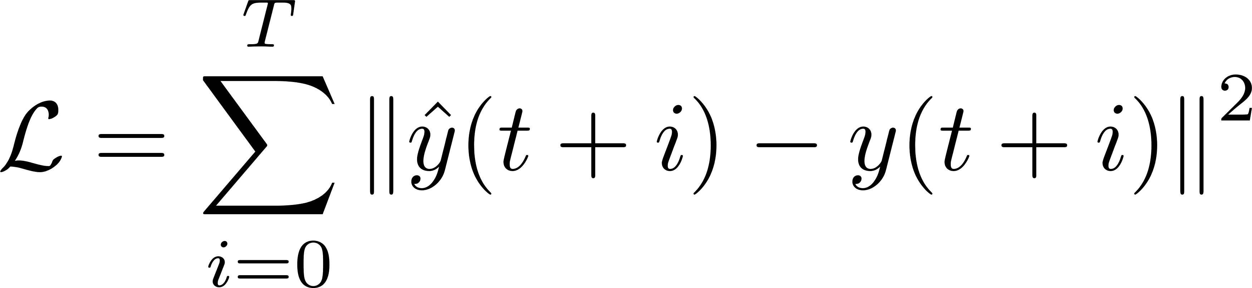





Recurrent Neural Networks (RNNs)
Architectures tailored to process time series data and temporal information (audio, text, video, signals, etc. )
$$\hat{y}(t)$$
$$\hat{y}(t)$$
$$\hat{y}(t+1)$$
$$\hat{y}(t+2)$$
$$\hat{y}(t+T)$$
h(t)
h(t)
h(t+1)
h(t+2)
h(t+T)
unfold
…
h(t-1)
u(t)
u(t)
u(t+1)
u(t+2)
u(t+T)
or skip some initial samples

Slide 9




Multi-layer RNN
$$\hat{y}(t)$$
$$\hat{y}(t+1)$$
$$\hat{y}(t+2)$$
$$\hat{y}(t+T)$$
…
…
…
…
…
Hidden states of a layer are also inputs of the next layer
…
…
u(t)
u(t+1)
u(t+2)
u(t+2)
u(t+T)

Slide 10
Bidirectional RNN
$$\hat{y}(t)$$
$$\hat{y}(t+1)$$
$$\hat{y}(t+2)$$
$$\hat{y}(t+T)$$
…
…
…
…
…
Causality is lost. Might not be useful for prediction, but for tasks like smoothing
…
…
u(t)
u(t+1)
u(t+2)
u(t+2)
u(t+T)

Slide 11
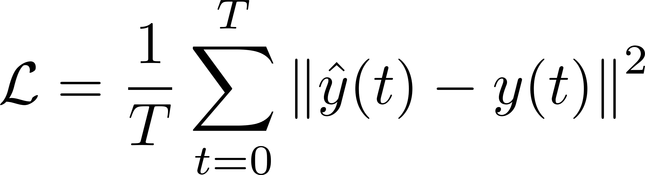
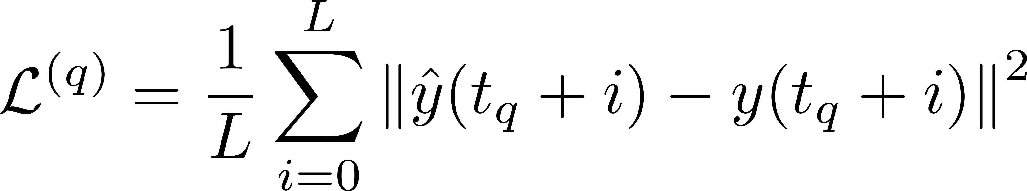
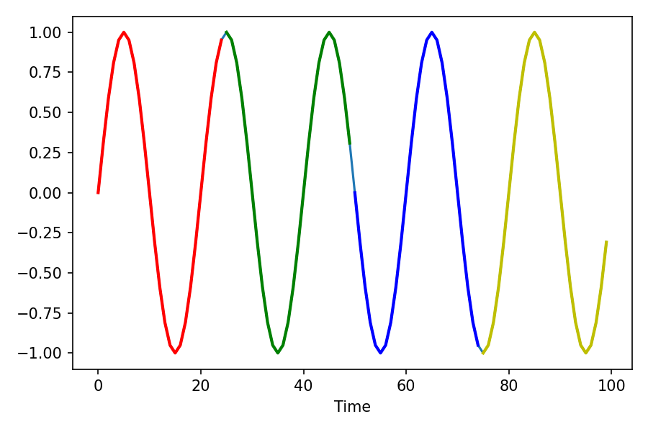
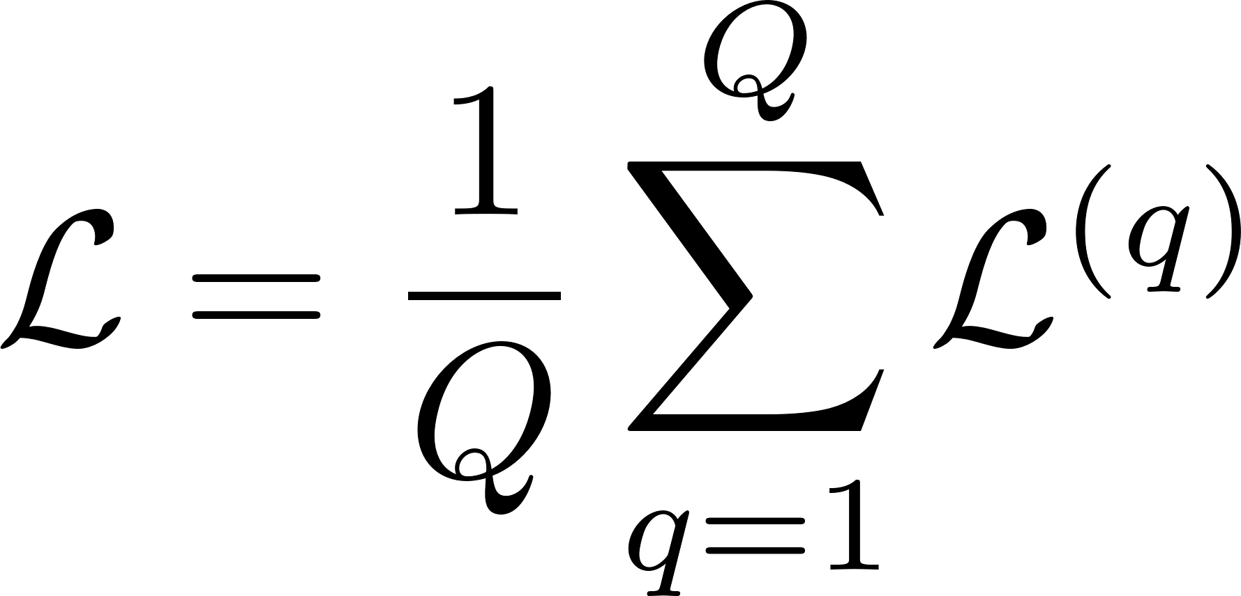
Creating training data
Given an input/output sequence of length T, we can unfold the network up to T steps (you simulate T-step time ahead)
… or we can split the sequence into shorter sub-sequences (overlapped or not) of length L<<T, and thus create batch of sub-sequences. Network is unfolded for L steps (when you train, you predict L-step time ahead)

Slide 12
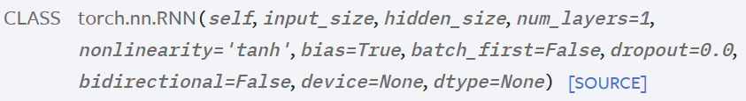
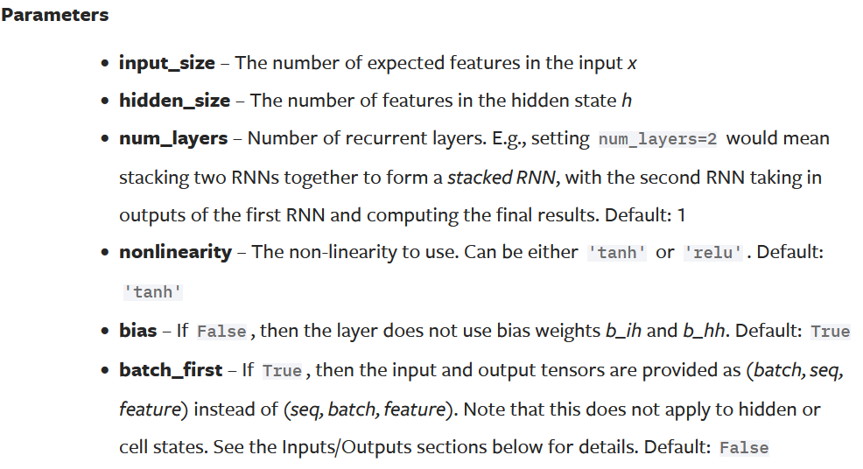
Vanilla Recurrent Neural Network
h(t)
u(t)

Slide 13
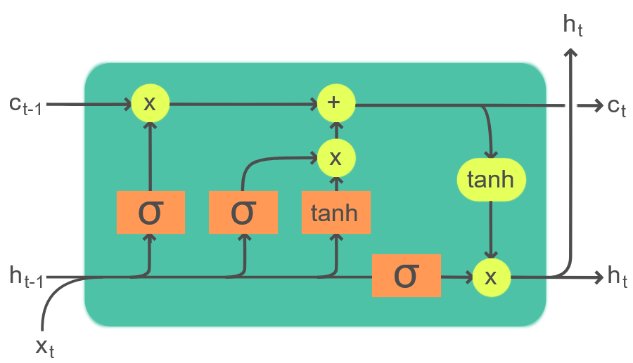
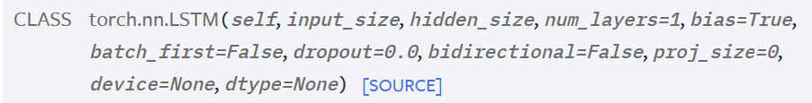
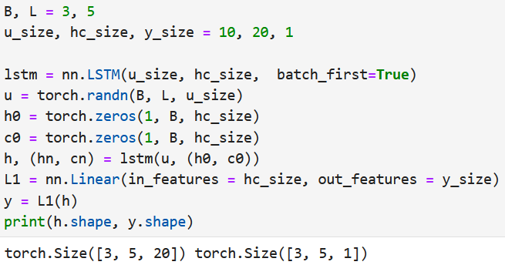
LSTM: Long Short-Term Memory Neural Networks
h(t)
h(t)
c(t)
Image by Guillaume Chevalier, CC BY-SA 4.0, via Wikimedia Commons
u(t)
Hochreiter, S., & Schmidhuber, J. (1997). Long short-term memory. Neural Computation, 9(8), 1735–1780

Slide 14
Backpropagation

Slide 15
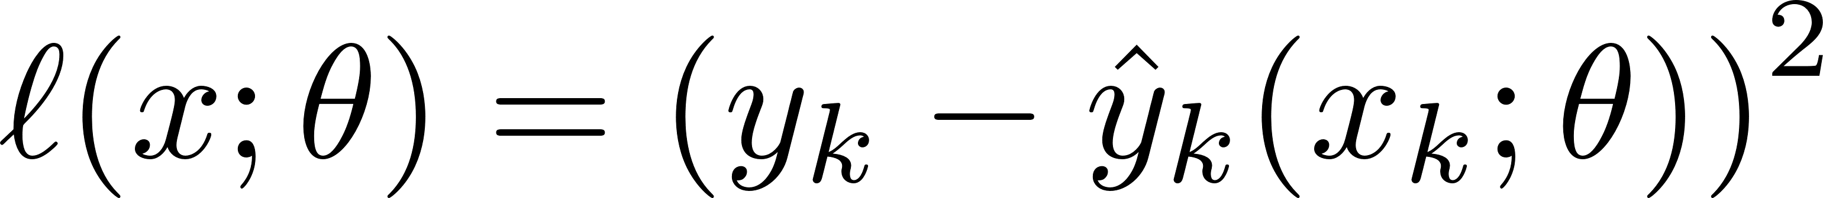
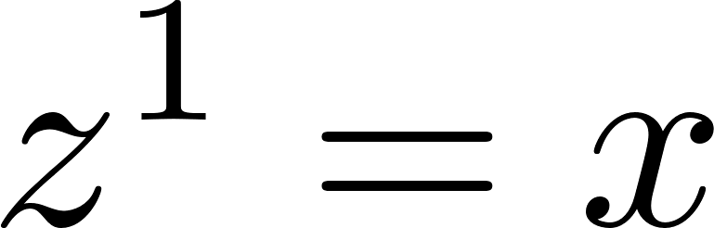
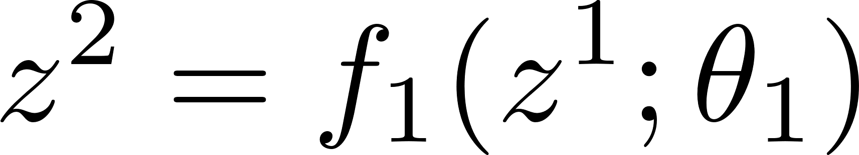
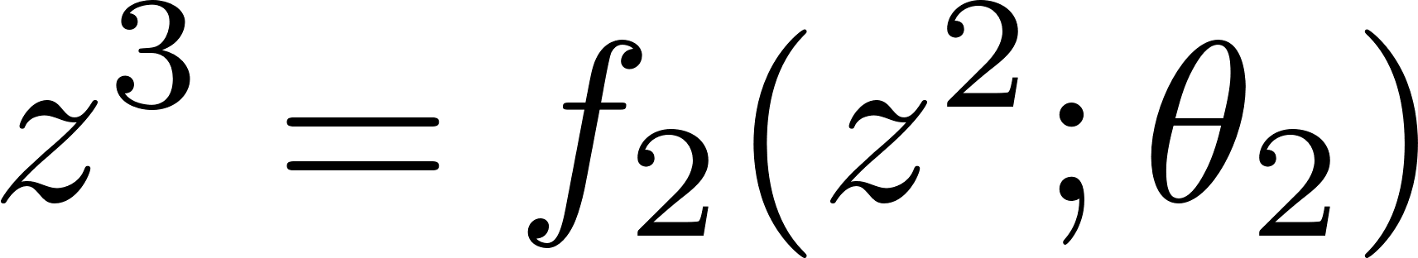
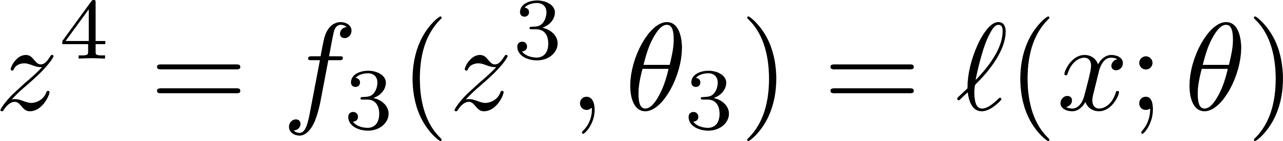



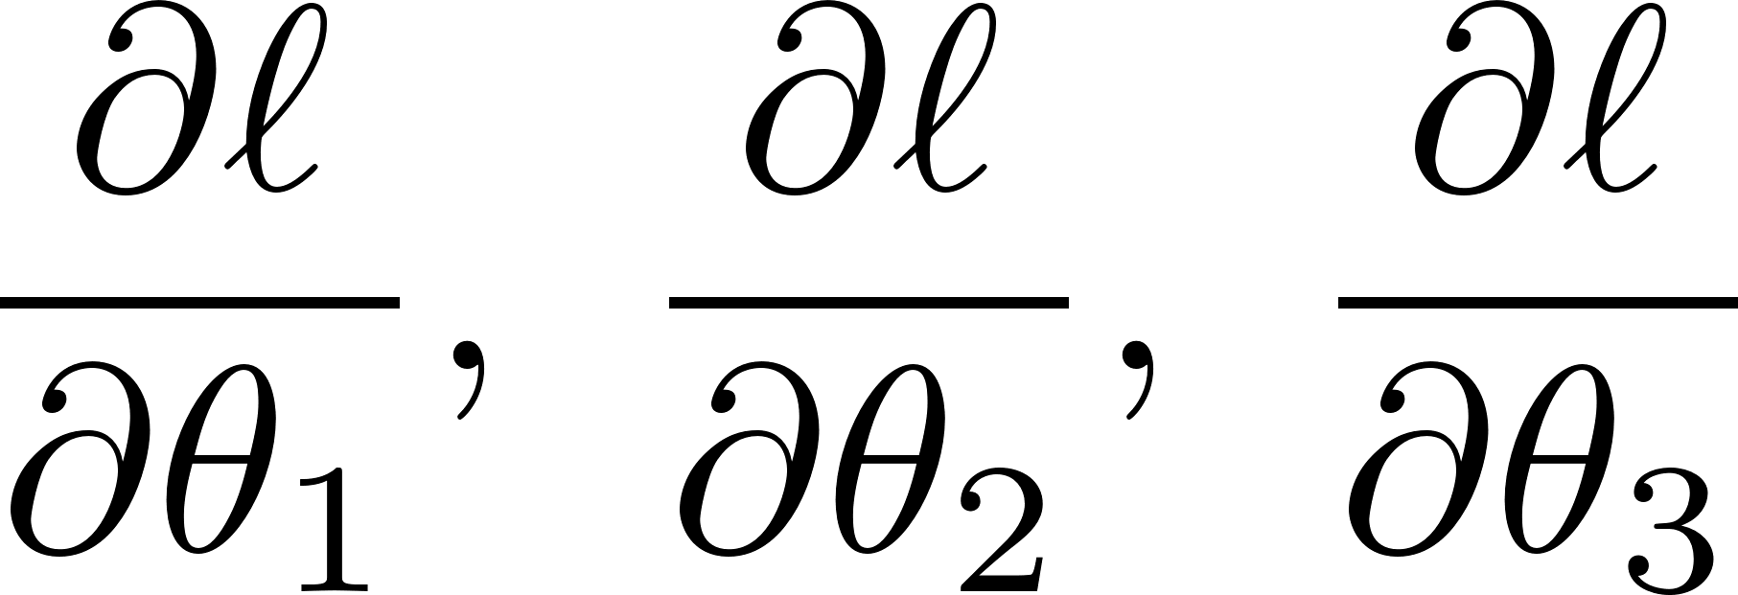
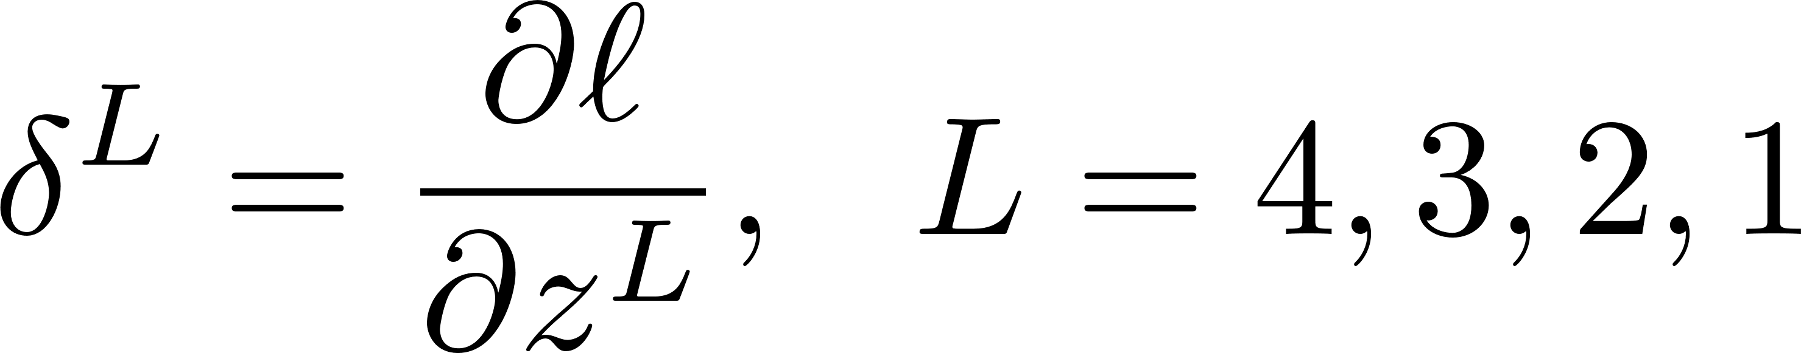
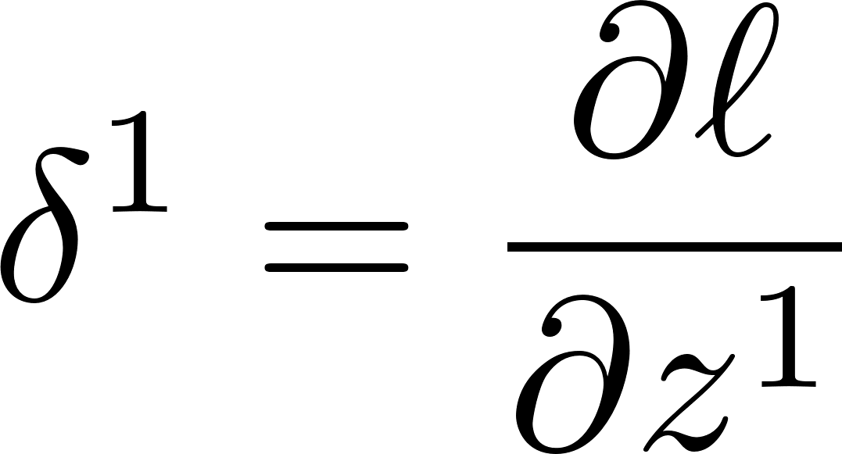
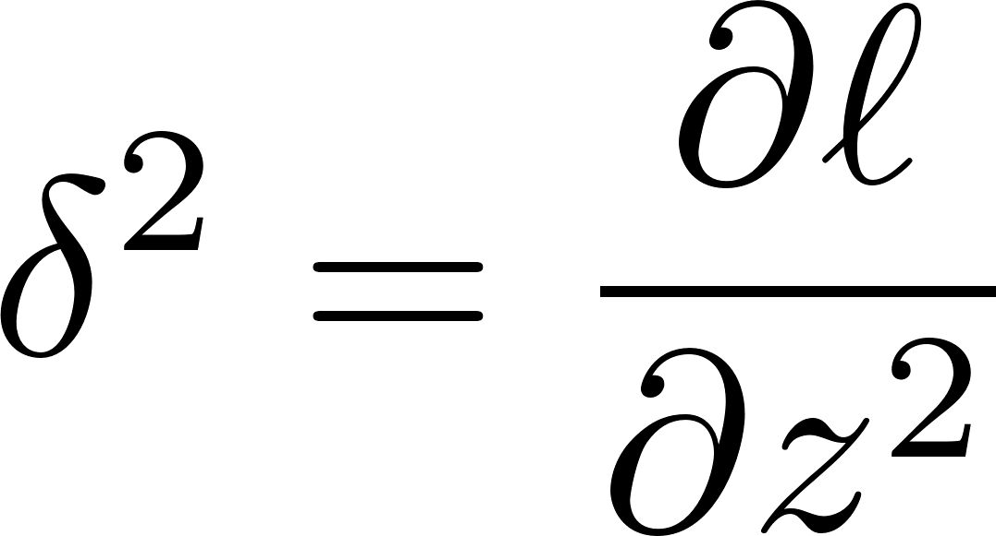

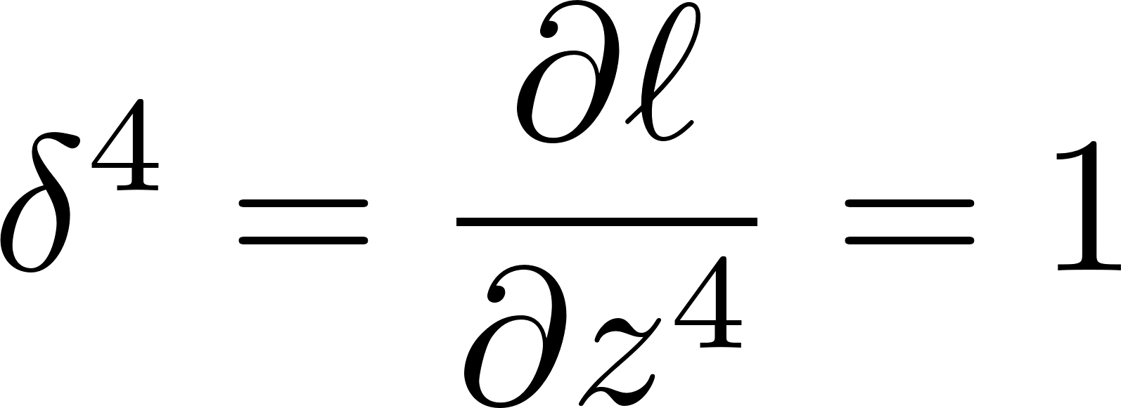
Back-propagation I
Layer 1
Layer 2
Layer 3
What we want:
Idea: Back propagate
Layer 1
Layer 2
Layer 3

Slide 16
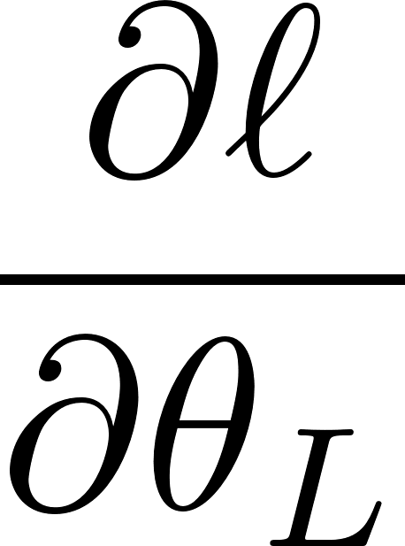
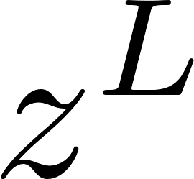
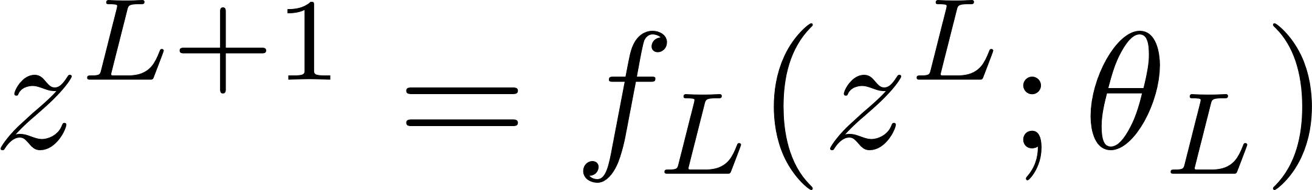
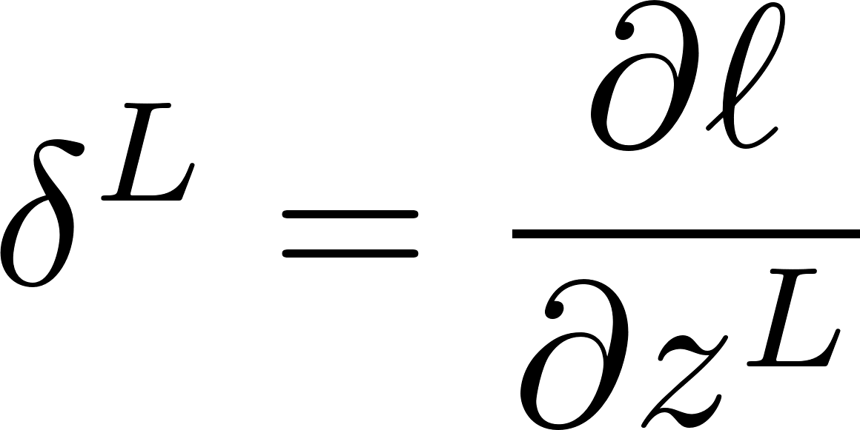

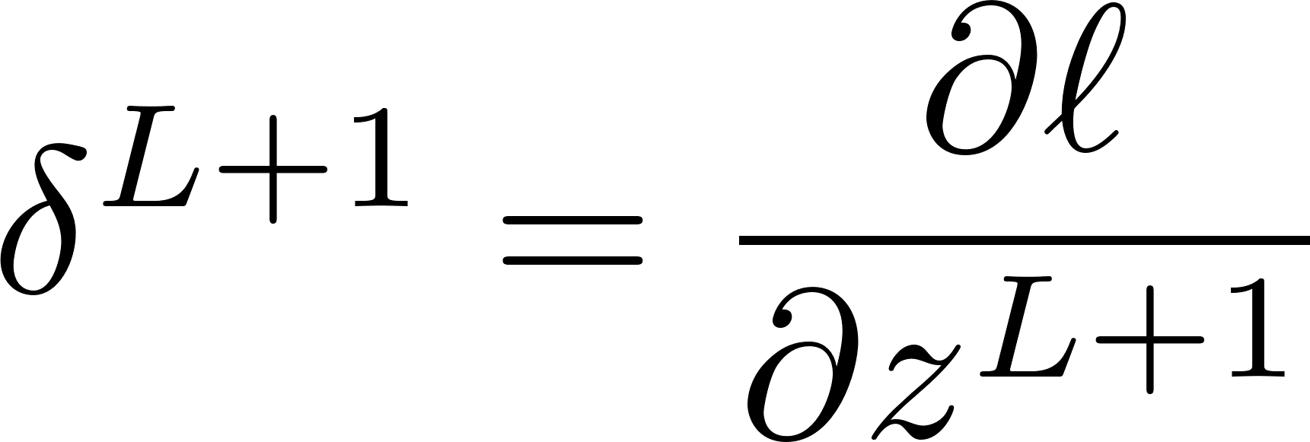
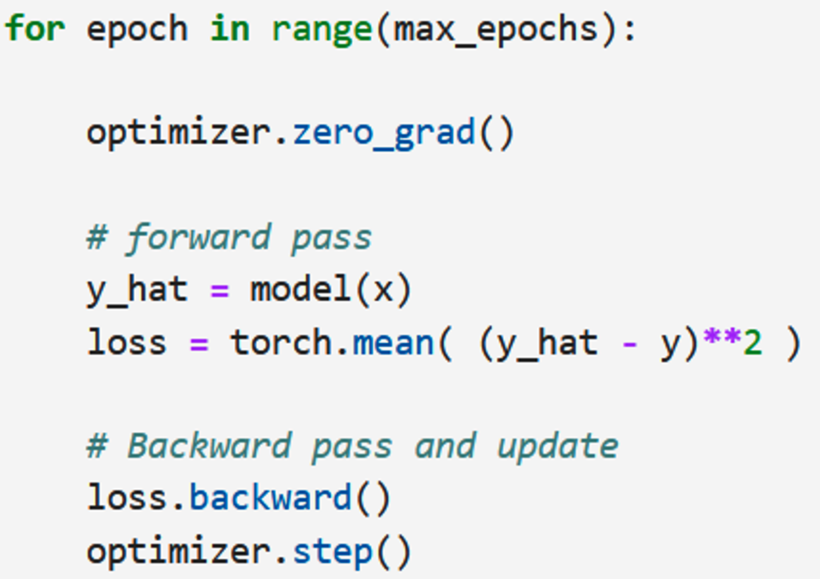
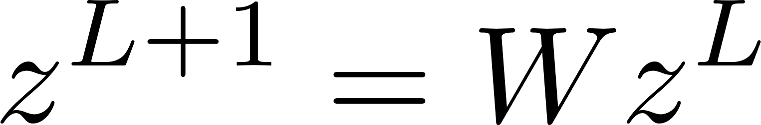
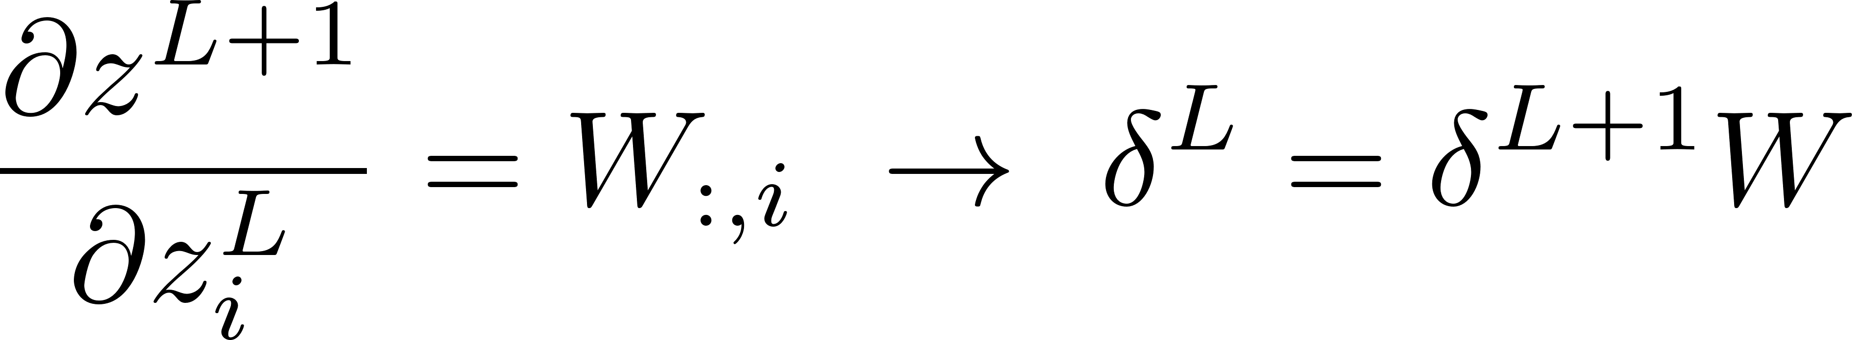

Back-propagation II
Focus on Layer L
Layer L
We have an interface to connect blocks/layers and recursively compute the derivatives!
Technicalities
Sigmoid activation function:
$σ\left(z\right)=\frac{1}{1+e^{−z}}=\frac{e^{z}}{1+e^{z}}$; $σ′\left(z\right)=σ\left(z\right)$(1- $σ\left(z\right)$)
Linear layer:
Algorithm: reverse-mode automatic differentiation. Application to neural network training is called back-propagation.

