Slide 1
Regression with Feed-Forward Neural Networks
Exercises in PyTorch
Nome e cognome relatore/i, funzione e settore SUPSI

Slide 2
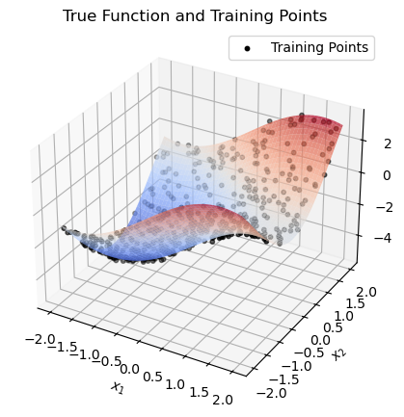
2D regression on synthetic data (synthetic_2d folder)
Consider the 2D function
Training and test datasets: 500 points uniformly sampled in the domain.
Additive noise with standard deviation 0.1

Slide 3
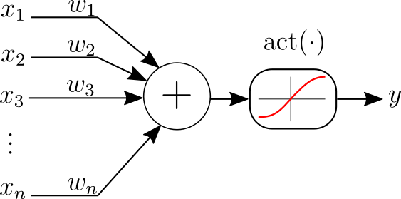
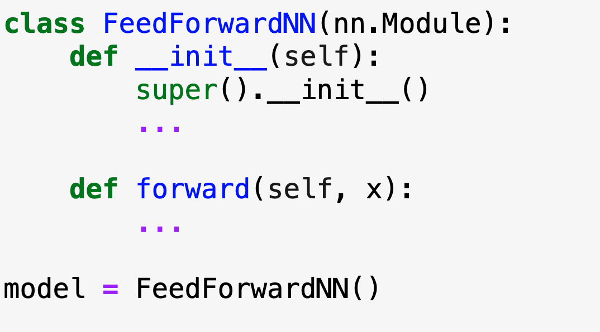

Feed-forward neural network model
2 inputs, 1 output - this is the structure of $f(x)$
2 hidden layers with [16, 8] neurons
tanh non-linearities

Slide 4
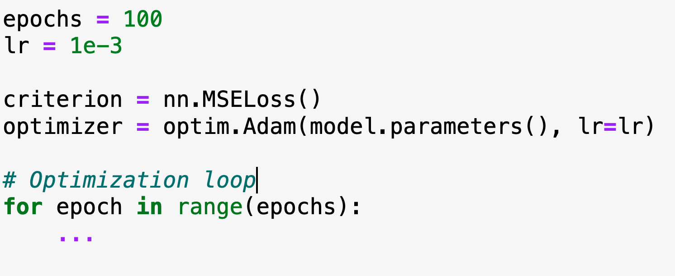
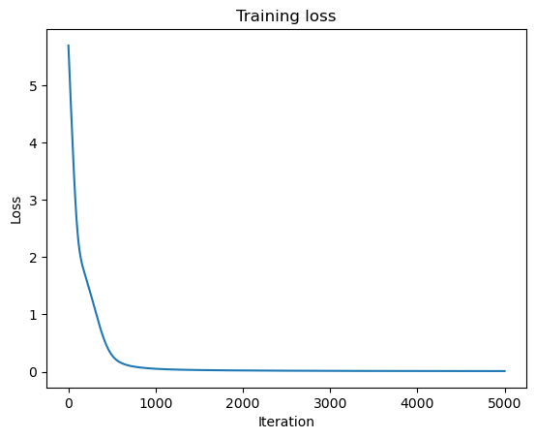
Model training

Slide 5
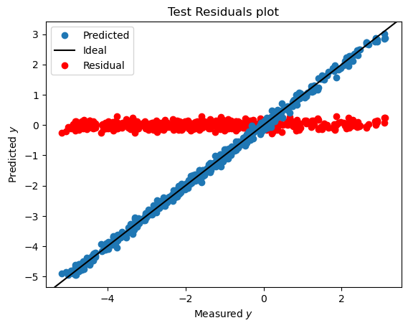
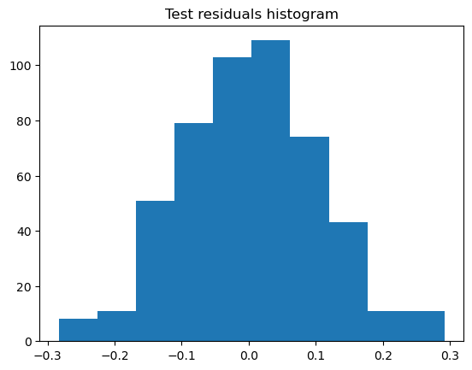
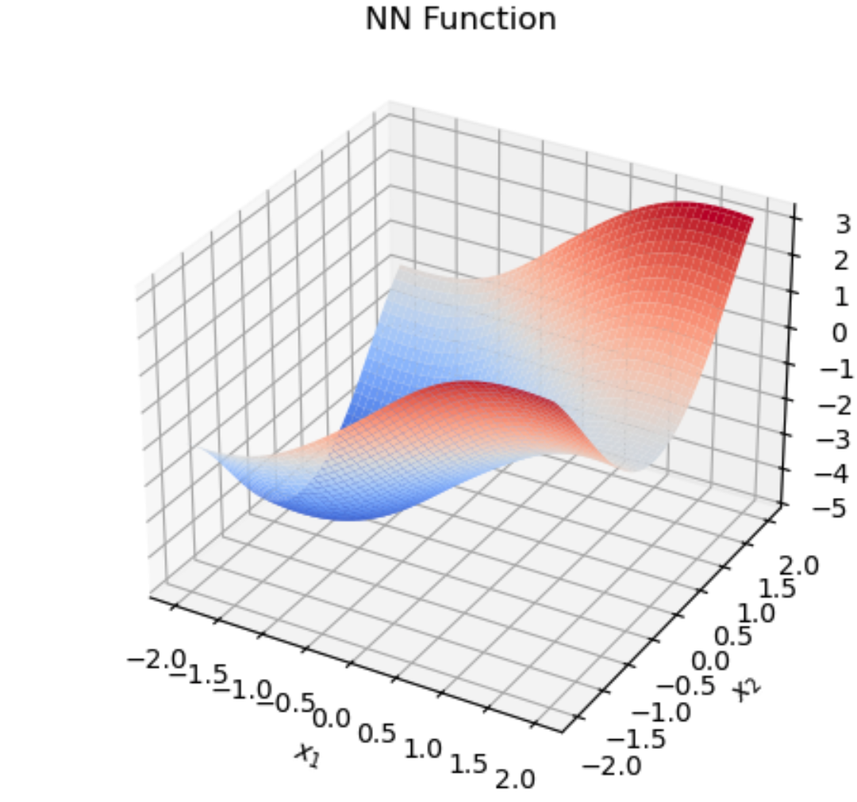
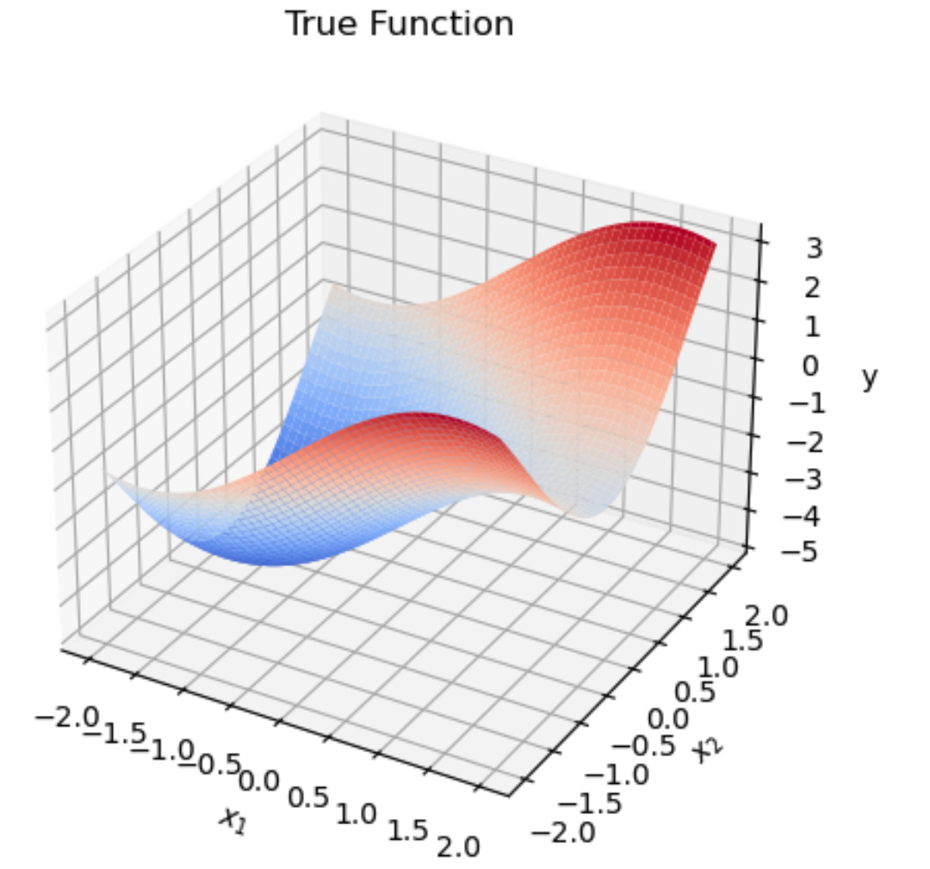
Model evaluation
It is common to inspect, on the test dataset:
Predictions and residuals vs measured y (top left)
Histogram of residuals (top right)
In this toy example:
The input is only 2D. We can visualize the learned function (bottom left)
The true function is known. We can visualize also visualize it in 2D (bottom right)
Everything seems to work well!

Slide 6
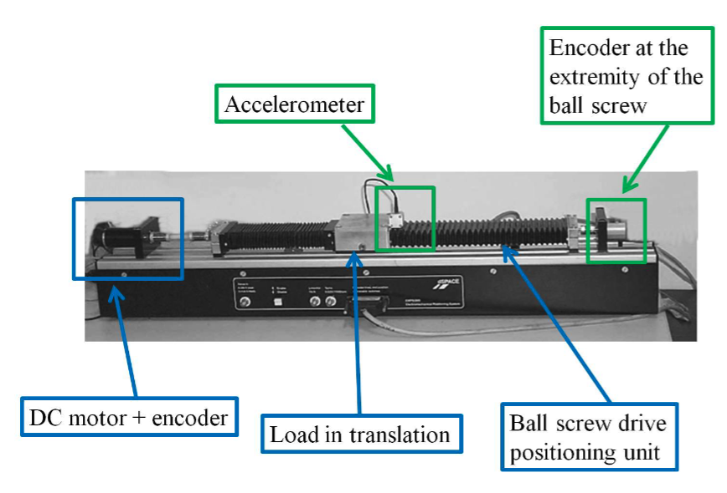

Inverse Dynamical Modeling on the EMPS benchmark (emps folder)
Real dataset from a (simple) mechanical system: the Electro-Mechanical Positioning System
Prismatic joint, 1-DoF mechanical system
$q(t)$: measured position (m)
$τ\left(t\right):$ known applied force (N)
$τ_{f}(t)$: unknown friction (N)
$M$: unknown mass (kg)
$b$: force measurement bias (N)
We want an inverse dynamical model (IDM):

Slide 7
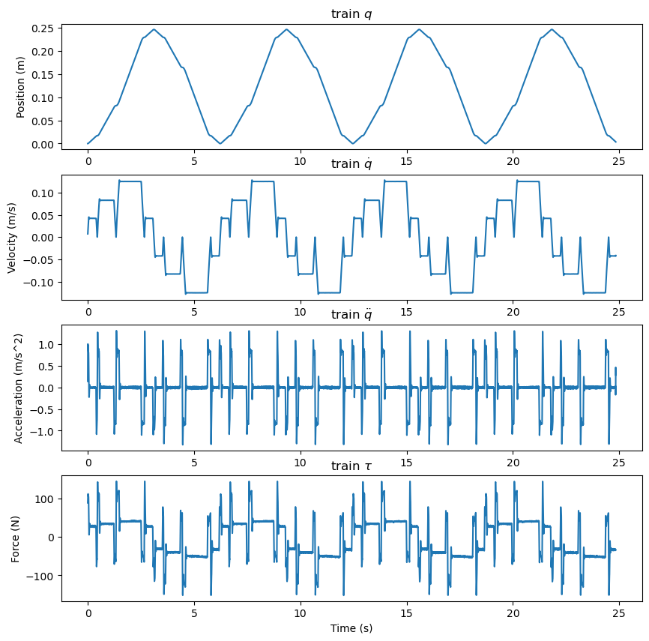
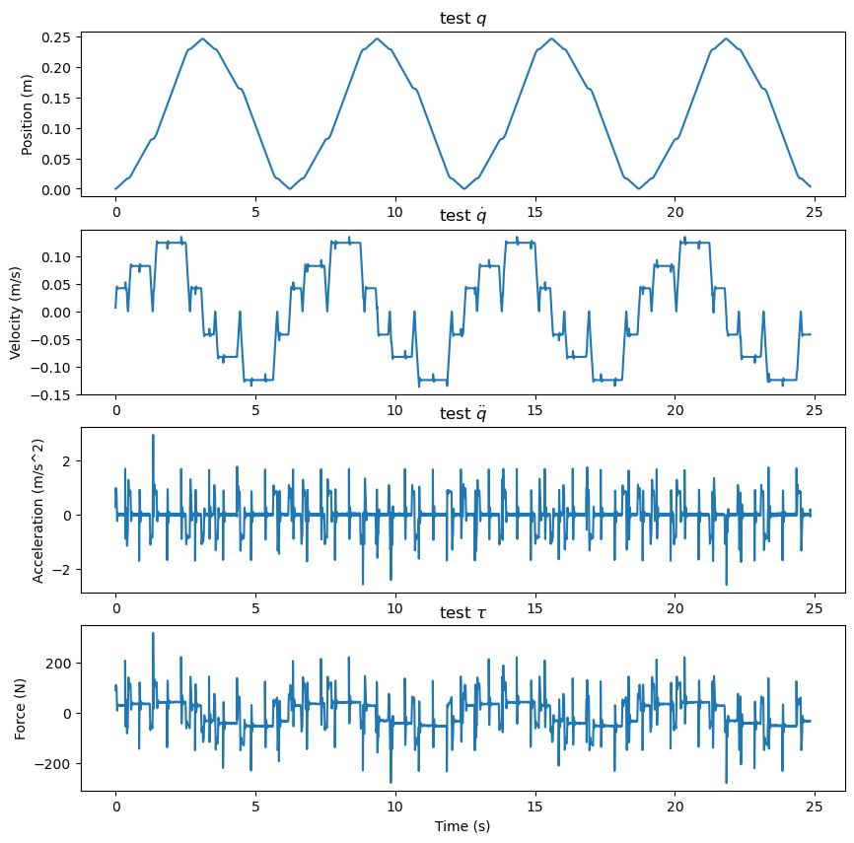
Training and test datasets

Slide 8
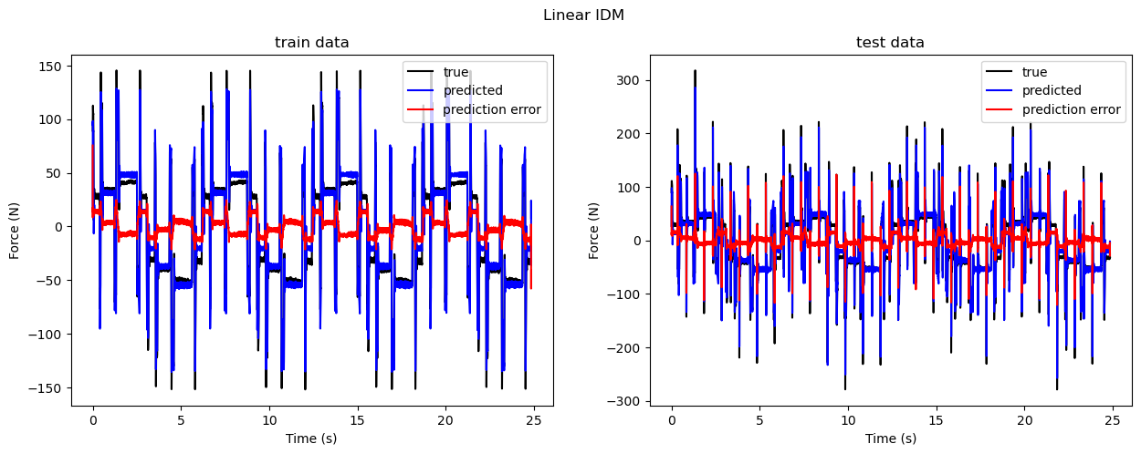
Linear model
We assume a linear friction model:
Then, the IDM is: . We can fit the IDM with a linear regression:

Slide 9
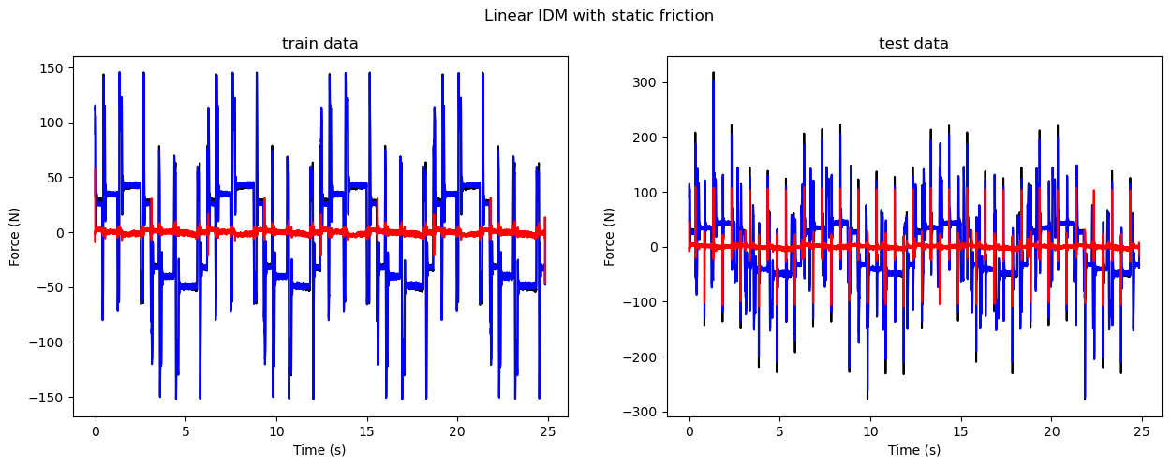
Linear model with static friction
We use a more sophisticated friction model:

Slide 10
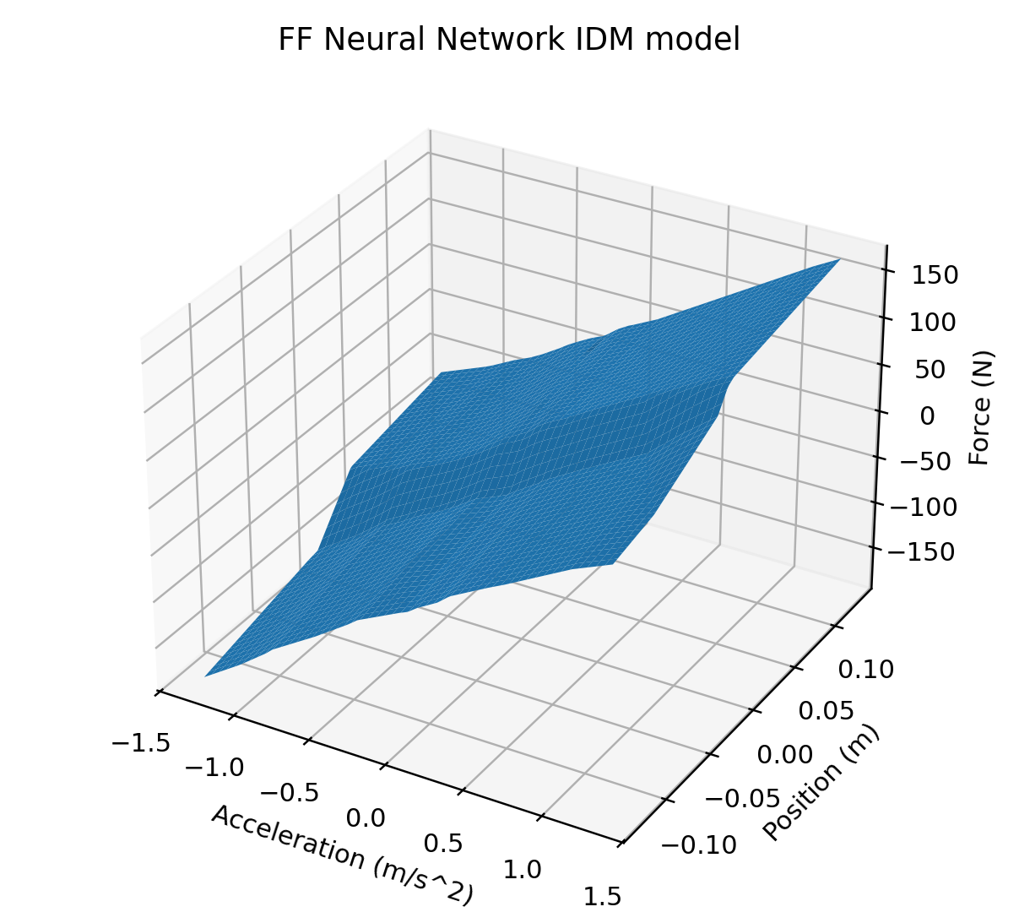
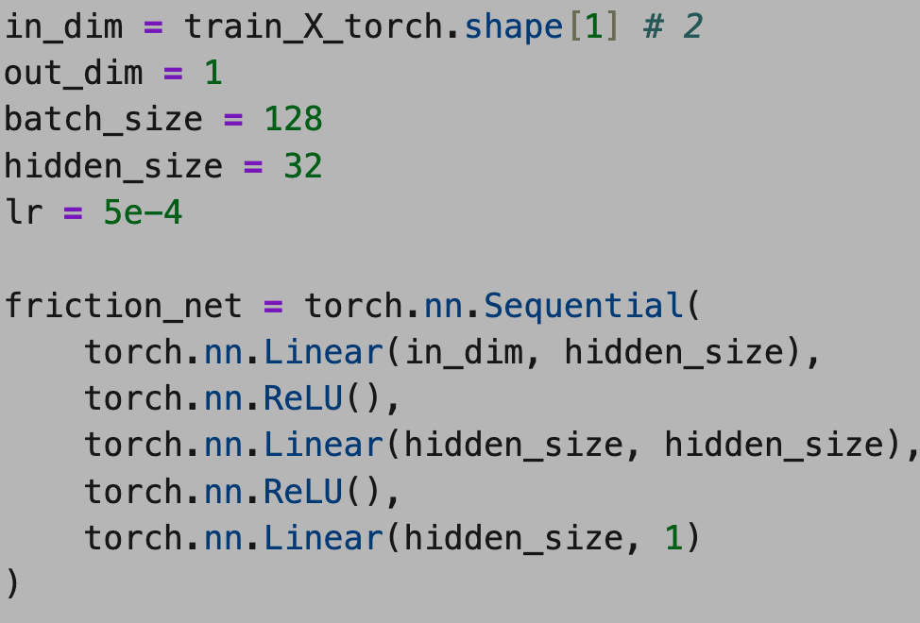
Feed-forward neural network
We ignore all physics and fit a feed-forward neural network instead:
Train it yourself!

Slide 11
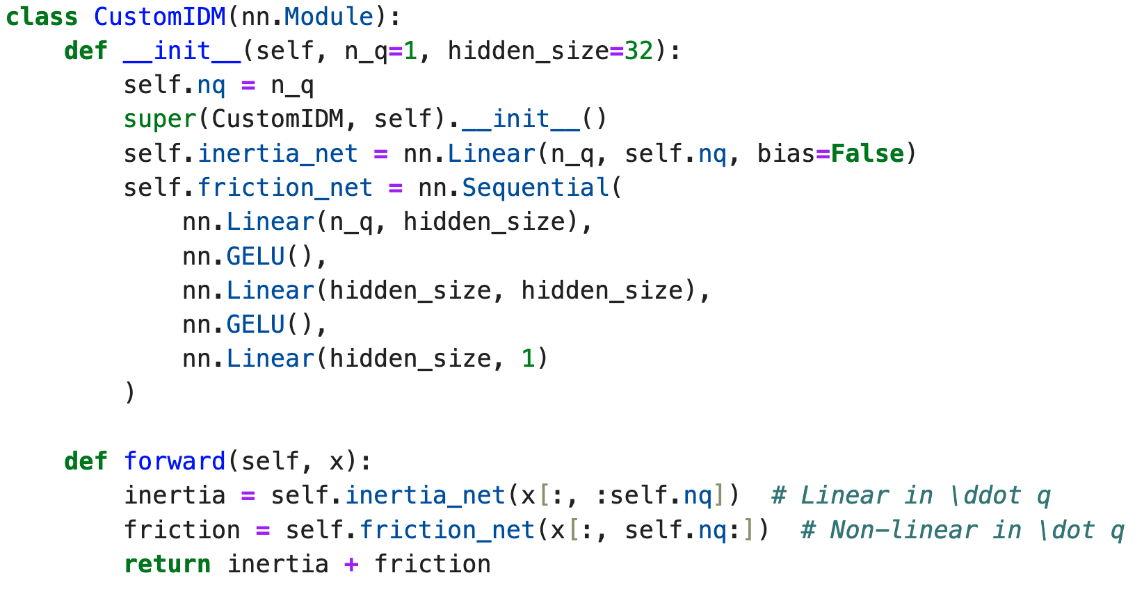
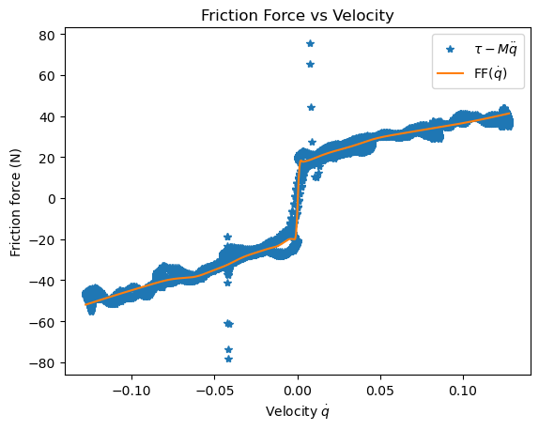
Physics-inspired neural network
We trust Newton’s law, but nothing else:
Train it yourself!

