Slide 1


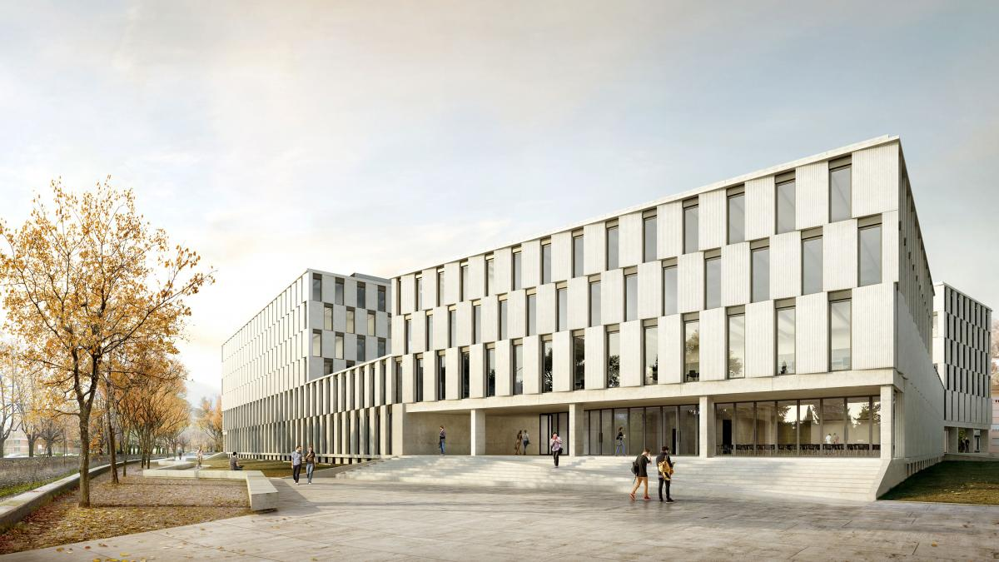
dynoNet: transfer functions in deep learning
Dario Piga, Marco Forgione, Dalle Molle Institute for Artificial Intelligence, Lugano, Switzerland

Slide 2
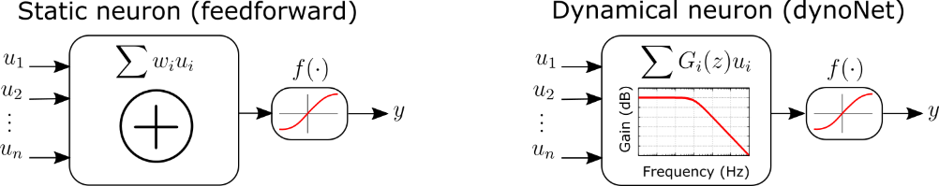
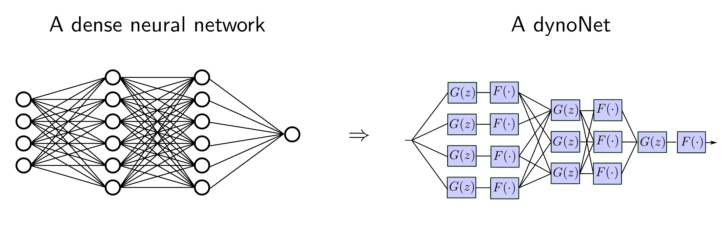
dynoNet: main idea
feedforward NN
dynoNet
Forgione, M., & Piga, D. (2021). dynoNet: A neural network architecture for learning dynamical systems. International Journal of Adaptive Control and Signal Processing, 35(4), 612-626.

Slide 3
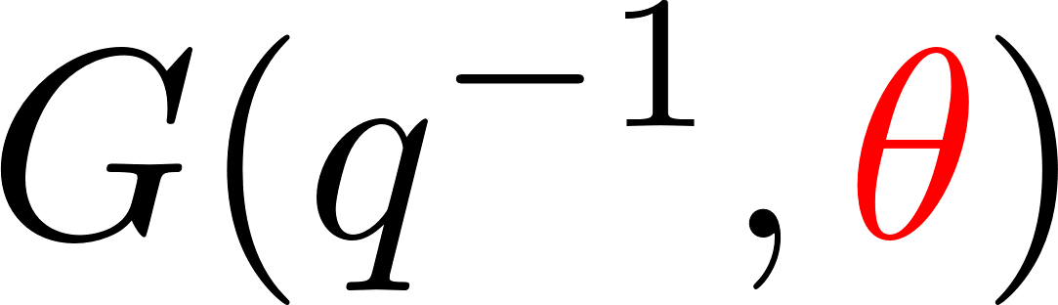
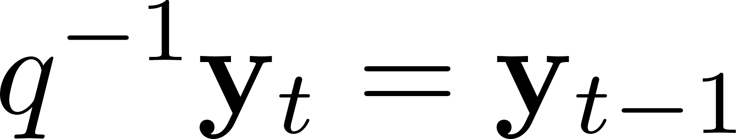
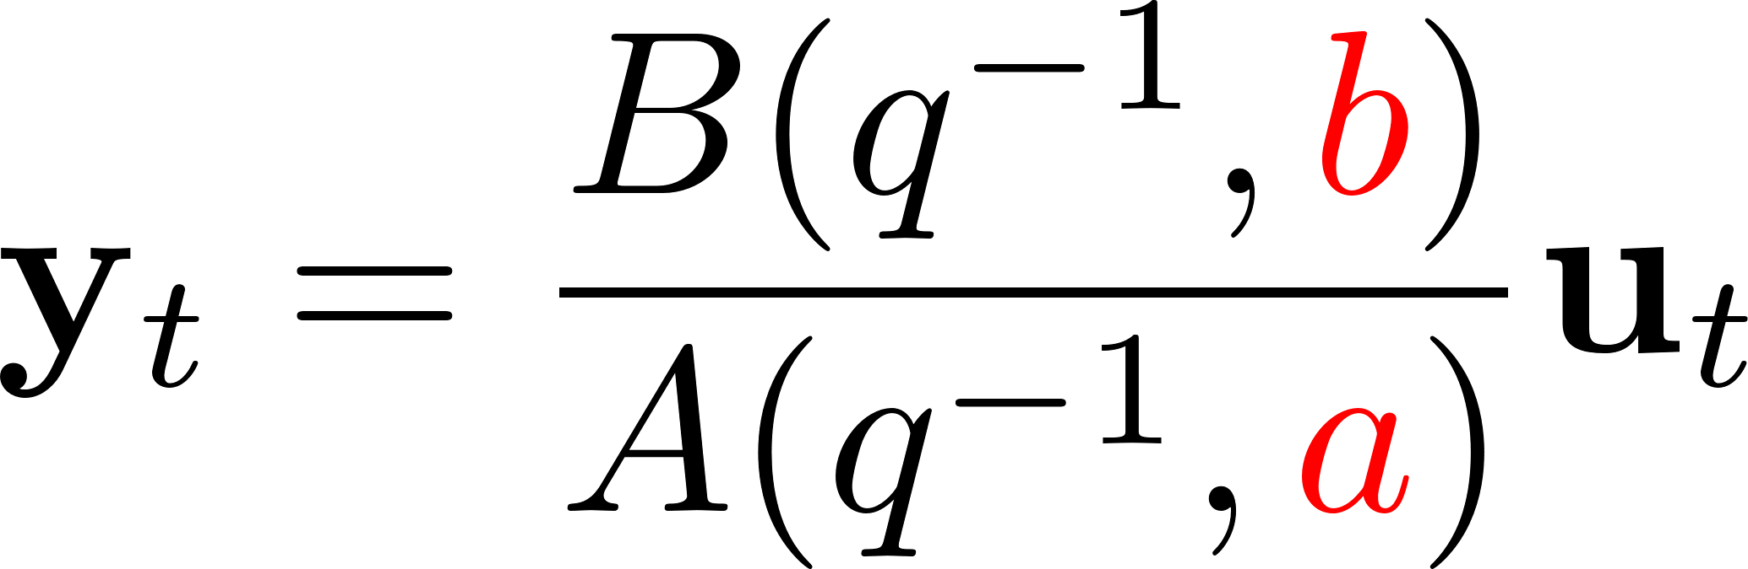
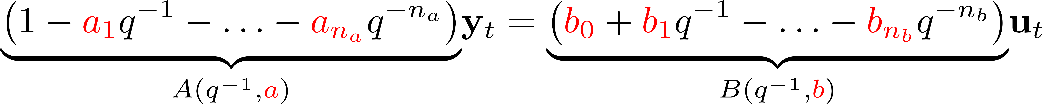
dynoNet: LTI operator
LTI linear operator
u
G(q)
y
recurrence equation

Slide 4
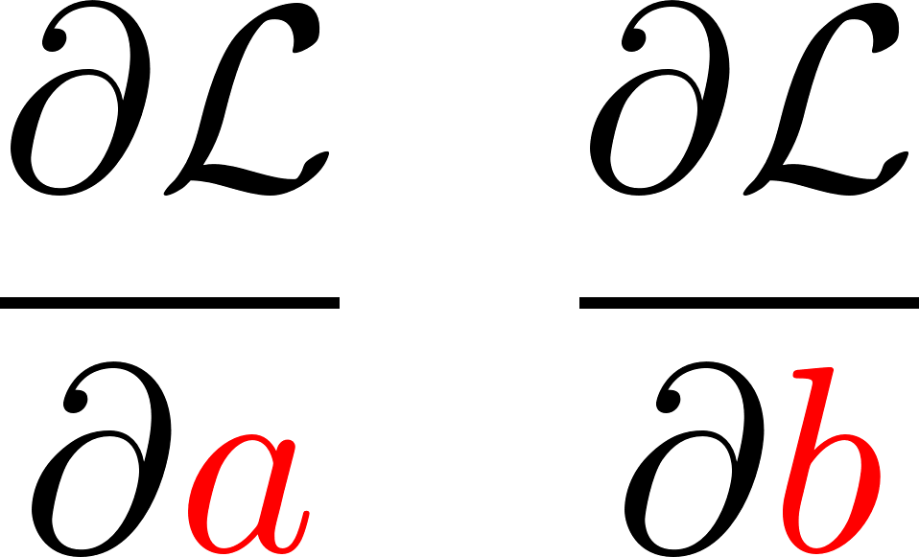
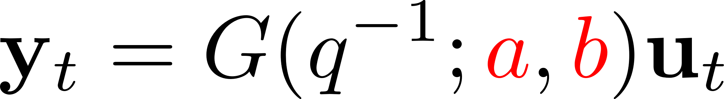
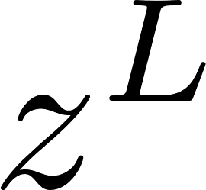
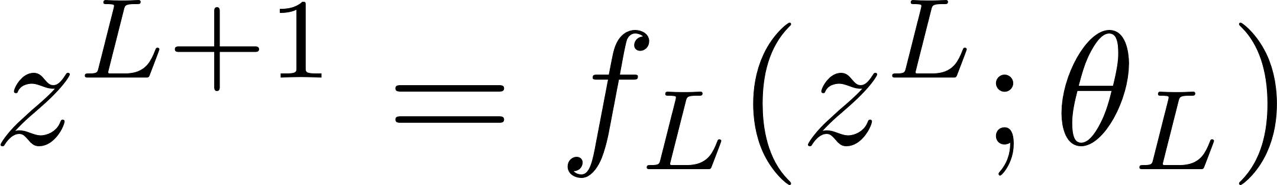

Integration in a DL framework
What do we need to integrate the LTI dynamic block in a neural network architecture?
u
y
G(q)
We need derivatives!
More in general, we need to transform the G operator into a differentiable layer!
Layer L

Slide 5
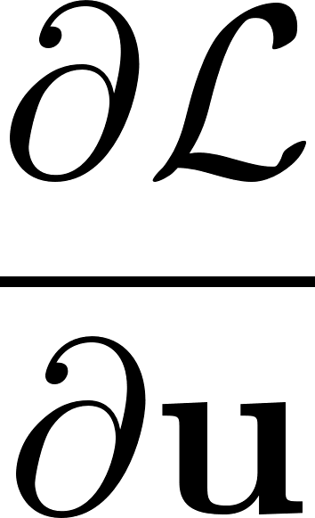


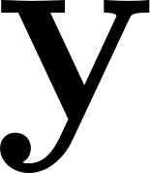
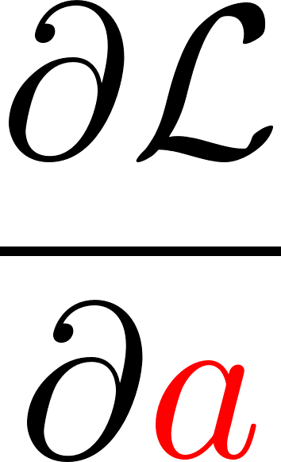
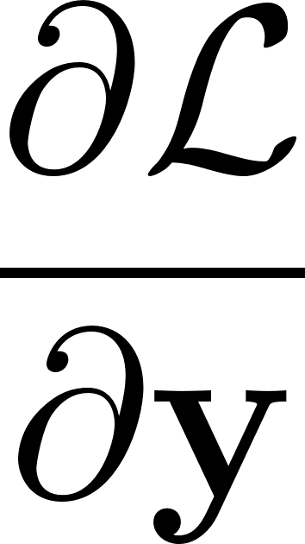

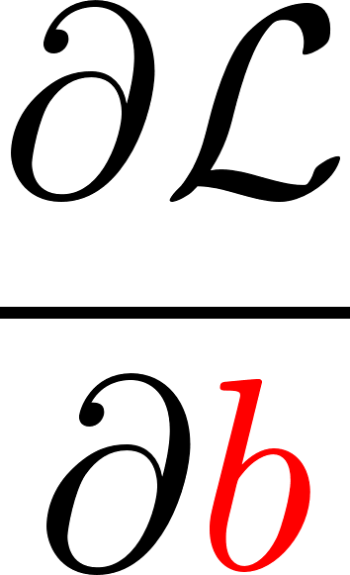
Transforming G into a differentiable layer
Layer L
Forward pass
Backward pass
Easy: O(T)
Differentiating dynamical blocks

Slide 6
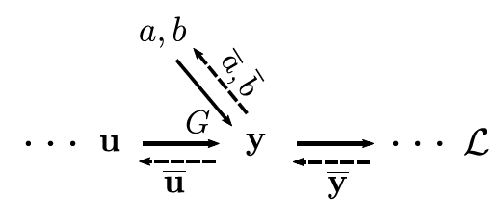
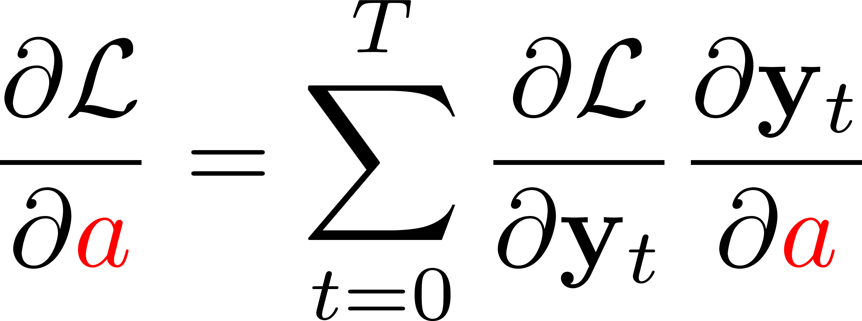
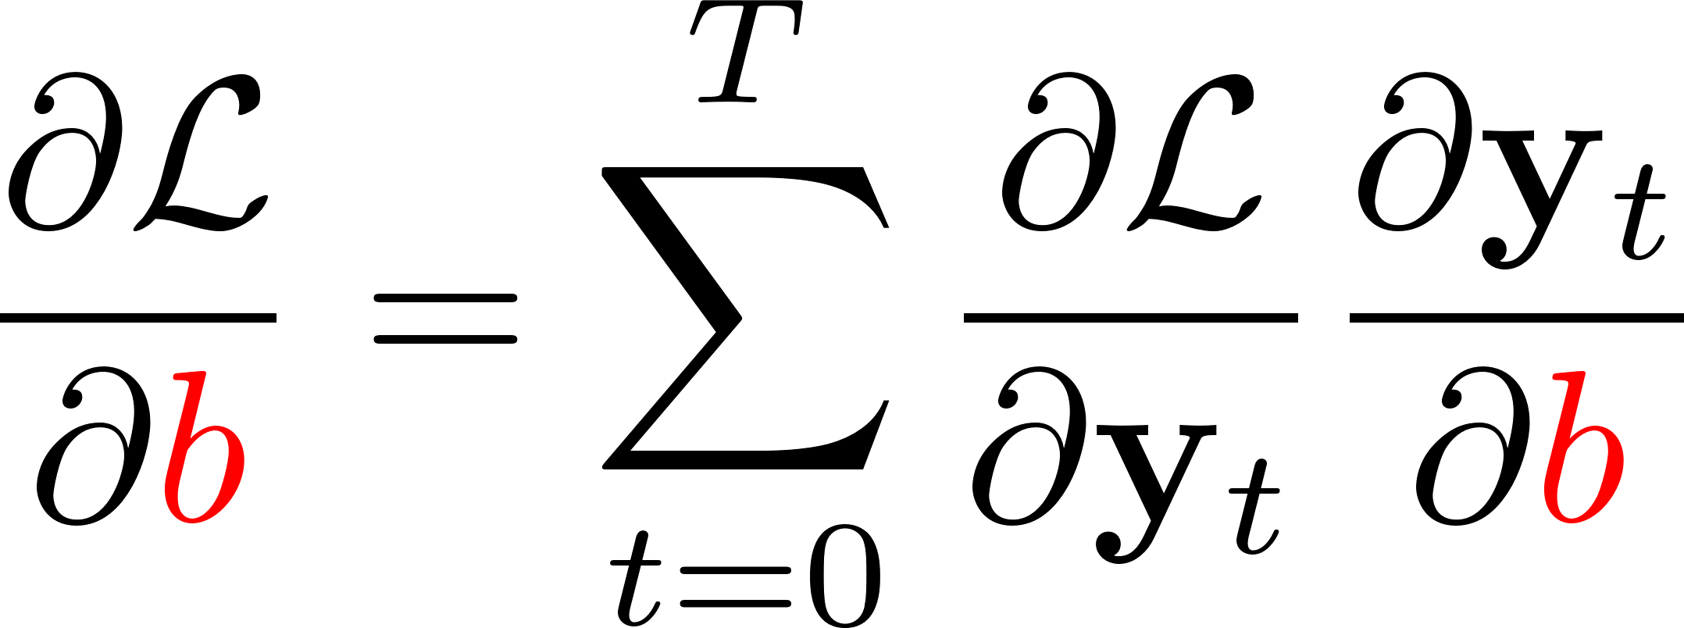
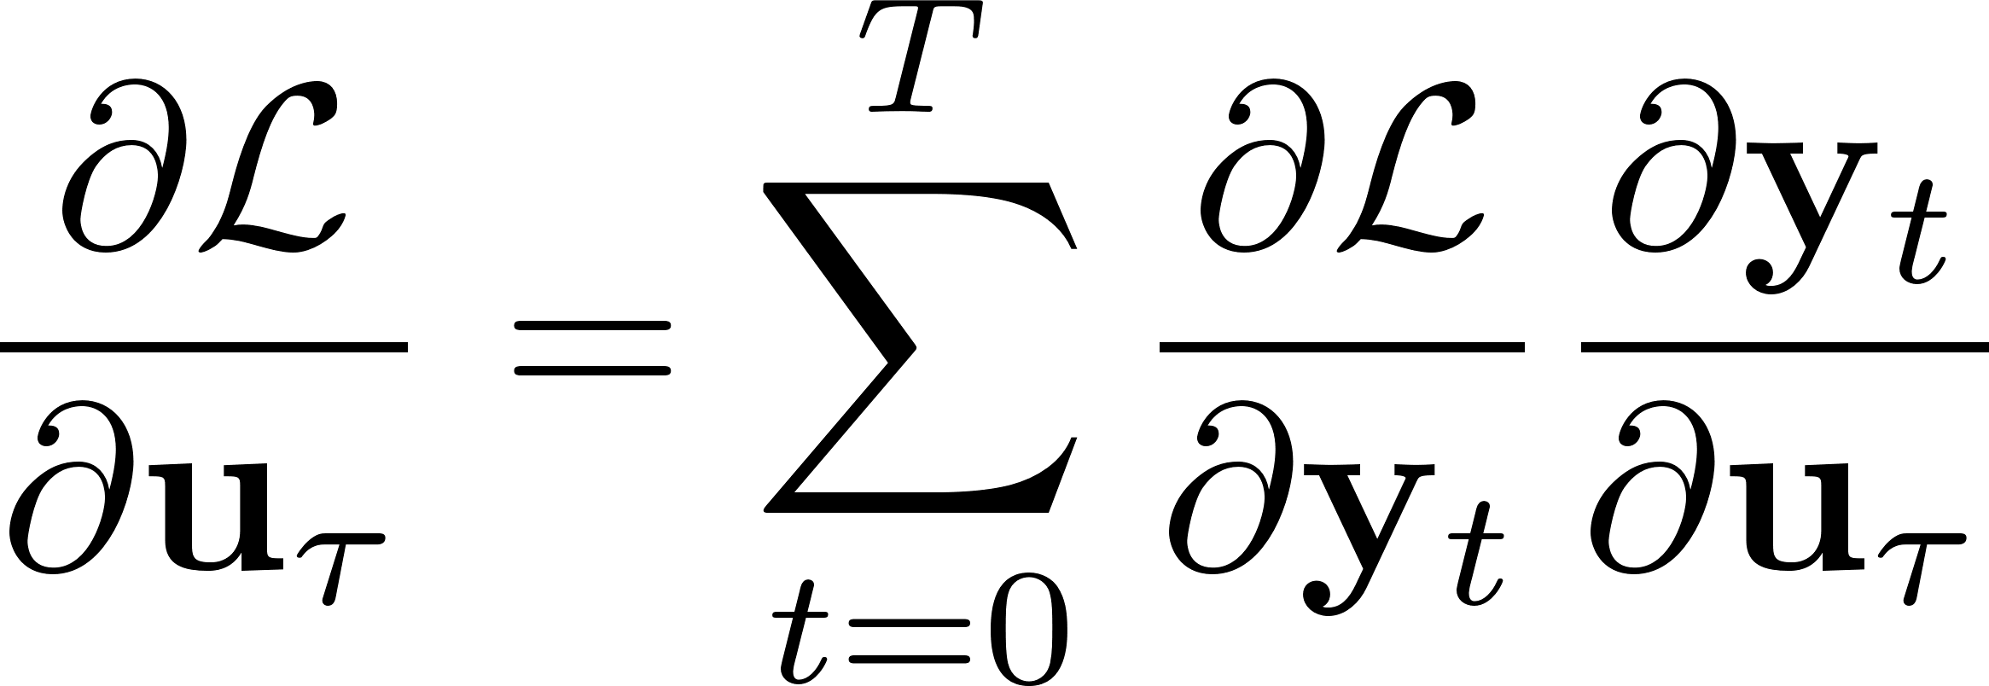
Backward pass
here’s what we really need

Slide 7
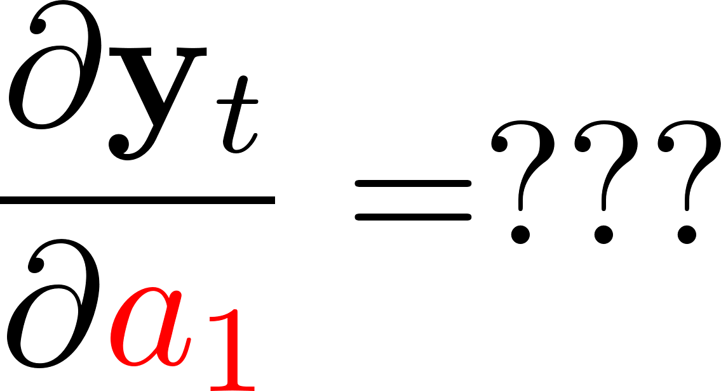
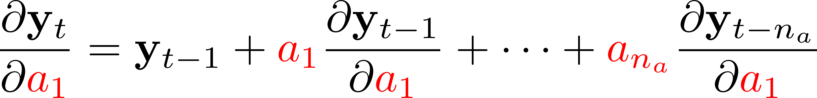
Backward pass
recurrence equation
Complexity: O(T)
Well-known derivation, see e.g. the classic book
Ljung, L. System Identification: Theory for the User. Prentice-hall, Inc. 2nd Edition

Slide 8
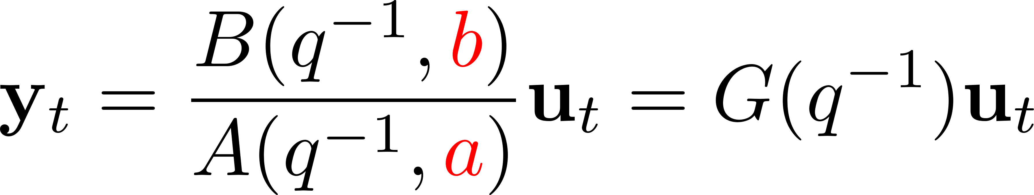
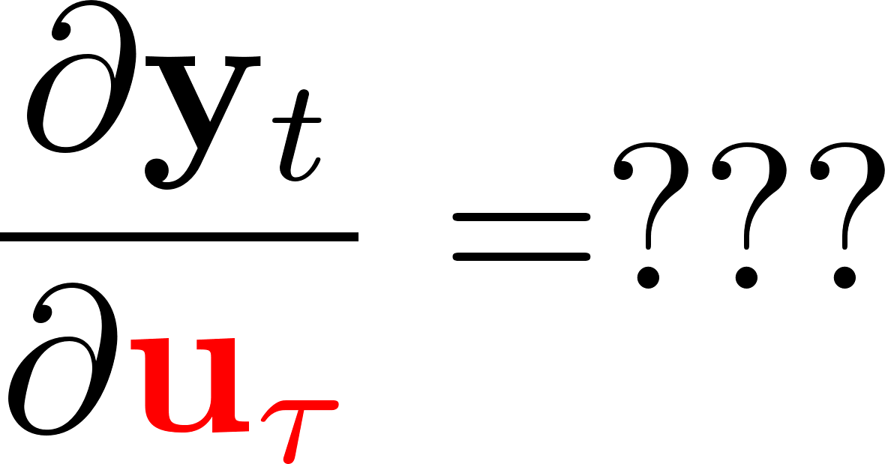
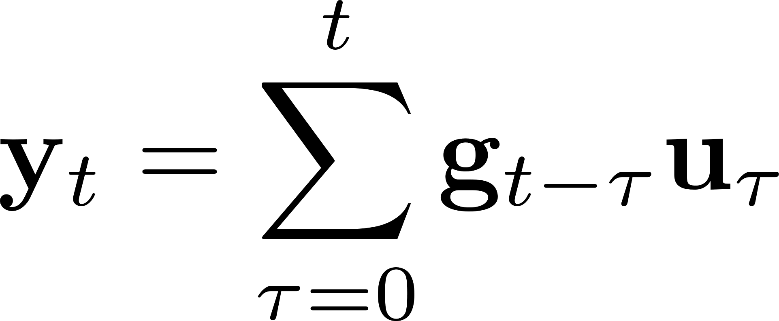
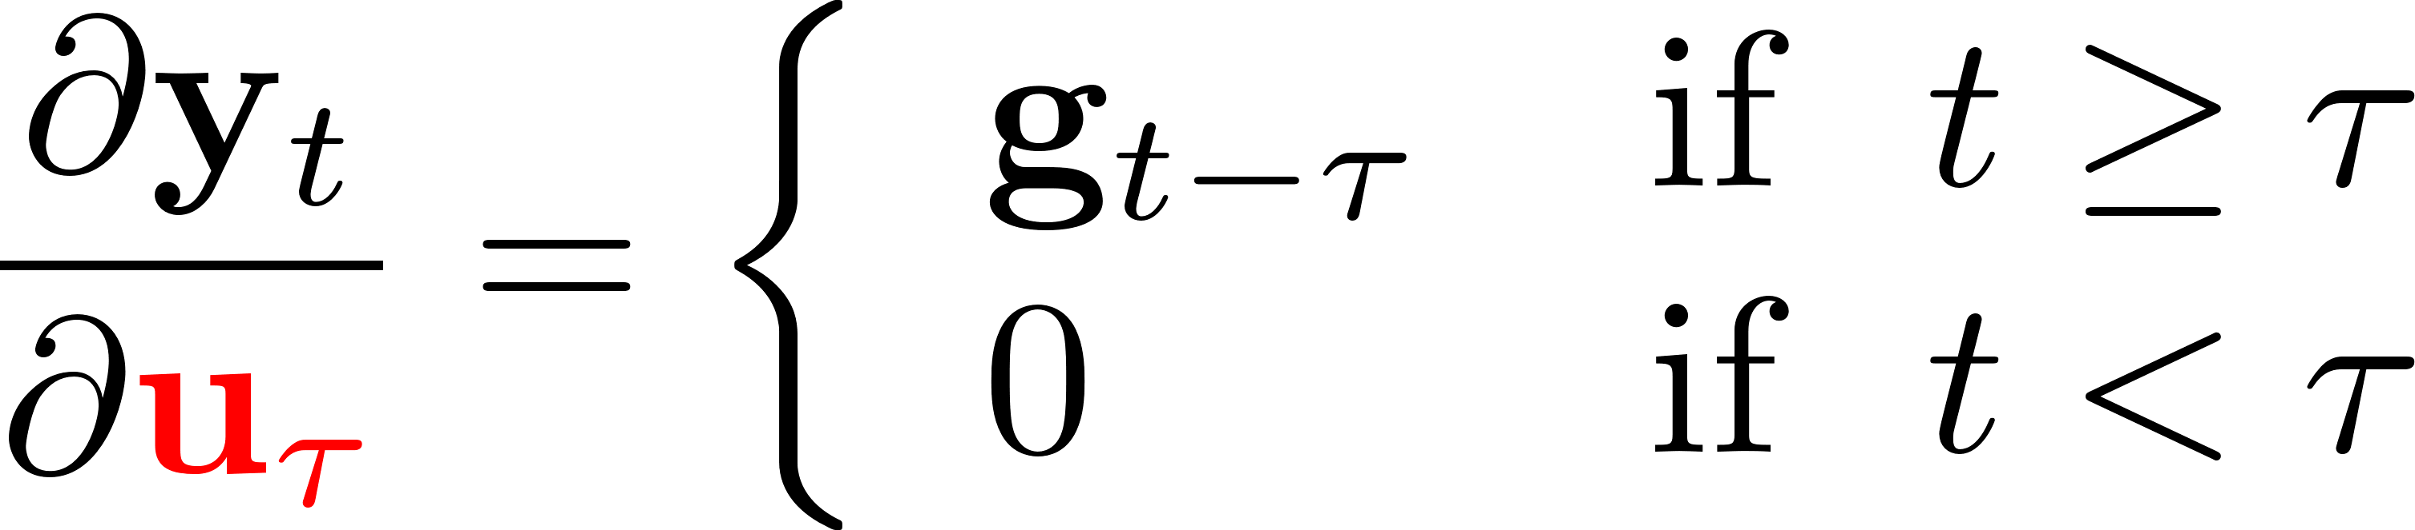
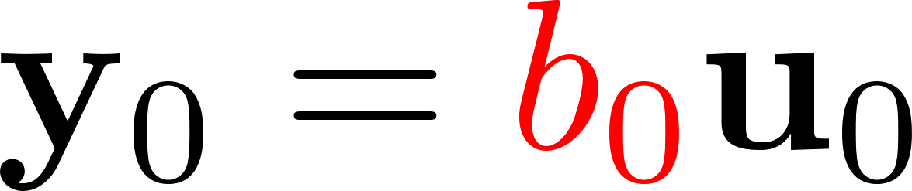
Backward pass
Impulse response

Slide 9
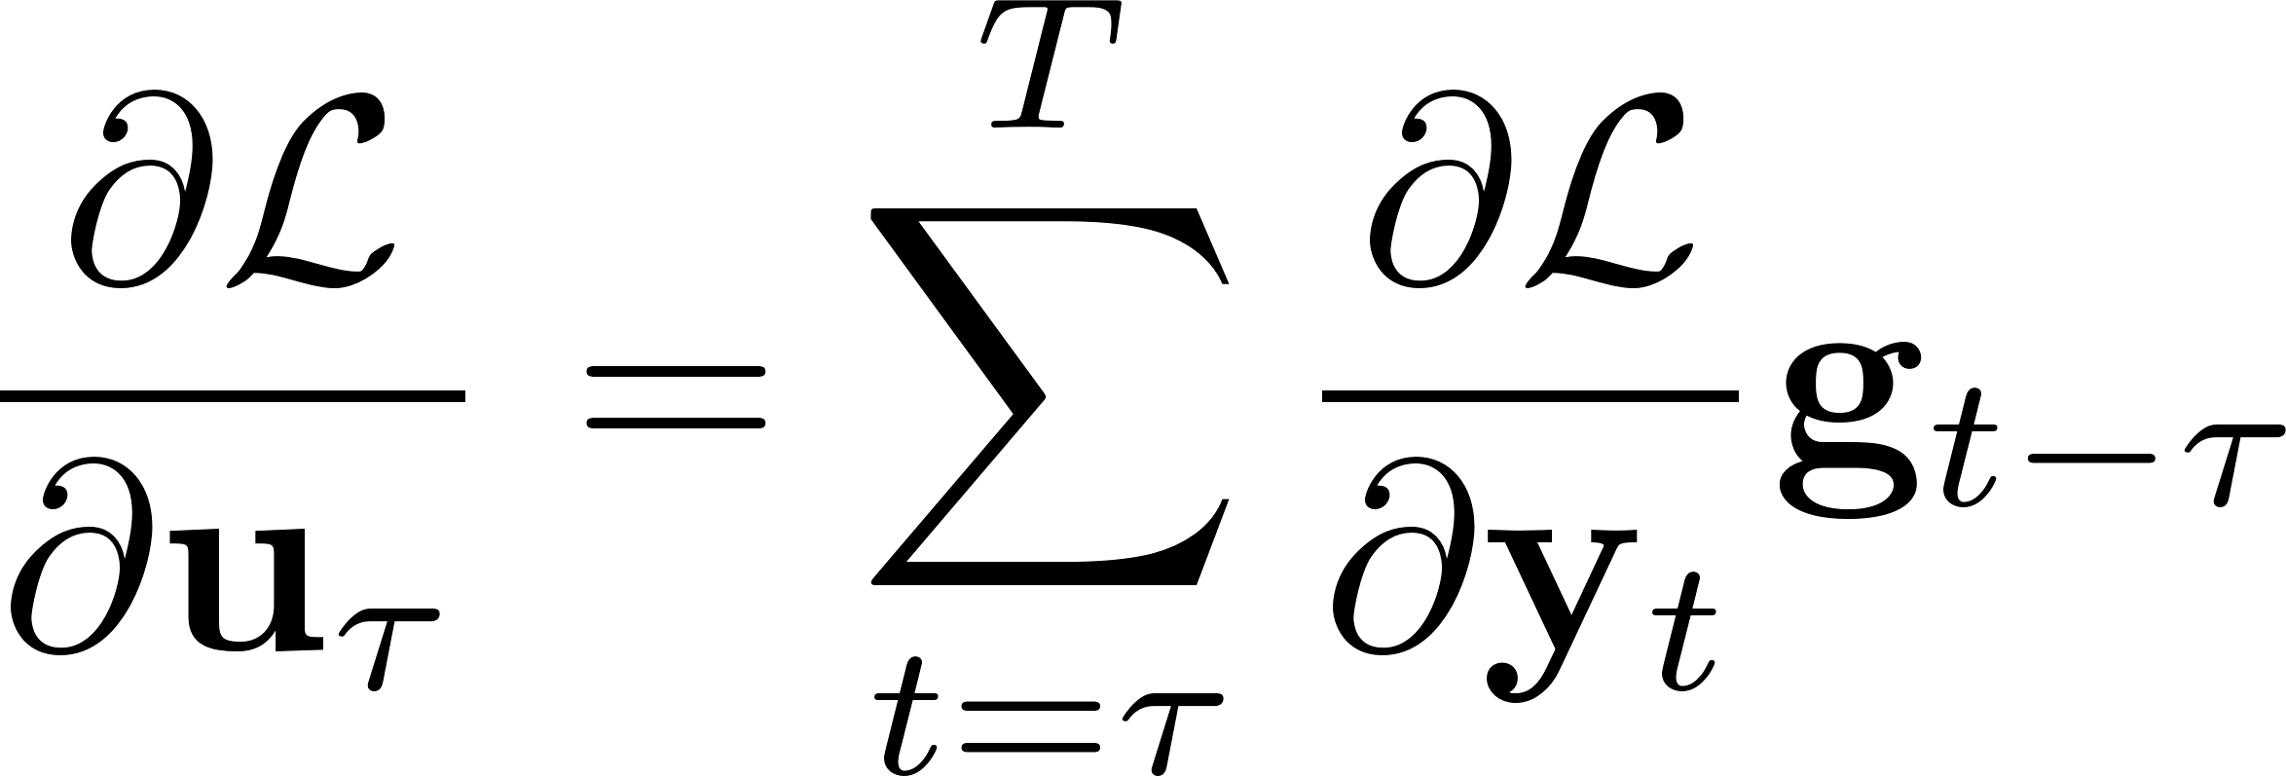
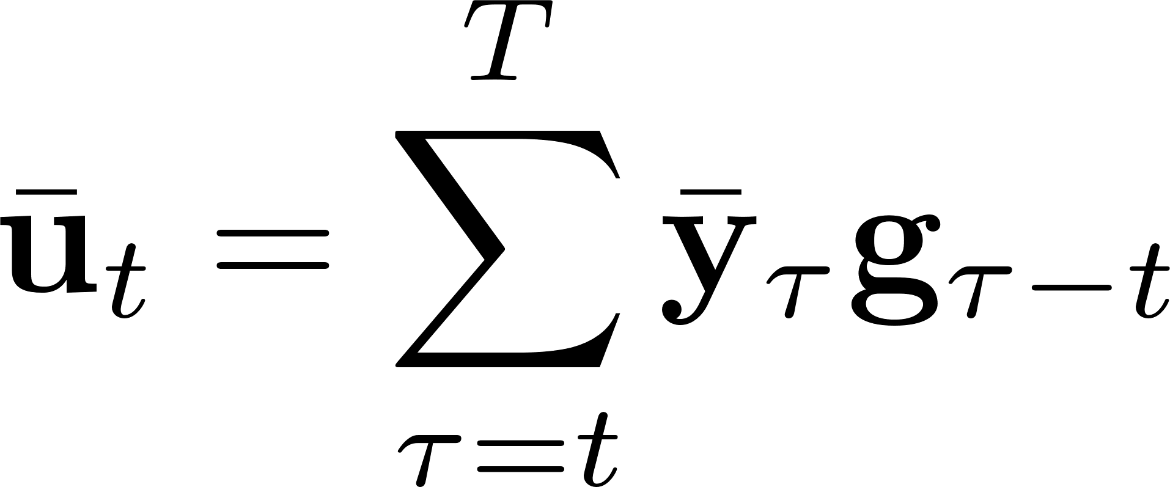
Backward pass: computational complexity
Complexity: O(T), τ=0,…,T
O(T²)
Change of notation
The latter looks a lot like a convolution product involving $g$ and $\overline{y}$, which would be easy to compute…
It is equivalent to filtering through G!

Slide 10
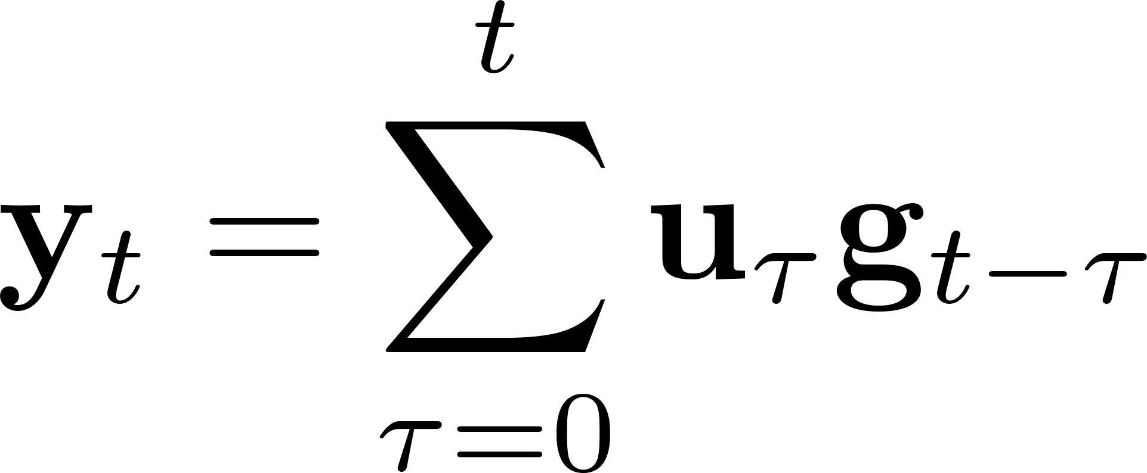
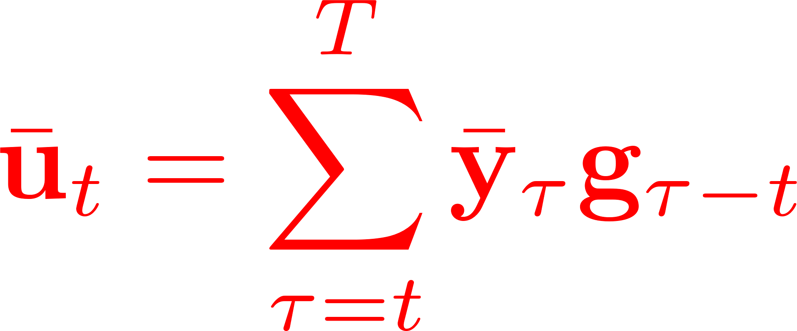
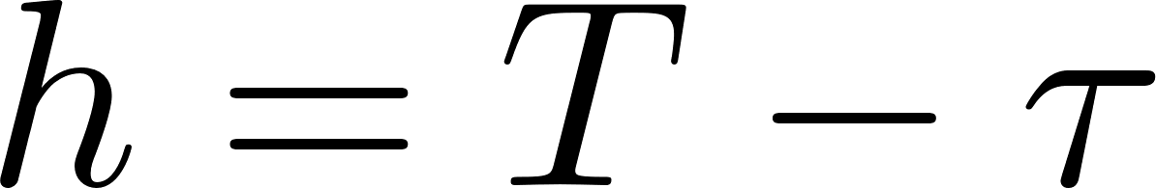
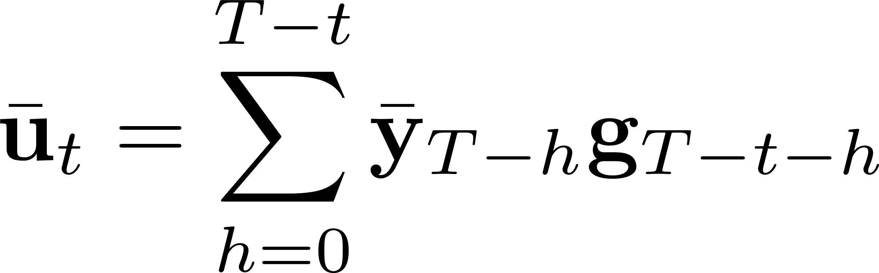

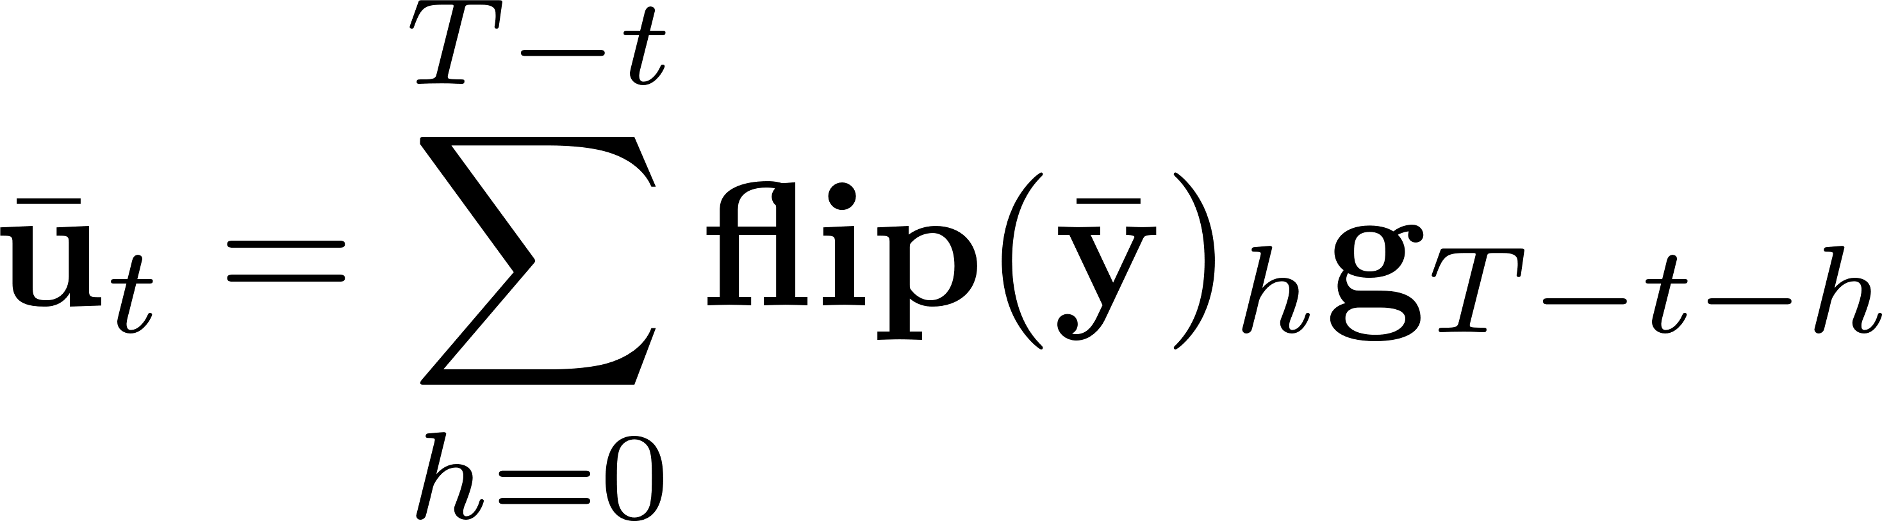
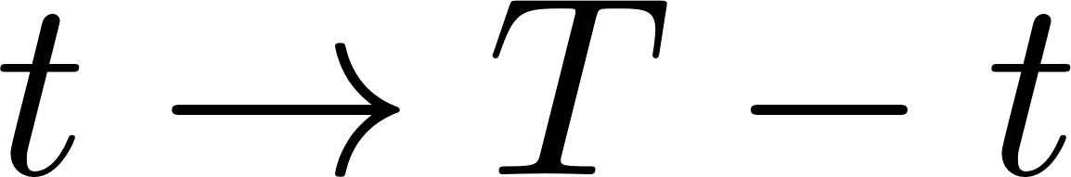
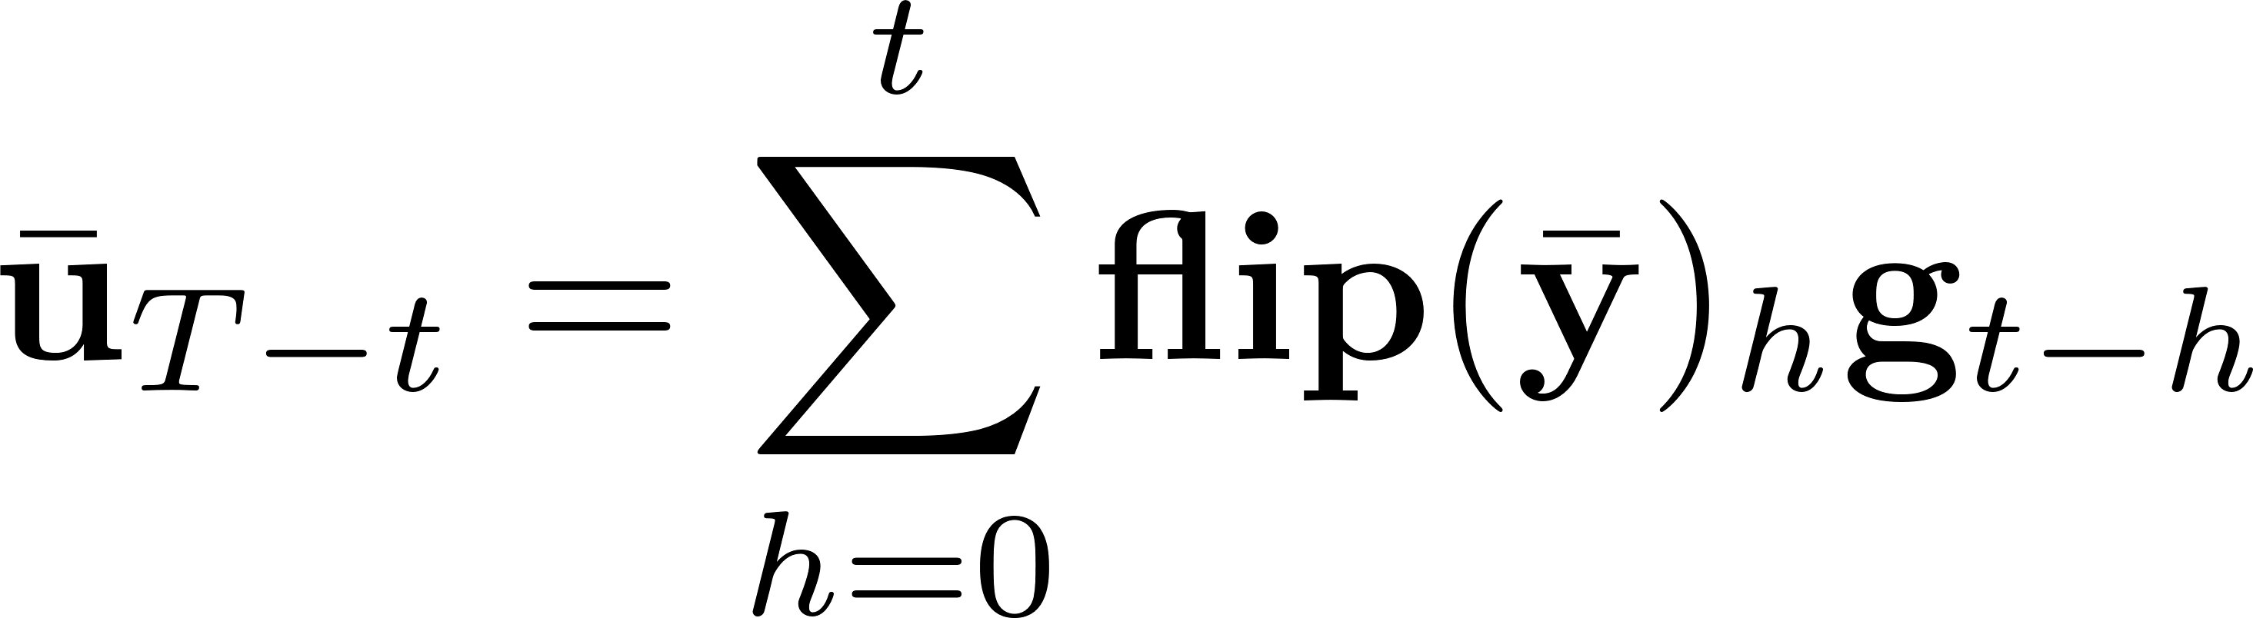
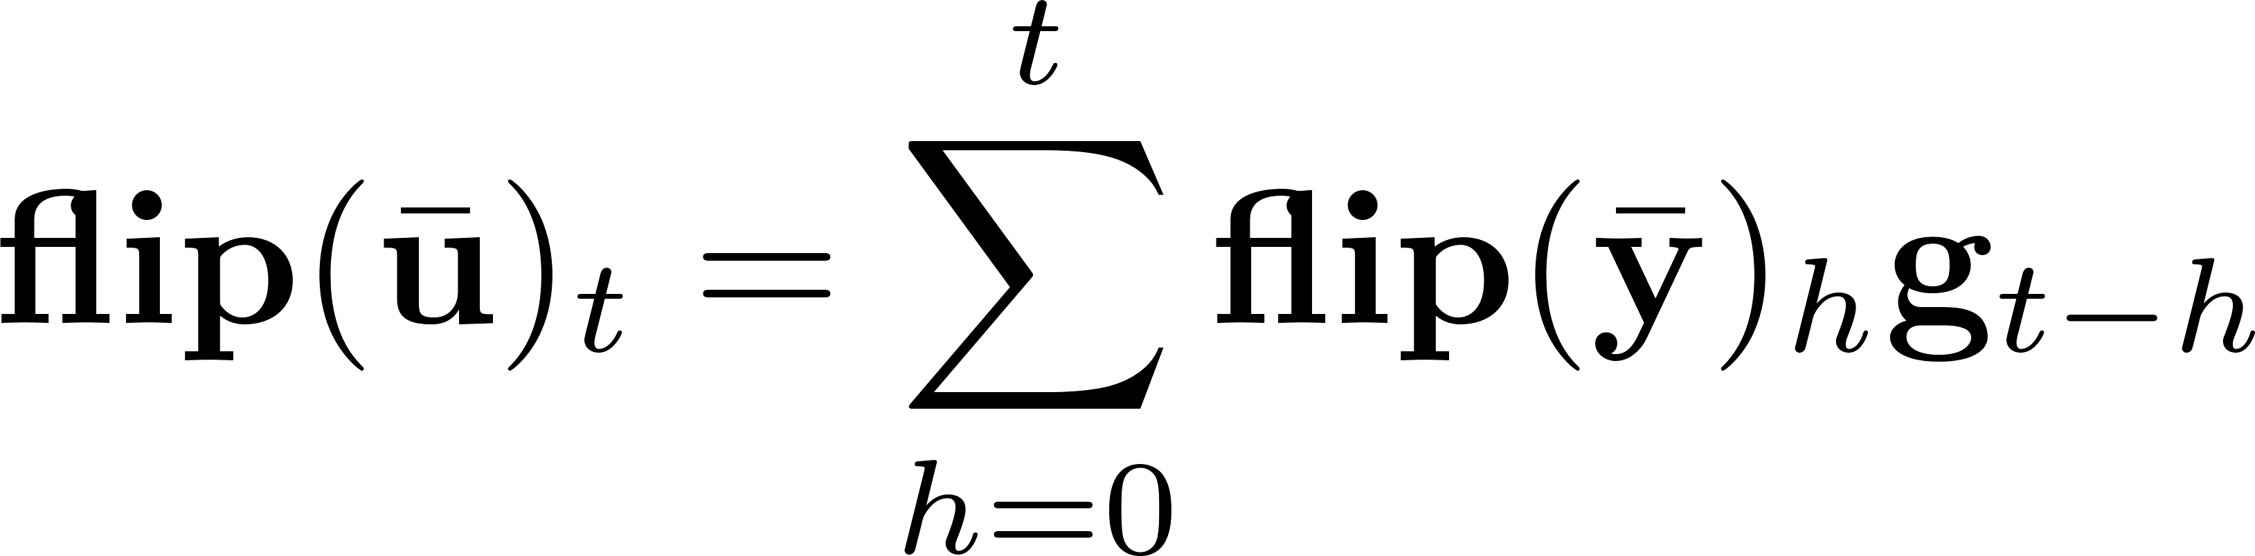
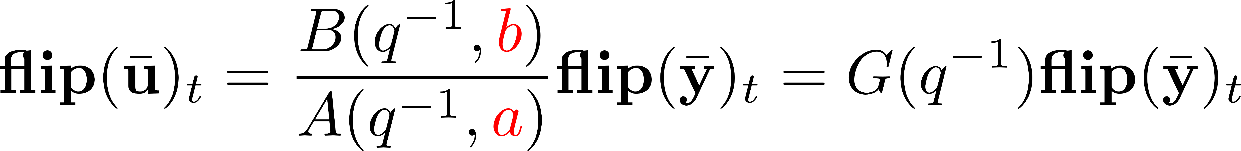
Backward pass: computational complexity
Can we also compute recursively?
Complexity: O(T)

Slide 11
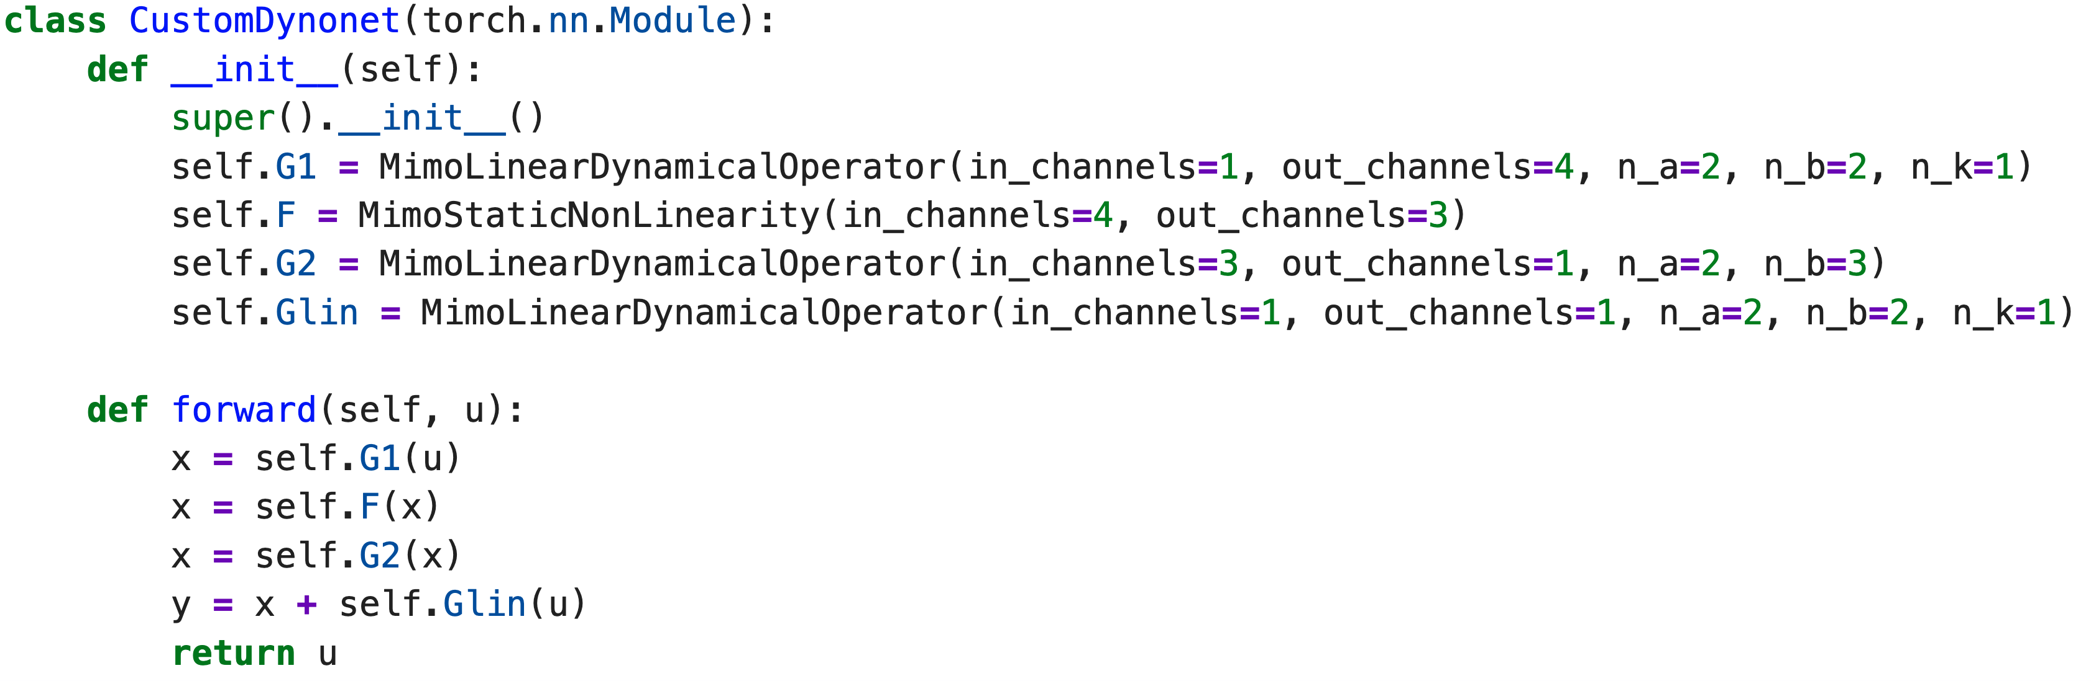
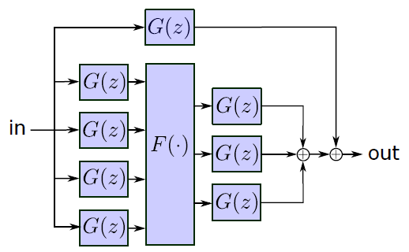
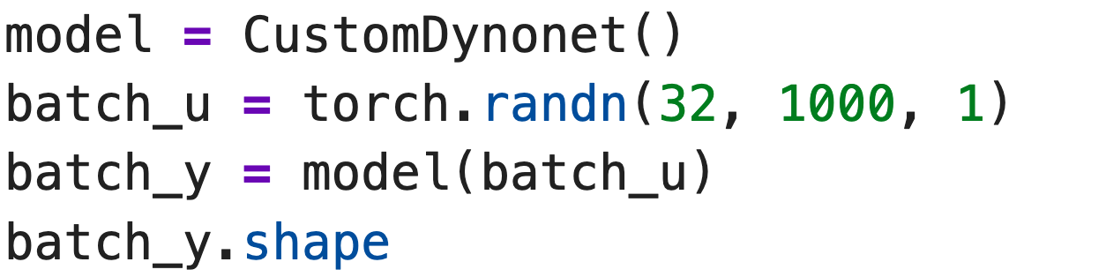

PyTorch implementation
PyTorch implementation of the G-block in the repository: https://github.com/forgi86/dynonet
dynoNet architecture
Python code
Any gradient-based optimization algorithm can be used to train the network, with gradients readily obtained through back-propagation

Slide 12
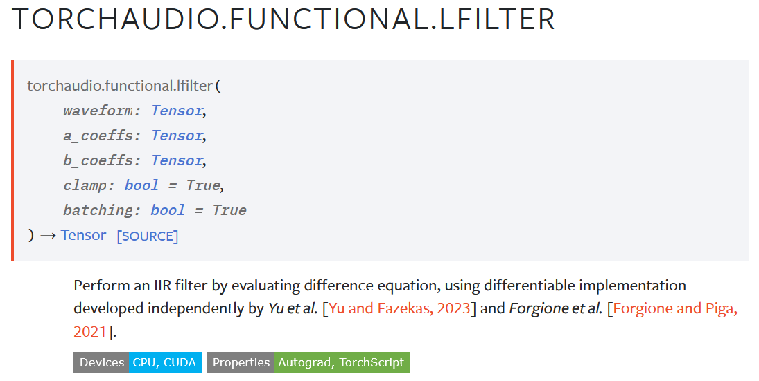

dynoNet in TorchAudio

Slide 13
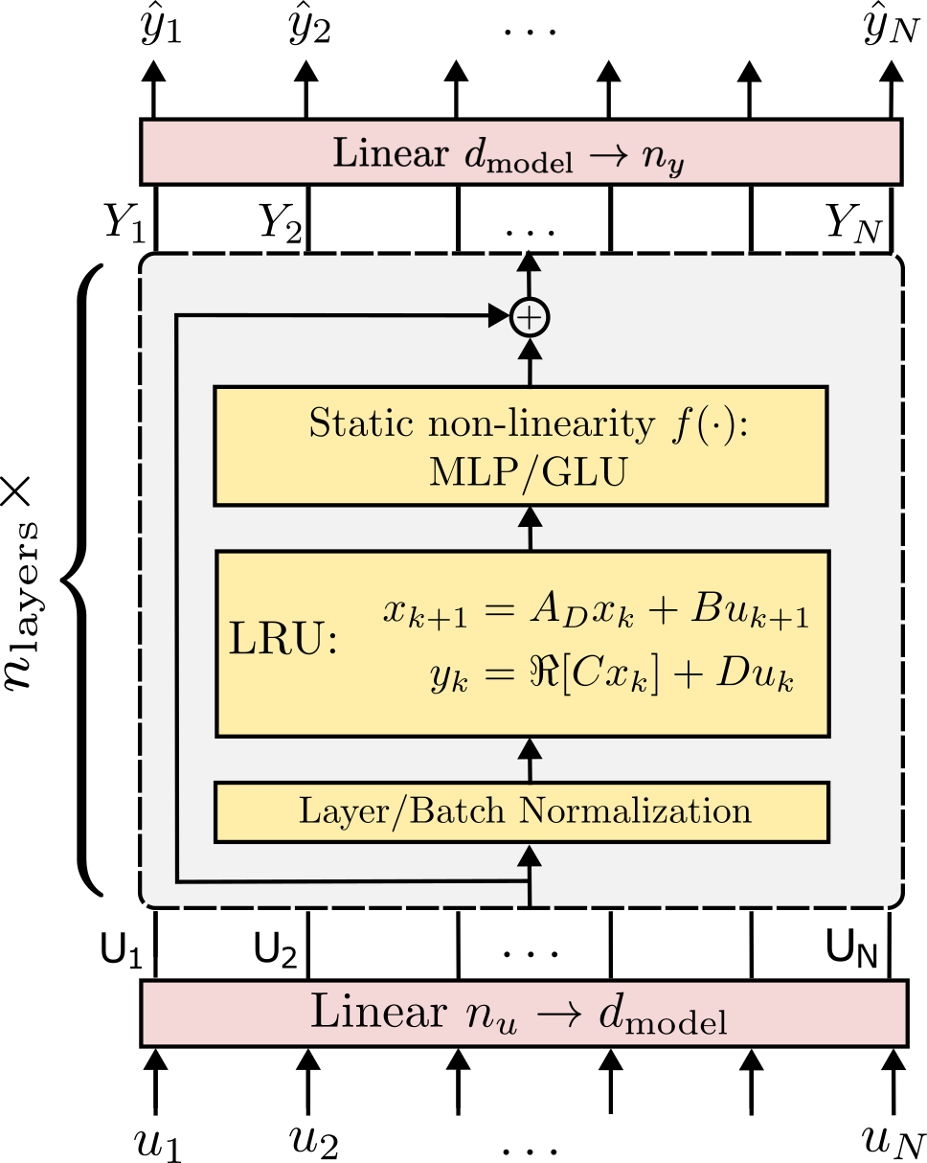
Other architectures with linear layers
Several new models with linear dynamical blocks: S4, S5, LRU, Mamba, …
Flexible and expressive
Fast to train and simulate
Stability almost for free
Potential for analysis and explainability
Keyword: structured state-space sequence models (S4).
Variations in the linear dynamical block:
Continuous/discrete-time
State-space/transfer function
Time-domain/frequency-domain
Time-invariant/time-varying
There’s room to apply system theory!
M. Forgione, M. Mejari, and D. Piga Model order reduction of deep structured state-space models: A system-theoretic approach, CDC 2024

Slide 14
dynoNet: conclusions
Key takeaways
Differentiable dynamic neuron
Extension of block-oriented models with arbitrary interconnections
Training through back-propagation at a cost O(T). No specialized algorithm required
Current work
System analysis and model reduction through linear tools
M. Forgione, D. Piga, dynoNet: A neural network architecture for learning dynamical systems, IJACSP, 2021
https://github.com/forgi86/dynonet

