Slide 1


ORBIT
Datensatz
Patryk Gadziomski
Hochschule der Medien
17.05.2025

Slide 2

Datensatz
ORBIT == Optimized Retrieval for Beyond Interstellar Technologies
Spezialisierte wissenschaftliche Publikationen aus dem Bereich „Intelligente Systeme in der Raumfahrt“.
KI in der Raumfahrt
Robotik in der Raumfahrt
Etc.
Organisationen: arXiv.org & OpenAlex.org
Lizenz: Creative Commons License (Hängt aber von jedem Paper ab)
Notes:
- arXiv is a free distribution service and an open-access archive for nearly 2.4 million scholarly articles in the fields of physics, mathematics, computer science, quantitative biology, quantitative finance, statistics, electrical engineering and systems science, and economics.
- a catalog of works. A research article is one kind of work, but there are others such as datasets, books, and dissertations. We keep track of these works—their titles (and abstracts and full text in many cases), when they were created, etc. We also keep track of the connections between these works, finding associations through things like journals, authors, institutional affiliations, citations, concepts, and funders.

Slide 3
Datenshema
Datenformat: JSONL
arXiv
Arxiv ID | DOI | Titel | Autor | Abstrakt | Veröf. Datum | Akt. Datum | Journal | Kategorie | Link | PDF-Link | Volltext
Str | Str | Str | List(Str) | Str | Str | Str | Str | List(Str) | Str | Str | Str
Datenformat: JSONL
OpenAlex
OpenAlex ID | Themen | Anzahl Zitierungen | Veröf. Ort | Open Access | Typ | Sprache | Lizenz | Paratext | Autor
Str | List(dict) | Int | List(dict) | boolean | Str | Str | Str | boolean | List(dict)
Zitierte Artikel | Verwandte Artikel | Biblio | Institutionen | Förderungen | Konkrete Fundstelle | Keywords
List(Str) | List(Str) | dict | List(dict) | List(dict) | dict | List(dcit)
Struktur der Daten: Kombination von unterschiedlich strukturierten Daten
Notes:
- arXiv is a free distribution service and an open-access archive for nearly 2.4 million scholarly articles in the fields of physics, mathematics, computer science, quantitative biology, quantitative finance, statistics, electrical engineering and systems science, and economics.
- a catalog of works. A research article is one kind of work, but there are others such as datasets, books, and dissertations. We keep track of these works—their titles (and abstracts and full text in many cases), when they were created, etc. We also keep track of the connections between these works, finding associations through things like journals, authors, institutional affiliations, citations, concepts, and funders.

Slide 4


Datenakquise
Teilmenge der Datenquelle
JSONL
ArXiv
Filtering
Stichwort Matching im Titel und Abstrakt
Artikel
& Metadaten
JSONL
Index
OpenAlex
Matching
Mit DOI OR arxiv_id OR Titel
JSONL
1163 Reihen
71,8 MB
(75.364.401 Bytes)
Zusätzliche Metadaten

Slide 5
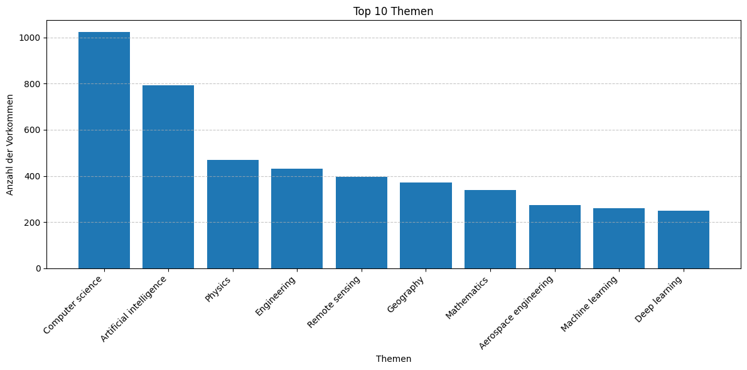
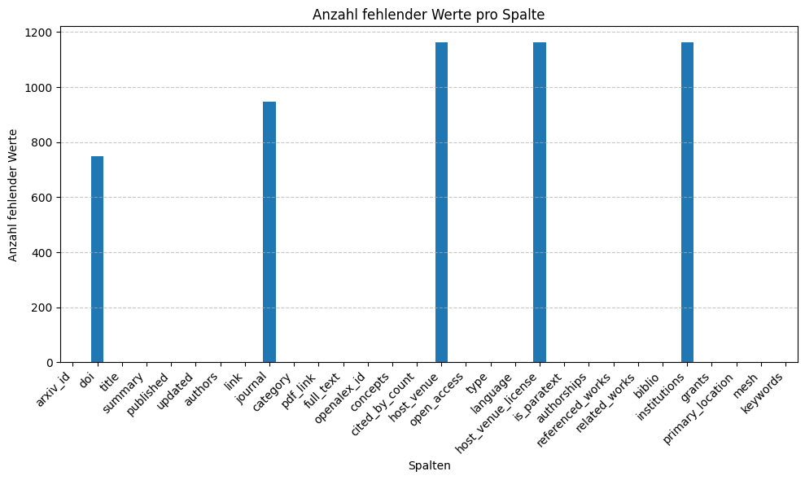
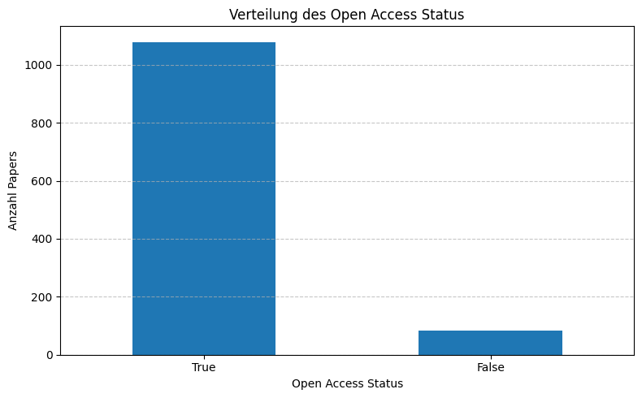
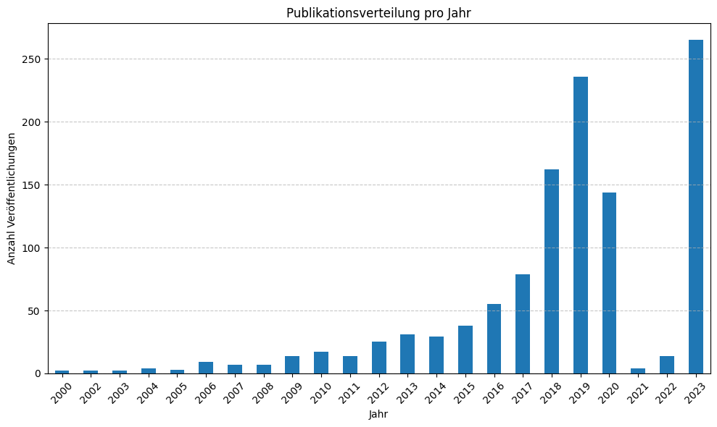
Datenanalyse

