Slide 1


ORBIT
Datensatz
Patryk Gadziomski
Hochschule der Medien
17.05.2025

Slide 2

Datensatz
Spezialisierte wissenschaftliche Publikationen aus dem Bereich „Intelligente Systeme in der Raumfahrt“.
KI in der Raumfahrt
Robotik in der Raumfahrt
Etc.
Organisationen: arXiv.org & OpenAlex.org
License: Creative Commons licenses
Notes:
- arXiv is a free distribution service and an open-access archive for nearly 2.4 million scholarly articles in the fields of physics, mathematics, computer science, quantitative biology, quantitative finance, statistics, electrical engineering and systems science, and economics.
- a catalog of works. A research article is one kind of work, but there are others such as datasets, books, and dissertations. We keep track of these works—their titles (and abstracts and full text in many cases), when they were created, etc. We also keep track of the connections between these works, finding associations through things like journals, authors, institutional affiliations, citations, concepts, and funders.

Slide 3
Datenshema
Datenformat: JSON
arXiv
Doi | Title | Summary (abstarct) | Published date | Updated date | Authors | link | pdf link | License
Str | Str | Str | Str | Str | List(str) | Str | Str | Str
Metadaten: Strukturiert
Volltext & Abstarct: Unstrukturiert
Datenformat: JSON
OpenAlex
Openalex id | Concepts | Cited by count | Host venue | Open access status | Etc | Etc | Etc
Str | List(dict(str)) | Int | … | boolean
Metadaten: Strukturiert
Volltext & Abstarct: Unstrukturiert
Notes:
- arXiv is a free distribution service and an open-access archive for nearly 2.4 million scholarly articles in the fields of physics, mathematics, computer science, quantitative biology, quantitative finance, statistics, electrical engineering and systems science, and economics.
- a catalog of works. A research article is one kind of work, but there are others such as datasets, books, and dissertations. We keep track of these works—their titles (and abstracts and full text in many cases), when they were created, etc. We also keep track of the connections between these works, finding associations through things like journals, authors, institutional affiliations, citations, concepts, and funders.

Slide 4
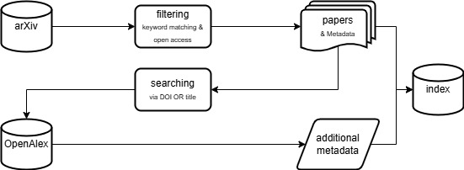
Filterung genauer beschreiben
Die ganzen Daten werden zusammengefasst -> neue JSON; Es ist eine Teilmenge, das aufzeigen
Via Python
Via Python
Wie groß? Gb? Rows?

Slide 5
Besonderheiten oder Herausforderungen bei der Verarbeitung des Datensatzes
- Besonderheit: Stemming auf Englisch, etc.
Erste Datenanalyse
optional

