Slide 1


IMPACT OF SAMPLING FREQUENCY ON THE PERFORMANCE OF EDGE STREAM PROCESSING ARCHITECTURE IN IIOT SYSTEMS FOR AGV VEHICLES
Author: Patryk Pięta
AGH University of Krakow

Slide 2

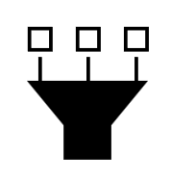

Challenges in Real-Time AGV Monitoring
Sensor fusion
Bottlenecks
Real-time data visualization

Slide 3
System Architecture: Event-Driven IoT Pipeline
Edge Computing Node
Event Streaming Platform
(Near-Edge Server)
Database and
visualizations
Sensor 1
3D visualization
Event Streaming Platform
Stream Processing Engine
Sensor 2
ARM-based edge platform
Database
Charts
Sensor 3
BI Platforms
Sensor 4

Slide 4





Experimental Setup & Methodology

Slide 5
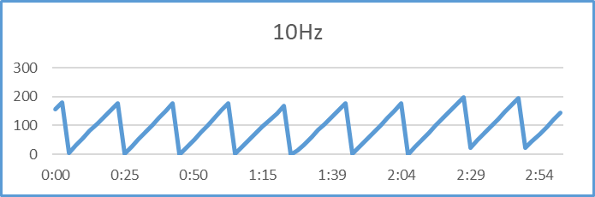
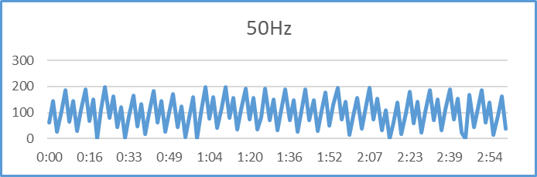
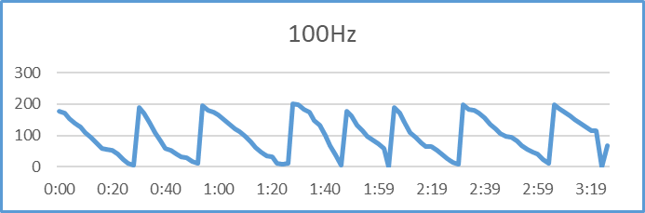
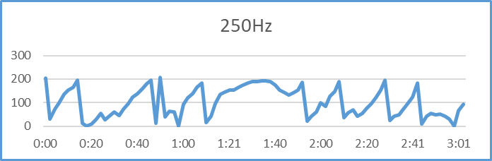
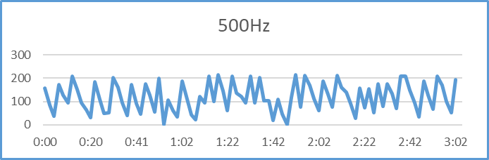
Performance Analysis: Message Broker Latency
Message Lag [Buffer Count]
Time [minutes]

Slide 6
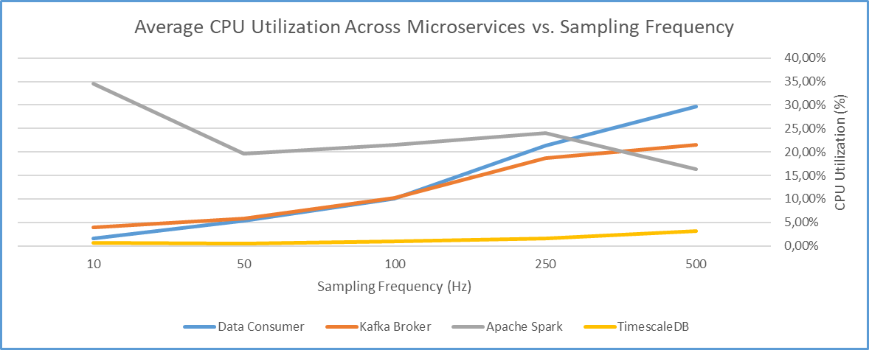
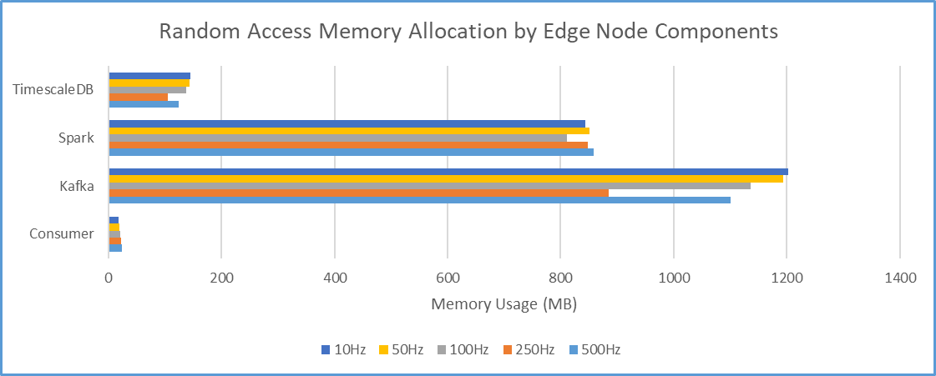
Resource Utilization: Scalability Metrics Part 1

Slide 7
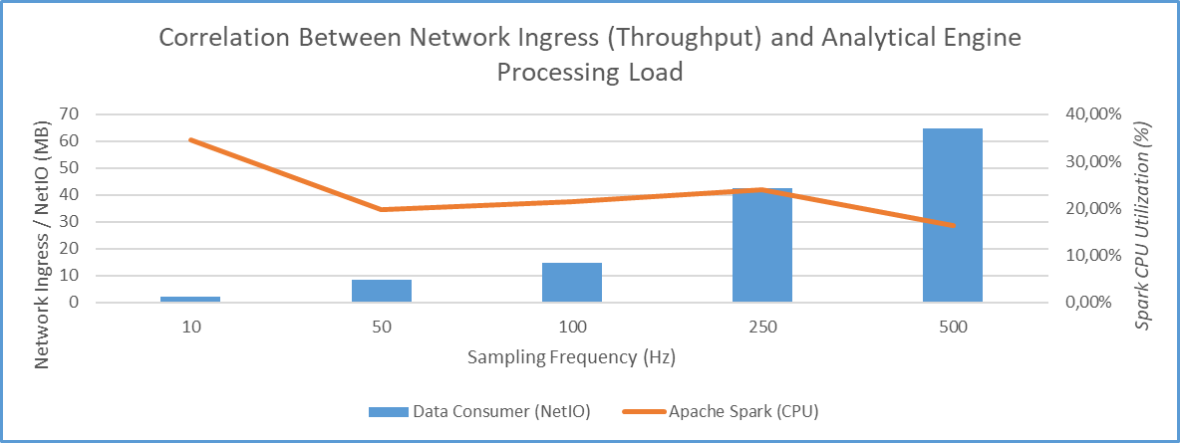
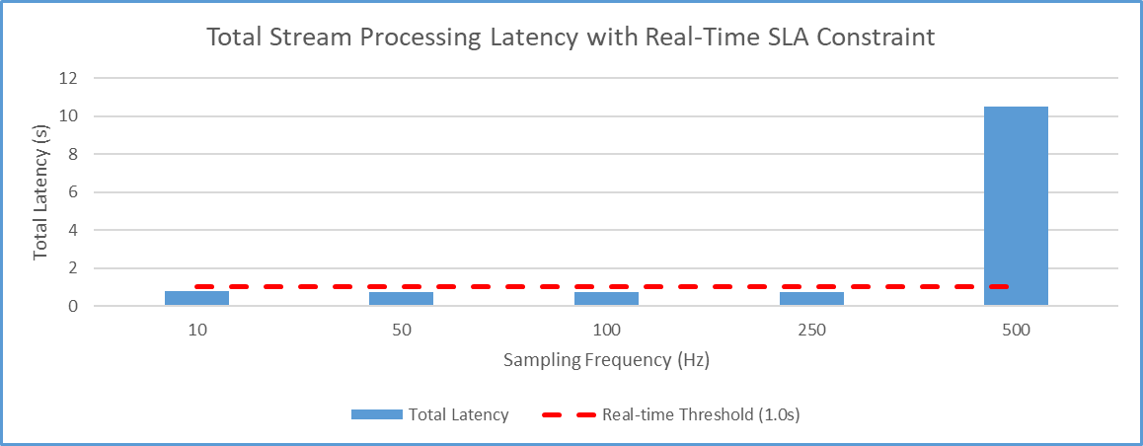
Resource Utilization: Scalability Metrics Part 2

Slide 8
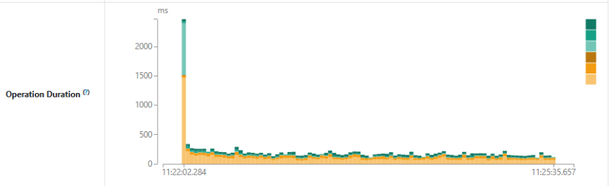
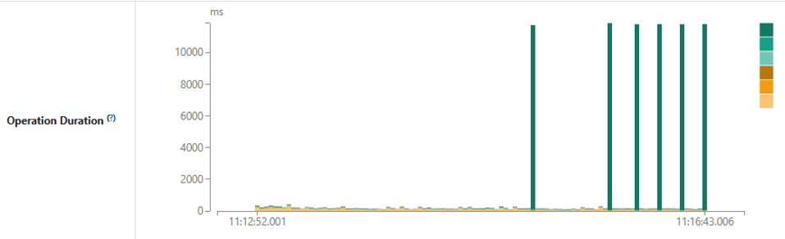
Bottleneck Identification & Saturation Points
10 Hz
500 Hz

Slide 9
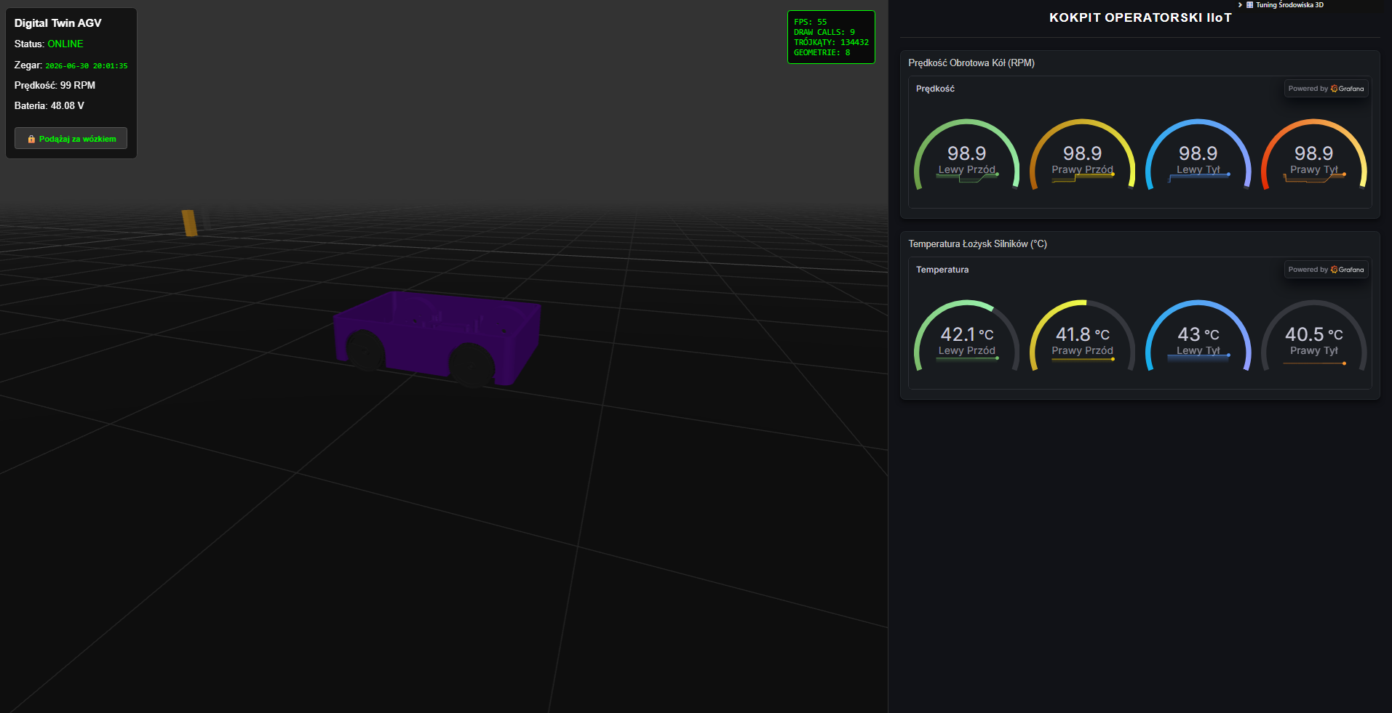
Digital Twin Visualization (Tween.js Integration)

Slide 10
Conclusions & Key Findings
Real-time Stability: Stable processing up to 250 Hz (latency < 0.75 s).
System Saturation: Critical architecture breakdown at 500 Hz.
The Real Bottleneck: Caused by I/O operations (disk/network), NOT the CPU.
Hardware Takeaway: Edge nodes must prioritize high-throughput storage (e.g., NVMe) over raw compute power.

Slide 11



FUTURE WORK
Predictive Machine Learning
Edge-based Sensor Fusion (Kalman filter)
Horizontal Fleet Scaling

Slide 12
Thank You & Q&A

