Slide 1
Neo4j – Graph Theory in use
https://github.com/PatrykStronski/Neo4jPlayground

Slide 2
What is Neo4j?
Neo4j is a graph database. It means, it uses nodes or vertices as the building blocks, which are connected with edges here specifically called relations.
Nodes can be described with numerous JSON-like properties. Nodes can also have
Relations are named and can be directed or non-directed.

Slide 3
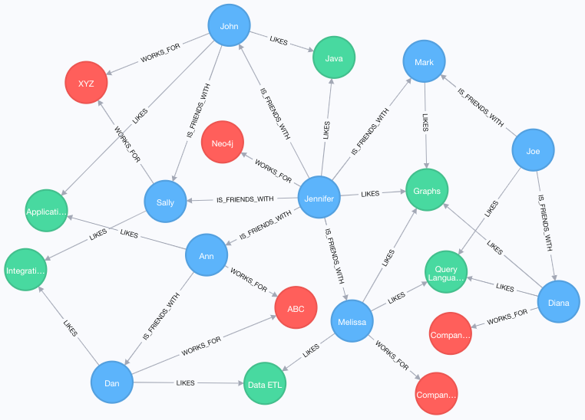
Neo4j - graph
Photo from Neo4j site

Slide 4
Neo4j possible products
Neo4j Community – community, open source
Neo4j in Docker – Docker-customized versions
Neo4j Desktop – Neo4j enterprise with quite forced GUI
Neo4j Enterprise – paid one
https://neo4j.com/download-center/
https://hub.docker.com/_/neo4j

Slide 5
Cypher
Cypher is a simple query language used for querying the resources. It is capable of fetching, modifying and removing nodes, as well as changing their properties.
https://neo4j.com/developer/cypher/

Slide 6
Cypher Cheatsheet
CREATE CONSTRAINT constraint_name ON (book:Book) ASSERT book.isbn IS UNIQUE
MATCH (n:Person {name: "Lana Wachowski"}) -[r]- (b:Person {name: "Taylor Hackford"}) DELETE r, n;
MATCH (n:Person {name: "Lana Wachowski"}) -[r]- (b:Person {name: "Taylor Hackford"}) DETATCH DELETE n;
MATCH (n:Person {name: "Taylor Hackford"}) MATCH (b:Person {name: "Lana Wachowski"}) MERGE (n) -[:LIKES]->(b);

Slide 7
Useful Requests
curl -X POST -H 'Content-Type: application/json' --data '{"name": "Jessica Thompson"}' localhost:3000/actors_relations
curl -X POST -H 'Content-Type: application/json' --data '{"born": 1958}' localhost:3000/actors_filter_born
curl -X GET localhost:3000/all_actors

