Slide 1
Rust programming language
Introduction

Slide 2
Chapter 1
Quick introduction to computer memory and pointers

Slide 3
Chapter 2
Rust as a language
Data types
References

Slide 4
Computer memory
The compiled program is stored in RAM, along with input data
Every piece of memory is indexed – it has an address
Pointer is the address storing object.

Slide 5
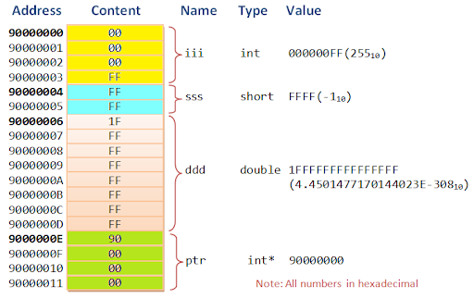
Computer memory

Slide 6
Pointer
Pointer is a variable pointing to a memory cluster. It holds the address
Type of the pointer defines how much memory does the value occupy.
Pointer always occupies the whole reserved memory.

Slide 7
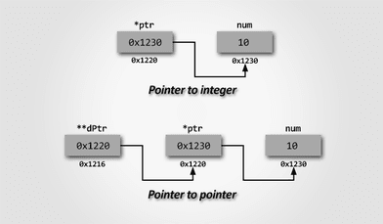
Pointer example

Slide 8
Rust programming language
Constructed to provide performance and safety
Close to C/C++, even though inherits ideas from other languages
Statically typed language with variety of types
No undefined behaviour

Slide 9
Safety in Rust
Static typing
Does not allow null pointers, dangling pointers and data races
Immutable (constant) variables by default
Reduced inheritance to traits (resolving diamond inheritance problem)

Slide 10
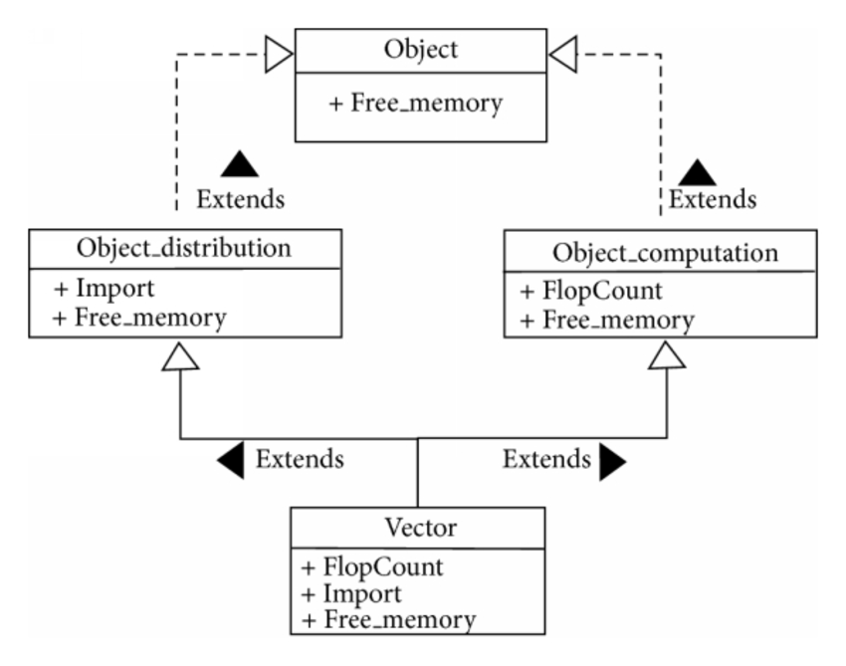
Deadly Diamond of Death
Classes Object_distribution and Object_computation inherit Free_memory member and override it
Which one should be used by Vector then as both are valid?
Causes a problem because of ambiguity

Slide 11
Variables
You define a variable by typing:
let variableName = value;
The type is infered (detected)
You need to always assign a value when creating a variable, like
let small_unsigned_integer = 15u8;
let mut small_mutable_unsigned_int = 15u8;
let mut small_mutable_unsigned_int: u8 = 15;

Slide 12
Basic Data Types
u8, u16, u32, u16, u128 – unsigned ints (always non-negative)
i8, i16, i32, i16, i128 – signed ints (negative and non-negative)
Arrays (always statically typed with predefined hardcoded length)
Array slices (“part” of an array as a pointer)
String, str (string slice)
Vec – dynamically sized array
Usize – length of an array/vector

Slide 13
References
Expressed with & symbol
Can be either immutable or mutable (mutable iff the referenced element is mutable)
Change the value under some address. It is permanently changed

