Slide 1



Garbage Classification

Slide 2

Learning Objectives
Understand the role of Deep Learning in Waste Classification.
Learn to apply EfficientNetV2B2 and transfer learning.
Address class imbalance in real-world datasets.
Deploy the model using Gradio Web Interface.
Evaluate model performance using metrics and visualization.
GOAL
Source :
www.freepik.com/

Slide 3
Tools and Technology used
Languages & Frameworks: Python, TensorFlow, Keras
Model: EfficientNetV2B2
Libraries: NumPy, Matplotlib, Seaborn, scikit-learn
Deployment: Gradio Interface for real-time prediction
Dataset Source: TrashType Image Dataset
Notebook Environment: Google Collab

Slide 4
Methodology
1. Data Acquisition
Used TrashType_Image_Dataset
6 classes: Cardboard, Glass, Metal, Paper, Plastic, Trash
Total images: 2527
2. Data Exploration
Analyzed class-wise image count
Found class imbalance (e.g., Trash = 5.91%)
Visualized distribution with bar plots
3. Preprocessing
Resized images to 124 × 124
Applied data augmentation: Flip, Rotation, Zoom, Contrast
Normalized pixel values

Slide 5
4. Model Selection
Chose EfficientNetV2B2 with pre-trained ImageNet weights
Frozen first 100 layers to preserve learned features
5. Class Imbalance Handling
Computed class weights using compute_class_weight
Applied weights during training to balance minority classes
6. Model Compilation
Optimizer: Adam (lr=1,e-4)
Loss: Sparse Categorical Crossentropy
Metric: Accuracy

Slide 6
7. Model Training
Trained for 5 epochs with EarlyStopping
Validation split: 20%
Achieved ~66% test accuracy
8. Evaluation
Used Confusion Matrix and Classification Report
Visualized accuracy/loss curvesS
9. Deployment
Saved model in .keras format
Built web interface using Gradio
Live prediction on uploaded images

Slide 7
Problem Statement:
Manual waste sorting is inefficient, error-prone, and costly.
Real-world datasets suffer from class imbalance, making it hard for models to generalize.
Goal: Automate garbage classification using a deep learning model that performs well even with imbalanced data.
Overprediction of majority classes leads to poor classification of minority waste types.
A reliable automated system can improve recycling efficiency and reduce human involvement.

Slide 8
Solution:
Used EfficientNetV2B2 for its balance between accuracy and efficiency.
Tackled class imbalance using class weights and data augmentation.
Built a modular, trainable model with a web-based interface using Gradio.
Applied transfer learning with frozen base layers to reduce training time.
Achieved 66% test accuracy with validation through confusion matrix and classification report.

Slide 9
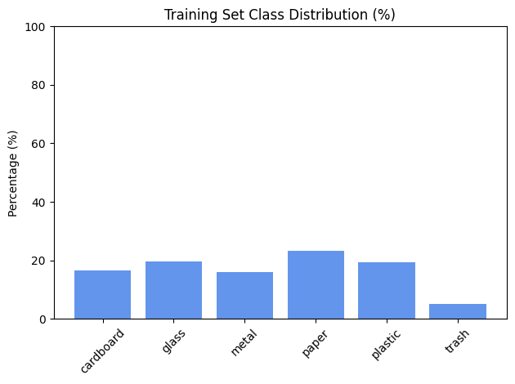
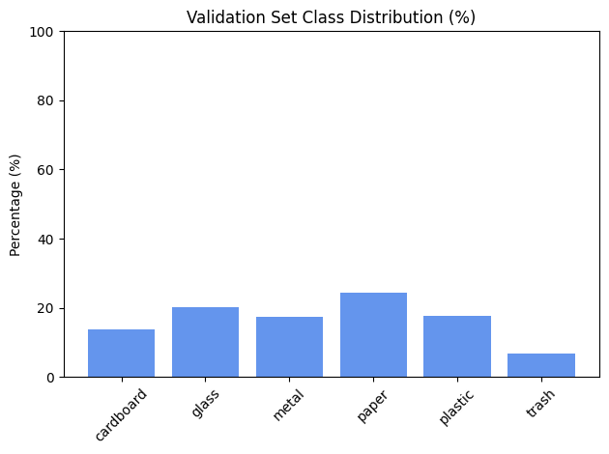
Screenshot of Output:

Slide 10
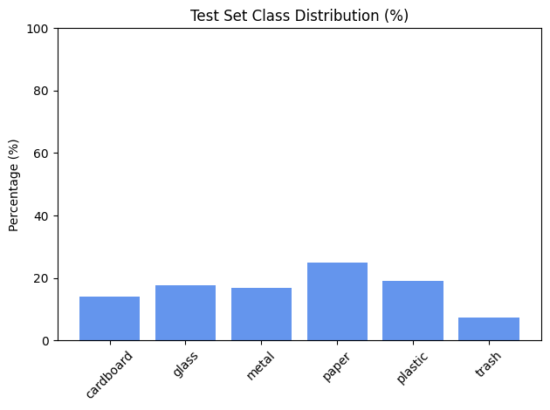


Slide 11
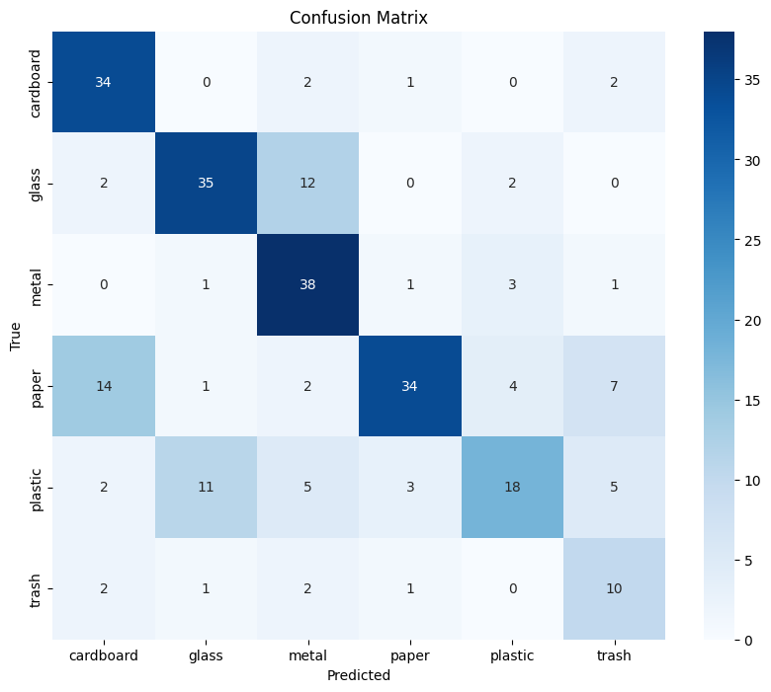
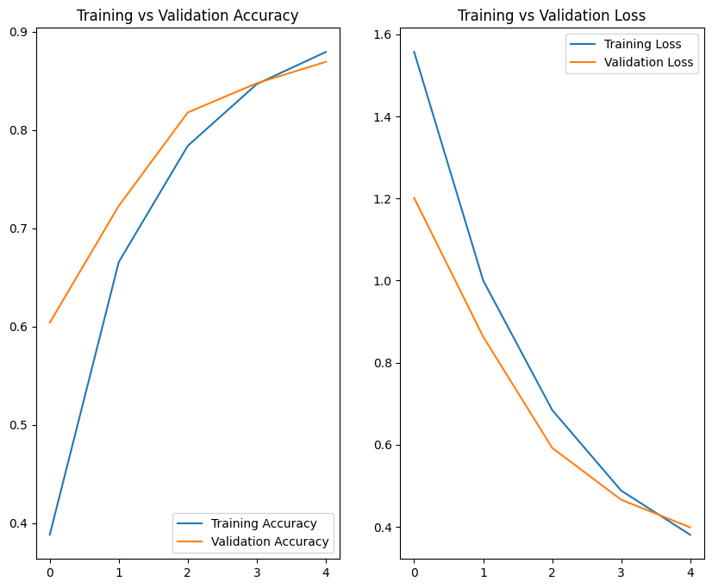

Slide 12
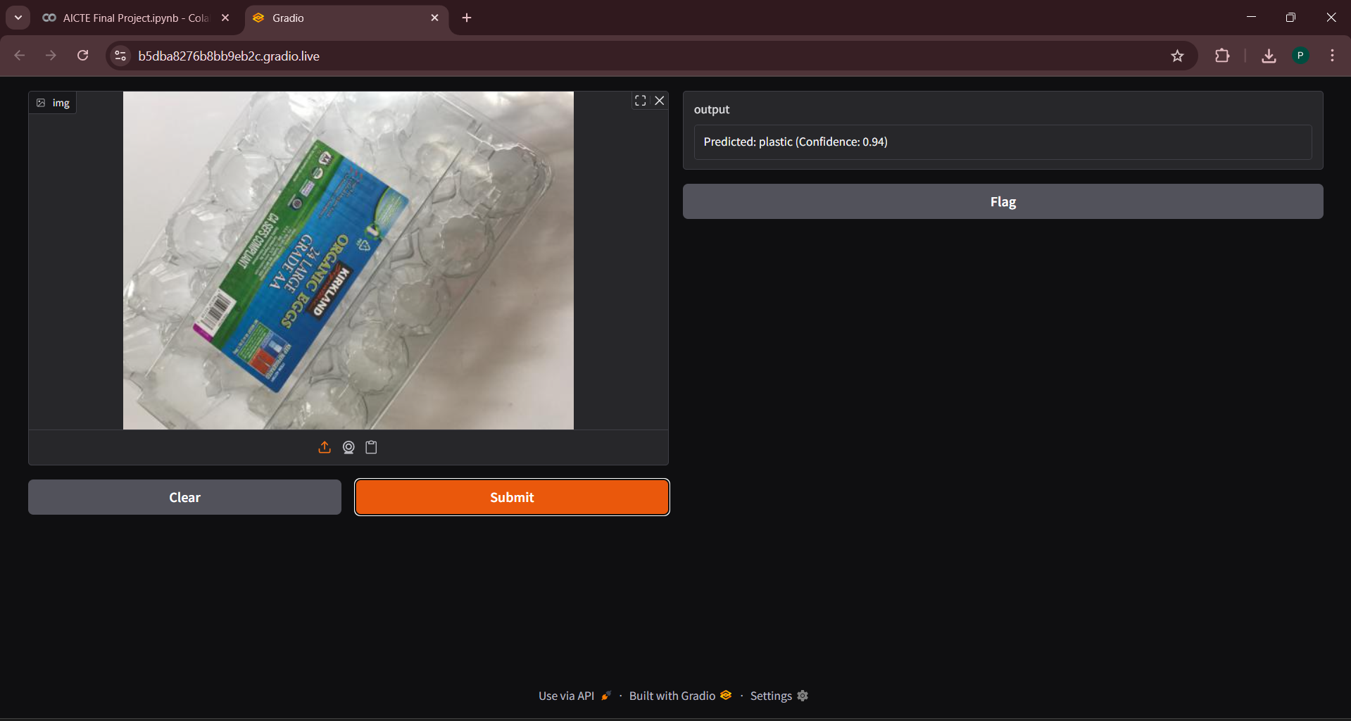

Slide 13
Conclusion:
Achieved 66% accuracy with limited data and imbalance.
Successfully deployed using Gradio for real-time classification.
Demonstrated potential for AI-powered waste management.
Future Work:
Improve minority class performance (e.g., "trash")
Use synthetic data generation
Extend to multi-label classification

